Slide 1
Chapter 43 Red Black Trees

Slide 2
Objectives
To know what a red-black tree is (§43.1).
To convert a red-black tree to a 2-4 tree and vice versa (§43.2).
To design the RBTree class that extends the BinaryTree class (§43.3).
To insert an element in a red-black tree and resolve the double red problem if necessary (§43.4).
To insert an element from a red-black tree and resolve the double black problem if necessary (§43.5).
To implement and test the RBTree class (§§43.6-43.7).
To compare the performance of AVL trees, 2-4 trees, and RBTree (§43.8).

Slide 3
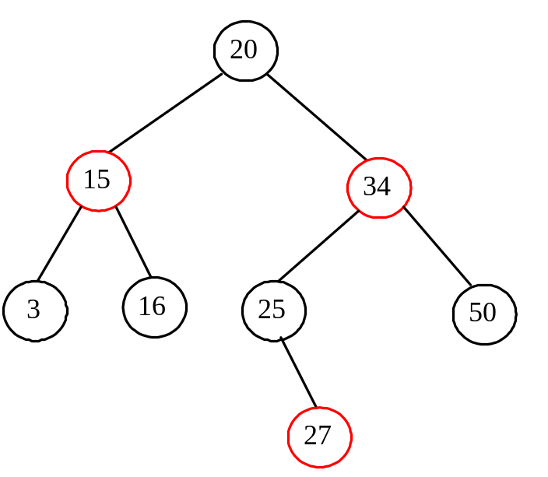
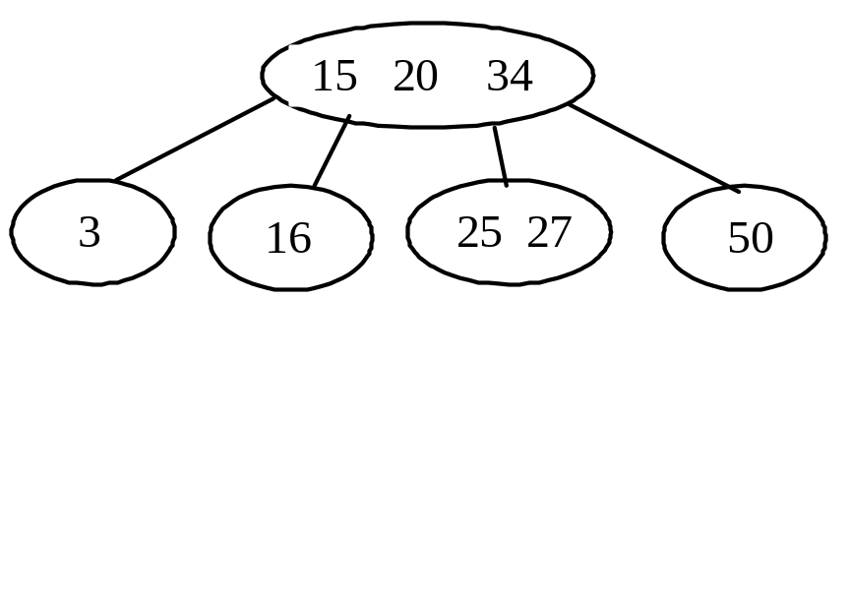
What is a Red Black Tree?
A red-black tree is a binary search tree, which is derived from a 2-4 tree. A red-black tree corresponds to a 2-4 tree. Each node in a red-black tree has a color attribute red or black.

Slide 4
What is a Red Black Tree?
A node is called external if its left or right subtree is empty. Note that a leaf node is external, but an external node is not necessarily a leaf node. For example, node 25 is external, but it is not a leaf. The black depth of a node is defined as the number of black nodes in a path from the node to the root. For example, the black depth of node 25 is 2 and the black depth of node 27 is 2.

Slide 5
Properties
A red-black tree has the following properties:
The root is black.
Two adjacent nodes cannot be both red.
All external nodes have the same black depth.

Slide 6
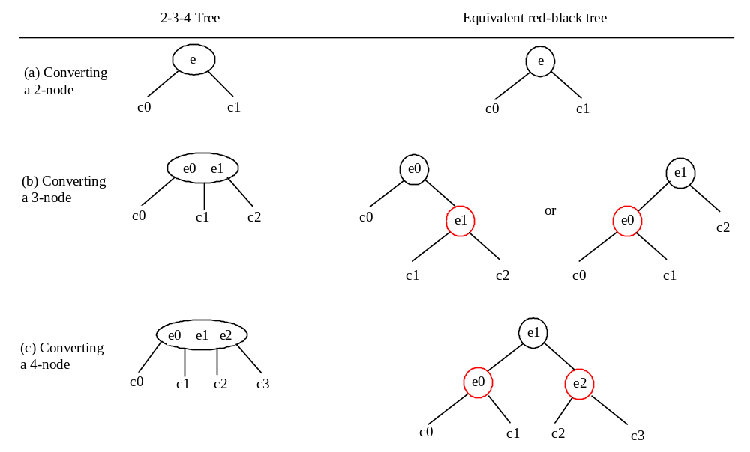
Conversion between Red-Black Trees and 2-4 Trees
To convert a red-black tree to a 2-4 tree, simply merge any red nodes with its parent to create a 3-node or a 4-node.
To convert a 2-4 tree to a red-black tree, perform the transformations for each node :

Slide 7
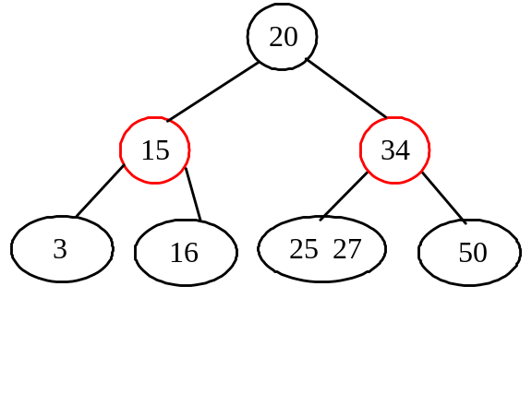
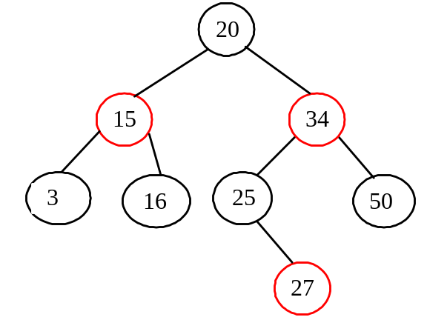
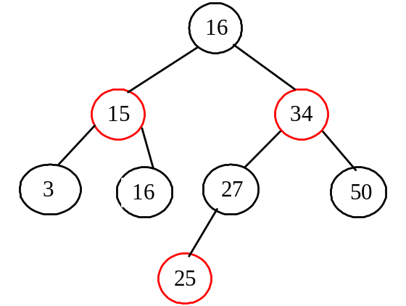
Conversion not unique
the conversion from a 2-4 tree to a red-black tree is not unique.

Slide 8
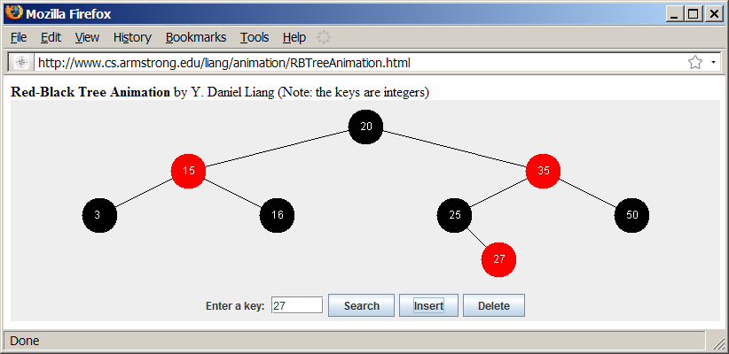
2-4 Tree Animation
http://www.cs.armstrong.edu/liang/animation/RBTreeAnimation.html

Slide 9
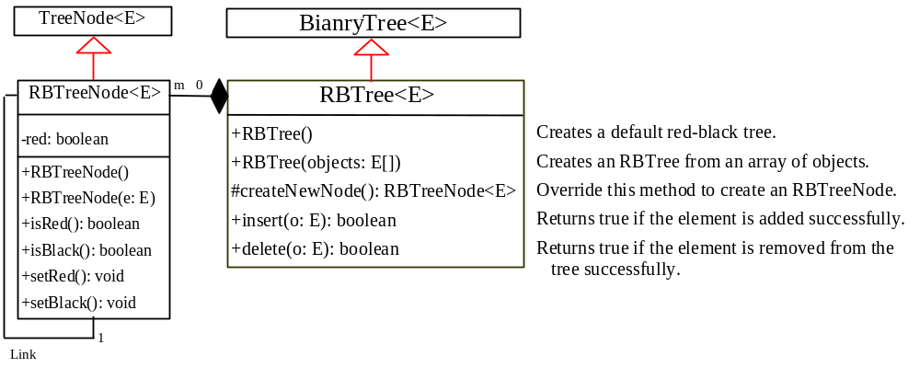
Designing Classes for Red Black Trees
RBTree
TestRBTree
Run

