Slide 1
Work this week
Peter Kennedy

Slide 2
Ethics training
In Summary:
-Have an ethics board, consult it when doing/changing a study
-Avoid (potential) conflicts of interest, harm
-Informed consent, without presentation of either of above
-don’t arbitrarily include/exclude particular groups/people

Slide 3
Getting Simulations working
-To be safe ROS requires at least ~20GB disk space
-if you run out of space (Ubuntu black screens on boot) >> increase VM disk, mount GParted to allocate that new disk space
-Give lots of processor, memory, video memory to avoid lag
-Enable Graphics acceleration ^^^^^^^^
-Lots of installs, be careful everything goes into the right catkin workspace folder
-Best practice to add all the source ... commands for ROS into .bashRC
-Rviz shows you what a robot sees, Gazebo presents a simulated 3d scene
-Start Gazebo before Rviz, otherwise Jackal_viz breaks

Slide 4
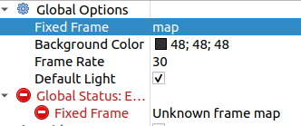
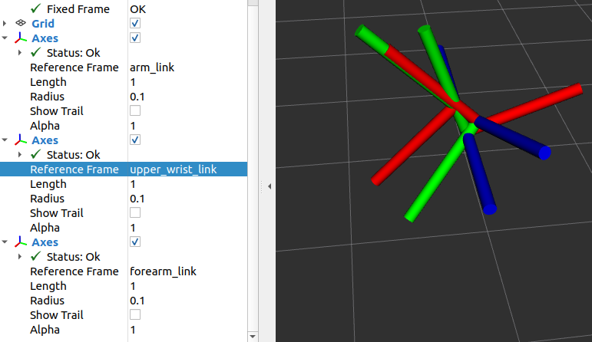
Cont.
-Still stuck with this:
Which I suspect is what leads to this issue?: (broken model in Rviz)

Slide 5
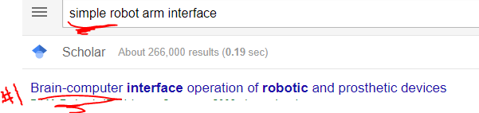
Papers
-Springer doesn’t give you access when VPN’d to UNB
-Designing an API at an appropriate abstraction level for programming social robot applications
Experiment where programmers are given a new API developed by the authors specifically meant for
programming social robots at a high level of abstraction. It was found that the programmers appreciated this
but still found programming speech interactions to be hard/tedious.

Slide 6
More papers
Middleware for Robotics: A Survey
Survey of the objectives of various robotics middleware. Also discusses some common issues middleware faces.
On device abstractions for portable, reusable robot code
Paper describing initial software architecture of the open source player/stage project
(gazebo was initially a 3d extension of this project and retains features such as the same robot code
being used for both the simulator and physical robot).

Slide 7
More papers
Unmanned aerial vehicle abstraction layer: An abstraction layer to operate unmanned aerial vehicles
Discusses architecture and use cases for UAL, a framework to provide a high-level interface for programming
UAVs without referring to lower level systems such as DJI's proprietary autopilot or open source equivalents.
UAL is built on ROS and is compatible with gazebo and Unreal Engine.
A Survey of Robot Programming Systems
A survey of different methods for programming robots with categories such as graphical,
textual, programming by demonstration, learning AI, and instructive systems. The paper also discusses
some recent developments in the field.

Slide 8
More papers
Robotics Middleware: A Comprehensive Literature Survey and Attribute-Based Bibliography
Middleware is a stage between an OS and an application, this paper describes the architecture of some
middleware, and then some different capabilities of various middleware.

Slide 9
Work today
-Get ROS setup at campus computer
-Make custom install & setup guide+script for next student
-Search term: “Low-dimensional interface” == simple controls (joystick or controller)
-Small potential progress on Error.

