Slide 1



root folder
future
EC-Earth3-Veg
2021-2040
2041-2060
2061-2080
2081-2080
ssp245
wc2.1_10m_bio_1_s
wc2.1_10m_bio_12_s
ssp585
wc2.1_10m_bio_1_s
wc2.1_10m_bio_12_s
1
2
3
4
5
6

Slide 2
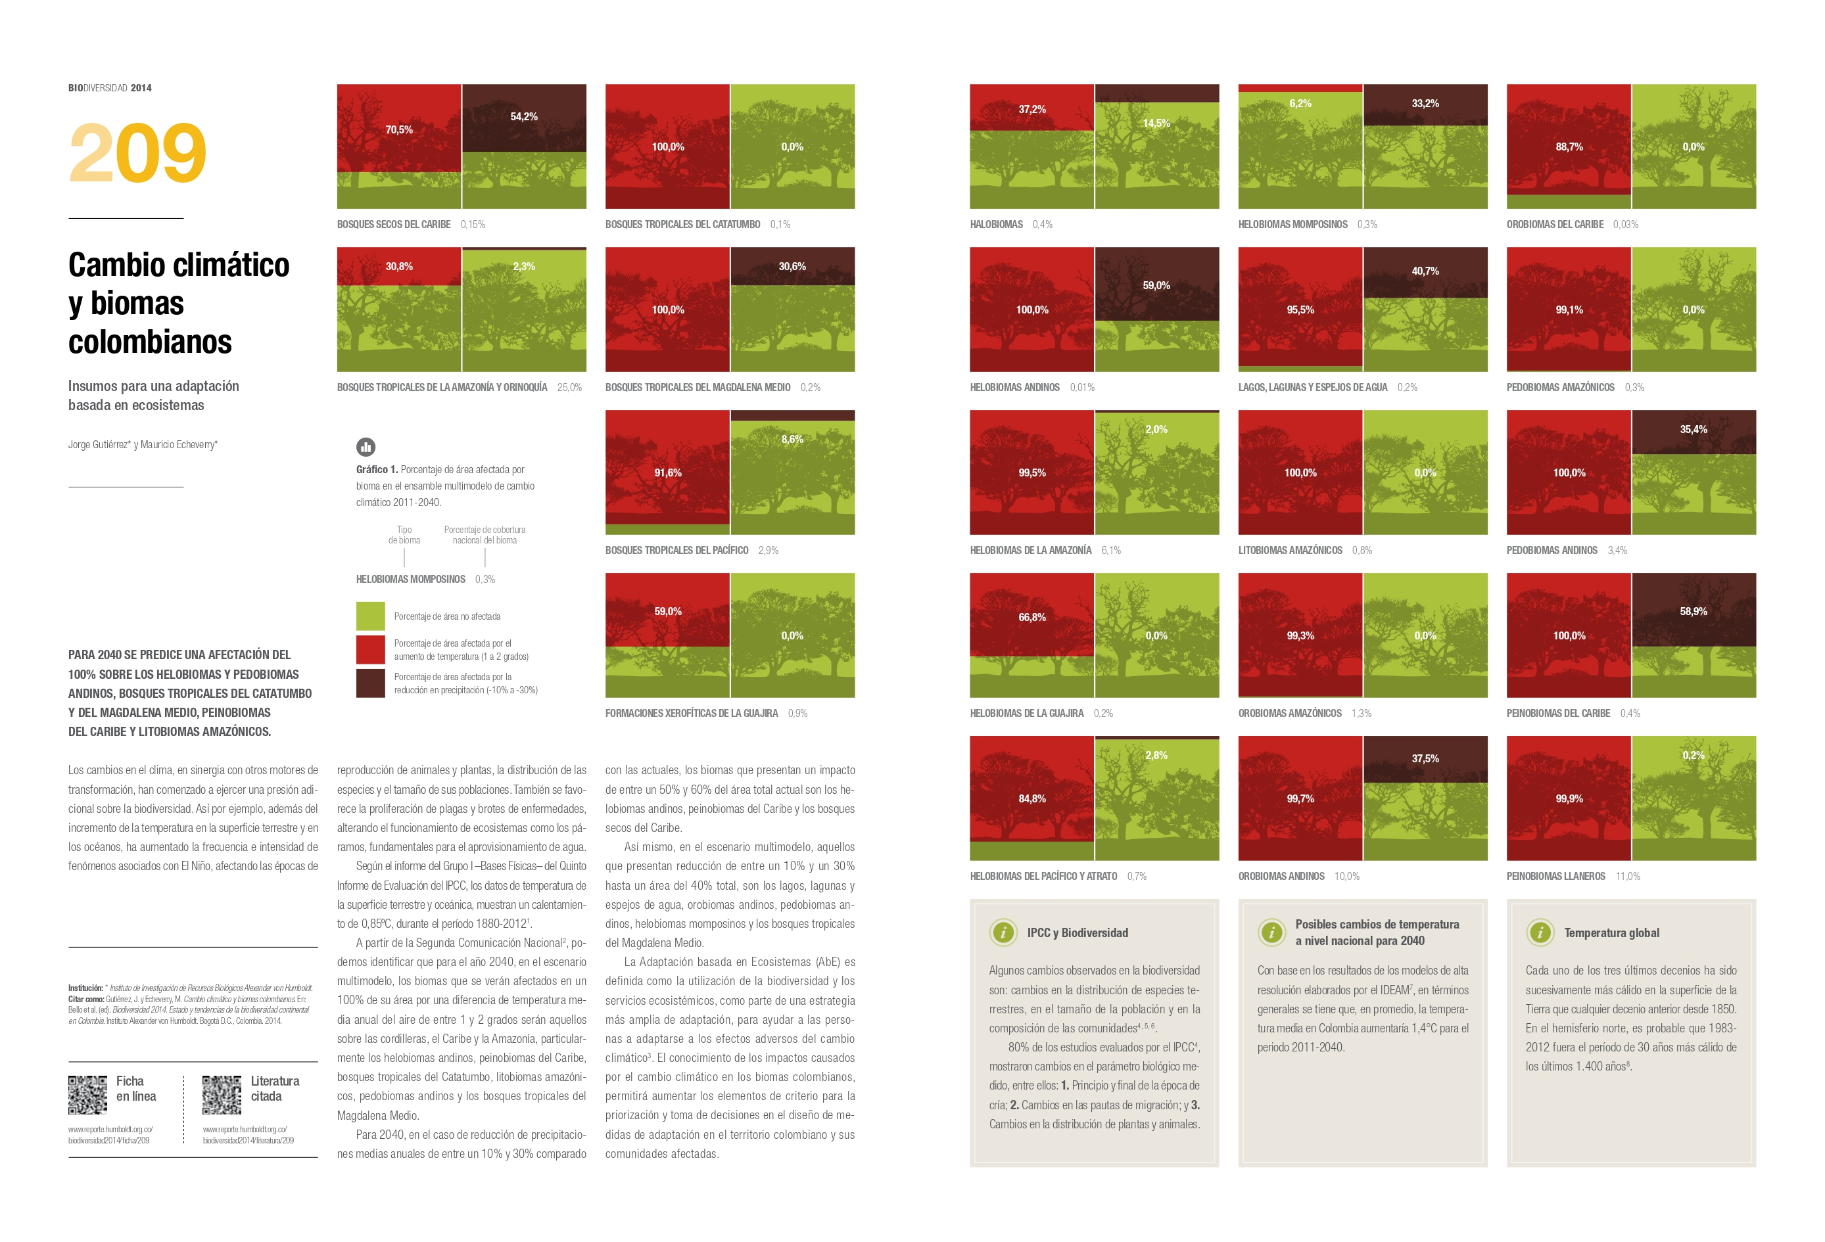

Slide 3
EC-Earth3-Veg
General Circular Model
2021-2040
2041-2060
Time period 1
CV
devstd
CV
devstd
sum
sum
0 threshold
2061-2080
0 threshold
10 threshold
10 threshold
20 threshold
20 threshold
2081-2100
30 threshold
30 threshold
Continuos surface
Continuos surface

