Slide 1



root folder
future
EC-Earth3-Veg
2021-2040
2041-2060
2061-2080
2081-2080
ssp245
wc2.1_10m_bio_1_s
wc2.1_10m_bio_12_s
ssp585
wc2.1_10m_bio_1_s
wc2.1_10m_bio_12_s
1
2
3
4
5
6

Slide 2
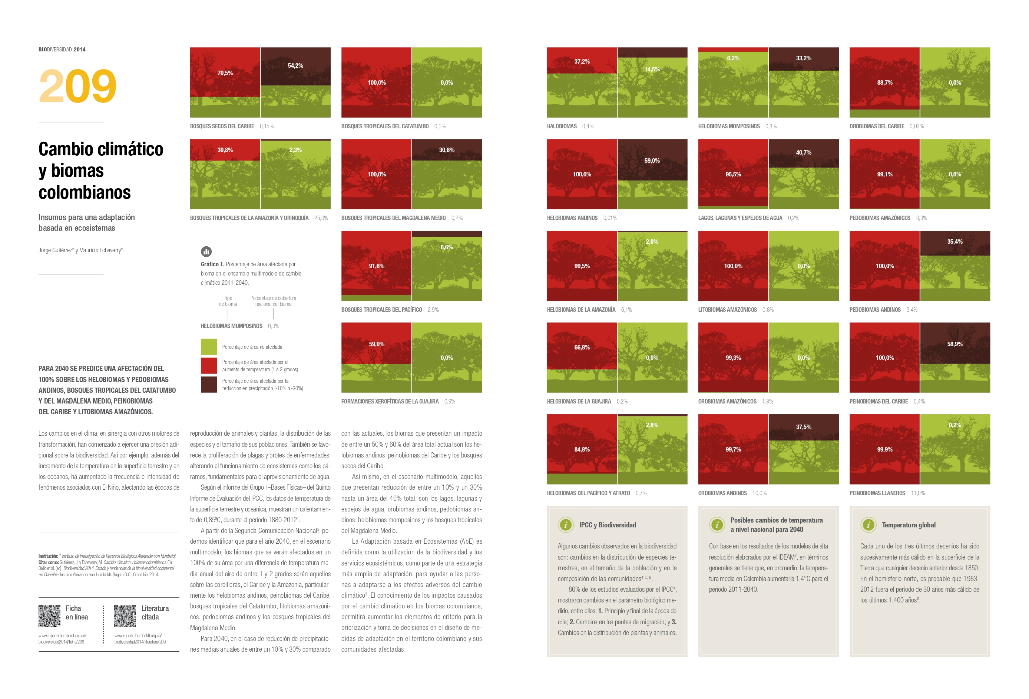

Slide 3
EC-Earth3-Veg
General Circular Model
2021-2040
2041-2060
Time period 1
CV
devstd
CV
devstd
sum
sum
0 threshold
2061-2080
0 threshold
10 threshold
10 threshold
20 threshold
20 threshold
2081-2100
30 threshold
30 threshold
Continuos surface
Continuos surface

Slide 4
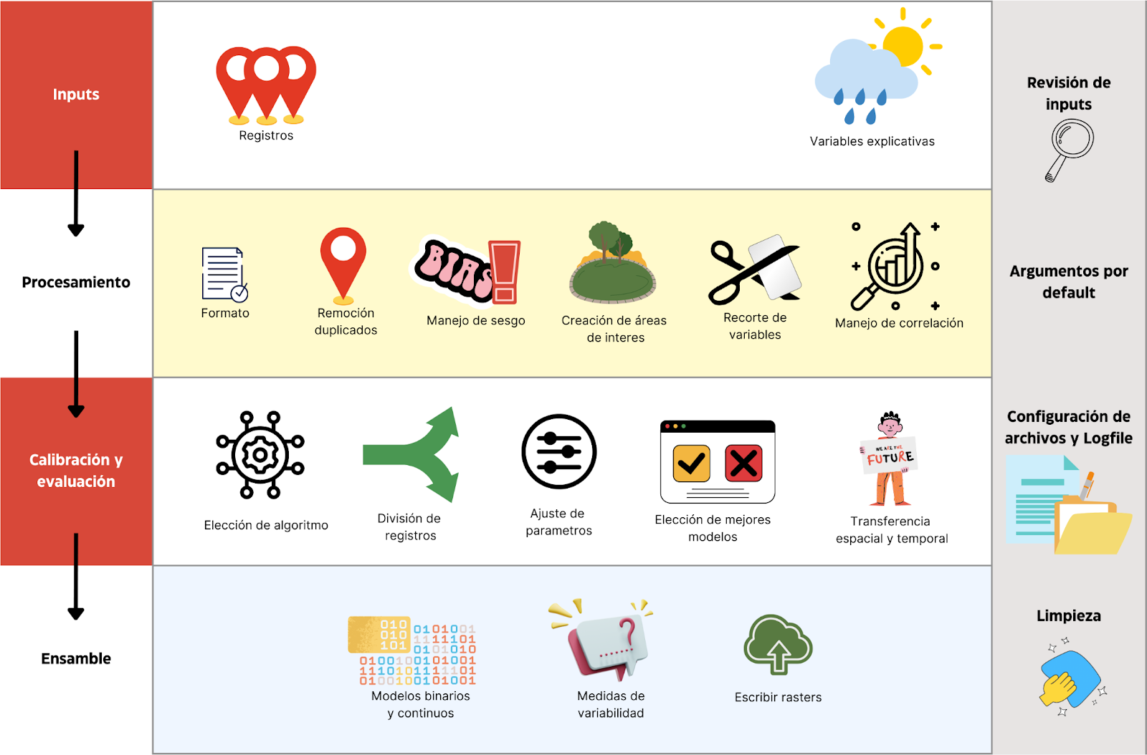

Slide 5
Review
inputs
Occurrences
Explanation variables
Processing
Default arguments
Formatting
Duplicate
remotion
Bias management
Area of interest creation
Variable masking
Correlation management
Files and Logfile setup
Training and evaluation
Choose algorithm
Splitting data
Adjust hyperpameters
Selecting best models
Spatial and temporal transferency
Cleaning files
Ensemble
Binary and continuos surfaces
Variability measures
Write rasters

Slide 6
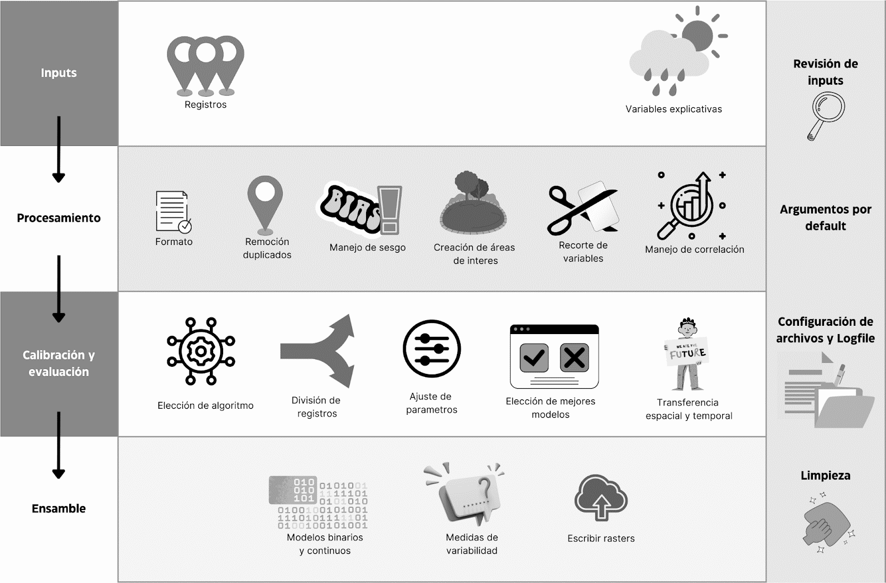
Review
inputs
Occurrences
Explanation variables
Processing
Default arguments
Formatting
Duplicate
remotion
Bias management
Area of interest creation
Variable masking
Correlation management
Files and Logfile setup
Training and evaluation
Choose algorithm
Splitting data
Adjust hyperpameters
Selecting best models
Spatial and temporal transferency
Cleaning files
Ensemble
Binary and continuos surfaces
Variability measures
Write rasters

