Slide 1
Depth Generation on More Realistic Scenes
B04901096 蔡昕宇

Slide 2
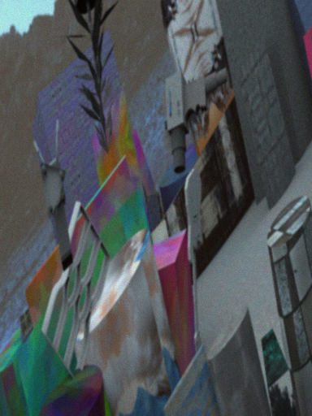
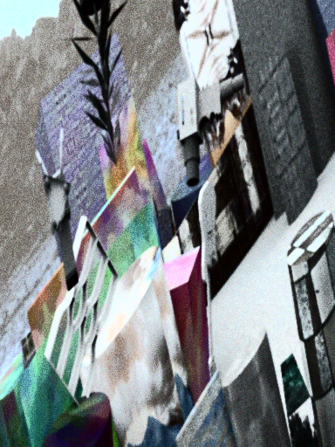
Pre-process
Disparity Finding
using SURF to find feature points, calculate feature point distance
Preprocess
histogram equalization
bilateral image filtering

Slide 3
Cost Volume Computation
Implementation of ADCensus paper
On Building an Accurate Stereo Matching System on Graphics Hardware
Cost Computation: AD cost + Census Cost
Cost Aggregation: Cross-based Cost Aggregation
Disparity Optimization: Scanline Optimization
Disparity Refinement:
Outlier Detection
Iterative Region Voting
Proper Interpolation
Depth Discontinuity Adjustment
Subpixel Enhancement
Median Filter

Slide 4
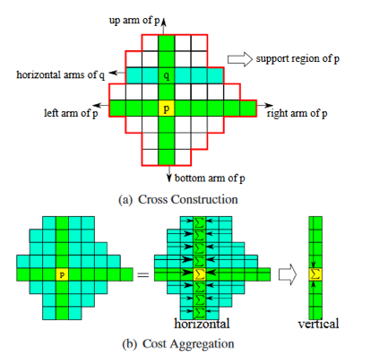
Initialization
& Aggregation
Cost Computation: AD cost + Census Cost
Absolute difference cost
Census Cost
Cost Aggregation: Cross-based Cost Aggregation

Slide 5
Optimization
Scanline Optimization
compare cost in neighboring pixel on one direction
avoiding a cost peak, penalize color difference in local areas
compute cost and average from four direction

Slide 6
Refinement
Outlier Detection
Check D_l(p) = D_r(p - (D_l(p), 0))
Iterative Region Voting
make a histogram for neighboring, choose the most voted to replace the outliers detected
Proper Interpolation
interpolation from 16 direction, find lowest cost to replace outliers
Depth Discontinuity Adjustment
sobel filter to detect edge, fix edge discontinuity
Subpixel Enhancement
quadratic interpolation -> more smooth
Median Filter

Slide 7
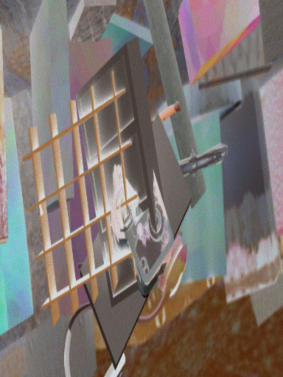
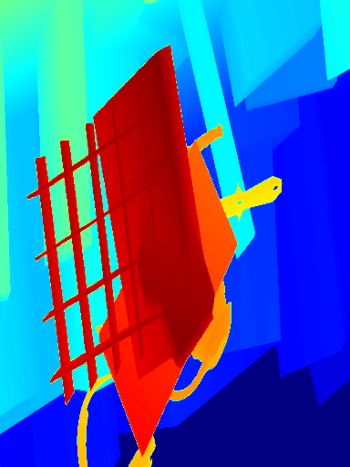
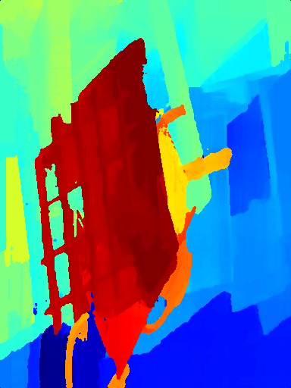
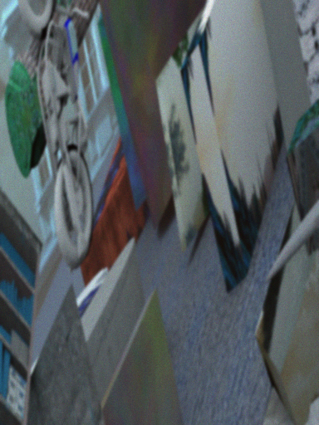
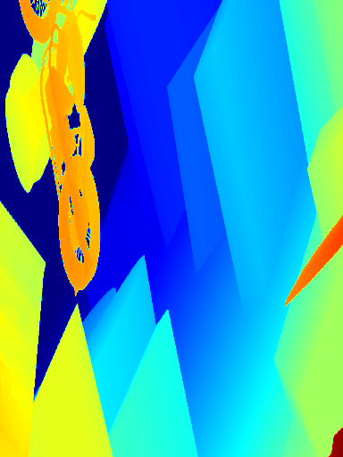
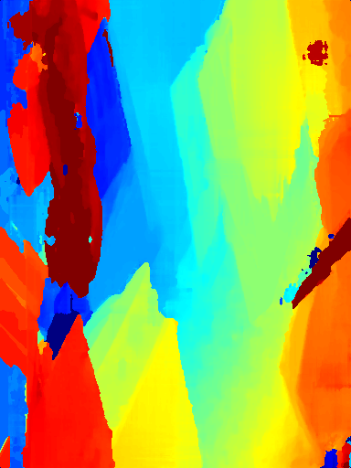
Results
Synthetic

Slide 8
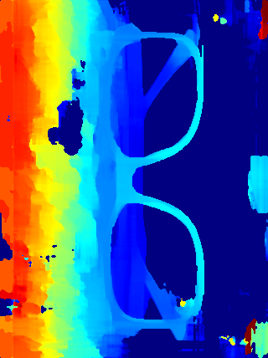
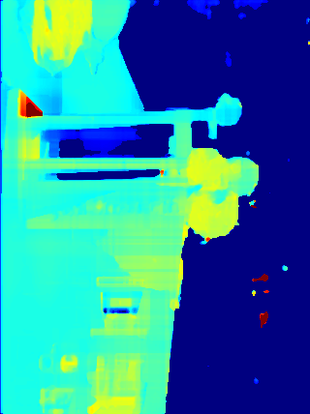
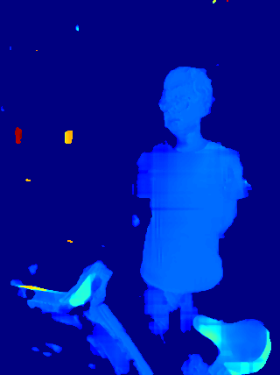
Results
Real

Slide 9
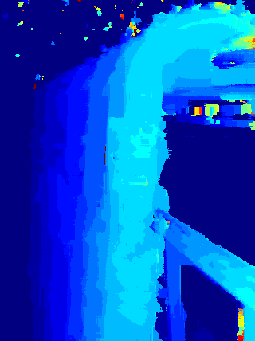
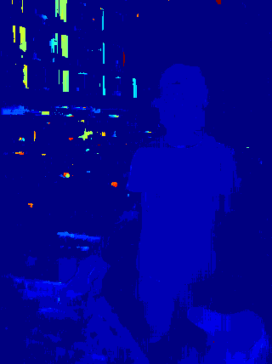
Deep Methods
Implementation of “Efficient Deep Learning for Stereo Matching”
Fit on KITTI dataset
Bad results on synthetic data

Slide 10
Reference
X. Mei, X. Sun, M. Zhou, S. Jiao, H. Wang, and X. Zhang. On Building an Accurate Stereo Matching System on Graphics Hardware, GPUCV 2011
W. Luo et al., Efficient Deep Learning for Stereo Matching, CVPR 2016
J. R. Cheng, Y. S. Chen, Pyramid Stereo Matching Network, CVPR 2018

