Slide 1


TWO ROOMS, ONE NETWORK / RELATED WORK #1
01
Room Escape at Class turns real network operations into puzzles.
What is it?
An educational escape-room activity for Computer Networks and Information Security students.
ESCAPE ROOM
What can it do?
IP PACKET
• Use IP-packet construction as a game mechanic
• Use LZ77-compressed email as a puzzle
• Make course knowledge operational
LIMITATION
Everyone sees the same evidence; roles and information asymmetry are not separated between players.
[1] Borrego et al. (2017)
Notes:
[Sources]
[1] Borrego, C. et al. (2017). Room escape at class: Escape games activities to facilitate motivation and learning in computer science.

Slide 2
TWO ROOMS, ONE NETWORK / RELATED WORK #2
02
Digital escape rooms improve engagement in technical learning.
What is it?
A 2022 study of a digital escape room focused on HTML and Computer Networks for vocational high-school students.
DIGITAL
ESCAPE ROOM
Reported impact
HTML + NETWORKS
MOTIVATION
↑
higher
ENGAGEMENT
↑
higher
SATISFACTION
↑
higher
LIMITATION
Single-player: no real-time communication, shared discovery, or coordination between two learners.
[2] Education Sciences, 12(10), 682 (2022)
Notes:
[Sources]
[2] The Impact of a Digital Escape Room Focused on HTML and Computer Networks on Vocational High School Students. Education Sciences, 12(10), 682 (2022).

Slide 3
TWO ROOMS, ONE NETWORK / OUR WORK
03
Two Rooms, One Network is a 2D co-op networking escape room.
Two players are separated into different rooms and must reason together to open the gateway.
EXPLORE
→
TERMINAL
WASD
E
explore the room
interact with a terminal
→
SERVER VALIDATES
→
GATE OPENS
CMD
SERVER
ping / traceroute / nslookup
validate commands and gate state
The client renders the world; the server owns the answer, score, room state, and door state.
Notes:
[Sources]
Project implementation: Phaser.js, Node.js/Express, Socket.IO, PostgreSQL/Prisma.

Slide 4
TWO ROOMS, ONE NETWORK / OUR CONTRIBUTION
04
The project adds cooperation as part of the networking problem.
Previous digital escape rooms
Our game
single-player
two-player real-time co-op
same information
EXTENSION
different rooms / partial evidence
answer can be local
ping must be understood by both
engagement through puzzles
communication is required to progress
Learning outcome: students must explain network evidence to another person, not only select an answer.
Notes:
[Sources]
Comparison synthesized from [1] and [2], plus the project design specification.

Slide 5
TWO ROOMS, ONE NETWORK / PROTOTYPE / UI
05
The question appears through exploration, not as a static quiz list.
ROOM A
ROOM B
UI callouts
1 WASD movement
2 E interaction
3 CMD terminal overlay
4 Mission / gate status
5 Gateway to next room
>_ TERMINAL
>_ TERMINAL
A playable 2D scene with two rooms, terminal quests, and a shared gateway.
Notes:
[Sources]
Project prototype visuals use the supplied character sprites: public/assets/character-left.png and character-right.png.

Slide 6
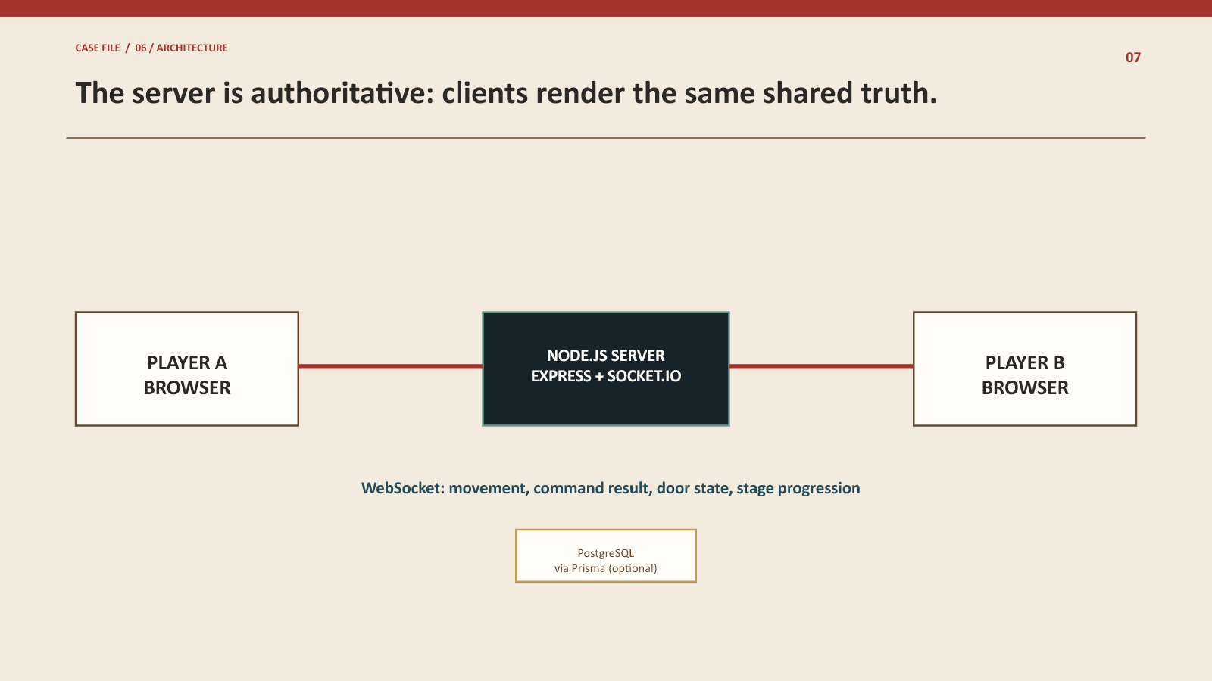
TWO ROOMS, ONE NETWORK / PROOF OF IMPLEMENTATION
06
The application, source code, and co-op flow are testable.
SERVER-AUTHORITATIVE EVENT
socket.on('ping-quest', ({ command }) => {
const result = validateCommand(command);
io.to(roomId).emit('quest-result', result);
if (result.complete) io.to(roomId).emit('door-open');
});
TEST RESULT
Two browsers join one room → players move independently → both reach terminals → valid ping is broadcast → gateway unlocks.
Notes:
[Sources]
Project source code and implementation: public/game.js, public/index.html, public/styles.css. Architecture reference: Socket.IO documentation.

Slide 7
TWO ROOMS, ONE NETWORK / REFERENCES
07
References and technical foundations.
[1] Borrego, C. et al. (2017). Room escape at class: Escape games activities to facilitate motivation and learning in computer science.
[2] The Impact of a Digital Escape Room Focused on HTML and Computer Networks on Vocational High School Students. Education Sciences, 12(10), 682 (2022).
[3] Socket.IO Documentation. https://socket.io/docs/v4/
[4] Phaser Documentation. https://phaser.io/learn
[5] Express.js Documentation. https://expressjs.com/
[6] Prisma Documentation. https://www.prisma.io/docs/
Member names / student IDs: ________________________________
Notes:
[Sources]
[1] Borrego et al. (2017). [2] Education Sciences 12(10), 682 (2022). [3] Socket.IO docs. [4] Phaser docs. [5] Express docs. [6] Prisma docs.

