Slide 1

Malla Reddy College of Engineering & Technology (Autonomous Institution- UGC, Govt. of India) (Affiliated to JNTU-H, Hyderabad, Approved by AICTE, NBA & NAAC with ‘A’ Grade) Maisammaguda, Kompally, Dhulapally, Secunderabad – 500100 Department of Electronics and Communication Engineering Mini Project-I
AUTISM SPECTRUM DISORDER CLASSIFICATION AND PREDICTION
Batch Members
M.Ganesh 21N31A04D8
P.George 21N31A04G0
R.Rajshekar 21N31A04J7
Name of the Guide
Dr. R Chinna Rao
Associate professor

Slide 2
CONTENT
Objectives
Abstract
Literature Review
Block diagram
Design Methodology
Implementation of Software
Tools Required (Software / Hardware)
References

Slide 3
Objectives
Autism Spectrum Disorder (ASD) is a developmental disorder that affects communication, behavior, and social interactions. .
Early and accurate detection is crucial for effective intervention and support. We will make our model in order to increase the performance and accuracy.
Machine learning and data analysis techniques in Python can significantly aid in the detection of autism by identifying patterns and anomalies in behavioral and developmental data.

Slide 4
Abstract
This project utilizes machine learning techniques in Python to develop an automated system for detecting Autism Spectrum Disorder (ASD).
The output of the autism detection project includes a well-trained machine learning model capable of accurately classifying individuals as having Autism Spectrum Disorder (ASD) or not, based on input features
The motive of the autism detection project is to leverage machine learning and data analysis techniques to develop an automated, accurate, and efficient system for early detection of Autism Spectrum Disorder (ASD).

Slide 5
Literature Review
Title: Prediction and Analysis of Autism Spectrum Disorder Using Machine Learning
Author: Muhammad Shuaib Qureshi , 1 Muhammad Bilal Qureshi , 2 Junaid Asghar,3Fatima Alam, 4 and Ayman Aljarbouh
Year of Publication: 2023
Methods: Compared Random Forest, SVM, Decision Trees using behavioral datasets.
Results: Random Forest showed the highest accuracy in predicting ASD.
Challenges: Data quality issues (missing values, class imbalance) and model interpretability in clinical settings.
Conclusion: Machine learning can assist early ASD diagnosis; future work involves improving data integration and model accuracy for clinical applications.
Paper: https://onlinelibrary.wiley.com/share/DUH4TBNIXKH72RMPINKU?target=10.1155/2023/4853800

Slide 6
Title: Evaluating Decision Tree vs. Random Forest for Autism Spectrum Disorder Classification
Author: Brian McNamara, Camila Lora, Donyoung Yang, Fabiana Flores, Paul Daly
Year of publication: 2018
Methods: Addressed missing values, removed outliers, selected relevant variables, and split data into training/testing subsets and Used methods to choose the most suitable models and evaluate performance.
Results: Random Forest significantly outperformed Decision Tree, with fewer false positives and false negatives.
Challenges: The dataset was heavily biased towards negative responses.
Conclusion: Random Forest is more accurate for ASD classification; further research with balanced data is needed to enhance prediction.
Paper: https://rstudio-pubs-static.s3.amazonaws.com/383049_1faa93345b324da6a1081506f371a8dd.html

Slide 7
Block Diagram
Dataset
Data Preprocessing
Data Training & Testing
Random Forest Algorithm
Model Deployment
Output

Slide 8
Design Methodology
Problem Definition : Identify the specific goal of the project, such as predicting the likelihood of Autism Spectrum Disorder (ASD) based on behavioral and demographic data.
Data Collection : Source behavioral datasets with relevant features for ASD prediction. Ensure data quality and relevance to the project's objectives.
Data pre-processing : is a technique in which transform the raw data into a meaningful and understandable format.
Training and Testing Model: The whole dataset has been split into two parts i.e. one part is training the dataset and the other one is testing dataset.
Random Forest Algorithm: The Random Forest algorithm is an ensemble learning method used for classification and regression tasks. It combines multiple decision trees to improve performance and control overfitting.

Slide 9

Decision Trees: Each trained decision tree makes a prediction based on its learned patterns
Output: The output of the Random Forest model will provide a prediction of whether an individual is likely to have Autism Spectrum Disorder (ASD) based on their behavioral and demographic features, along with the probability score indicating the confidence level of the prediction.

Slide 10
Screening Questions
Does the person find it difficult to maintain eye contact?
Does the person prefer to be alone rather than with others?
Does the person struggle with starting or maintaining a conversation?
Does the person find it hard to understand non-verbal communication, like facial expressions or gestures?
Does the person show repetitive movements (e.g., hand flapping)?
Is the person overly sensitive to certain sounds, lights, or textures?
Did the person meet developmental milestones, like talking or walking, on time?
Is there a family history of autism spectrum disorder?
Does the person display unusually focused interests or activities?
Has the person received any treatment or interventions for developmental or behavioral concerns?

Slide 11
Implementation of Software
Software: Python Programming Language
Environment: Visual Studio Code
Data Preprocessing: Using Pandas Library for data cleaning, transformation, and feature preparation.
Data Training: Using Pandas and Numpy Libraries for Data Training and Testing
Model Development: Implement Random Forest using Scikit-learn Library.

Slide 12
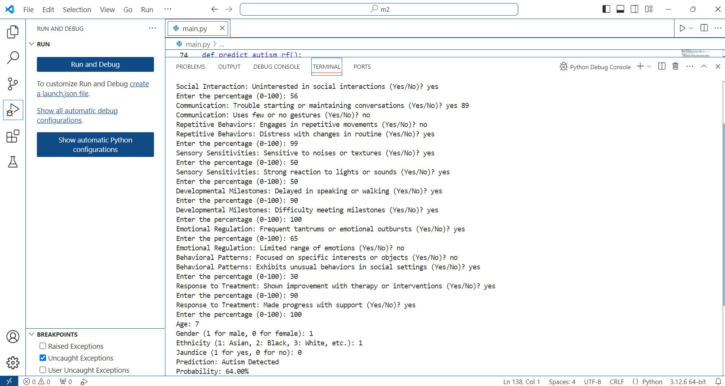
Result

Slide 13
Tools Required (Software / Hardware)
Software Requirements:
Operating System: Compatible with Windows , macOS , linux.
Programming Language :Python Program Language
Development Environment : VS Code , Python IDLE.
Hardware Requirements:
RAM: 4GB or High
Processor: Intel i5 or Above
Hard Disk: 4GB or Above

Slide 14
References
M. S. Qureshi, M. B. Qureshi, J. Asghar, F. Alam, and A. Aljarbouh, "Prediction and Analysis of Autism Spectrum Disorder Using Machine Learning," 2023. https://onlinelibrary.wiley.com/share/DUH4TBNIXKH72RMPINKU?target=10.1155/2023/4853800.
2. B. McNamara, C. Lora, D. Yang, F. Flores, and P. Daly, "Evaluating Decision Tree vs. Random Forest for Autism Spectrum Disorder Classification," 2018.
https://rstudiostatic.s3.amazonaws.com/383049_1faa93345b324da6a1081506f371a8dd.html

