Slide 1

DBMS Level 3
SmartDesk
Semantic IT & Facilities Helpdesk
It understands what a ticket means: finds similar solved problems, routes the ticket, assigns a technician and tracks the deadline.
Team: [Member 1 name, SRN] | [Member 2 name, SRN]
PES University | October 2026
Notes:
Introduce the project in one sentence: SmartDesk is a helpdesk that understands the meaning of a ticket. Database option: SQL plus vector database (PostgreSQL with pgvector). Mention the team split.

Slide 2






The problem with today's helpdesks
Duplicate tickets
Slow routing
Lost knowledge
One outage is reported by many people and handled many times.
Staff read each ticket and pick the department by hand.
"Internet unstable" and "Wi-Fi disconnects" look unrelated to a keyword search.
Uneven workload
Missed deadlines
No insight
Tickets go to whoever is habitual, not whoever has capacity.
Late tickets are noticed only when someone complains.
Recurring problems and workload are hard to see.
Notes:
Helpdesks store tickets but forget how they were fixed. Walk through the six problems quickly; they motivate every feature on the next slides. Problem statement: how can a helpdesk understand free-text problems well enough to reuse past solutions, route tickets, balance workload and enforce deadlines, while keeping the data correct and secure?

Slide 3

Our idea: search by meaning
1
2
3
4
5
Describe it
Embed it
Find similar
Decide
Assign + track
The employee types the problem in plain English
A local pre-trained model (MiniLM) turns it into 384 numbers
pgvector finds the 5 closest verified, solved tickets
Suggest a fix, route to a team, or send to an Admin
Least-loaded technician; SLA deadline set by a trigger
Pre-trained models only. Nothing is trained. PostgreSQL keeps the data correct; pgvector finds earlier solutions by meaning; Gemini only writes the explanation.
Notes:
Explain the five steps. Embedding = a list of 384 numbers where similar meanings are close together. Everything uses pre-trained models: nothing is trained. The database then does assignment, deadlines and audit automatically through triggers and stored procedures.

Slide 4
One search, three outcomes
Suggest
Route
Triage
Strong match
Medium match
Weak match
"Wi-Fi keeps dropping in the 3rd floor lab"
"AC dripping water near the server room"
"Need a standing desk"
similarity 0.86
similarity 0.58
similarity 0.22
Shows the past fix with its source ticket and routes to that department.
No fix shown. Routed by a similarity-weighted vote of the nearest tickets.
Goes to the Admin queue. Also used if the AI step fails.
Notes:
The best similarity score decides. Thresholds are configuration values tuned by measurement, not constants. The numbers on this slide are illustrative. Important: if the embedding step fails, the ticket is still saved and goes to triage; the AI layer never blocks ticket creation.

Slide 5
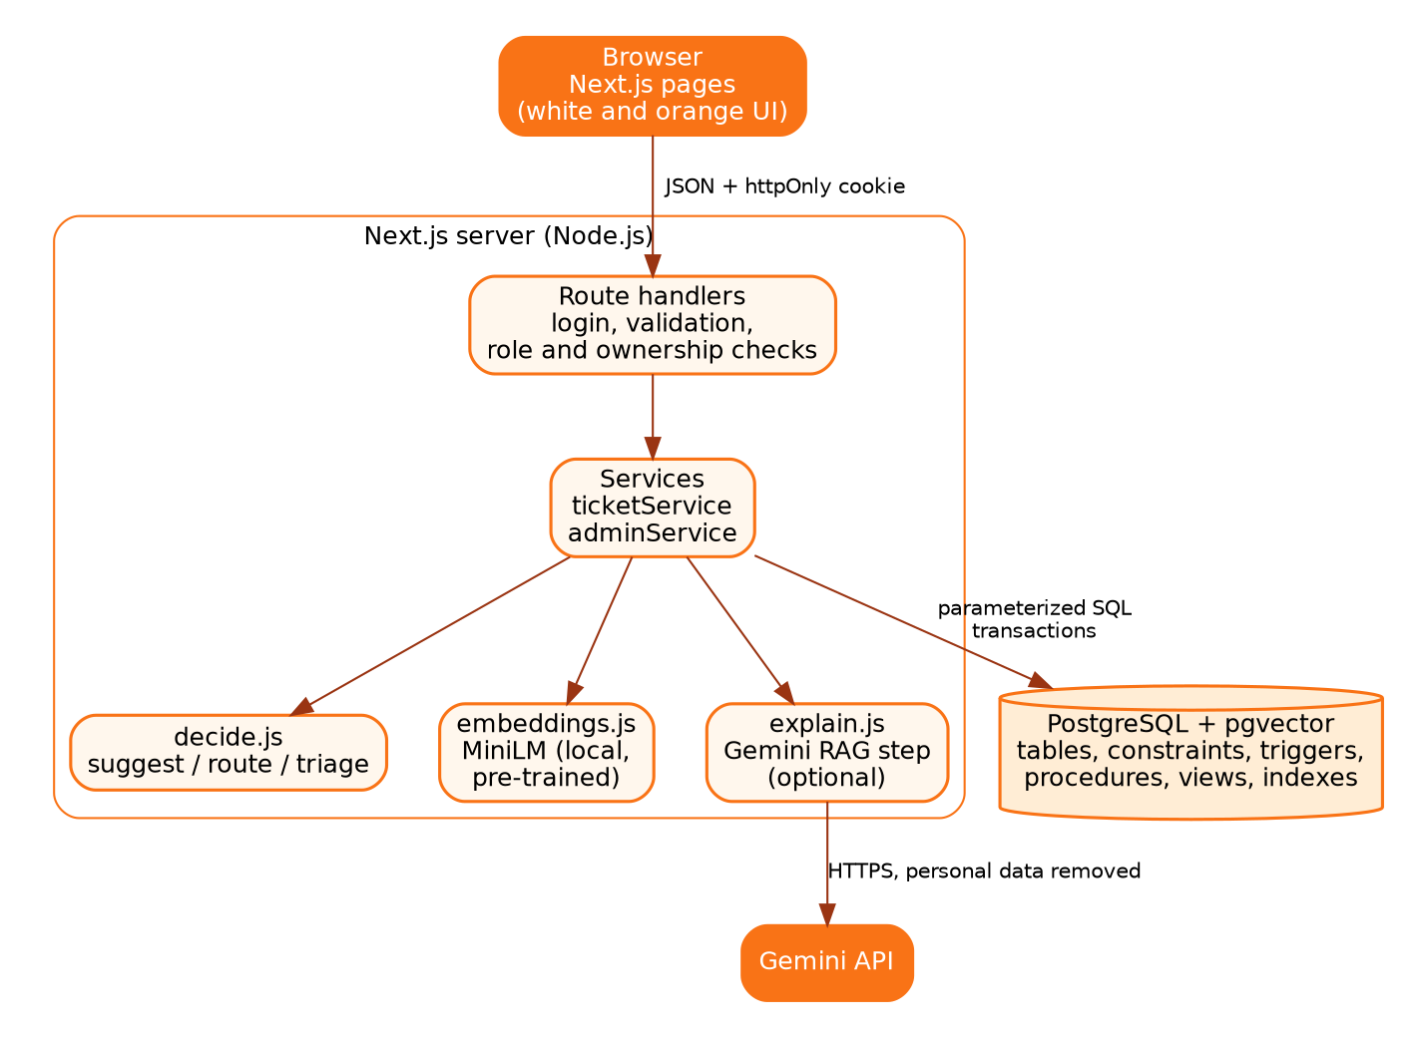
Architecture
Presentation
Next.js pages, role-based navigation
API
Login, validation, role and ownership checks
Services
Ticket flow, admin actions, transactions
AI
MiniLM embeddings, decision logic, Gemini explanation
Data
PostgreSQL + pgvector: constraints, triggers, procedures, views
Notes:
Layers: browser, Next.js route handlers (authentication, validation, role checks), services, the AI helpers, and PostgreSQL with pgvector. Rules that keep it clean: pages never touch the database, routes hold no business logic, the decision function is pure so it is easy to test, and every rule that must not be skipped lives in the database.

Slide 6
Technology stack
Layer | Technology | Why
Frontend | Next.js 14, React | Required; one framework for pages and API
Backend | Next.js route handlers | No second server to run
Database | PostgreSQL 14+ | Integrity, joins, triggers, procedures, views
Vector search | pgvector, HNSW, cosine | Same database and transaction as the ticket
Embeddings | all-MiniLM-L6-v2 (pre-trained) | Local, free, nothing is trained
LLM | Gemini API | Readable explanations, used after retrieval only
Security | bcrypt, signed cookie, zod | Hashed passwords, sessions, input checks
Notes:
Everything is deliberately small enough for two people to build and explain. Embeddings are pre-trained and local, so no ticket text leaves the machine. Gemini is used for one job only: writing an explanation from the retrieved fixes. We did not use Kubernetes, microservices, queues, model training or a second vector database.

Slide 7
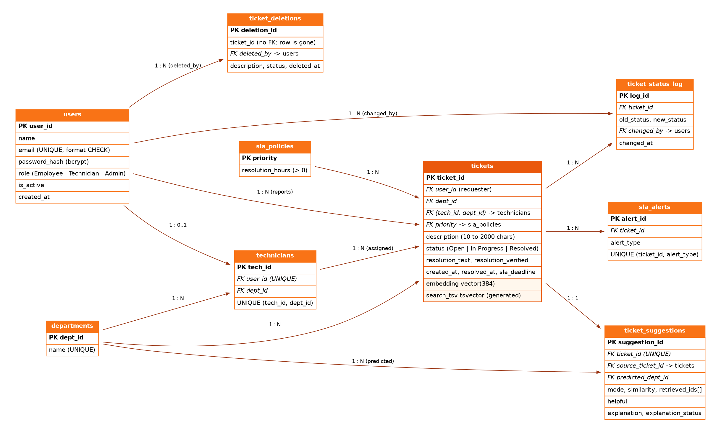
Database design: nine tables
Composite foreign key
A ticket can only be assigned to a technician of its own department
Validation in the database
CHECK constraints for length, status, resolved fields and email format
Two special columns
tickets.embedding vector(384) and a generated full-text search vector
Notes:
Third normal form. Two derived values are stored on purpose and documented: sla_deadline is a snapshot so later policy changes do not rewrite history, and predicted_dept_id is kept next to the final department so routing accuracy can be measured. The composite foreign key means a ticket can only be assigned to a technician of its own department, enforced by the database.

Slide 8







Seven advanced database concepts
Transactions
Triggers
Stored procedures
Views
Ticket submission with a savepoint around technician assignment
Audit with actor, SLA deadline, breach alerts, deletion log
assign_technician (lock), escalate_ticket, SLA scan
Workload, resolution summary, recurring issues (HAVING), AI performance
Indexing
Full-text search
Vector similarity
B-tree, GIN full-text, partial HNSW vector index
Generated tsvector; ticket search and evaluation baseline
vector(384), cosine distance, nearest 5 tickets
Notes:
The course asks for at least four. Point out the advisory lock in assign_technician: the decision reads an aggregate, and row locks cannot protect an aggregate. Also point out that a trigger cannot detect time passing, which is why a scheduled scan exists for overdue tickets.

Slide 9
Gemini explains, retrieval decides
Retrieve the top tickets (pgvector)
1
Safeguards
Only retrieved tickets are used; cites ticket numbers
Answer rejected if it cites anything else
Ticket text treated as data (prompt injection)
Emails and phone numbers removed first
One call per ticket (cached), hourly limit, timeout
Key in an environment variable; switch to turn off
Build a grounded prompt, personal data removed
2
Gemini writes a short explanation
3
Check it cites only supplied tickets
4
If Gemini fails or is switched off, the employee simply sees the raw past fix.
Notes:
This is the RAG step. Retrieval is done by pgvector. Gemini only writes the explanation. It never decides routing, assignment or access. The answer is accepted only if it cites ticket numbers that were supplied, otherwise the raw past fix is shown. Mention that free-tier content may be used by the provider, so only synthetic tickets are used in demos. The explanation was demonstrated with a labelled mock because the test environment had no internet.

Slide 10
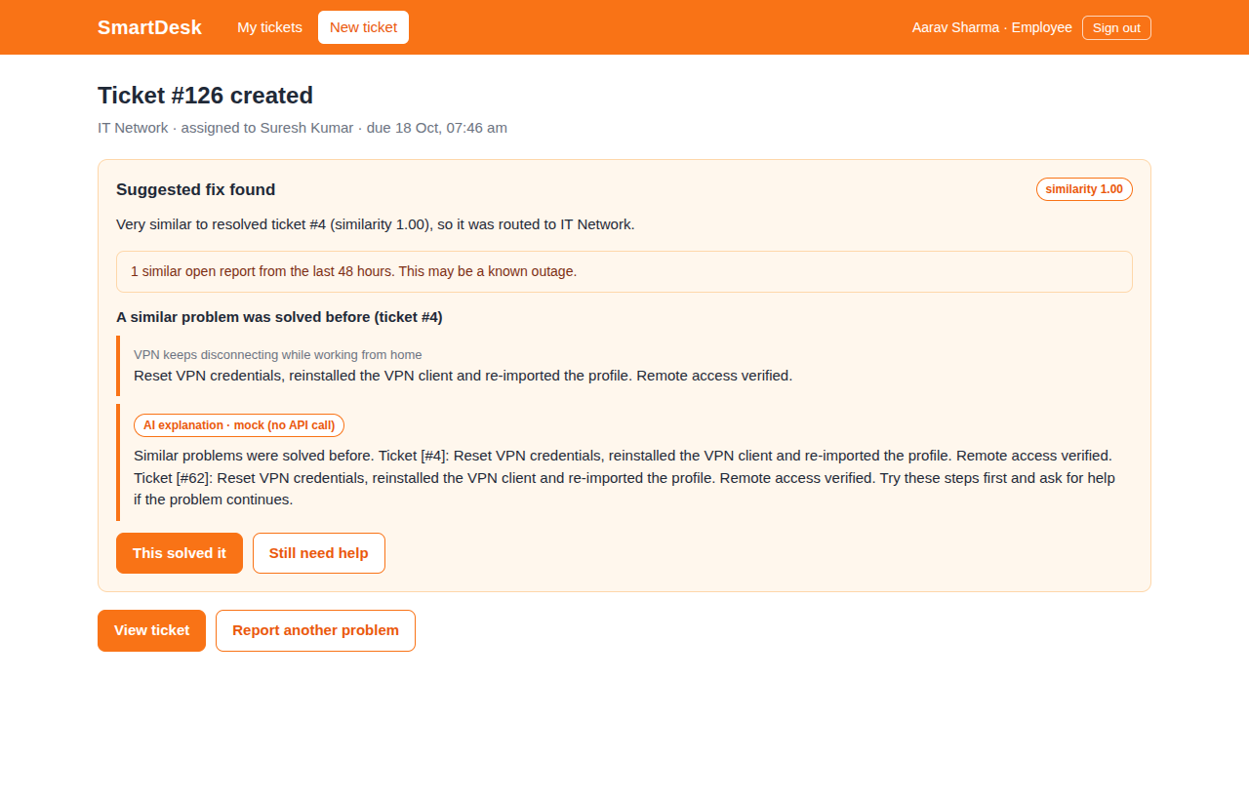
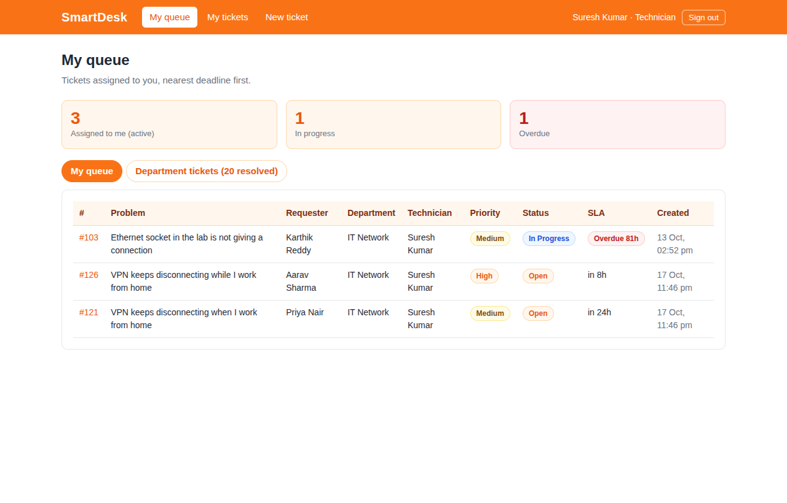
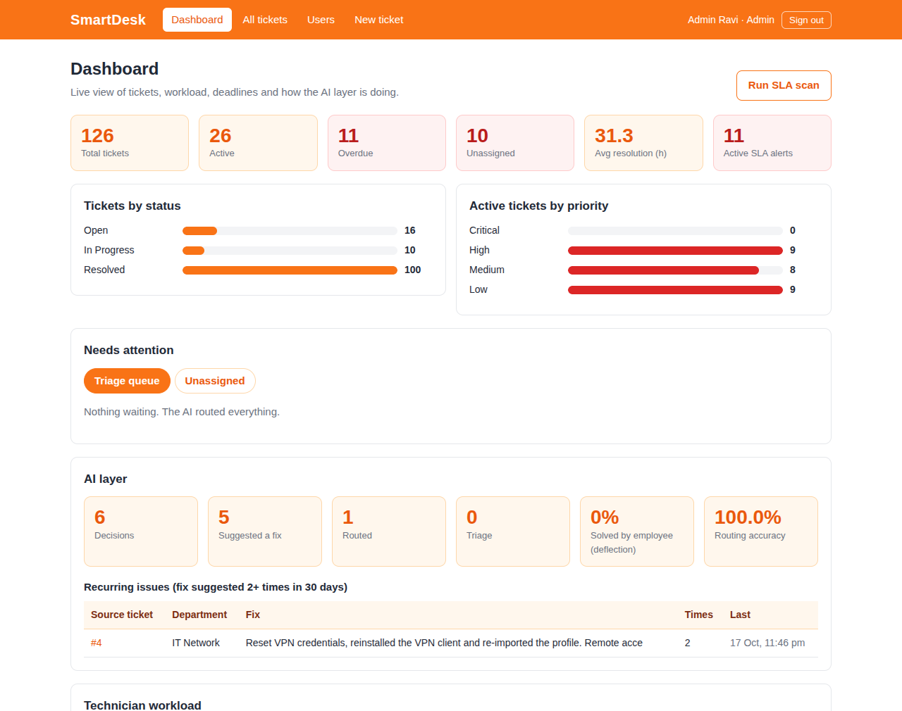
What it looks like
Employee: suggested fix and explanation
Technician: queue by SLA deadline
Admin: dashboard and AI performance
Screens captured from the running production build with seeded demo data. The AI explanation is a labelled offline mock in these screenshots.
Notes:
Three roles, one simple white and orange interface. Left: an employee gets a suggested fix with the source ticket, a similar-open-reports warning and the AI explanation. Middle: the technician queue sorted by deadline. Right: the admin dashboard. The explanation card in the screenshot is labelled mock because Gemini was not reachable in the test environment.

Slide 11






Security and integrity built in
Passwords
Access control
Sessions
bcrypt hashes; never stored in plain text
Role and ownership checks on the server for every route
Signed httpOnly cookie; user re-checked on every request
Database rules
Web security
Audit trail
CHECK, keys and a composite foreign key reject bad data
Parameterized SQL, Origin check, login rate limit
Every status change logged with who changed it
Notes:
Walk through each card. Note the database refuses invalid data even if the application has a bug. A ticket the caller may not see returns 404, so the system does not reveal that it exists. Before real deployment: remove demo accounts, use HTTPS and proper TLS certificate checks.

Slide 12
Tested at four levels
15 / 15
25 / 25
62 / 62
3 / 3
Unit tests
Database tests
API checks
Concurrency
Why the lock matters
The assignment reads an aggregate (open tickets per technician).
Row locks cannot protect an aggregate, so a per-department advisory lock serialises the decision.
Without it, 41 of 43 tickets went to one person.
Notes:
Unit tests for the decision logic, database tests inside a rolled-back transaction, 62 end-to-end API checks as each role, and a concurrency experiment. The concurrency experiment: 40 tickets submitted in parallel to one department. Without the lock almost every ticket goes to one technician because transactions cannot see each other uncommitted assignments; with the lock the load is balanced. Note: these ran offline with a fallback embedding and a mock Gemini because the test environment had no internet.

Slide 13
What we measured
51 ms to 0.07 ms
Open tickets, newest first (200,000 rows, B-tree index)
17 ms to 2.6 ms
Nearest 5 vectors (20,000 rows, HNSW; approximate)
Measured with the offline fallback embedding, not MiniLM. Re-run with MiniLM before the demo.
Notes:
The evaluation uses a hand-written set of 56 tickets that is separate from the seed data. Thresholds were tuned on one half and results are reported on the other. Be honest: these numbers come from the offline fallback embedding because MiniLM could not be downloaded in the test environment. Re-run npm run embed and npm run eval with MiniLM before the final demo and update this slide. The index results are on generated data: 200,000 rows for B-tree and 20,000 clustered vectors for HNSW; HNSW is approximate and the recall was 65 percent on this synthetic data.

Slide 14
Team and contributions
Member 1
[Name, SRN]
Member 2
[Name, SRN]
Ticket lifecycle and access
Intelligence and analytics
Users, roles, constraints
Audit and SLA triggers
assign_technician with lock; escalate_ticket
Login, sessions, role checks
My tickets, ticket detail, technician queue
Admin users, SLA alerts and scan
pgvector column, HNSW index, full-text search
Similarity query; views for dashboards
Embeddings, decision logic, Gemini step
Ticket submission and suggestion card
Admin dashboard
Evaluation scripts
Notes:
Work is split by feature, so each member designs SQL and builds Next.js pages for their own area. This satisfies the requirement that each member contributes to both the database and the application. Fill in names, roll numbers and the commits or pull requests that show each contribution.

Slide 15
What we built
Meaning-based routing
Rules in the database
A checked explanation
pgvector finds earlier solutions; plain rules decide suggest, route or triage
Constraints, triggers, procedures and an assignment lock, each tested
Gemini writes it from retrieved tickets and is rejected if it strays
Next steps
Run MiniLM and Gemini with real credentials; tune thresholds
Replace the fallback evaluation numbers with MiniLM results
Notifications, priority suggestion, row-level security
Questions?
Notes:
Wrap up: relational integrity plus meaning-based search in one database; the rules that must never be skipped live in the database and are tested; the LLM is used only for wording and is checked against evidence. Be upfront about what remains: run MiniLM and Gemini with real credentials, tune thresholds, replace the fallback evaluation numbers. Then take questions.

