Slide 1
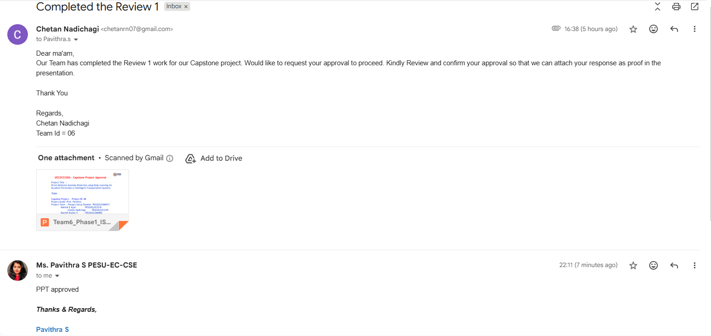

Slide 2
UE23CS320A – Capstone Project Approval
Project Title :
Driver Behavior Anomaly Detection using Deep Learning for Accident Prevention in Intelligent Transportation Systems
TEAM:
Capstone Project — Project ID: 06
Project Guide :Prof. Pavithra
Project Team : Poojary Sairaj Shankar- PES2UG23AM073
Mahesh E Ajjer - PES2UG23CS316
Chetan Nadichagi - PES2UG23CS149
Ranjith Kumar.V - PES2UG23AM082

Slide 3
Outline
Problem Statement
Scope and Feasibility study
Applications/Use cases
Expected Deliverables
Capstone (Phase-I Phase-II, Phase-III) Project Timeline
Any other information

Slide 4
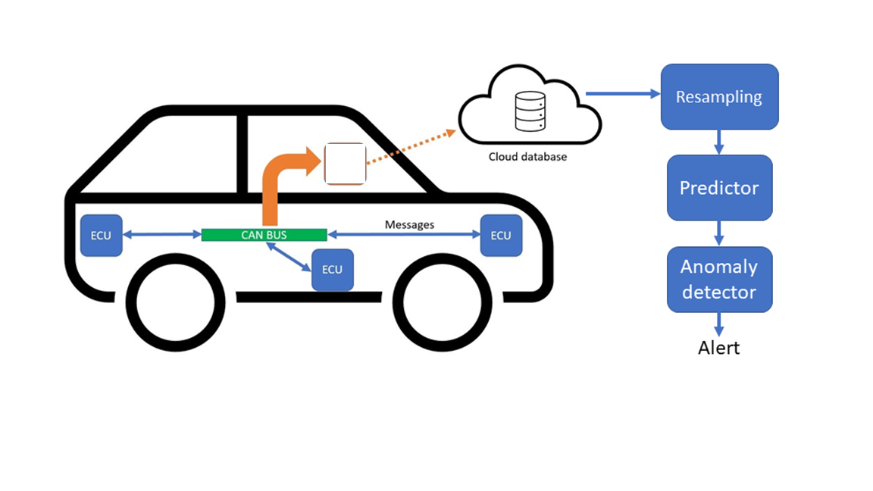


Driver Behavior Anomaly Detection
Using Deep Learning for Accident Prevention in
Intelligent Transportation Systems

Slide 5
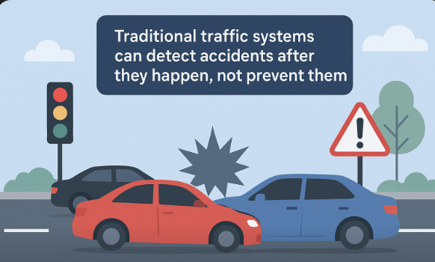
Problem Statement
This project develops a deep-learning system to detect abnormal driver behaviors (drowsiness, yawning, phone use, lane deviation, harsh braking, overspeeding) in real-time and provide timely alerts to drivers and ITS infrastructure to reduce accident risk...
An intelligent system that detects anomalies in real-time and alerts nearby vehicles/ITS infrastructure to prevent accidents

Slide 6
Background Work
1. Driver-related Accidents
Studies show that human error is the main contributor to traffic crashes. Drowsiness, mobile phone use etc, increase accident risk.
2. Trends in Research
Multi-modal learning (camera, GPS, accelerometer, steering angle) improves accuracy over single-source systems.
3. Research Gap
Few solutions integrate multi-modal fusion + explainability + real-time edge deployment.

Slide 7

Scope Study
01
02
03
Anomaly Detection
Model Development
Testing & Evaluation
Detect abnormal driver behavior (overspeeding, sudden braking, lane deviation, drowsiness).
Develop advanced ML/DL models (CNN, LSTM, Autoencoders) and refine with diverse
Validate models on simulated & real-world datasets and benchmark for accuracy
04
05
Integration
Deployment
Incorporate into Intelligent Transportation Systems (ITS) and enable IoT/sensor communication.
Build user-friendly applications for real-time alerts and accident prevention.

Slide 8
Feasibility study
01
02
03
Real-time Monitoring
Multi-modal Data Handling
Adaptive Learning
Continuous driver behavior analysis using sensors & cameras.
Process GPS, accelerometer, eye-tracking, and steering data
Models improve with more driving data (self-learning).
04
05
Early Warning System
Scalability
Provide alerts for risky driving in advance
Deployable across personal vehicles, public transport, and fleets.

Slide 9

Novelty
Multi-modal, real-time edge-to-cloud detection pipeline.
Personalized driver profiling that adapts thresholds per driver.
Explainable alerts (visual heatmaps + reasons) for better user trust.
Designed and evaluated for real-world deployment.
Smart Context Awareness(smarter decisions)
Novel Feedback System(Instead of just a beep)

Slide 10
Challenges
01
02
03
Data Collection
Real-time Processing
Model Generalization
Difficult to acquire large, high-quality, and diverse driving datasets
Ensuring low-latency predictions on limited hardware
Adapting to regions, weather, vehicle types, and driver habits.
04
05
Privacy & Security
Deployment Barriers
Handling sensitive driver and vehicle data responsibly.
Integration with existing ITS and user adoption challenges

Slide 11



Applications & Use Cases
Road Safety & Accident Prevention
Autonomous & Assisted Driving
Insurance & Risk Assessment
Real-time detection of risky driving behaviors (overspeeding, harsh braking, lane drifting) to reduce accidents.
Enhance ADAS (Advanced Driver Assistance Systems) by identifying human errors and supporting autonomous vehicle decision-making
Advanced threat detection for critical infrastructure such as power grids, transportation hubs, and government buildings.

Slide 12
Use Cases
Smart City Traffic Management
Fleet Management & Logistics
Insurance & Risk Profiling
Integrates with Intelligent Transportation Systems (ITS) to provide traffic authorities with insights for congestion control and emergency response
Helps companies track driver behavior, reduce fuel costs, improve safety compliance, and lower accident-related losses
Enables insurance providers to assess risk more accurately using driver behavior analytics for premium adjustments

Slide 13
Expected Deliverables
Capstone-I → Research & Baseline :
Collect and preprocess datasets (e.g., AICity Challenge).
Build a baseline model (simple CNN or Autoencoder) for anomaly detection.
Capstone-II → Model Development :
Design multi-modal deep learning models (CNN–LSTM).
Evaluate accuracy, precision, recall, F1-score for anomaly detection.
Compare different deep learning methods (CNN vs LSTM vs Autoencoder).

Slide 14
Expected Deliverables
Capstone-III → Integration & Testing :
Integrate system into an Intelligent Transportation System (ITS) simulation.
Implement real-time driver monitoring (latency < 200 ms).
Add an alerting mechanism (buzzer, screen alert, braking).
Test prototype under different driving scenarios (day/night, highway/city).
Capstone-IV → Deployment & Finalization :
Deploy the anomaly detection system.
Conduct final validation with live test
repare final documentation, publication paper(s), and project report.

Slide 15
Capstone Project Timeline

Slide 16
REFERANCE
https://dl.acm.org/doi/10.1145/3616901.3616942
https://ijsrmt.com/index.php/ijsrmt/article/view/128
https://arxiv.org/html/2503.13195v1
https://www.sciencedirect.com/science/article/abs/pii/S0360835224007897

Slide 17

…..Thank You

