Slide 1
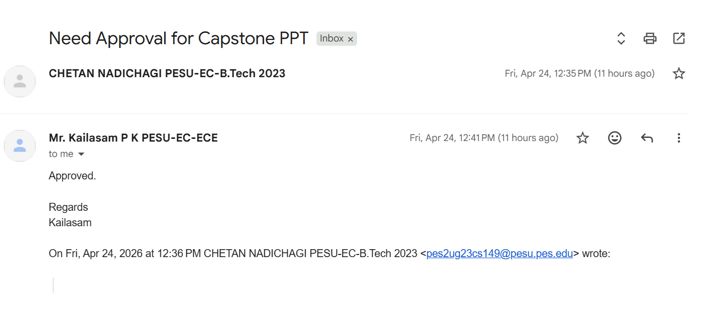

Slide 2
UE23CS320B – Capstone Project Phase-2 ESA
Project Title : Driver Behavior Anomaly Detection using Deep Learning
Project ID : 06
Project Guide : Prof.Kailasam
Project Team : Chetan Nadichagi - PES2UG23CS149
Poojary Sairaj Shankar - PES2UG23AM073
Ranjith Kumar.V - PES2UG23AM082
Mahesh E Ajjer - PES2UG23CS316

Slide 3
Outline
Abstract
Suggestions from Review – 1
Suggestions from Review – 2
Analysis and Critique of Research/Relevance -Application in Real world
High Level Design
Design Methodology
Project Progress (Minimum 20% implementation)
Data Preprocessing and Base Model Implementation
Individual Contribution
References

Slide 4
Abstract
Problem :
Driver fatigue and distraction are major causes of road accidents. Existing driver monitoring systems are often expensive and not suitable for real-time applications.
This project proposes a real-time driver behavior anomaly detection system using deep learning.
It combines MediaPipe Face Mesh for facial feature analysis and YOLOv8 for detecting distraction objects like mobile phones.
The system uses temporal modeling with BiLSTM to analyze behavior over time and generate alerts for abnormal conditions such as drowsiness and distraction.
The solution is low-cost, efficient, and suitable for real-world deployment.

Slide 5
Suggestions from Review – 1
Suggestion :
Increase dataset size and add custom dataset.
Progress:
Collected additional custom data.
Included multiple driver states (Normal, Distracted, Yawning).
Improved dataset diversity and model performance.

Slide 6
Suggestions from Review – 2
Suggestion :
Add face recognition and create driver database.
Progress:
Implemented real-time face recognition system
Created driver database with details (name, phone, license, etc.)
Integrated recognition with live system to display driver information

Slide 7
Analysis and Critique of Research/Relevance -Application in Real world
Analysis and Critique of Research:
Existing driver monitoring systems use deep learning for detecting fatigue and distraction
Many approaches achieve good accuracy but require high computational resources
Some systems lack real-time performance and are expensive to deploy
Gap identified: Need for a low-cost, real-time, and efficient solution
Relevance:
Road accidents due to drowsiness and distraction are a major global issue
The problem is highly relevant to current transportation and safety systems
Aligns with industry need for real-time driver monitoring solutions
Increasing demand for AI-based safety systems in vehicles
Application in the Real World:
Can be implemented in cars, trucks, and public transport systems
Works using a simple webcam → low-cost deployment
Provides real-time alerts to prevent accidents
Scalable for integration into smart vehicles and safety systems

Slide 8
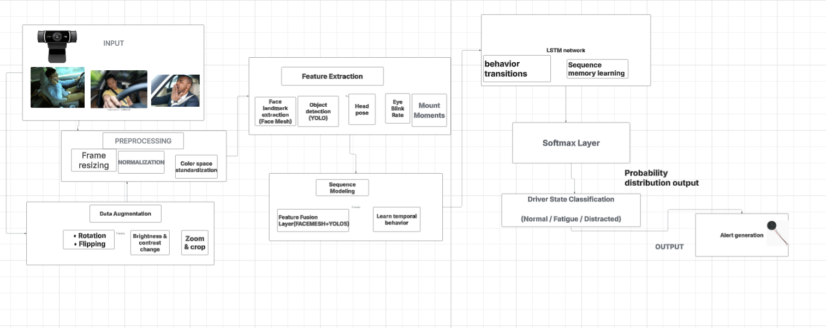
high-level design

Slide 9
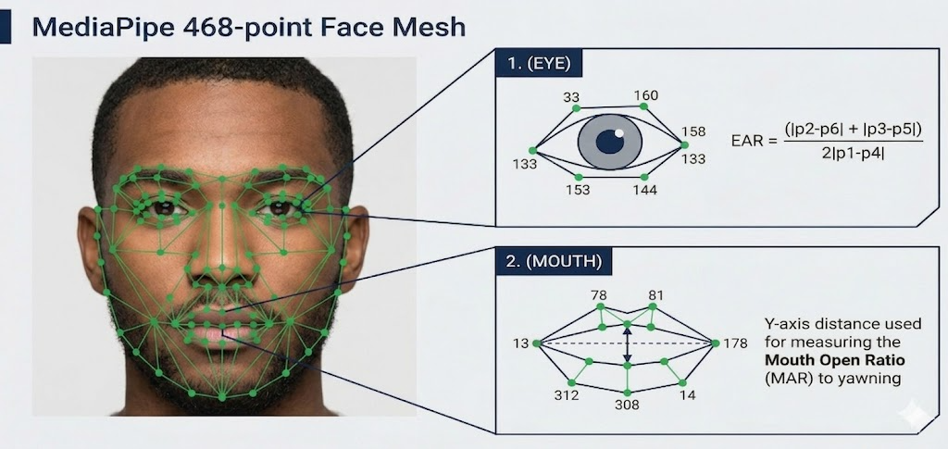

Slide 10
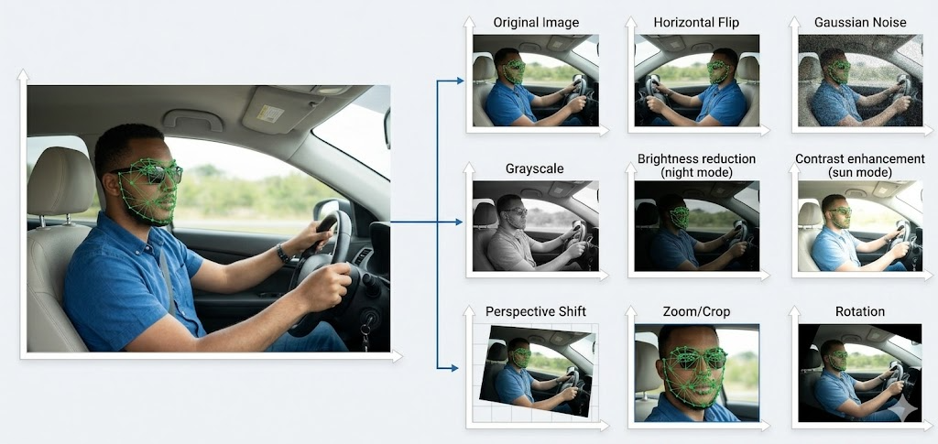


Slide 11
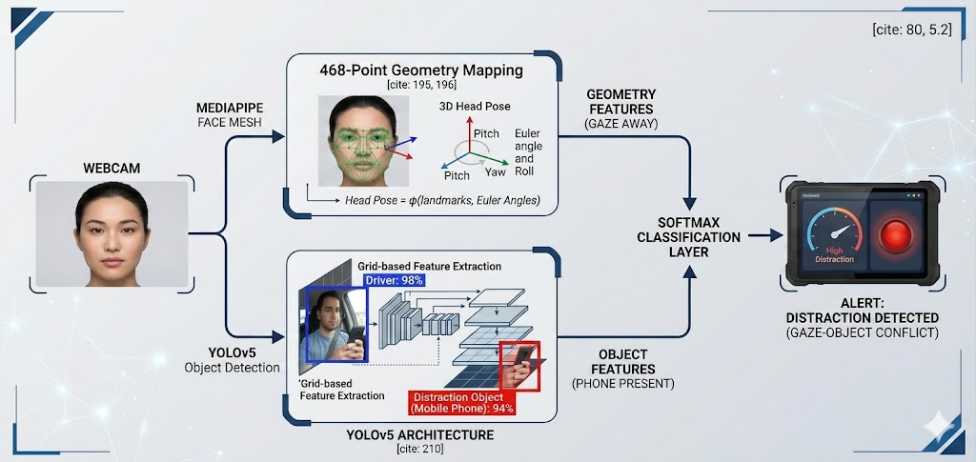

Slide 12
Design methodology
Other Components:
Webcam → Real-time input source
Feature Extraction → EAR (Eye Aspect Ratio), MAR (Mouth Aspect Ratio)
Temporal Modeling → BiLSTM for behavior analysis over time
Alert System → Generates warning for drowsiness and distraction
Technology Selection
Programming Language:
Python → Used for implementing the complete system
and model logic
Tools & Frameworks:
OpenCV → Video capture and real-time frame processing
MediaPipe → Face Mesh for extracting facial landmarks
YOLOv8 → Object detection (mobile usage, distractions)
PyTorch → Deep learning framework for BiLSTM model

Slide 13
Project Progress-Data Preprocessing and Base model implementation
Completed:
Real-time webcam integration
Face Recognition system implemented
Driver database system created
Face Mesh feature extraction implemented
Behaviour classification (Normal / Distracted)
Achievements:
Real-time detection working
Driver details displayed dynamically
FPS-based live system

Slide 14
Project Progress-Data Preprocessing and Base model implementation
Implementation Overview :
Continuous frame capture loop
BGR → RGB conversion
Face detection & encoding
Landmark extraction using Face Mesh
Behaviour classification using trained model
Output displayed with bounding boxes and details
Future Enhancements :
YOLOv8 integration
Add LSTM for temporal modeling
Improve accuracy using larger dataset
Deploy on embedded systems
Add cloud logging system

Slide 15
Individual Contribution
Chetan : Face Recognition
Implemented real-time face detection and identification.
Displayed driver name with confidence score.
Sairaj : Behaviour model
Developed behavior classification using Face Mesh
Classified driver states (Normal/Distracted)
Mahesh : Driver database
Built GUI for storing driver details and images.
Manages data for Face recognition module.
Ranjith : Model Integration and Alert System
Integrated all modules into one system.
Implemented real-time alert generation.

Slide 16
Conclusion
Conclusion from Phase-2 :
Developed a real-time driver monitoring system.
Successfully Implemented :
Face Recognition
Behaviour Detection
System works efficiently in real-time
Provides a low-cost solution for driver safety.
Ready for further enhancement in phase-3.

Slide 17
References
[1] M. A. Uddin et al., “Abnormal Driving Behavior Detection: A Machine and Deep Learning Based Hybrid Model,” Int. J. Intell. Transp. Syst. Res., 2025.
[2] E. Civik and U. Yuzgec, “Real-Time Driver Fatigue Detection System with Deep Learning on a Low-Cost Embedded System,” Microprocessors Microsyst., 2023.
[3] F. Qu et al., “Comprehensive Study of Driver Behavior Monitoring Systems Using Computer Vision and Machine Learning Techniques,” J. Big Data, 2024.
[4] B. B. Gupta et al., “Deep Learning Model for Driver Behavior Detection in Cyber-Physical System-Based Intelligent Transport Systems,” IEEE Access, 2024.

Slide 18
References
[5] S. Abbas et al., “Naturalistic Driving Data-Based Anomalous Driving Behavior Detection Using Hypertuned Deep Autoencoders,” Electronics, 2023.
[6] A. Author et al., “Enhanced Deep Neural Network Model for Anomalous Driving Behavior Detection,” Wiley J. Surveillance, 2024.
[7] R. Kumar and S. Gupta, “Driver Drowsiness Detection Using CNN-LSTM Hybrid Deep Learning Model,” IEEE Sensors J., 2023.
[8] H. Zhang et al., “Multi-Modal Driver Fatigue Detection Using Infrared and RGB Fusion,” IEEE Trans. Intell. Veh., 2023.

Slide 19
Thank You

