Slide 1
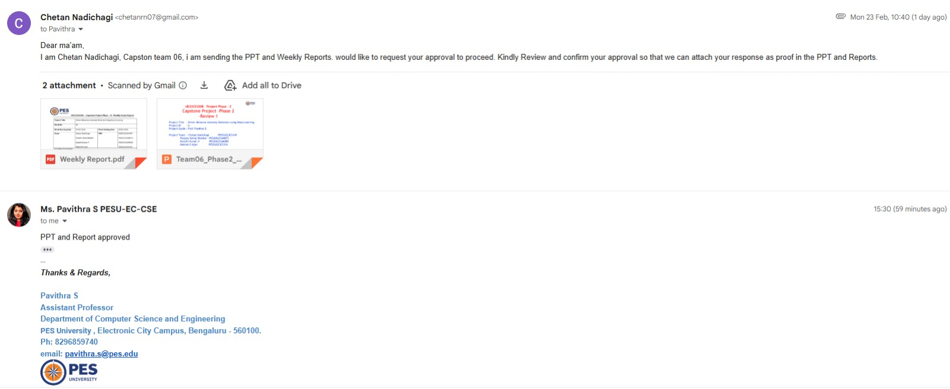

Slide 2
UE23CS320B– Project Phase – 2
Capstone Project –Phase 2 –Review 1
Project Title : Driver Behavior Anomaly Detection using Deep Learning
Project ID : 6
Project Guide : Prof. Pavithra S
Project Team : Chetan Nadichagi -PES2UG23CS149
Poojary Sairaj Shankar -PES2UG23AM073
Ranjith Kumar.V -PES2UG23AM082
Mahesh E Ajjer -PES2UG23CS316

Slide 3
Agenda
Problem Statement
Abstract and Scope
Suggestions from Phase-1
Requirements Specification
Data set and requirements
Design Approach
Design Constraints, Assumptions & Dependencies
Proposed System / Approach
Architecture
Design Description
Project Progress
References

Slide 4
Problem Statement
Despite significant advancements in vehicle technology, human error remains one of the leading causes of road accidents.
Drivers often exhibit abnormal behaviors such as drowsiness, distraction, mobile phone usage, which can lead to severe collisions and loss of life.
Existing systems in vehicles primarily focus on post-accident analysis rather than real-time detection and prevention of such unsafe driving behaviors.

Slide 5
Abstract
This project, “Driver Behavior Anomaly Detection using DeepLearning,” aims to reduce road accidents caused by human error.
Using deep learning, the system detects unsafe behaviors like drowsiness, distraction, and rash driving from real-time data and provides early alerts to prevent accidents. It contributes to building safer, smarter, and more reliable transportation systems.

Slide 6
Scope
The main scope of this project is to detect and prevent unsafe driving behaviors in real time using deep learning techniques. By analyzing driver actions and generating early alerts, the system aims to reduce accidents caused by human error and promote safer, smarter transportation systems.

Slide 7
Suggestions from Review - 1
Key suggestions and remarks by the panel members:
Initially, we planned to use V2V/V2I communication to alert traffic authorities during anomalies, but the panel advised it’s not feasible for the current scope.
We planned to detect the lane deviation as well but the idea was dropped, since it will need us to have an extra camera angle which is facing towards the road to detect the lane deviation.
We were told to find more diversified dataset but couldn’t find much on the internet so we are planning to create our own custom dataset.

Slide 8
Requirements Specification
Functional Requirements
Detect driver face and landmarks in real time
Identify distracted driving behaviors
Detect objects such as mobile phone using object detection
Analyze temporal behavior patterns
Generate alert when anomaly is detected
Non-Functional Requirements
Real-time performance (<100 ms latency)
Accuracy above 85%
Lightweight model for deployment
Robust under varying lighting conditions
Scalable architecture

Slide 9
Requirements Specification
Technologies Used :
Python
OpenCV
MediaPipe Face Mesh
YOLOv8
LSTM
Deep Learning frameworks

Slide 10
System Requirements
Hardware :
Webcam
GPU
Laptop/PC
Software :
Python 3.x
PyTorch/TensorFlow
OpenCV
MediaPipe
YOLOv5 framework

Slide 11
Dataset
Dataset Used :
State Farm Distracted Driver Dataset
Future Dataset Plan :
Custom real-time webcam recordings
Multi-driver data collection
Temporal sequence generation for LSTM training
Data augmentation for robustness

Slide 12
Design Approach
Approach Followed
Modular deep learning pipeline architecture
Hybrid spatial + temporal behavior modeling
Real-time computer vision processing
Feature fusion from multiple detectors
This approach helps in
Driver behavior depends on visual cues
Modular design allows independent model improvement
Supports real-time anomaly detection

Slide 13
Alternate Approaches
CNN-only single frame classification
Classical computer vision (rule-based)
Sensor-based fatigue detection
End-to-end transformer models

Slide 14
Design Constraints, Assumptions
Design Constraints
Real-time processing requirement
Limited computational resources (GPU/CPU)
Camera angle and lighting variability
Dataset limited to static images
Accuracy vs speed trade-off
Assumptions
Driver face is visible to the camera
Single-driver monitoring environment
Adequate lighting conditions
Stable camera placement inside vehicle
No major occlusion of face

Slide 15
Dependencies
Media Pipe Face Mesh for landmark detection
YOLOv5 framework for object detection
Python + OpenCV runtime environment
Availability of labeled training dataset
Hardware performance for model inference

Slide 16
Design Details
Hybrid pipeline combining Face Mesh + YOLO + LSTM for smarter temporal driver behavior detection.
Interoperability : Works with webcams and vehicle cameras; easily integrates new datasets and models.
Performance : Real-time detection with low latency while maintaining high accuracy.
Security & Reliability : Local processing protects privacy and works across lighting and driver variations.

Slide 17
Design Details
Maintainability : Independent modules allow easy upgrades without redesigning the system.
Portability : Runs on laptops and edge devices for flexible deployment.
Reusability :
Architecture can be reused for other behavior monitoring applications.
Compatibility Fully compatible with Python, OpenCV, and modern deep learning frameworks.

Slide 18
Proposed System / Approach
Basic Approach
Face Mesh + YOLO used for frame-level detection
But this approach can detect distraction only in the static frames drivers behavior changes over time.
Need for Improvement
Driver behavior is time-dependent
Fatigue and distraction occur as sequences
Frame-based detection is insufficient

Slide 19
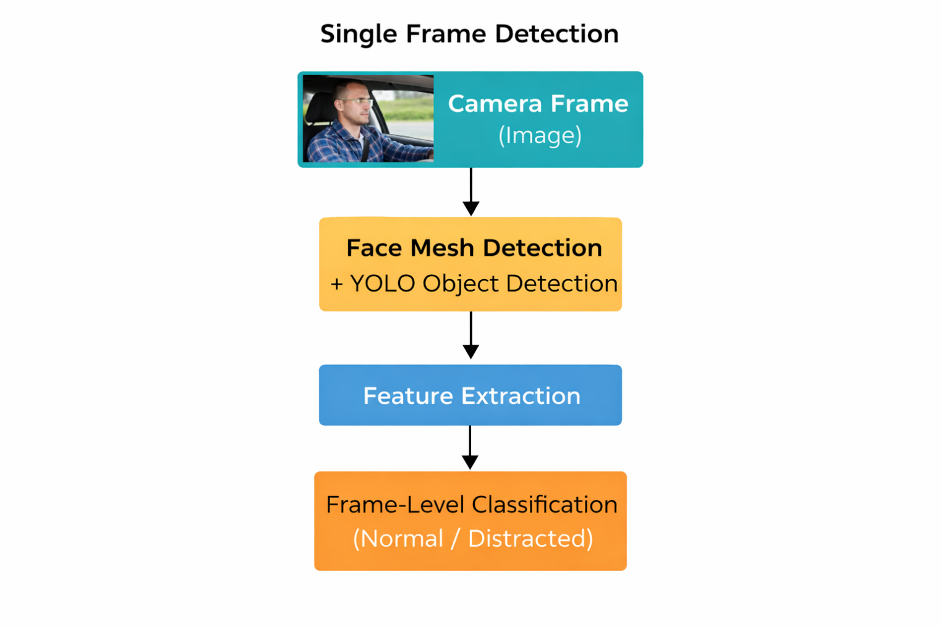
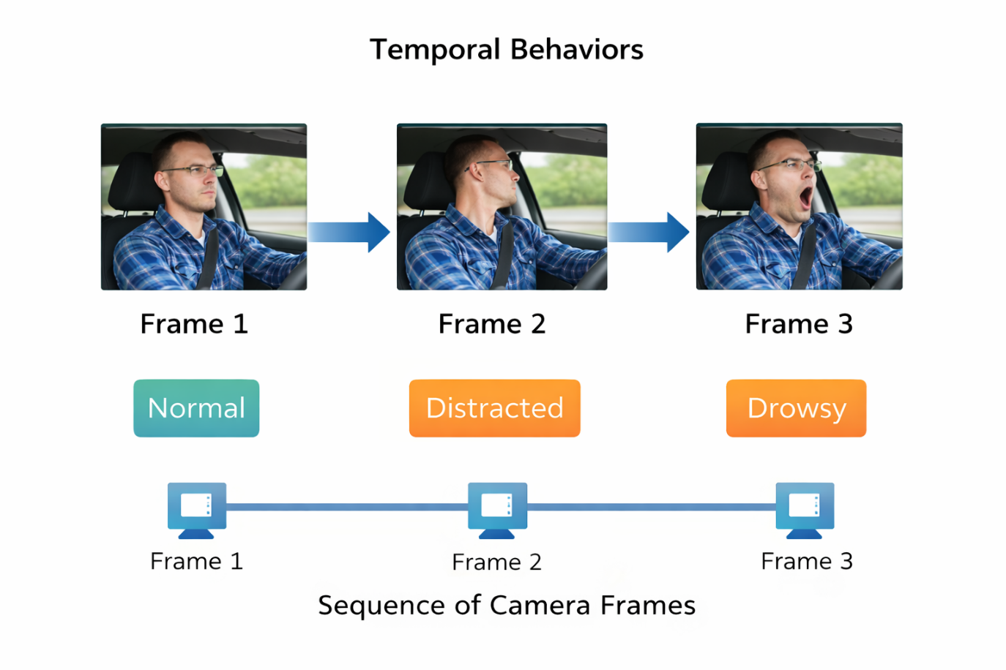

Slide 20
Proposed System / Approach
Hybrid Approach :
Added LSTM for temporal modeling
Combines spatial + time-based features
Enables real-time anomaly detection
Benefits :
Higher detection accuracy
Captures fatigue progression
Real-time monitoring

Slide 21
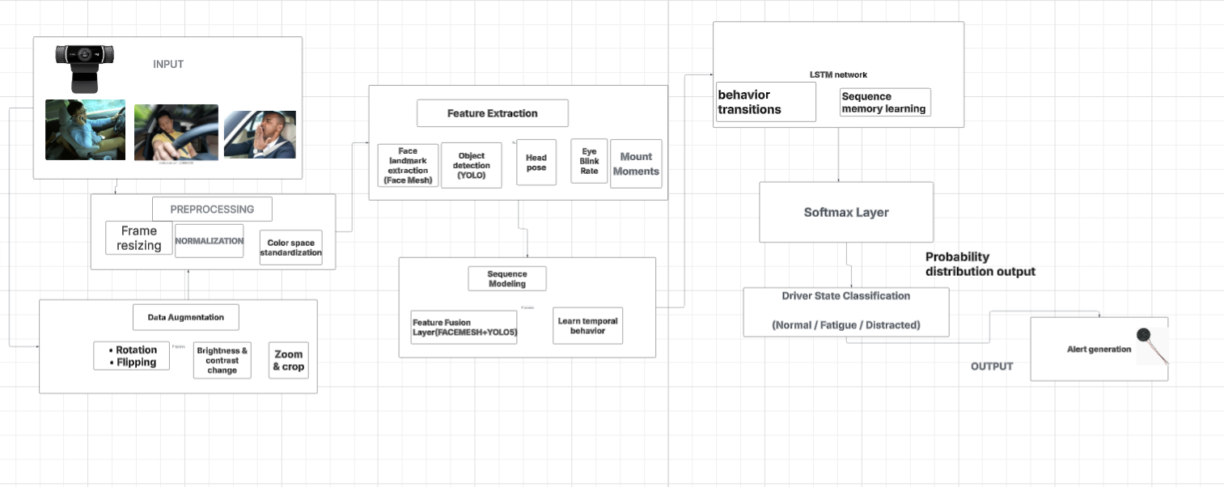
Architecture

Slide 22
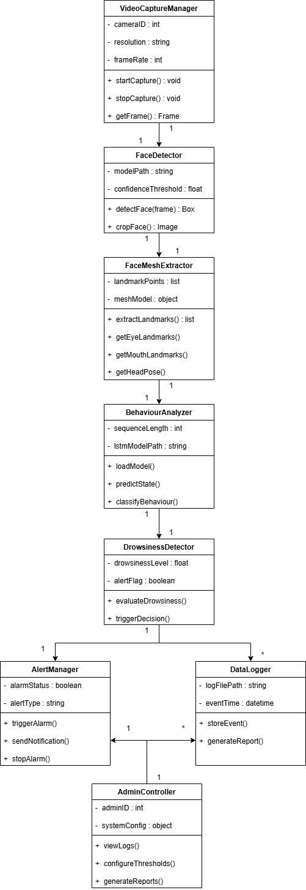
Master class diagram

Slide 23
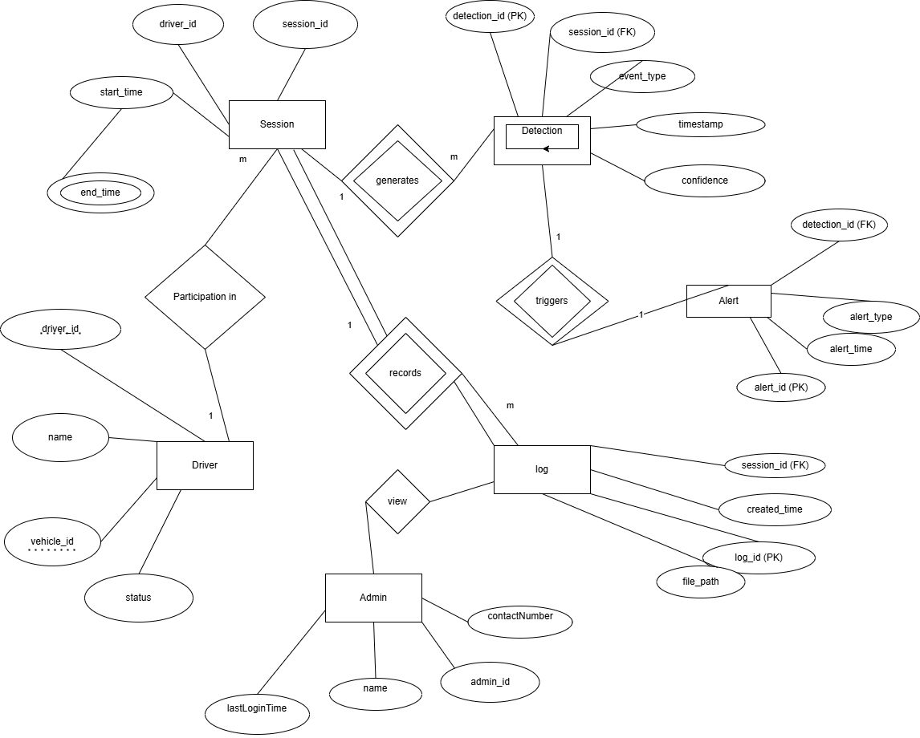
ER Diagram

Slide 24
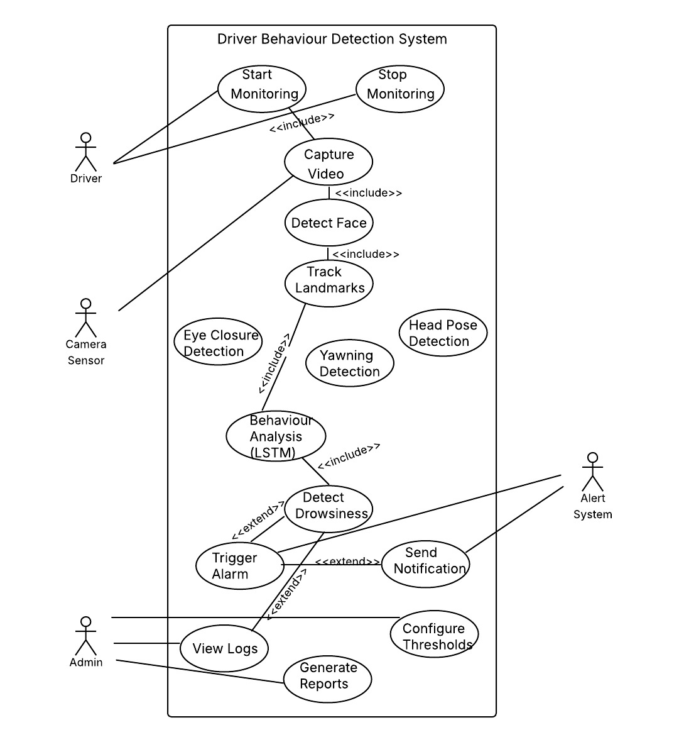
Use Case Diagrams

Slide 25
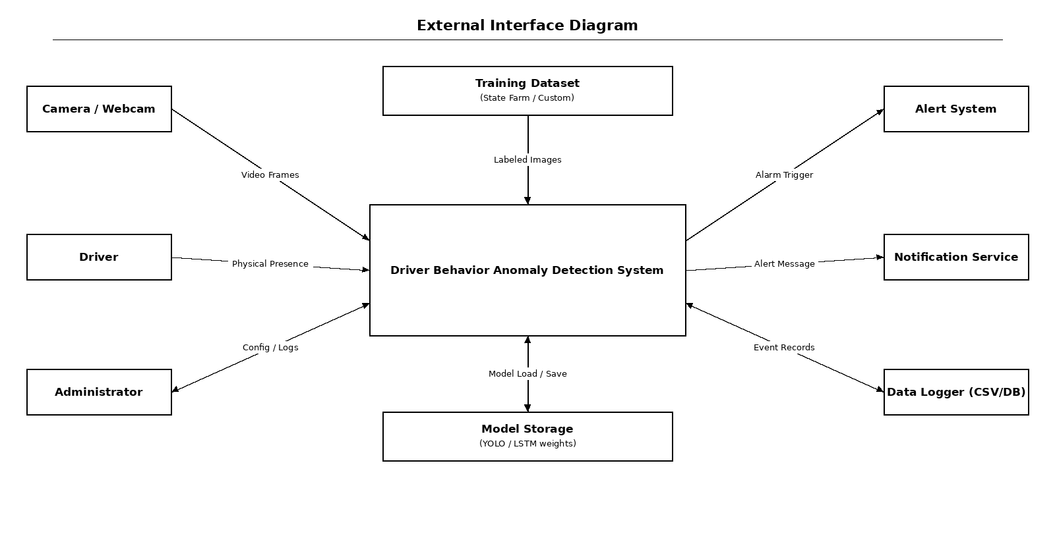
External Interfaces

Slide 26
Capstone (Phase-I ,Phase-II and phase -III) Project Timeline
Phase-I → Research & Baseline Development :
Activities:
Collect and preprocess datasets (e.g., State Farm Dataset).
Perform literature survey & problem analysis.
Build baseline anomaly detection models:
Simple CNN
Perform initial feature extraction & preprocessing.
Establish performance baseline metrics.

Slide 27
Capstone (Phase-I ,Phase-II and phase -III) Project Timeline
Phase-II → Model Development & System Integration :
Activities:
Design multi-modal deep learning models
Train and optimize models.
Evaluate using metrics:
Accuracy
Precision
Recall
F1-Score
Implement real-time monitoring (latency < 100 ms).
Add alert mechanisms:
Buzzer
Screen alert

Slide 28
Capstone (Phase-I ,Phase-II and phase -III) Project Timeline
Phase-III → Deployment & Final Validation :
Activities:
Deploy anomaly detection system.
Perform live testing & validation.
Optimize performance & stability.
Conduct final system evaluation.
Prepare deliverables:
Final documentation
Project report
Publication paper(s)
Presentation & demo

Slide 29
Capstone Project Timeline

Slide 30
Conclusion
The project “Driver Behavior Anomaly Detection using Deep Learning ” lays the foundation for an intelligent system that detects unsafe driver behaviors like drowsiness, distraction, and rash driving using CNN and LSTM models. By analyzing real-time data, it enhances road safety and minimizes human error. Future improvements include integrating multi-modal data, lightweight on-device models, and explainable AI to build safer and smarter transportation systems.

Slide 31
References
[1] M. A. Uddin et al., “Abnormal Driving Behavior Detection: A Machine and Deep Learning Based Hybrid Model,” Int. J. Intell. Transp. Syst. Res., 2025.
[2] E. Civik and U. Yuzgec, “Real-Time Driver Fatigue Detection System with Deep Learning on a Low-Cost Embedded System,” Microprocessors Microsyst., 2023.
[3] F. Qu et al., “Comprehensive Study of Driver Behavior Monitoring Systems Using Computer Vision and Machine Learning Techniques,” J. Big Data, 2024.
[4] B. B. Gupta et al., “Deep Learning Model for Driver Behavior Detection in Cyber-Physical System-Based Intelligent Transport Systems,” IEEE Access, 2024.

Slide 32
References
[5] S. Abbas et al., “Naturalistic Driving Data-Based Anomalous Driving Behavior Detection Using Hypertuned Deep Autoencoders,” Electronics, 2023.
[6] A. Author et al., “Enhanced Deep Neural Network Model for Anomalous Driving Behavior Detection,” Wiley J. Surveillance, 2024.
[7] R. Kumar and S. Gupta, “Driver Drowsiness Detection Using CNN-LSTM Hybrid Deep Learning Model,” IEEE Sensors J., 2023.
[8] H. Zhang et al., “Multi-Modal Driver Fatigue Detection Using Infrared and RGB Fusion,” IEEE Trans. Intell. Veh., 2023.

Slide 33
Thank You

