Slide 1
UE23CS320B – Capstone Project Phase – 2
Project Progress Review #2
Project Title : Driver Behavior Anomaly Detection using Deep Learning
Project ID : 06
Project Guide : Prof.Kailsam
Project Team : Chetan Nadichagi - PES2UG23CS149
Poojary Sairaj Shankar - PES2UG23AM073
Ranjith Kumar.V - PES2UG23AM082
Mahesh E Ajjer - PES2UG23CS316

Slide 2
What Problem Are We Solving ?
Problem :
Road accidents occur due to:
Drowsiness
Distraction (mobile usage)
Existing systems:
Expensive
Not real-time
Not accessible

Slide 3
Objectives & Novelty
Core Objectives: * Detect driver anomalies in real-time (Drowsiness & Distraction).
Generate alerts to prevent accidents.
Our Novel Approach:
Multi-Modal Fusion: Combining physiological data (Face Mesh) with object context (YOLOv8).
Two-Tier Classification: Blending instant rule-based thresholds with temporal sequence learning.
Attention Mechanism: Utilizing advanced neural network layers to focus on critical behavioral shifts (e.g., the exact moment eyes close)

Slide 4
Modules
Stage 1: Input & Preprocessing:
Webcam input
Frame extraction
Resizing
Color conversion
Stage 2: Feature Extraction:
MediaPipe Face Mesh
YOLOv8 object detection.
Stage 3: Temporal Analysis:
Bidirectional LSTM (BiLSTM) powered by PyTorch.
Stage 4: Classification & Alert:
Normal / Fatigue / Distracted state classification and immediate alert generation

Slide 5
Data Preprocessing & Training
Pipeline :
Webcam
Frames
Resize
Model Input
Training Phase Augmentation: Rotation, flipping, brightness adjustment, and zoom applied to improve robustness and handle lighting variations.
Architecture Validation: Phase 2 temporal logic validated and tested using synthetic sequence data.
RGB Conversion
Note : Preprocessing is done in real-time for efficient model input

Slide 6
Feature Extraction
MediaPipe Face Mesh (478 Landmarks):
Eye Aspect Ratio (EAR) for drowsiness detection.
Mouth Aspect Ratio (MAR) for yawning detection.
Head Pose Estimation (Pitch/Yaw/Roll) for cognitive distraction.
YOLOv8:
Detects mobile phones and other distraction objects in the driver's hands.

Slide 7
Temporal Modeling
Why Needed?
Driver behavior is time-based; for example, eyes closed for 3 seconds indicates fatigue, not just a blink
.
Approach:
Bidirectional LSTM (BiLSTM).
Advantage:
Captures behavior duration instead of single-frame detection, utilizing a 30-frame rolling window to understand past and future context.

Slide 8
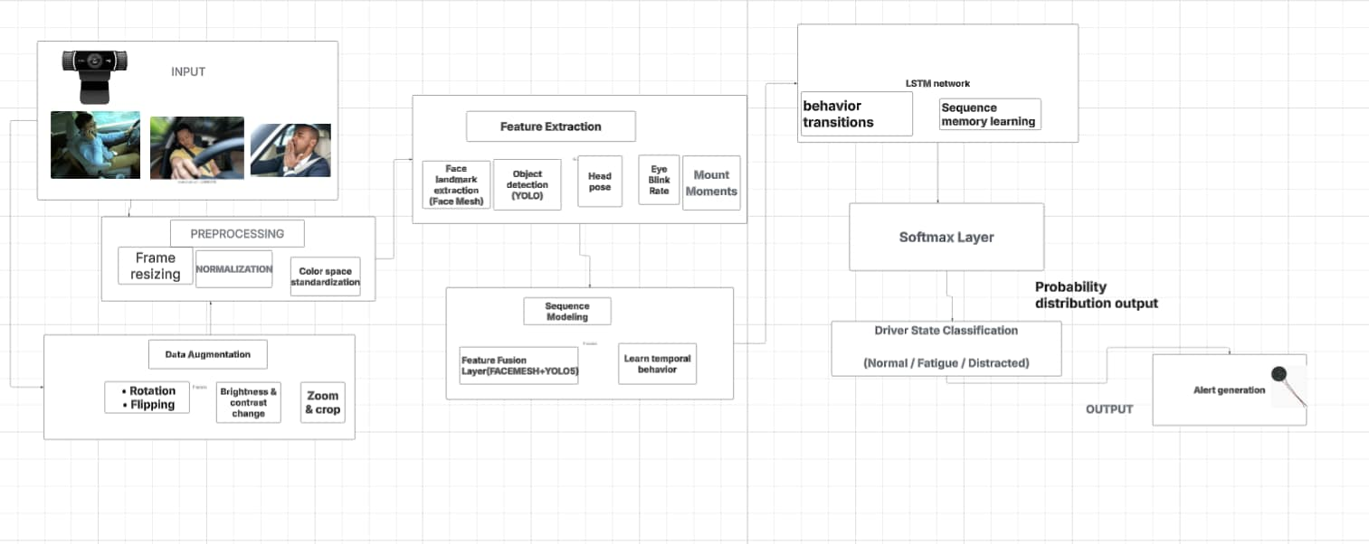

High-level Design

Slide 9
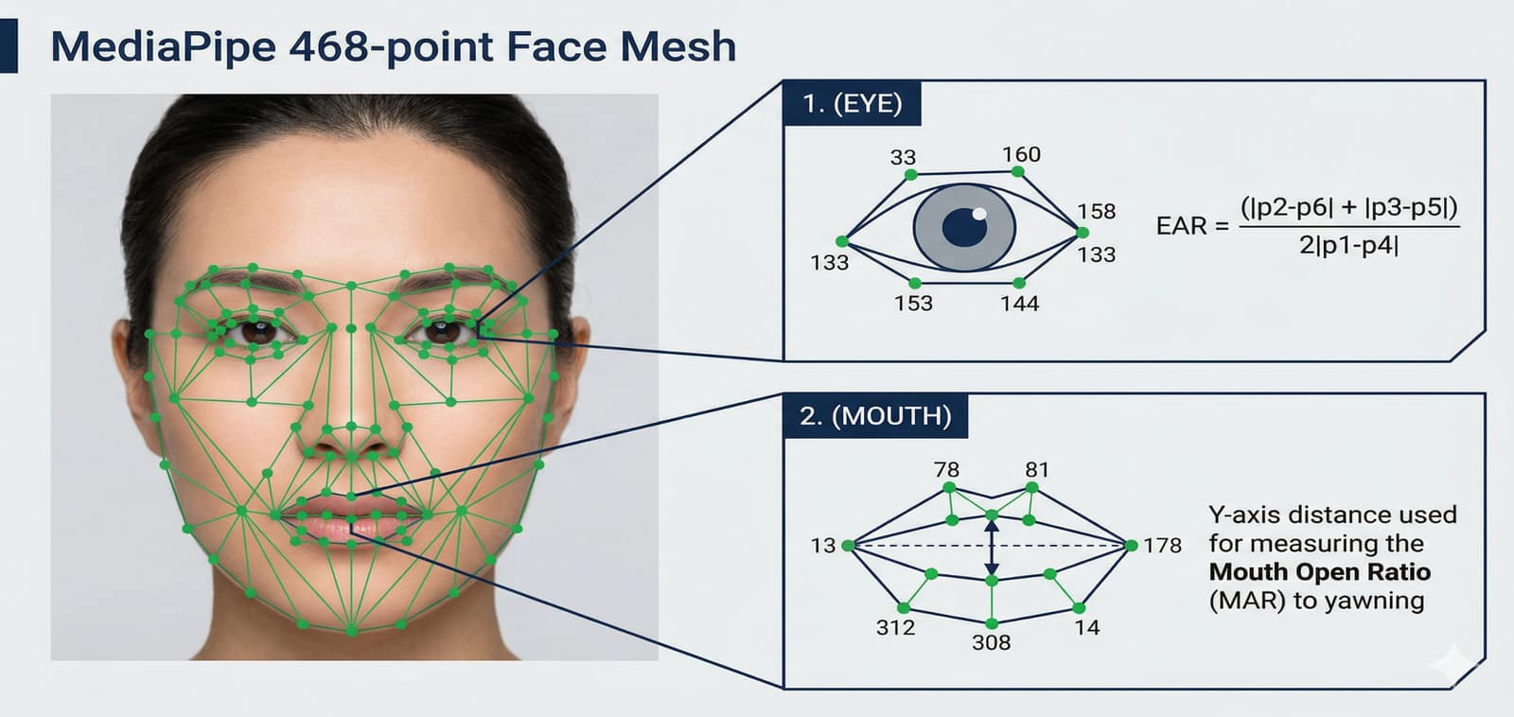

Slide 10
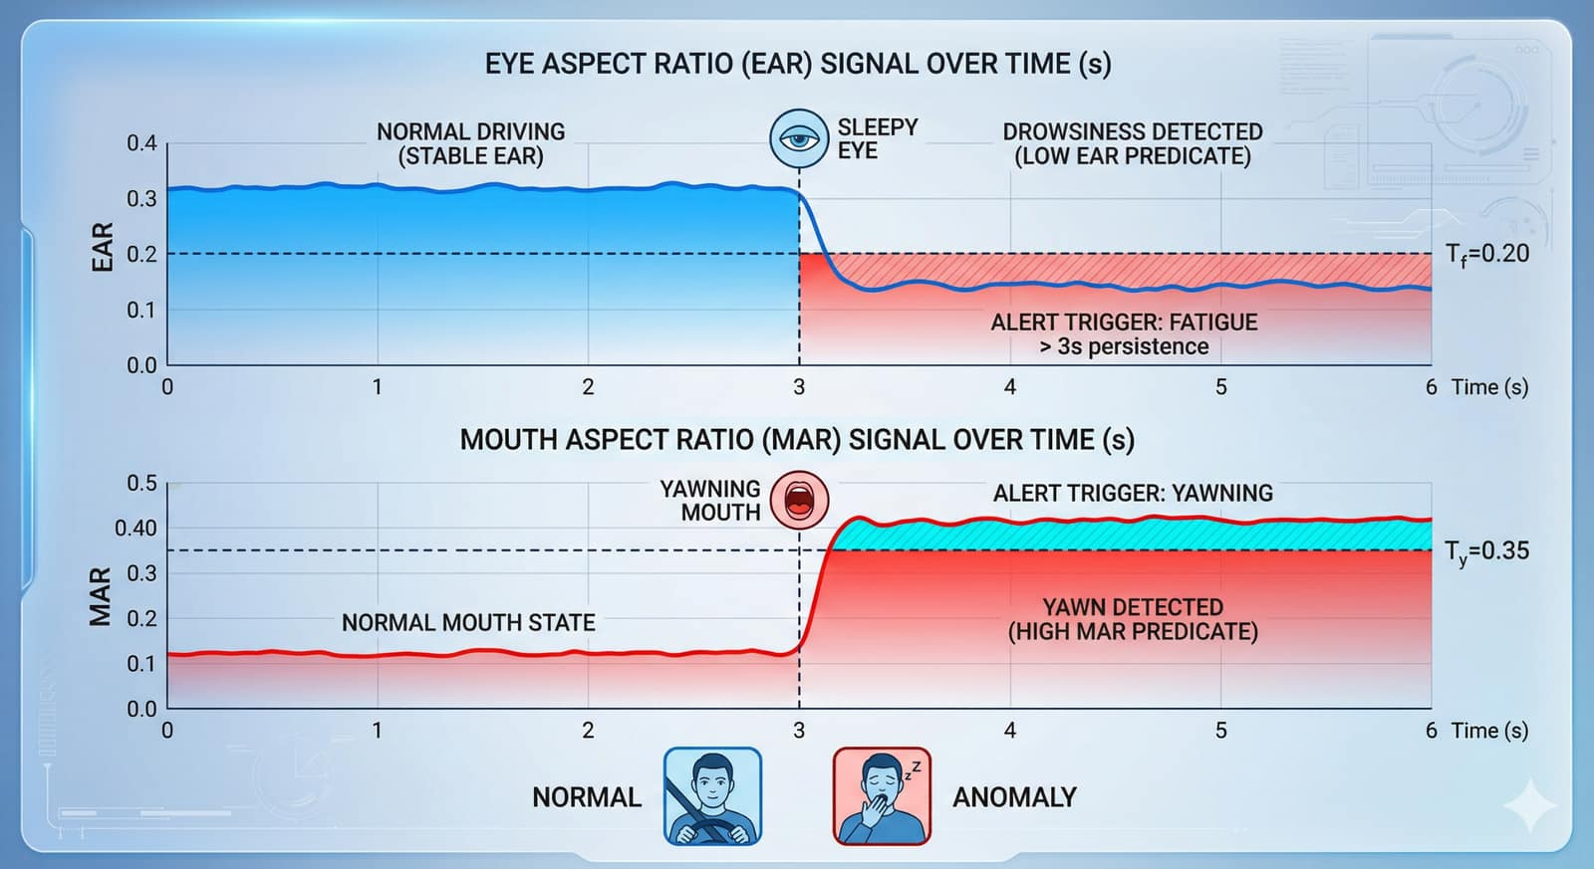

Slide 11
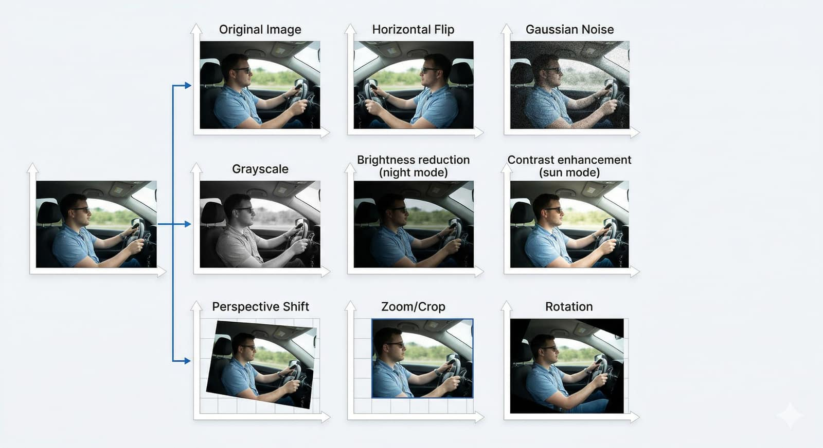

Slide 12
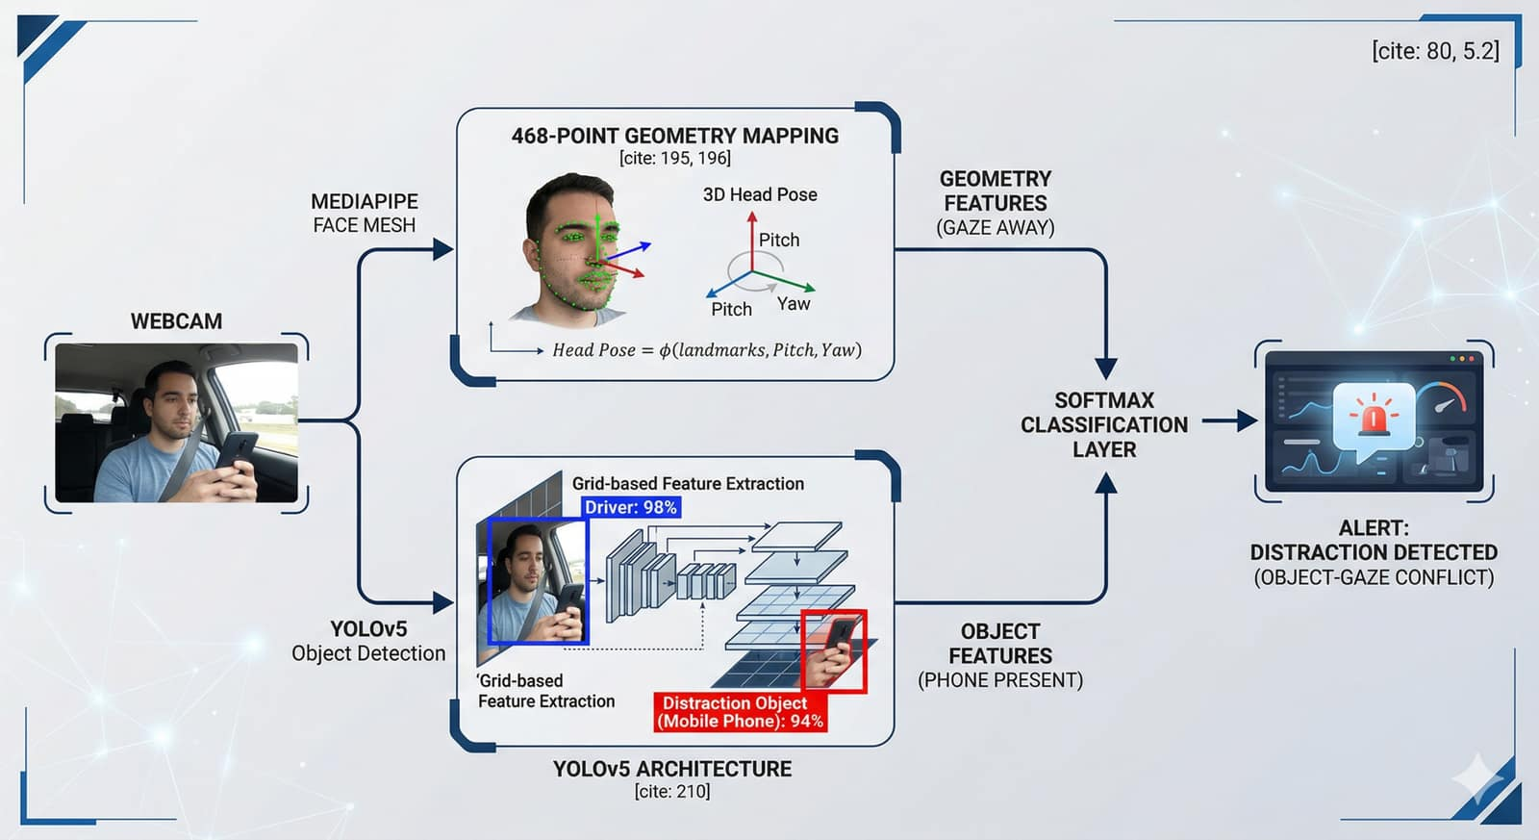

Slide 13
Tools & Tech
Tool | Purpose
OpenCV | Video processing & Visual Alerts
MediaPipe | Face landmarks
YOLOv5 | Object detection
Python | Core Implementation
Pytorch | Deep Learning Model Engine (BiLSTM)

Slide 14
Implementation
What we Have Built :
Real-time webcam detection
Face landmark extraction
YOLO object detection
Basic classification logic
Note : System successfully runs in real-time using laptop webcam

Slide 15
Implementation Progress
Completed :
Webcam pipeline
Face Mesh working
YOLO detection working
Basic anomaly logic

Slide 16
References
[1] M. A. Uddin et al., “Abnormal Driving Behavior Detection: A Machine and Deep Learning Based Hybrid Model,” Int. J. Intell. Transp. Syst. Res., 2025.
[2] E. Civik and U. Yuzgec, “Real-Time Driver Fatigue Detection System with Deep Learning on a Low-Cost Embedded System,” Microprocessors Microsyst., 2023.
[3] F. Qu et al., “Comprehensive Study of Driver Behavior Monitoring Systems Using Computer Vision and Machine Learning Techniques,” J. Big Data, 2024.
[4] B. B. Gupta et al., “Deep Learning Model for Driver Behavior Detection in Cyber-Physical System-Based Intelligent Transport Systems,” IEEE Access, 2024.

Slide 17
References
[5] S. Abbas et al., “Naturalistic Driving Data-Based Anomalous Driving Behavior Detection Using Hypertuned Deep Autoencoders,” Electronics, 2023.
[6] A. Author et al., “Enhanced Deep Neural Network Model for Anomalous Driving Behavior Detection,” Wiley J. Surveillance, 2024.
[7] R. Kumar and S. Gupta, “Driver Drowsiness Detection Using CNN-LSTM Hybrid Deep Learning Model,” IEEE Sensors J., 2023.
[8] H. Zhang et al., “Multi-Modal Driver Fatigue Detection Using Infrared and RGB Fusion,” IEEE Trans. Intell. Veh., 2023.

Slide 18
Thank You

