Slide 1
GEICO · AUTO QUOTE ANALYTICS
Predicting Quote Decisions
Turning 5,000 historic quotes into a conversion playbook
Business stakeholder presentation — Sales & Underwriting
Prepared by Phillip Smith · Senior ML Engineering
June 2026

Slide 2
THE BUSINESS QUESTION
Use Case & Objective
When a prospect requests an auto quote, can we tell up front how likely they are to accept — and what drives that decision?
Objective
Predict whether a quote ends in Accepted or Denied
Identify the levers that move conversion
Give Sales a data-backed targeting & follow-up guide
Why it matters
68.6% of quotes convert today
Even a few points of lift = meaningful premium
Focus effort where it actually pays off
Success criteria
Beat the 'accept everyone' baseline
Errors acceptable for a sales-prioritization use
Explainable to underwriting & sales
Scope & framing
This is a CLASSIFICATION problem (Accept vs. Deny) — not a pricing model. The data contains the decision outcome but no premium/price field, so margin impact is discussed qualitatively. Built on 5,000 historic quotes with a held-out 20% test set so results reflect unseen prospects.
Quote Decision Predictor · Confidential — Internal
2

Slide 3
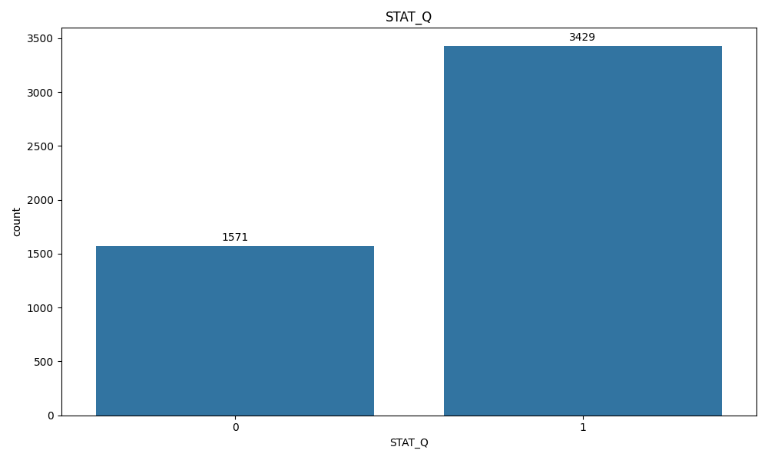
WHAT WE'RE WORKING WITH
Data Snapshot
5,000
15
68.6%
0
historic quotes
applicant & vehicle attributes
overall acceptance rate
missing values
What each quote tells us
Applicant: age, gender, marital & home status, education
Behavior: driving experience, risk tier, daily / annual mileage
Vehicle: car type, car age, ownership, number of vehicles
Quote: type (Auto-only vs. bundled) and the final decision
Target = QuoteSts → Accepted (1) or Denied (0)
Outcome mix — a healthy, slightly imbalanced base
Quote Decision Predictor · Confidential — Internal
3

Slide 4
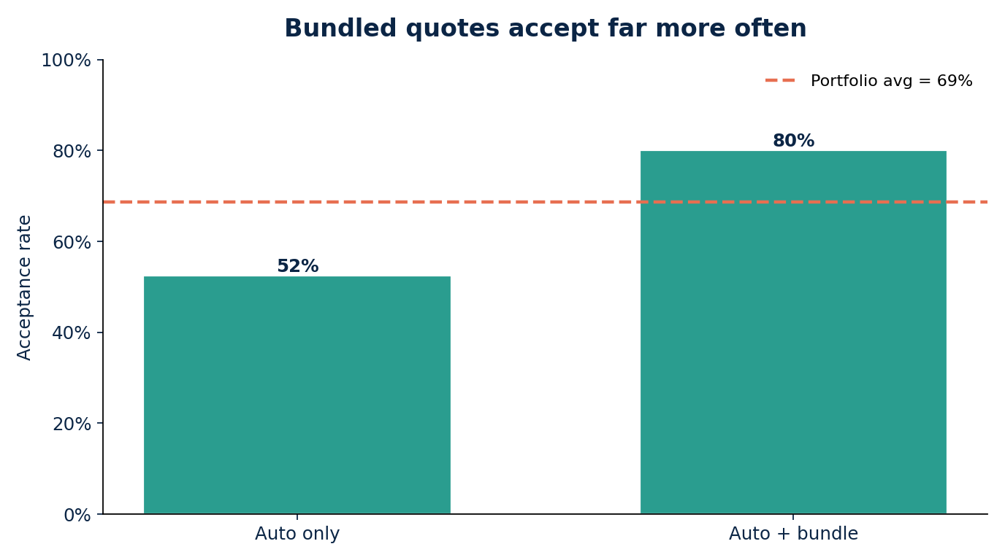
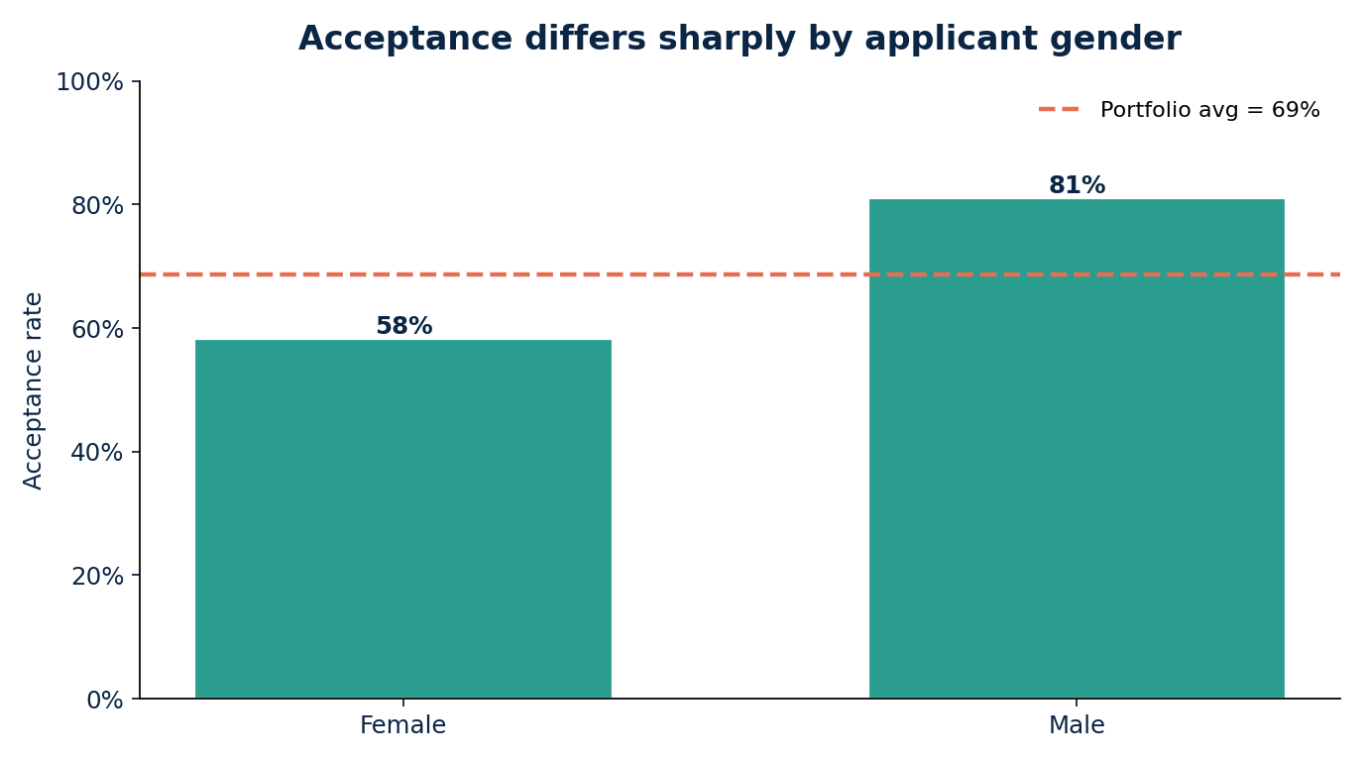
EDA FINDINGS — IN PLAIN TERMS
Two Factors Dominate the Decision
So what?
Bundled (Auto + another policy) quotes convert at 80% vs. 52% for auto-only — a 28-point gap. Male applicants accept at 81% vs. 58% for female applicants. These two signals alone explain most of the conversion story.
Quote Decision Predictor · Confidential — Internal
4

Slide 5
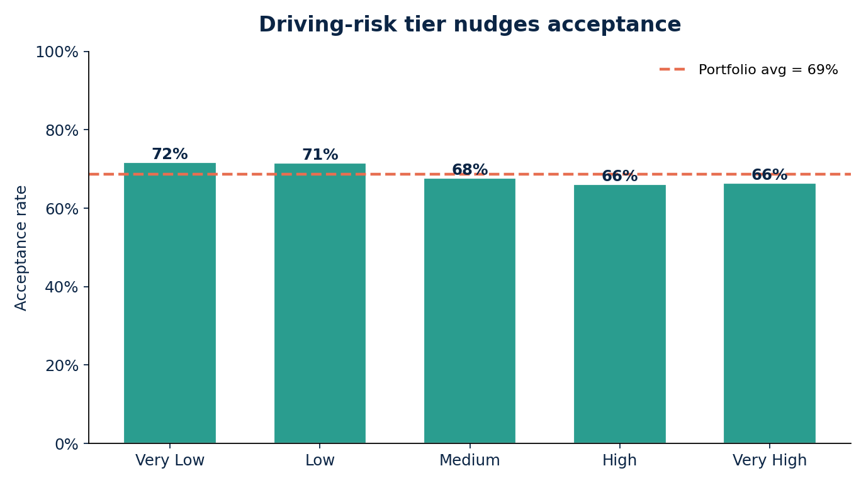
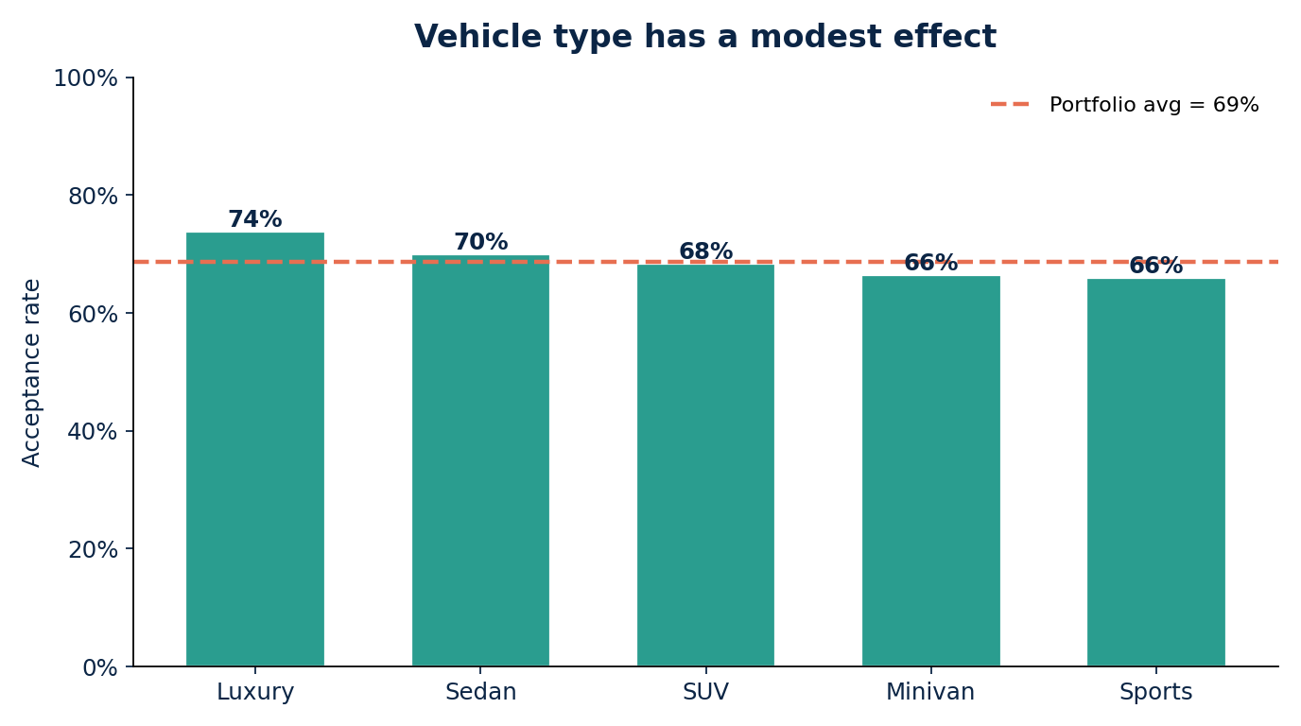
EDA FINDINGS — SECONDARY SIGNALS
Most Other Factors Barely Move the Needle
The long tail of weak factors
Driving-risk tier, car type, mileage, education, marital and home status all hover within a few points of the 69% average — interesting, but weak predictors on their own.
Age: volume, not discrimination
74% of applicants are 17–25. Acceptance is fairly flat across age bands, so age tells us where the customers are more than who converts.
Quote Decision Predictor · Confidential — Internal
5

Slide 6
GETTING THE DATA MODEL-READY
Data Preparation & Wrangling
Standardize & clean
Renamed 17 raw columns to clear names
Confirmed zero missing values
Raw file kept immutable; cached to Parquet
Encode categories
Yes/No fields → 0/1 (gender, quote type, ownership)
Ordered tiers → ranked numbers (risk, mileage, education)
Unordered types → one-hot (car type, marital status)
Binning
Grouped raw ages into bands (17–25, 26–35, …)
Made age patterns readable for stakeholders
Used for EDA storytelling, not as a model crutch
Feature selection
Chi-square test ranks each factor vs. outcome
Kept the 6 statistically significant signals
Dropped 12 fields that added only noise
Leakage guardrail
Scaling is fit inside the training fold only — never on the full dataset — so test results honestly reflect performance on brand-new quotes.
Quote Decision Predictor · Confidential — Internal
6

Slide 7
HOW WE TESTED THE QUESTION
Analytical Approach
1
Traditional analytics
Acceptance rates, cross-tabs, and a simple 2-variable business rule (bundled OR male → predict accept)
2
Machine learning
Three classifiers — Logistic Regression, Random Forest, Gradient Boosting — on the 6 selected features
3
Fair evaluation
80/20 stratified split; judged on accuracy, precision, recall and ROC-AUC against unseen quotes
4
Head-to-head
Compared ML to the simple rule and to the 'accept everyone' baseline to isolate true added value
Quote Decision Predictor · Confidential — Internal
7

Slide 8
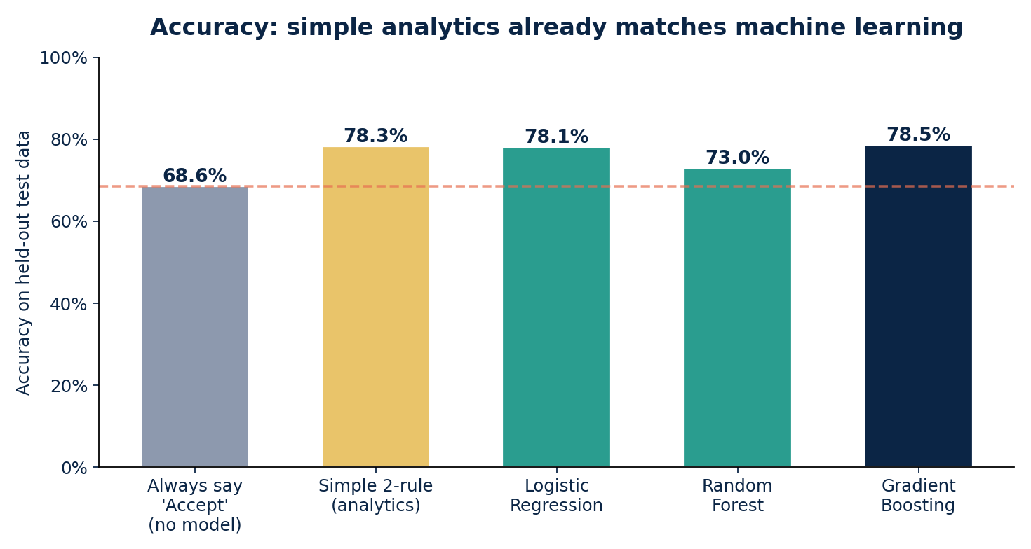
MODEL OUTPUT — THE HEADLINE
Results: Good, But Not Because of ML
Best model: Gradient Boosting
Accuracy 78.5% · ROC-AUC 0.72
Recall 91% (catches most true accepts)
Precision 80% · F1 0.85
The honest finding
A 2-variable rule hits 78.3% — within 0.2 pts of the best ML model. Almost all the signal lives in two factors any analyst can read.
Verified on held-out test data (1,000 quotes the models never saw). Lift over 'accept everyone' is ~10 points — but ML's lift over simple analytics is essentially zero.
Quote Decision Predictor · Confidential — Internal
8

Slide 9
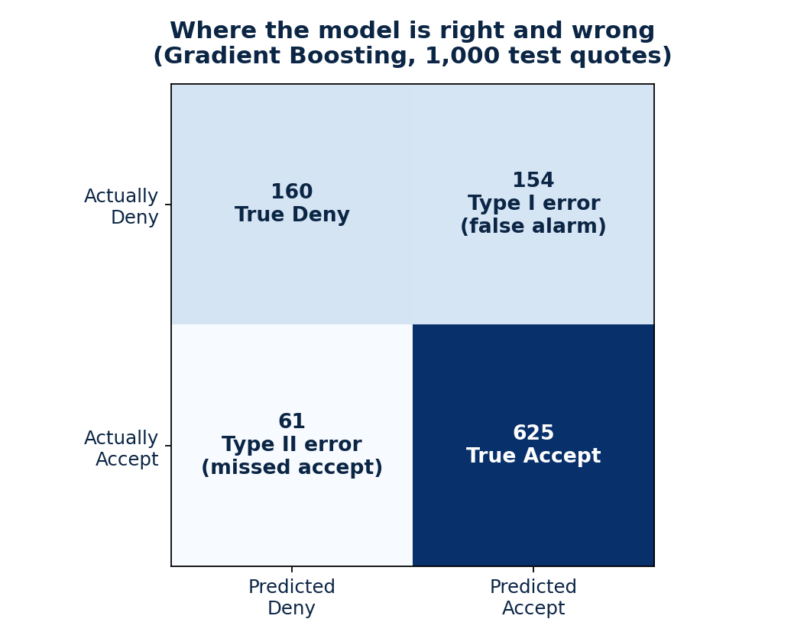
ARE THE MISTAKES ACCEPTABLE?
Type I & Type II Errors
Type II — missed accepts (61)
Model says 'deny' but they'd have accepted. The bigger business cost: under-served warm prospects. Kept low — recall is 91%.
Type I — false alarms (154)
Model says 'accept' but they deny. Low cost here: a follow-up call to someone who won't convert. Tolerable for sales prioritization.
Verdict
For prioritizing sales effort, this error balance is acceptable. We deliberately favor recall — better to over-include warm leads than miss them.
Quote Decision Predictor · Confidential — Internal
9

Slide 10
REFLECTION
Did Machine Learning Add Value Here?
Incremental value: minimal
ML beat 'accept everyone' by ~10 pts — but matched the simple rule
The dataset's signal is concentrated in 2 obvious factors
No complex interactions for trees to exploit
ROC-AUC 0.72 = useful ranking, not a step-change
Cost / benefit
Simple analytics: hours, fully transparent, easy to govern
ML pipeline: more build & maintenance, harder to explain
Here the ROI of ML over analytics is hard to justify
ML earns its keep when data is richer & relationships non-linear
What I learned about analytics vs. machine learning
Analytics explains the 'why' and is faster to trust; ML scales pattern-finding when relationships are too complex to eyeball.
More model complexity ≠ more value — match the tool to the signal in the data.
Did binning / prep help? Prep was essential for clean modeling and clear EDA, but binning aided human storytelling more than model accuracy.
Always benchmark ML against a dumb baseline AND a simple rule — or you can't tell whether the model is actually earning its complexity.
Quote Decision Predictor · Confidential — Internal
10

Slide 11
TURNING INSIGHT INTO CONVERSION
Business Value for Sales
Lead with the bundle
Auto-only converts at 52% vs. 80% bundled. Proactively offer a bundle on every auto-only quote.
Smart follow-up
Model recall of 91% flags warm prospects. Prioritize agent outreach on high-probability quotes; light-touch the rest.
Set realistic targets
Segment-level acceptance rates give Sales honest conversion benchmarks instead of one blanket number.
Pricing follow-on
Add the premium/price field to enable a price-range model for margin optimization — the natural next dataset.
Estimated impact
If bundle prompts and prioritized follow-up convert even 3–5% of today's auto-only decliners, that flows straight to written premium — at near-zero incremental cost, using rules the team already understands. (Estimated — to be validated with an A/B test.)
Quote Decision Predictor · Confidential — Internal
11

Slide 12
WHERE ELSE THIS PAYS OFF
Similar Use Cases Across the Company
Renewal / churn prediction
Flag policies likely to lapse and intervene early
Value: retained premium · Obstacle: needs behavioral + billing history
Claims fraud triage
Rank claims by anomaly for investigator focus
Value: loss reduction · Obstacle: labeled fraud cases are scarce
Dynamic price-to-convert
Recommend a quote price that balances win-rate & margin
Value: higher margin · Obstacle: requires price & competitor data
Cross-sell propensity
Predict who'll add home/life to an auto policy
Value: revenue per customer · Obstacle: data silos across product lines
Quote Decision Predictor · Confidential — Internal
12

Slide 13
WHAT TO TELL STAKEHOLDERS
Key Takeaways & Next Steps
What we now know
Conversion is driven mostly by bundling and applicant profile
We can predict acceptance at ~79% accuracy on unseen quotes
A transparent 2-rule model matches the ML — start simple
Error balance favors catching warm leads (91% recall)
No pricing field yet → margin work needs new data
Data is clean, complete, and ready for the next iteration
Recommended next steps
Ship bundle-prompt + follow-up rules to Sales now
Run an A/B test to measure real conversion lift
Acquire premium/price data to build a pricing model
Enrich data (credit, tenure, web behavior) before scaling ML
Revisit ML once relationships are genuinely non-linear
Monitor segment acceptance rates as a live dashboard
Quote Decision Predictor · Confidential — Internal
13

Slide 14
Start simple. Prove lift. Then scale.
Two factors explain most of the conversion story — and a simple, explainable model already captures it. The win is acting on it.
Phillip Smith · Senior ML Engineering · Quote Decision Predictor

