Slide 1
IDS PROJECT
VIDEO GAME SALES
By : SRP

Slide 2
Submitted to:-DR Mamatha HR
Submitted by:-
Prerana Sirigeri PES1201701497
Rachana B Karennavar PES1201700653
Shreya Banerjee PES1201700198

Slide 3
DATA SET:RANKING OF VIDEO GAME SALES
Description:
This Dataset contains the fields rank, name, platform, year, genre, publisher.
This Dataset collects the sales of video games from North America, Europe, Japan, from the rest of the world, and the global(total worldwide) sales.

Slide 4
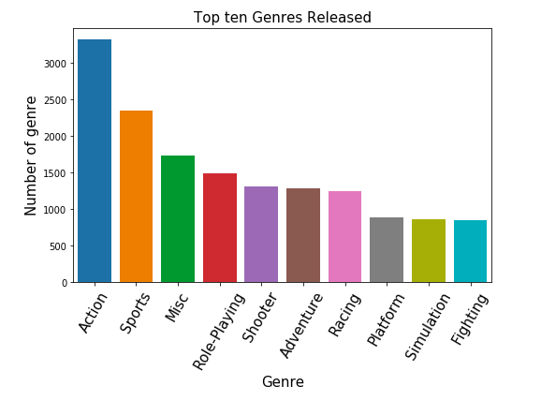

Slide 5
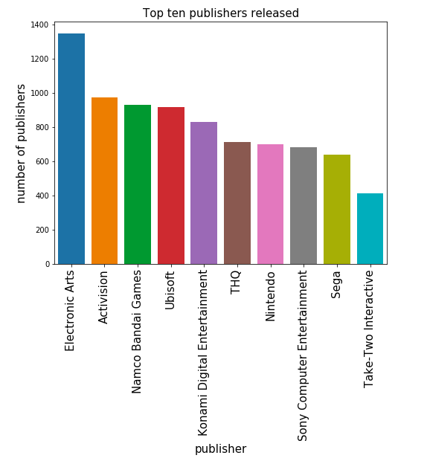

Slide 6
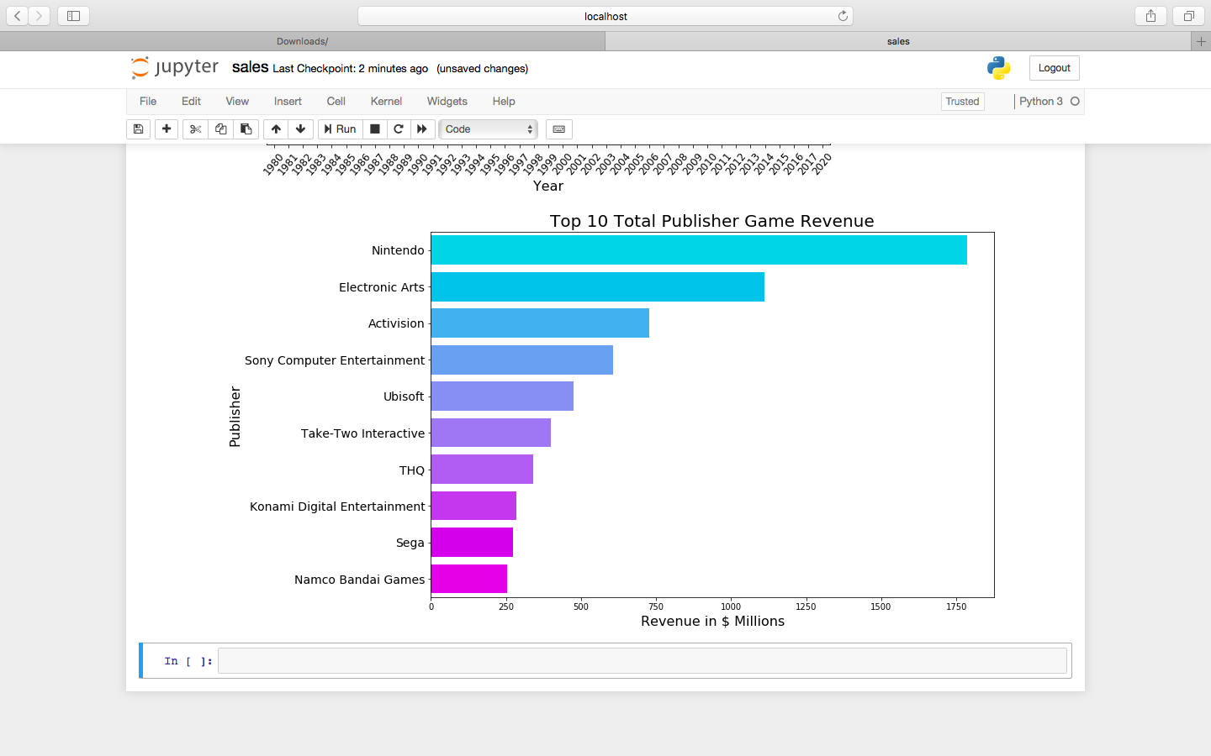

Slide 7
Why is nintendo so popular?
Nintendo is always coming up with new and interesting ideas for their consoles
PlayStation had the same controls and games since 1994. Xbox had the same controls since 2001.
Nintendo came out with the NES and rebuilt the gaming industry with great games.

Slide 8
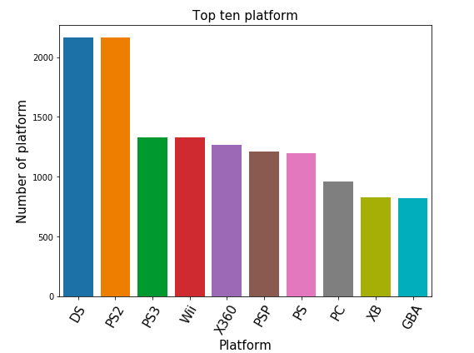

Slide 9
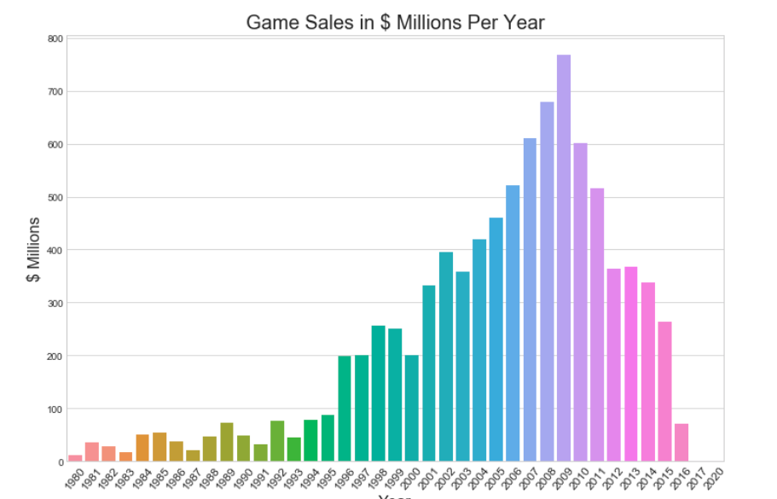

Slide 10
Why is there a peak in sales in 2009?
Till 1996-1997 technology was very less developed.
But during 2009,the boom in technology made the video games sales go skyrocketing.
So there is a peak of sales and releases in 2009.
But later people lost interest in video games because of other varied options.

Slide 11
SALES IN DIFFERNET REGIONS

Slide 12
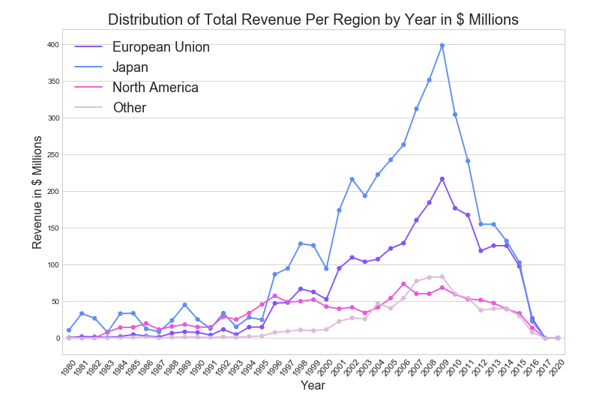

Slide 13
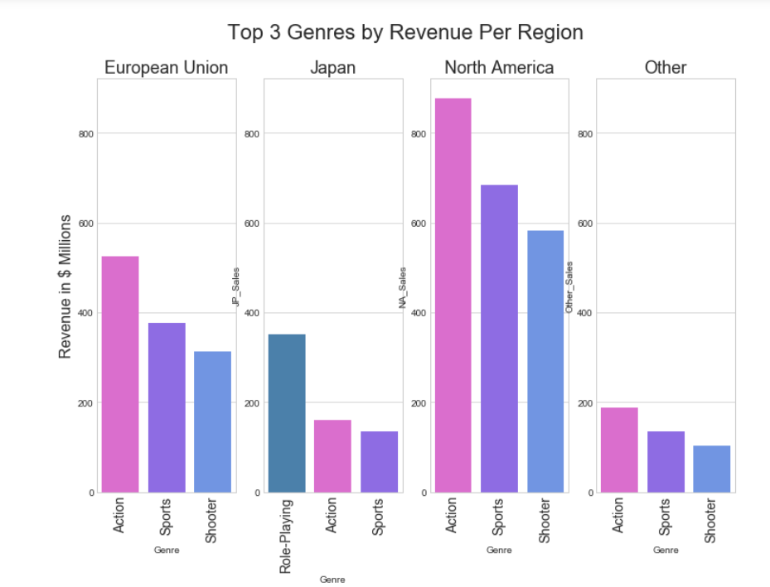

Slide 14
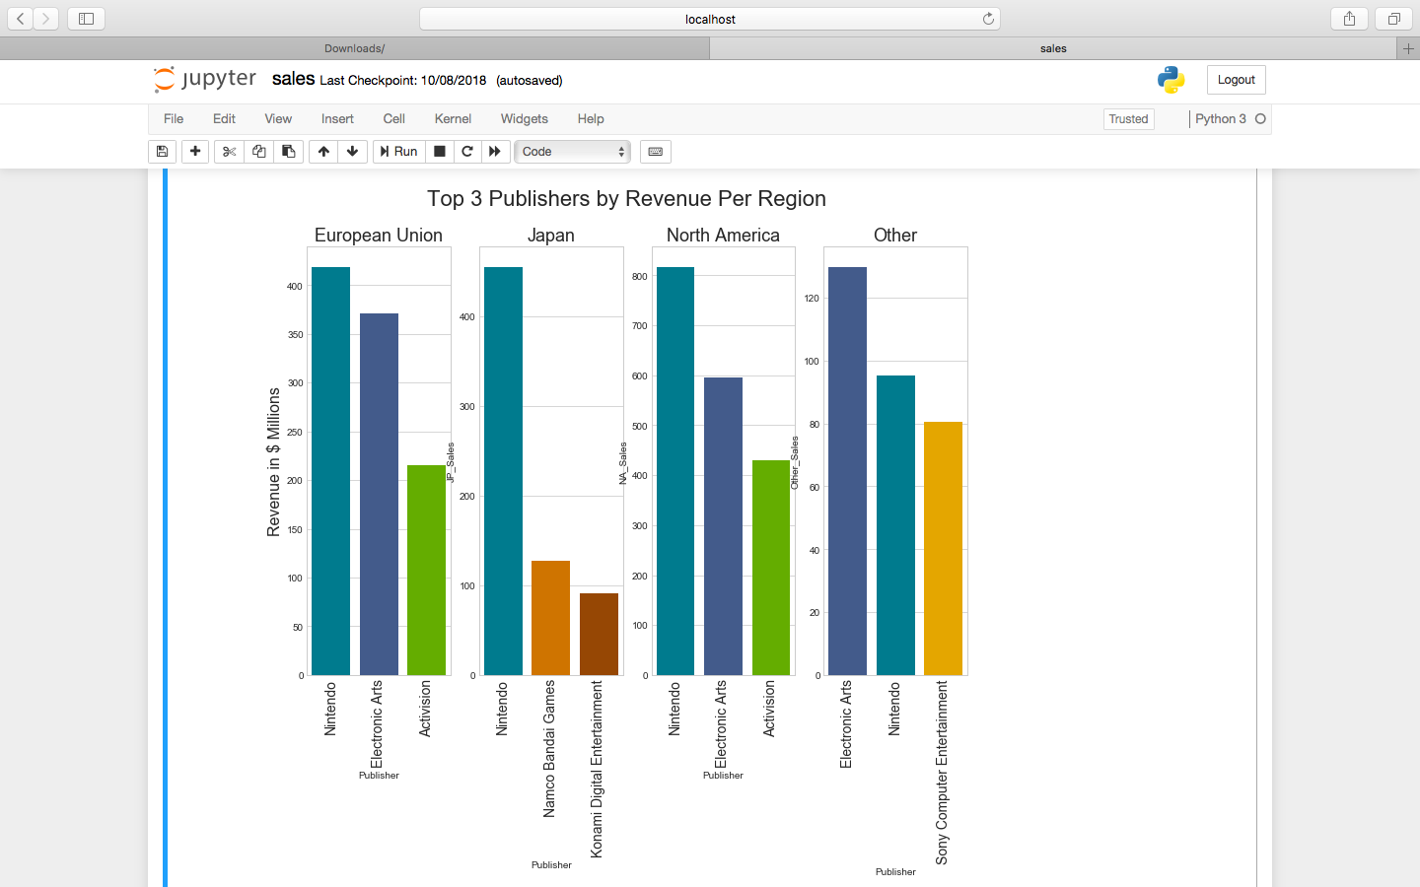

Slide 15
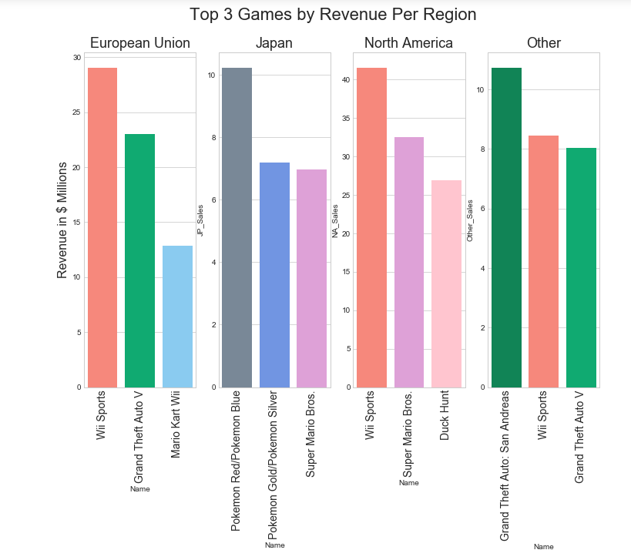

Slide 16
Hypothesis Test

Slide 17
Nintendo claims that their sales are greater than average video
games sales. Is there sufficient evidence to support its claim?
Population mean: 0.53744065550074
Population Standard Deviation: 1.5549810910296504
Let us take a sample of 500 video games published by Nintendo.
X_bar=0.5374406555006627
H₀ : mu <= X_bar H₁: mu > X_bar
P-value= 0.3989422804014327

Slide 18
conclusion
Since P>=0.05, we fail to reject null Hypothesis.
We cannot conclude that the null hypothesis is true. The alternate hypothesis is also plausible.

Slide 19
Thank You!

