Slide 1
TASK 6
BI REPORT
PARAMETERS WITH MULTIPLE SHEETS

Slide 2
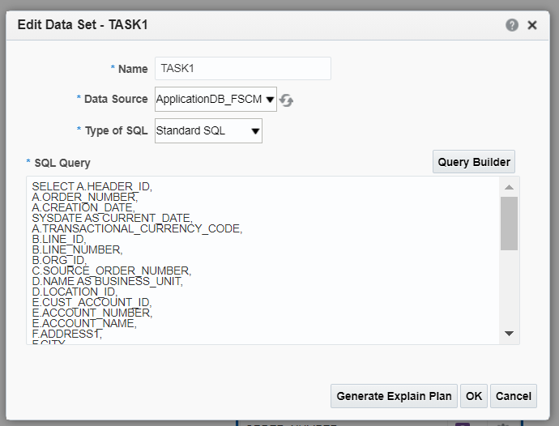
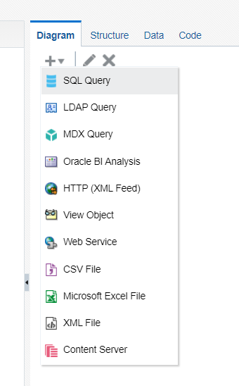
NAVIGATION - BI REPORTS
Go to instance --> Browse Catalog --> New --> Data Model
Create a sql query data set.
Type the query for the data set.

Slide 3
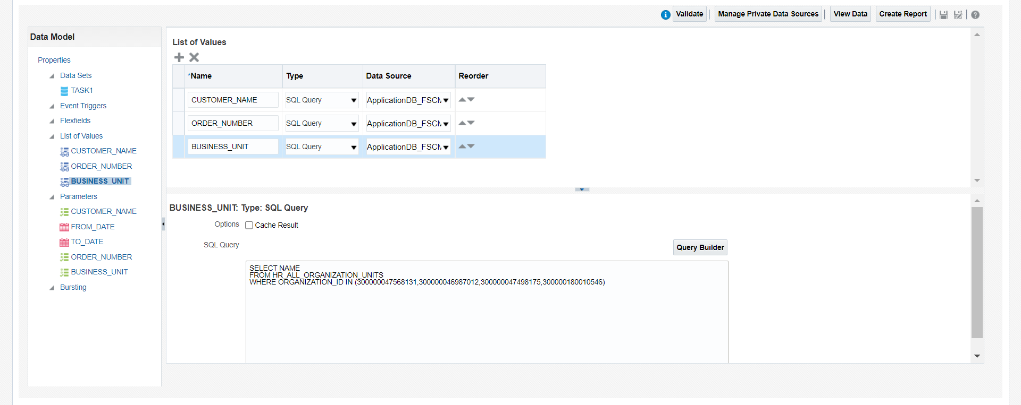
Create list of values for the corresponding parameters created in the data set.

Slide 4
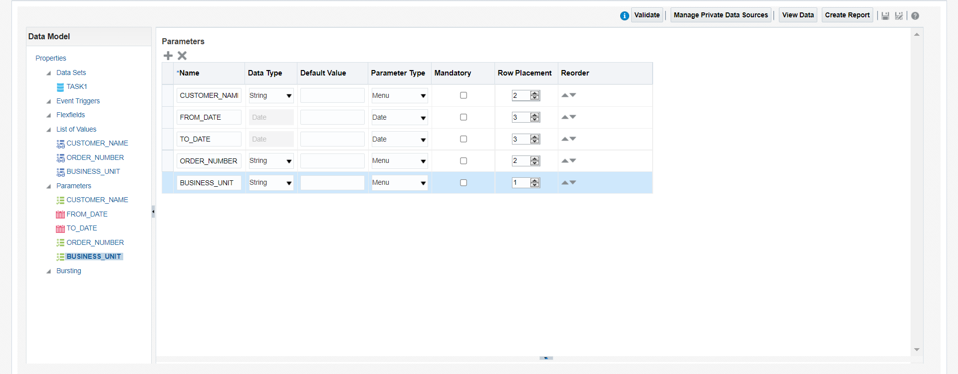
Set the parameter type and row placement in parameters.

Slide 5
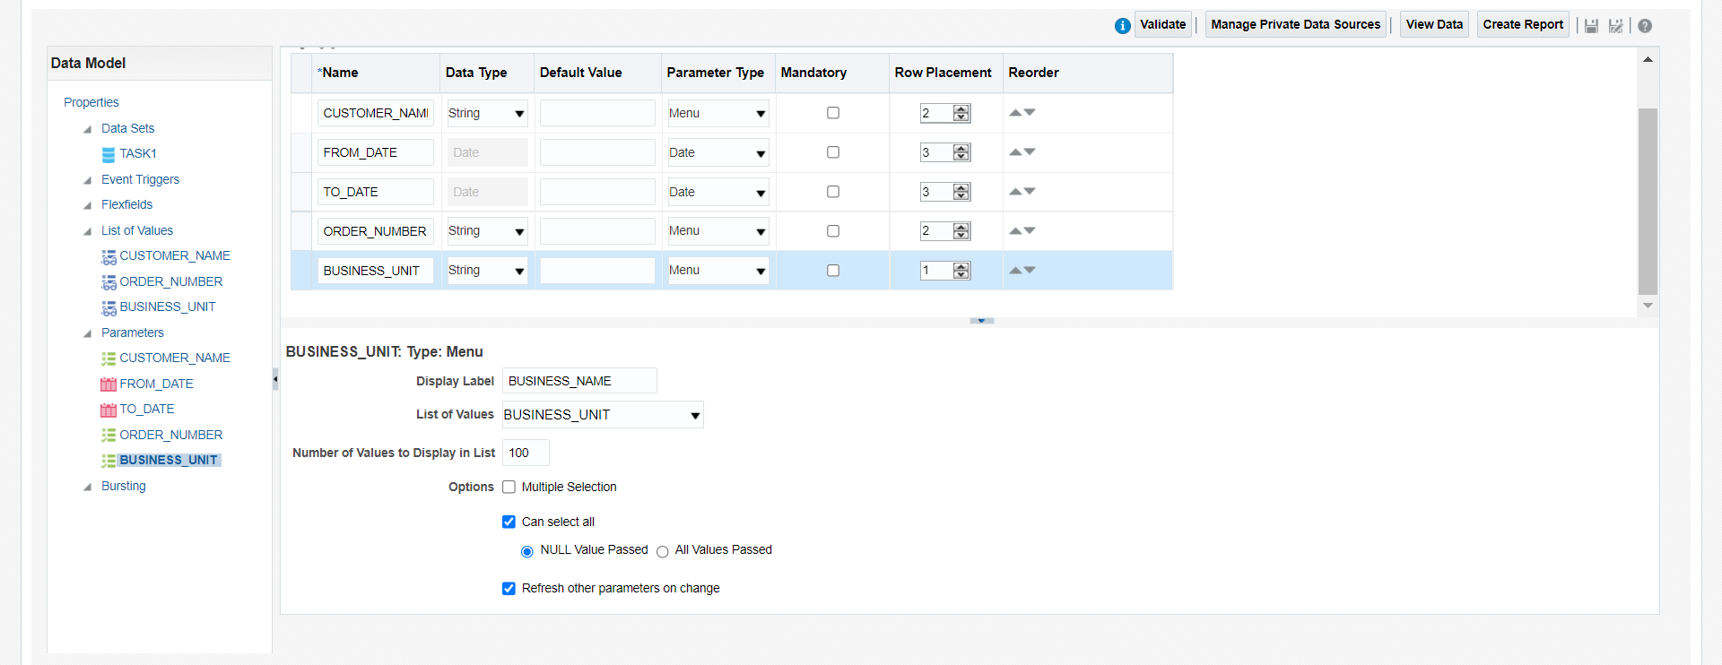
Map the correspondinfg List Of values for the parameters.
Check the “Refresh other parameter on range” for the dependency parameter.

Slide 6
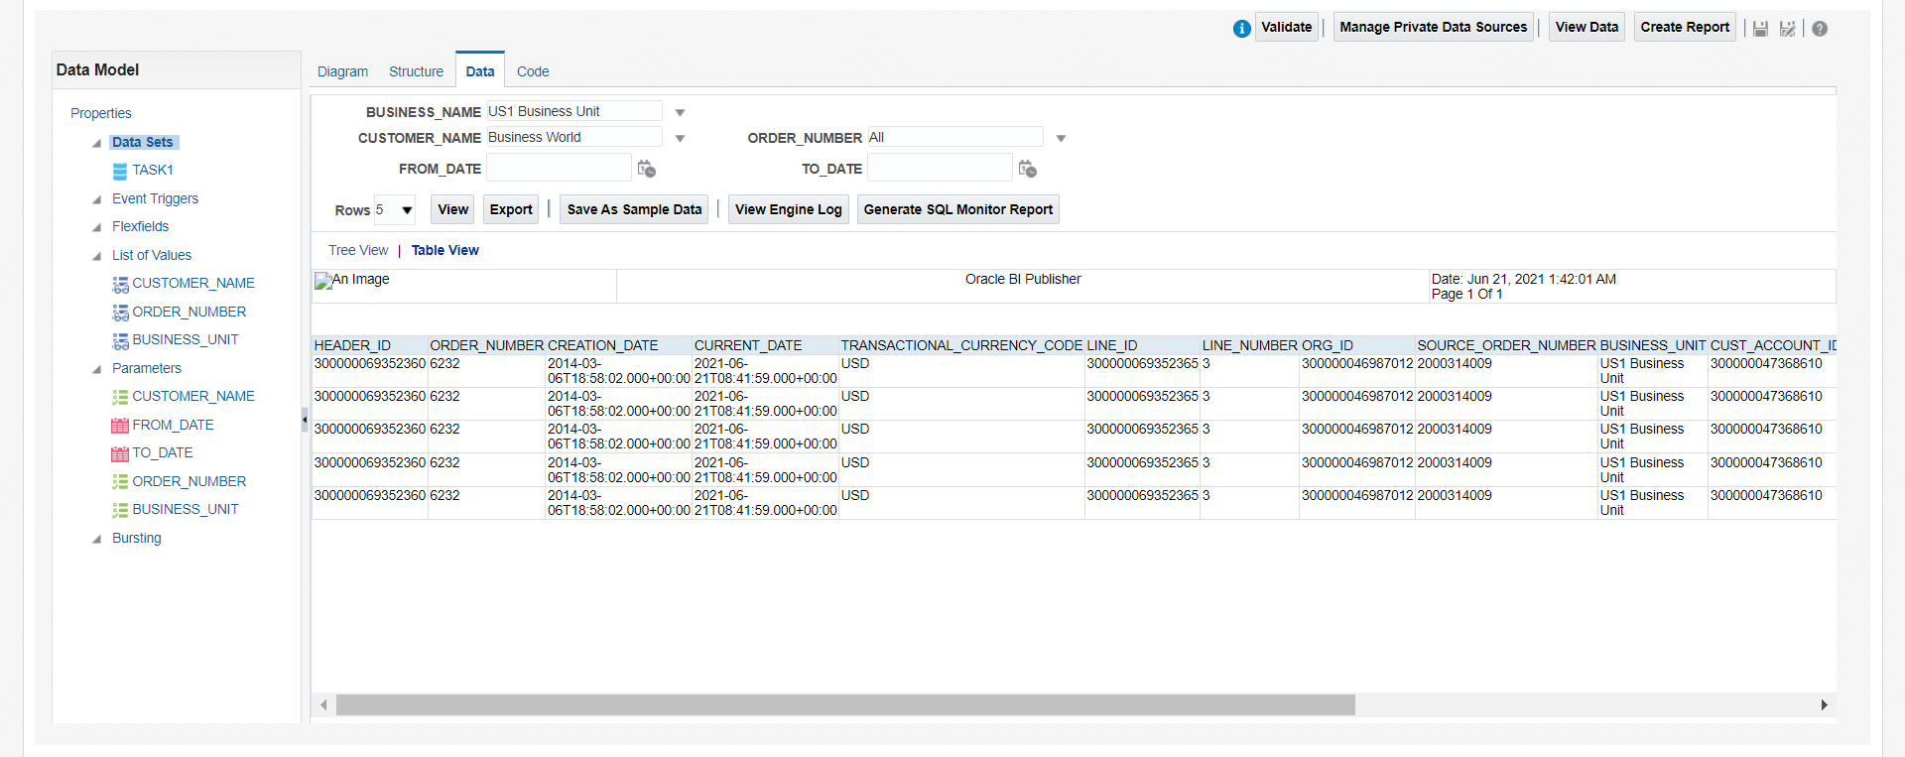
Change the parameters values and click on view --> table view.
Click save as sample data and save the Data model and click on the export button to download the XML file.

Slide 7
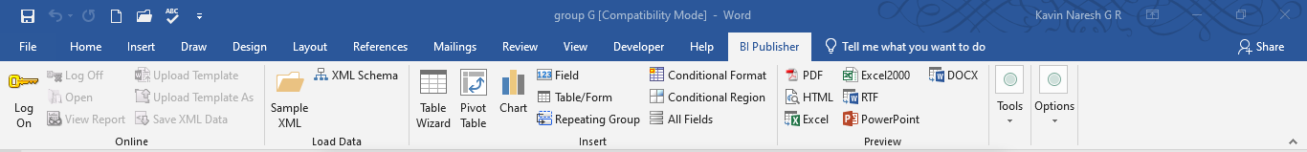
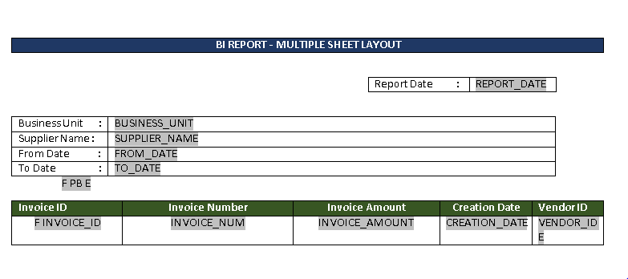
Open BI publisher in word and load the XML file in sample XML data.
Design a table for columns and insert the parameters from the field menu.

Slide 8
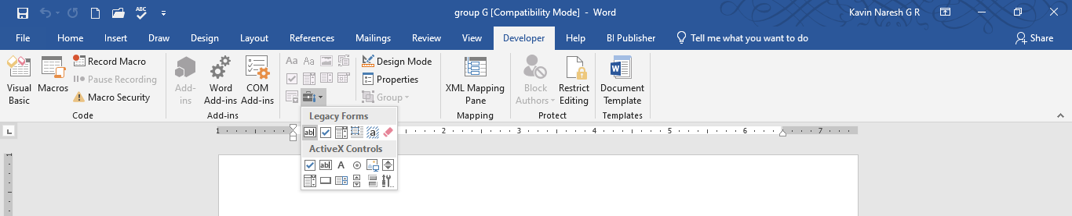
Enabling the developer option by clicking Word option --> Customize Ribbon and check developer option in
main tabs.
Create a legacy form for the page break with for-each statement.

Slide 9
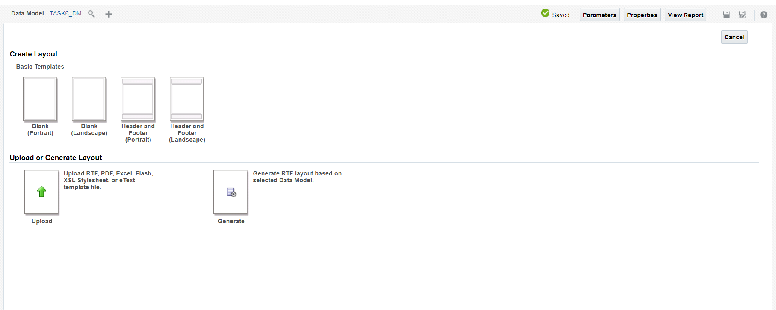
Save the template as RTF file.
Click New --> Report and map the Data model.

Slide 10
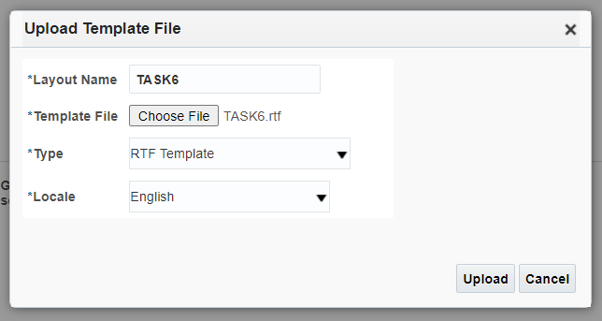
Upload the RTF template in create report page.

Slide 11
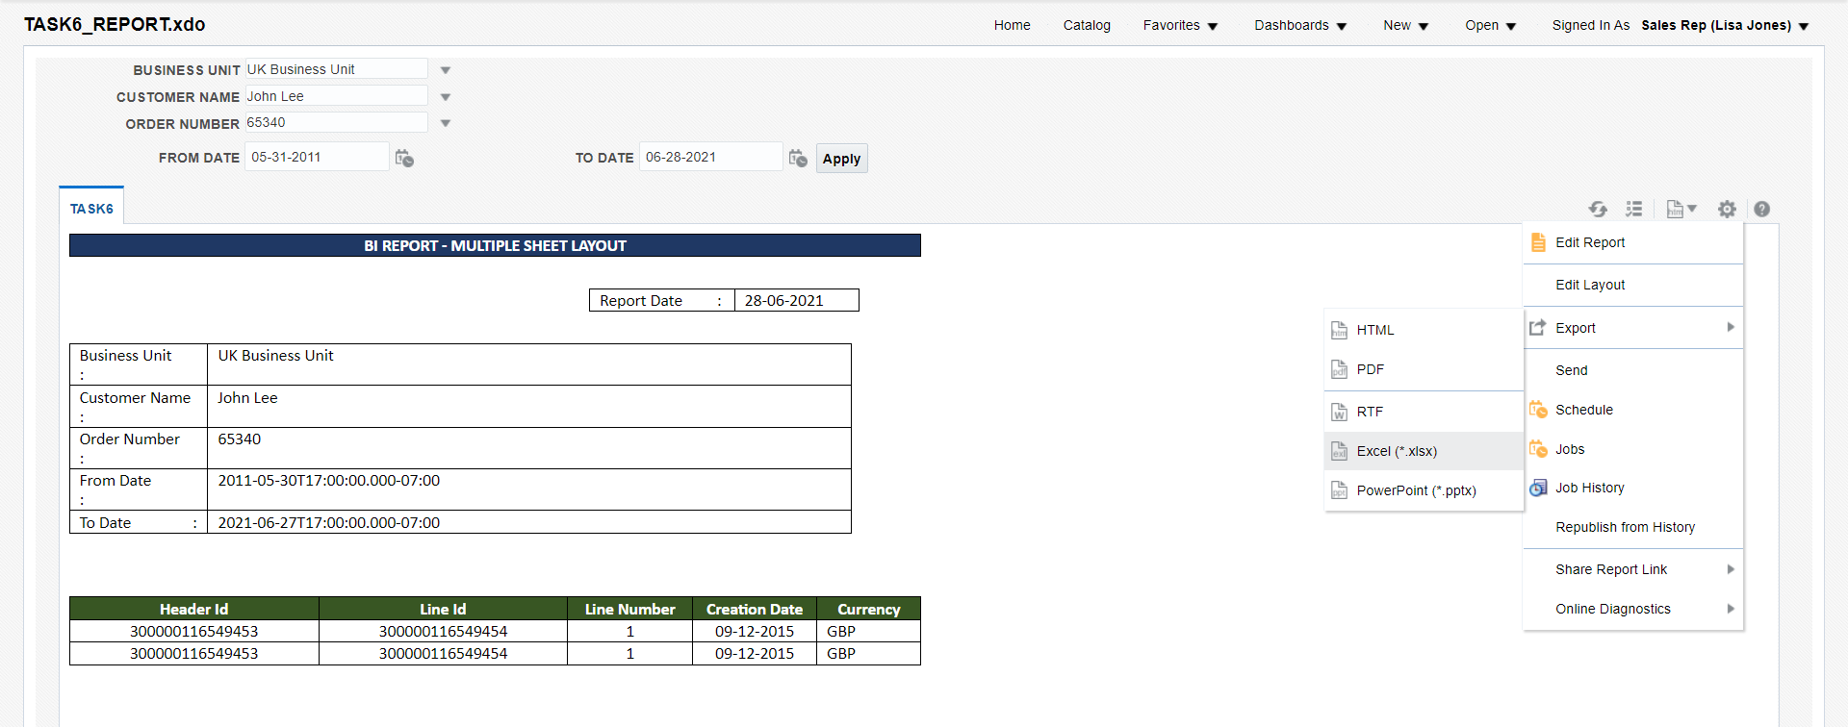
Save the layout and Report.
Change the parameters and export as EXCEL format.

Slide 12
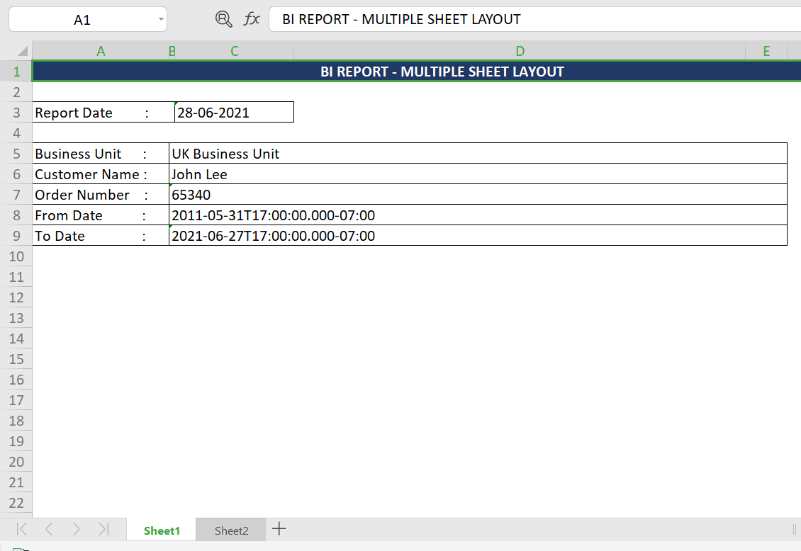
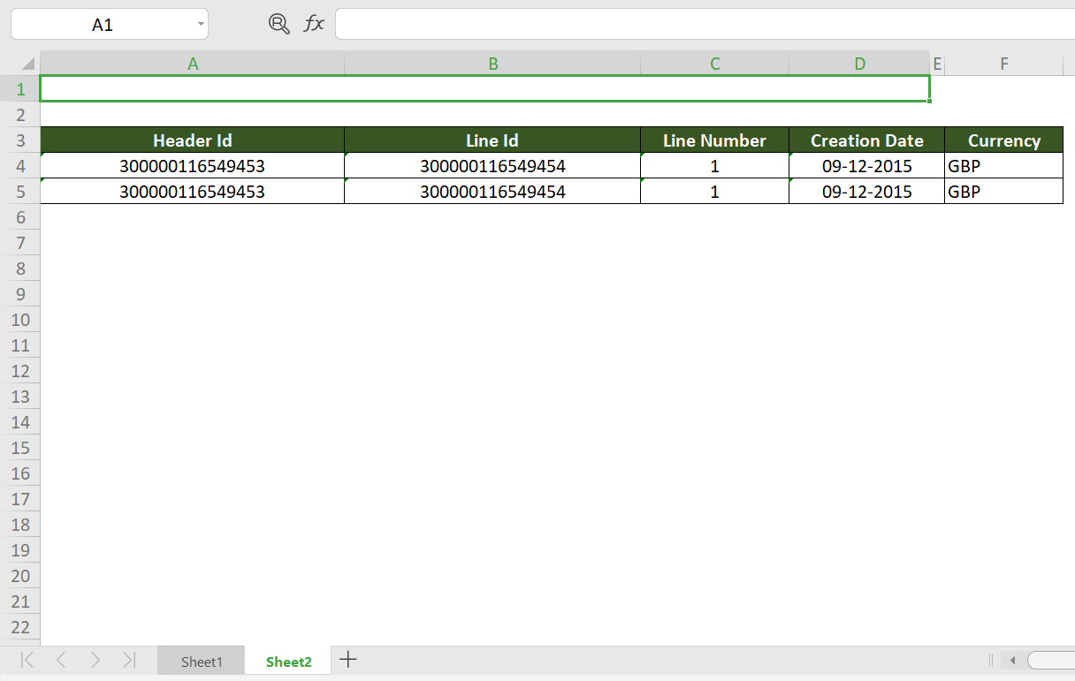
Report will be downloaded with multiple sheets for corresponding parameters.

Slide 13
END

