Slide 1
TASK 6
SECURITY CONSOLE

Slide 2
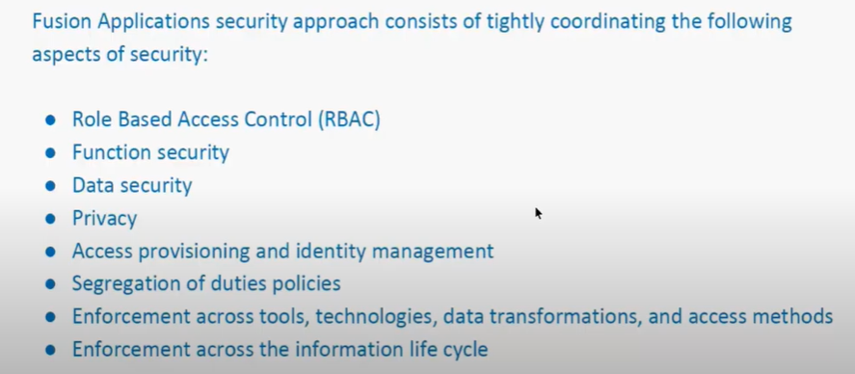
Overview

Slide 3
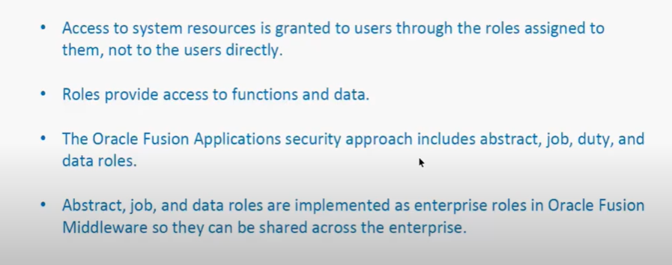
Role Based Access Control (RBAC)

Slide 4
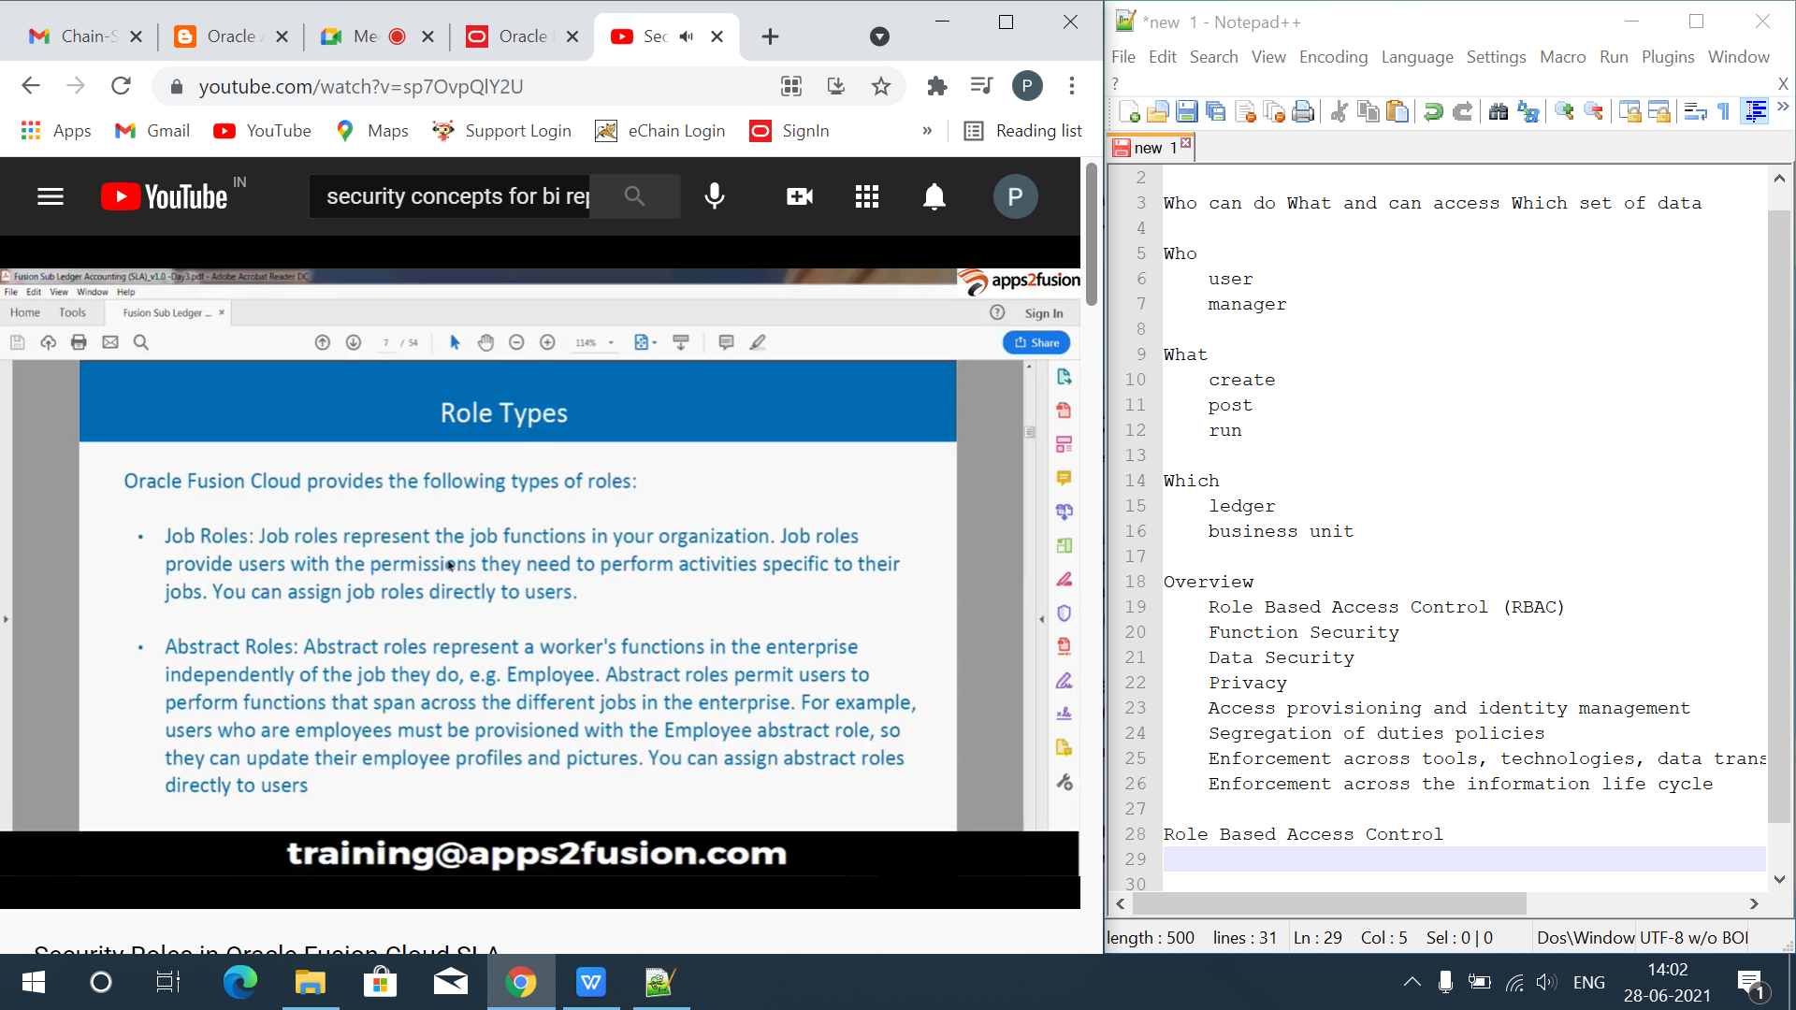
Job Role

Slide 5
Abstract Role

Slide 6
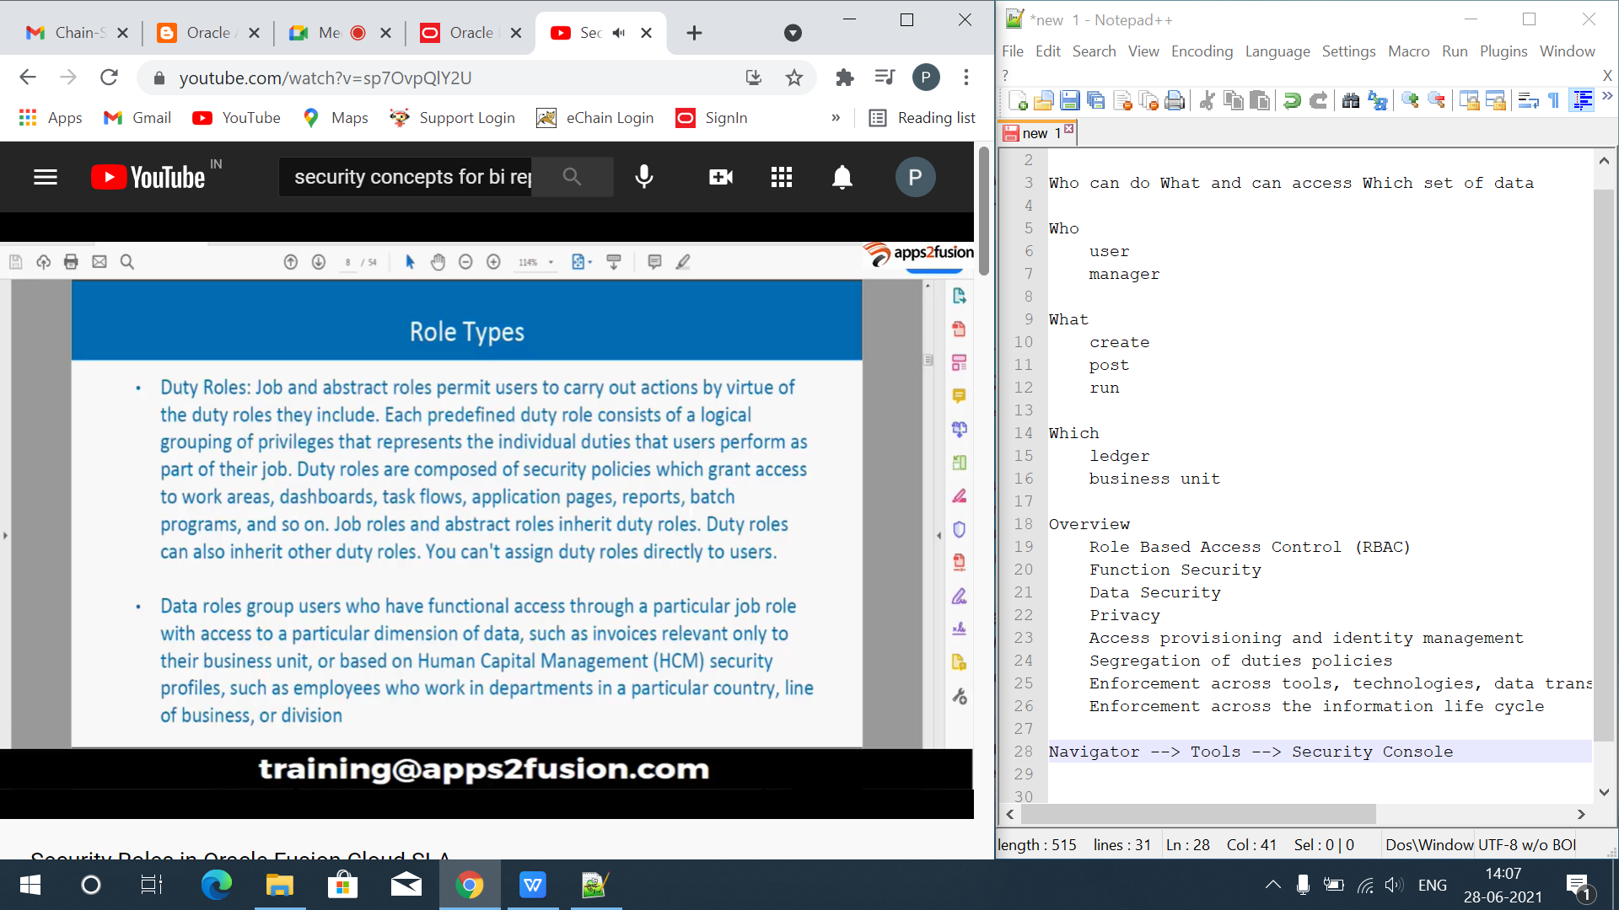
Duty Role

Slide 7
Data Role

Slide 8
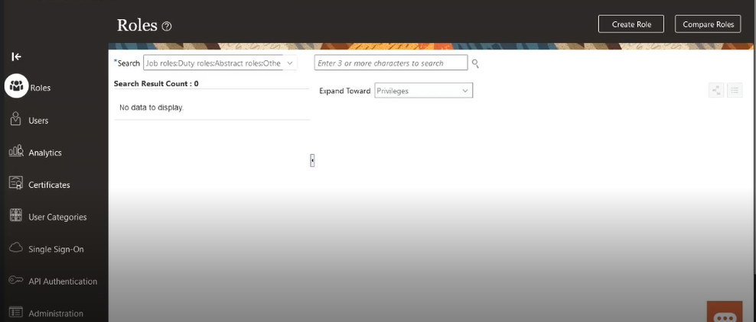
Navigator
Navigator --> Tools --> Security Console

Slide 9
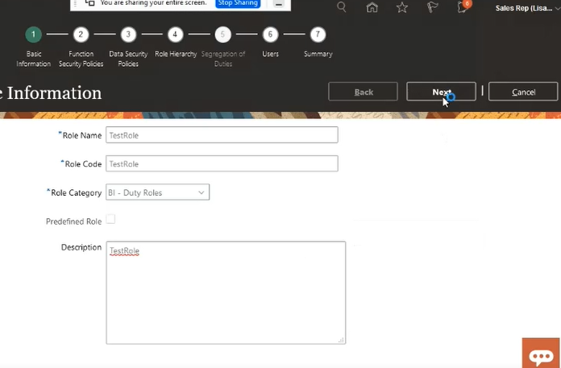
Create Role

Slide 10
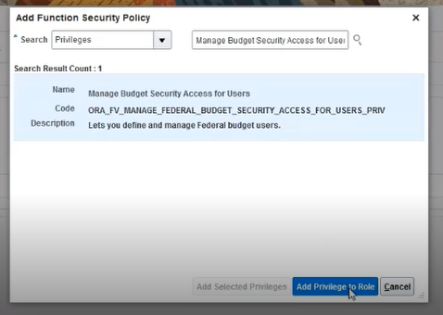
Create Privileges

Slide 11
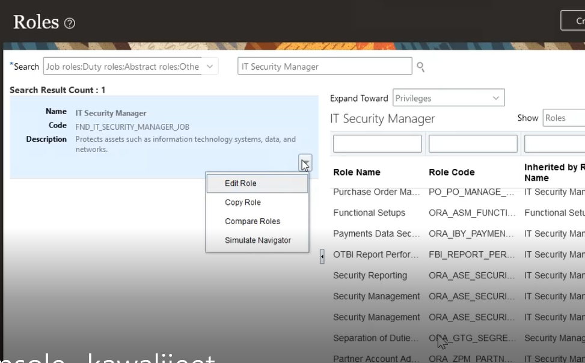
View and Edit Role

Slide 12
END

