Slide 1
TASK 3
BI REPORT
EXCEL TEMPLATE

Slide 2
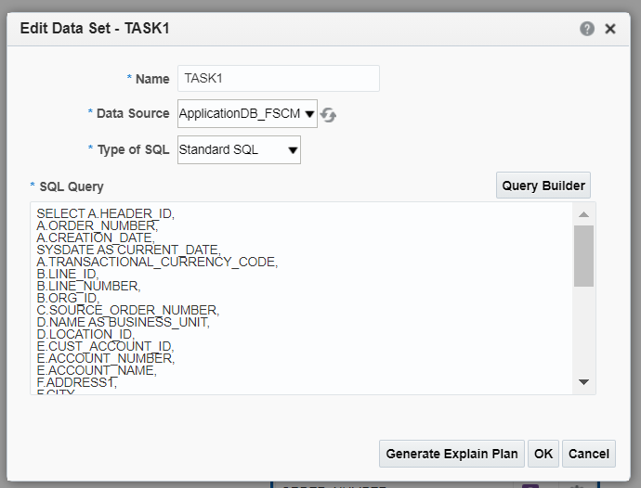
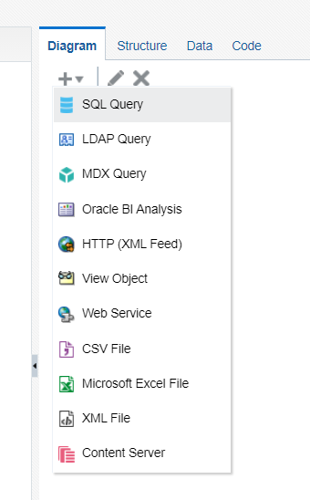
NAVIGATION - BI REPORTS
Go to instance --> Browse Catalog --> New --> Data Model
Create a sql query data set.
Type the query for the data set.

Slide 3
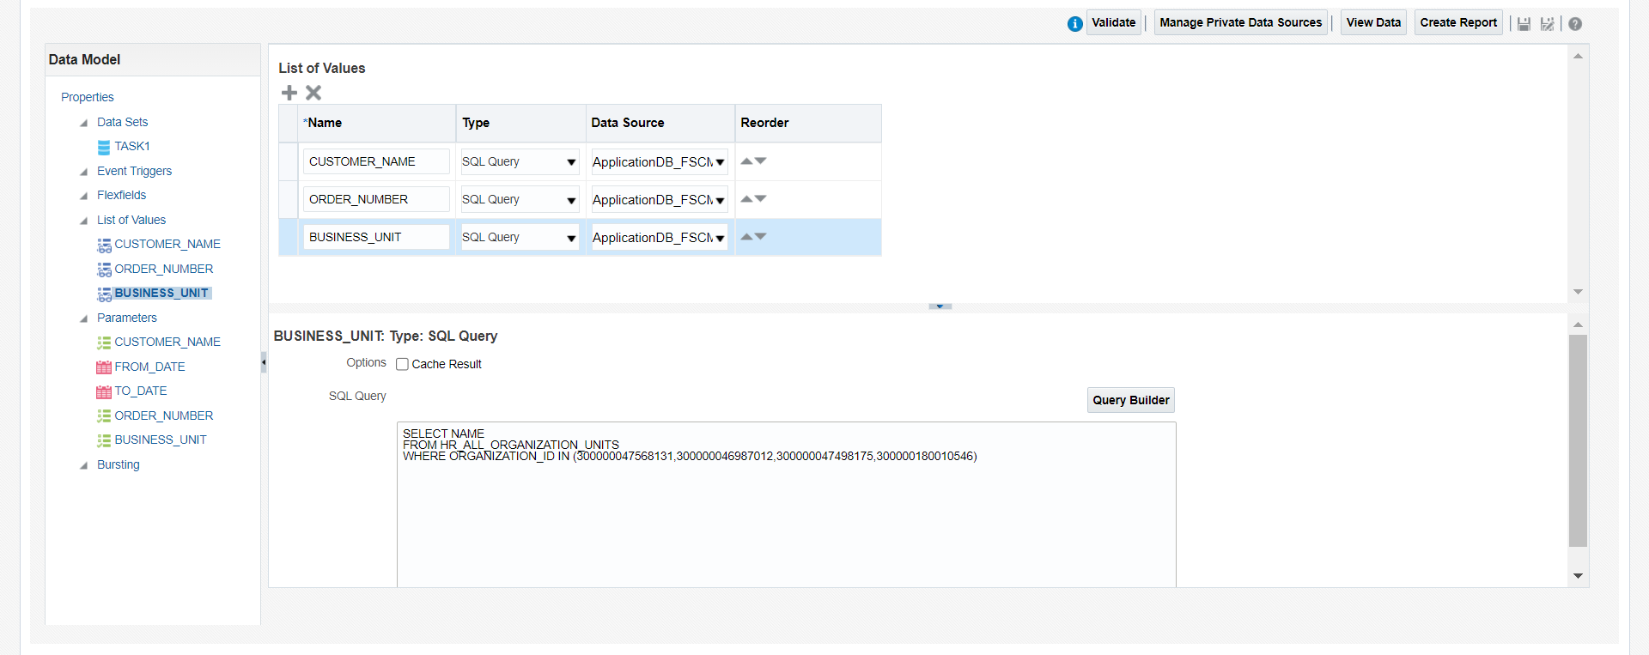
Create list of values for the corresponding parameters created in the data set.

Slide 4
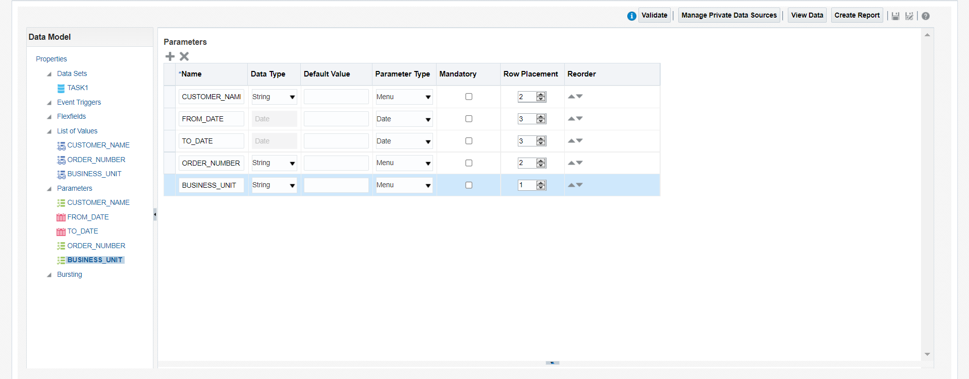
Set the parameter type and row placement in parameters.

Slide 5
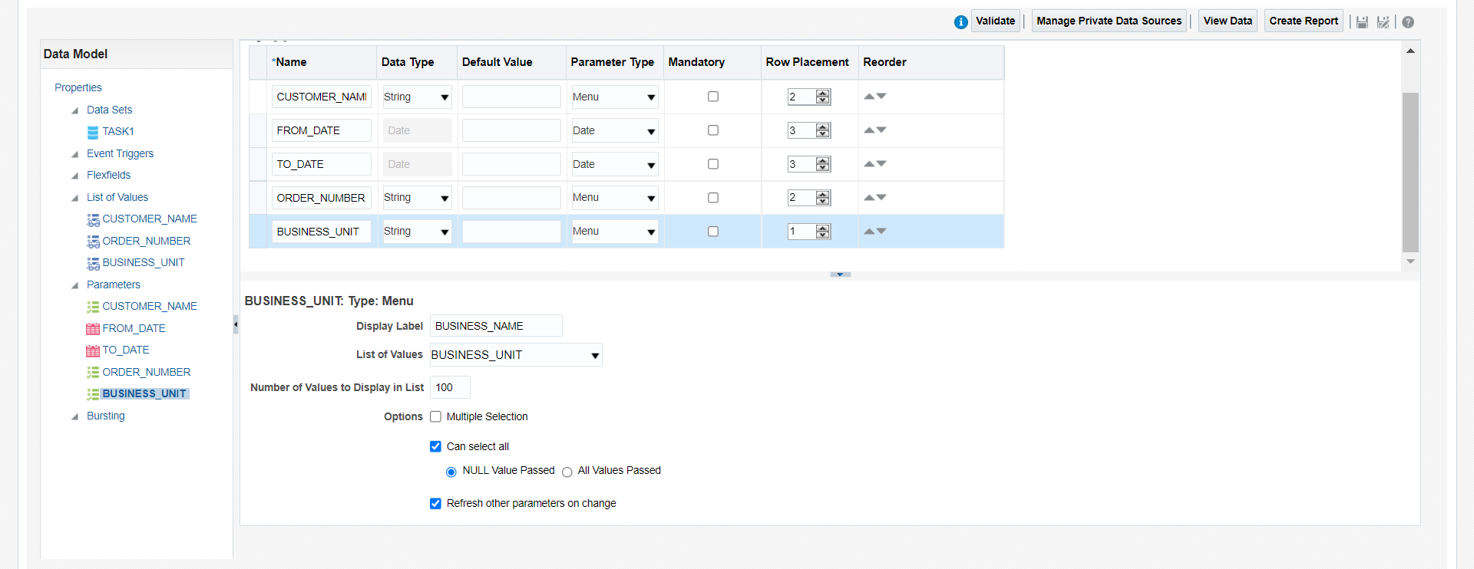
Map the correspondinfg List Of values for the parameters.
Check the “Refresh other parameter on range” for the dependency parameter.

Slide 6
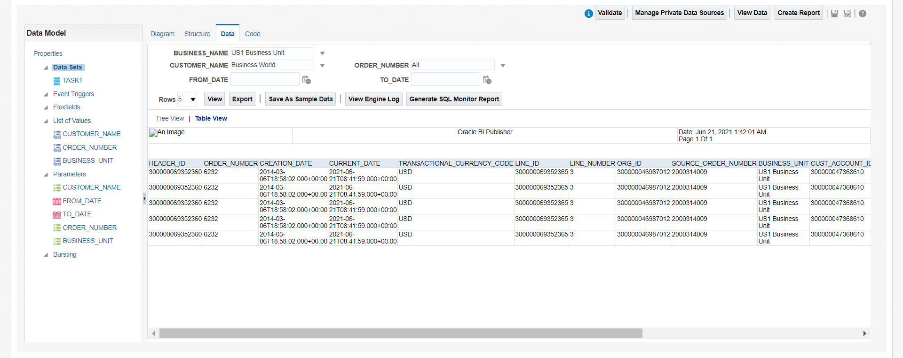
Change the parameters values and click on view --> table view.
Click save as sample data and save the Data model and click on the export button to download the XML file.

Slide 7
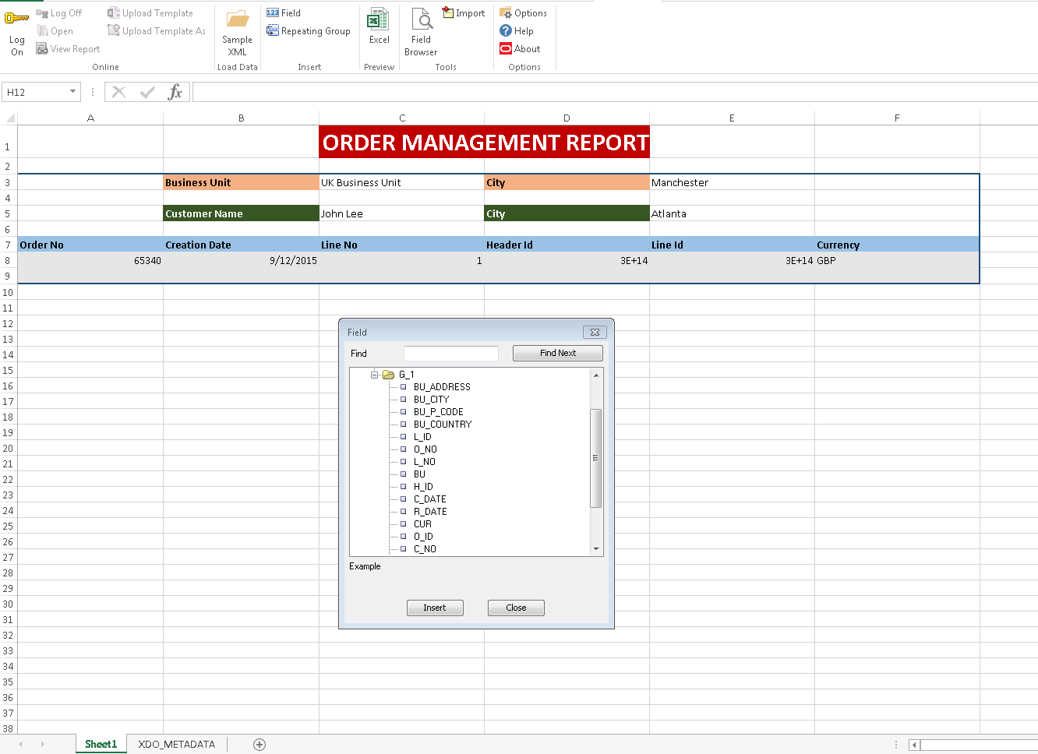
Open BI publisher in exceland load the XML file in sample XML data.
Design a layout using labels.
Click on the field and inser the columns in the corresponding label.

Slide 8
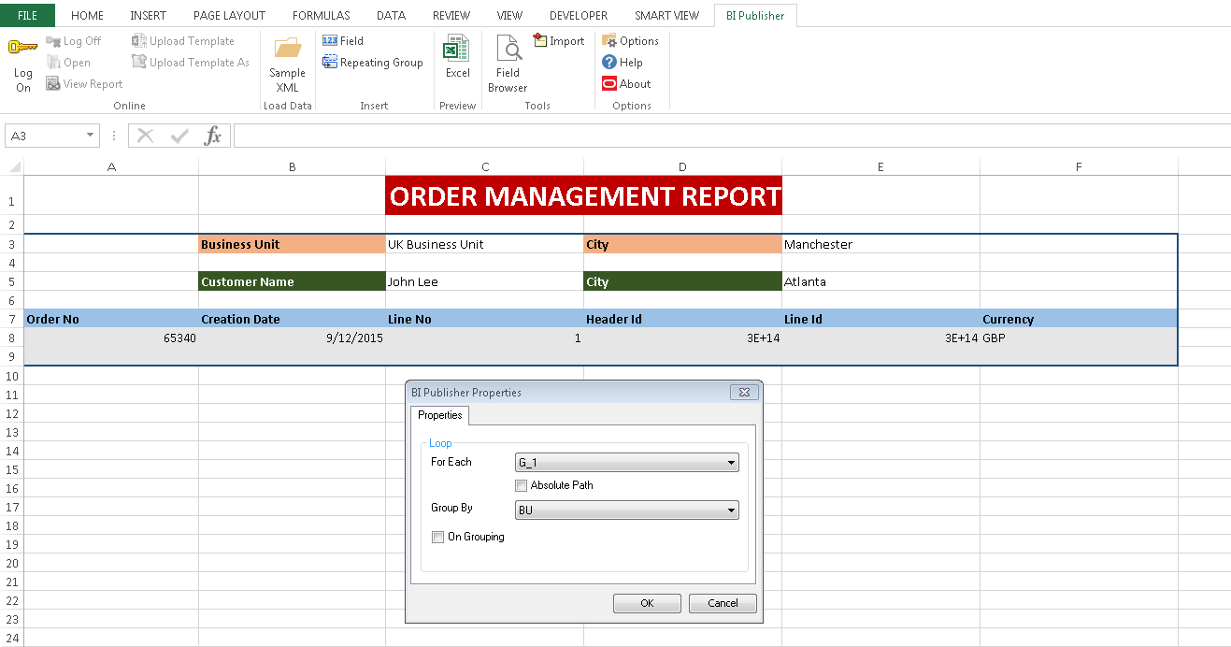
Select from the BU label and make group by as Business Unit.

Slide 9
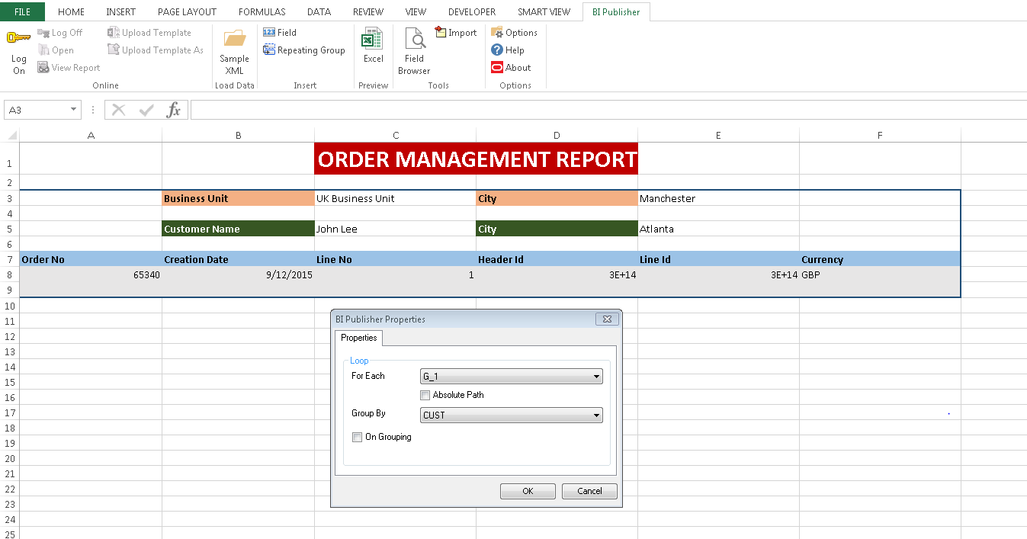
Select from the Customer label and make group by as Customer.

Slide 10

Select the column parameter and make repeating group by G_1.

Slide 11
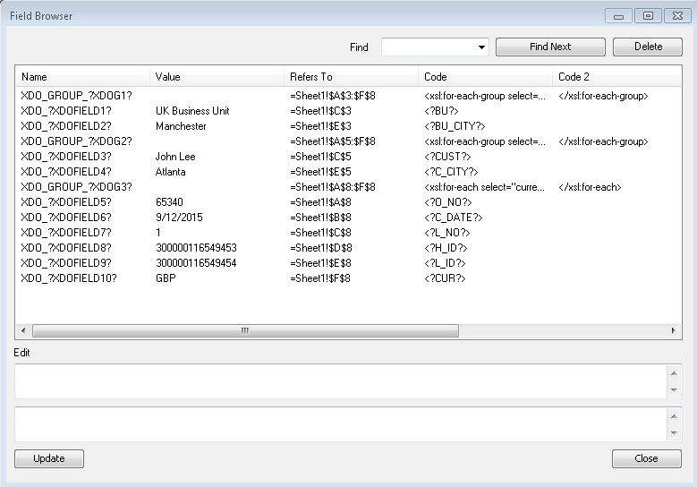
The field browser looks like this.
We can also edit from the name manager in the formula menu.
Save the template in the Excel format.

Slide 12
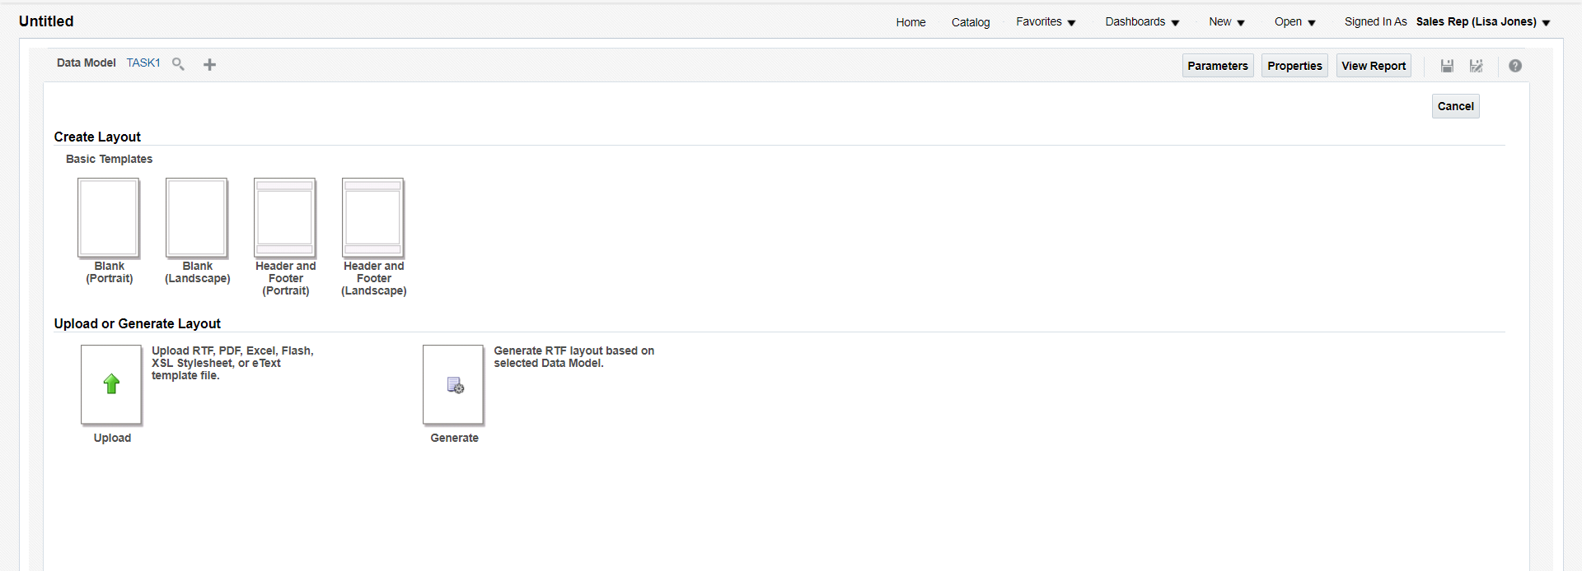
Click New --> Report and map the Data model.
Upload the Excel template and save the layout and report.

Slide 13
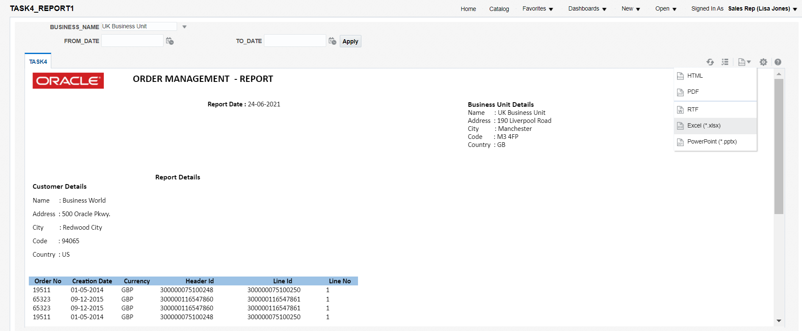
Save the layout and Report.
Change the parameters and export as Excel format.

Slide 14
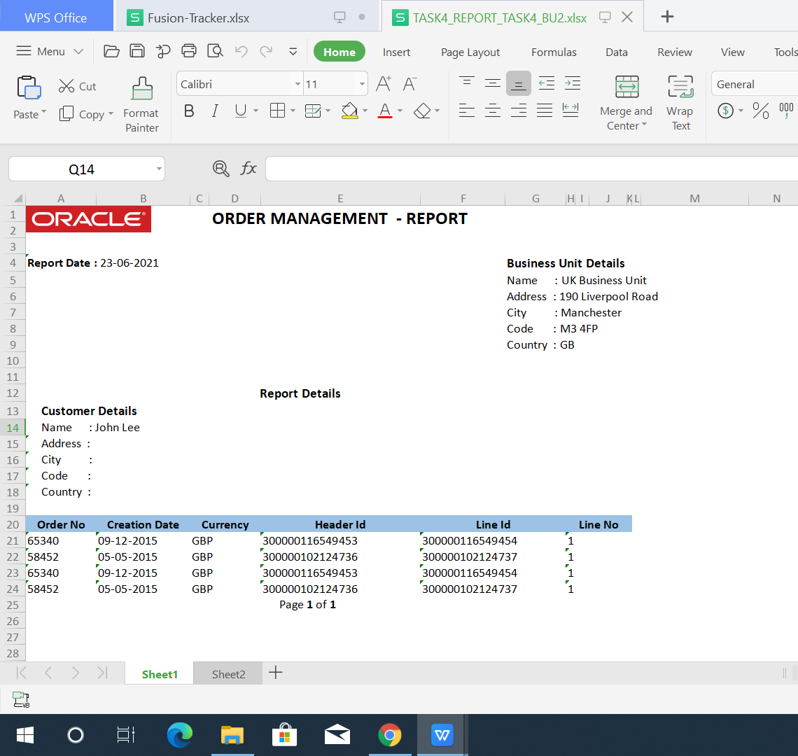
Report will be downloaded with multiple sheets.

Slide 15
END

