Slide 1
TASK 1
BI REPORT
MULTIPLE LAYOUTS

Slide 2
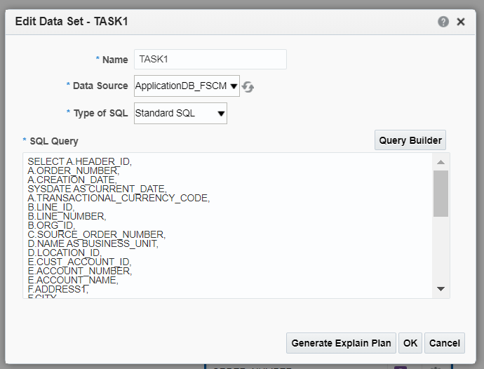
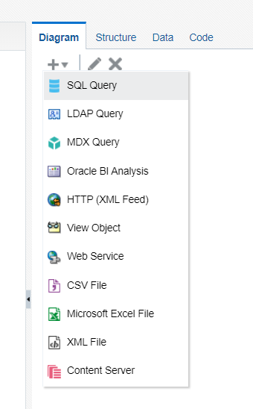
NAVIGATION - BI REPORTS
Go to instance --> Browse Catalog --> New --> Data Model
Create a sql query data set.
Type the query for the data set.

Slide 3
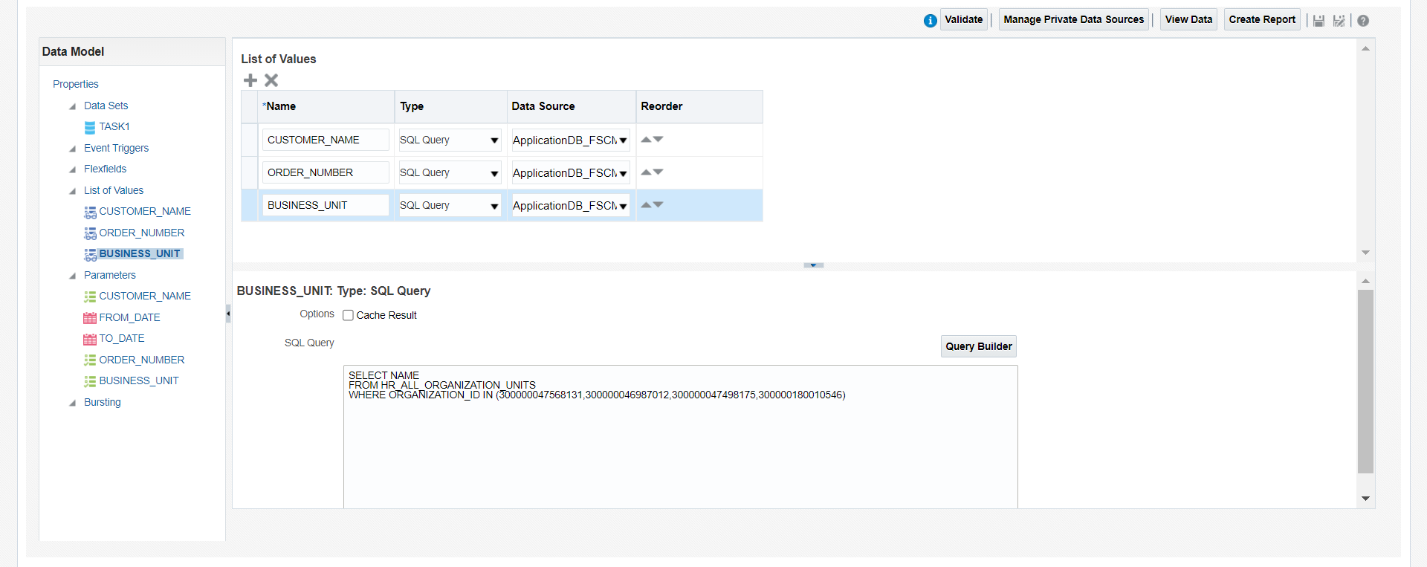
Create list of values for the corresponding parameters created in the data set.

Slide 4
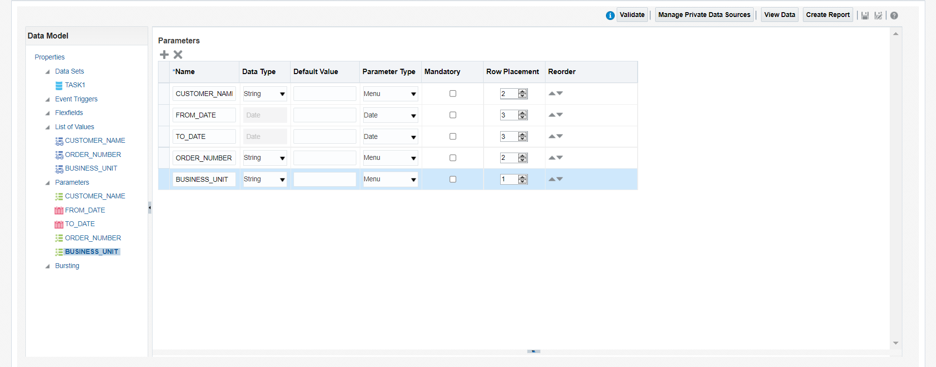
Set the parameter type and row placement in parameters.

Slide 5
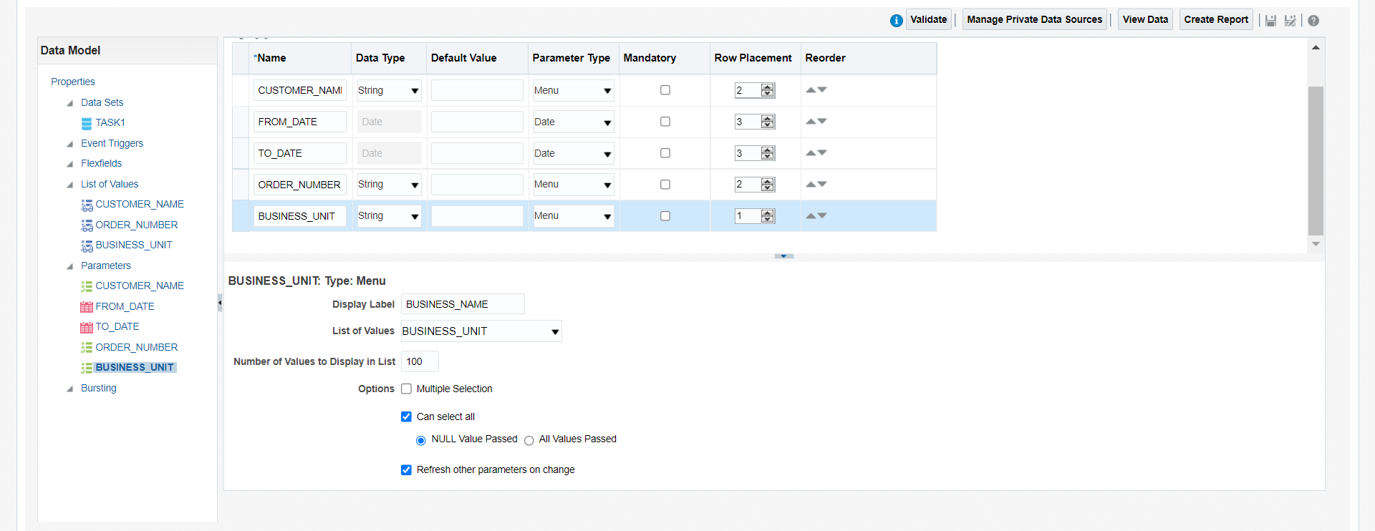
Map the correspondinfg List Of values for the parameters.
Check the “Refresh other parameter on range” for the dependency parameter.

Slide 6
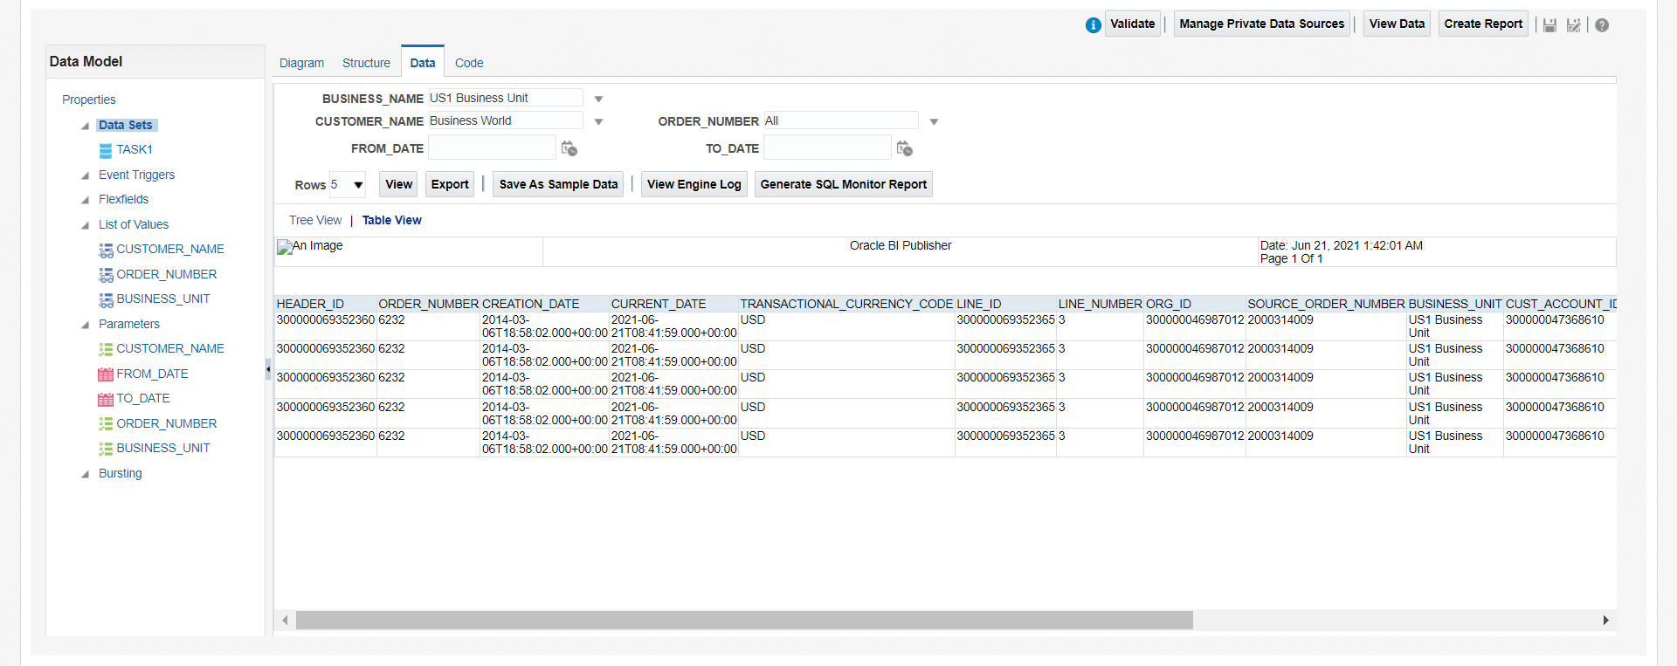
Change the parameters values and click on view --> table view.
Click save as sample data and save the Data model and click on the export button to download the XML file.

Slide 7
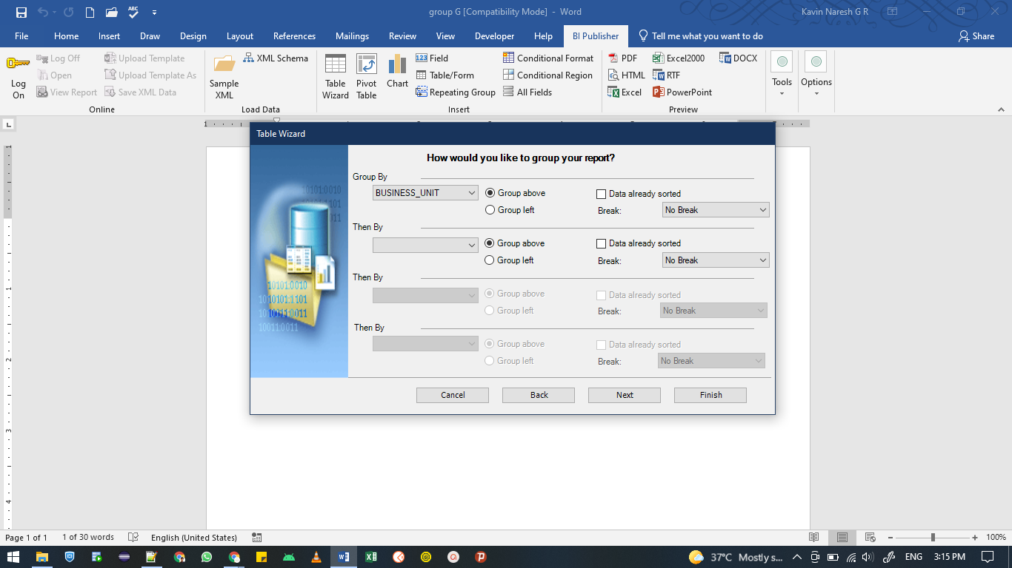
Open BI publisher in word and load the XML file in sample XML data.
Click on the table wizard and insert the columns and make BU as group by element.

Slide 8
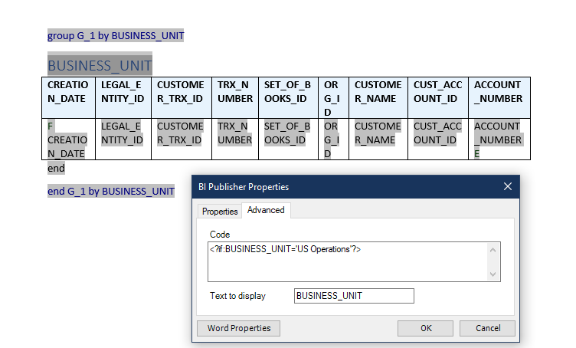
Give the If condition for the Business Unit by double click on the Group by header.

Slide 9
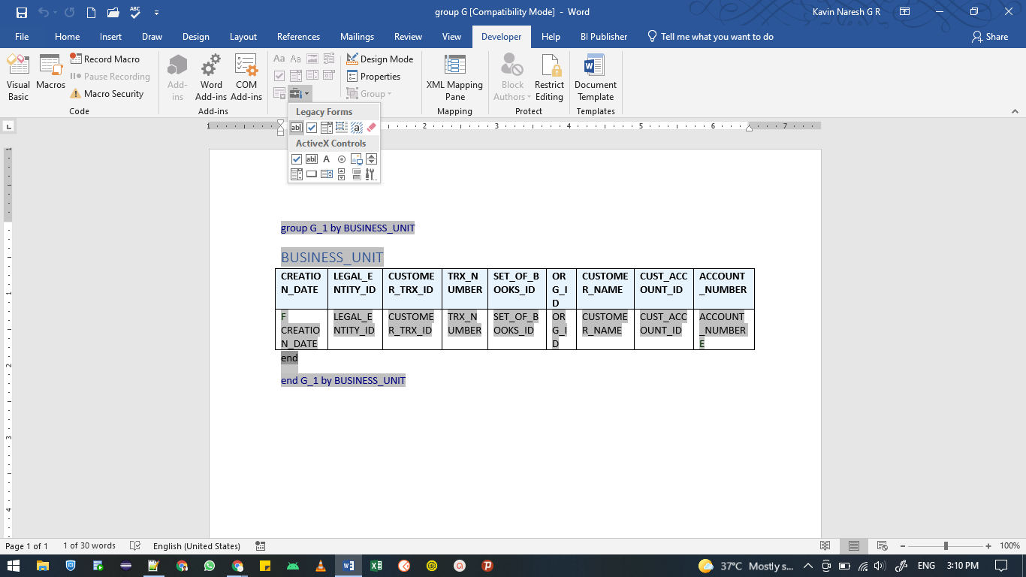
Enabling the developer option by clicking Word option --> Customize Ribbon and check developer option in
main tabs.
Create a legacy form for the end if statement.

Slide 10
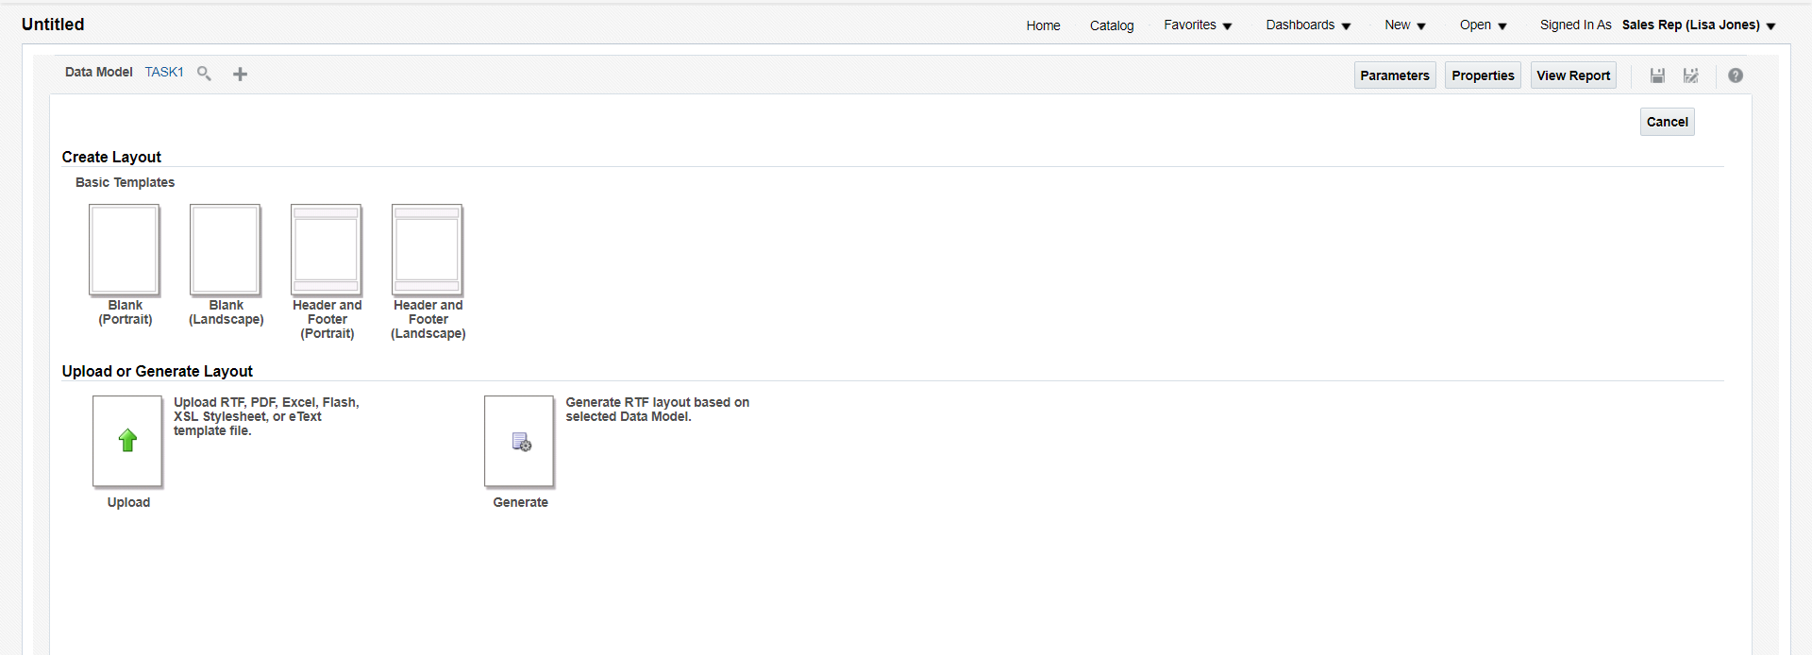
Create table wizard for various BU and save the template as RTF file.
Click New --> Report and map the Data model.

Slide 11
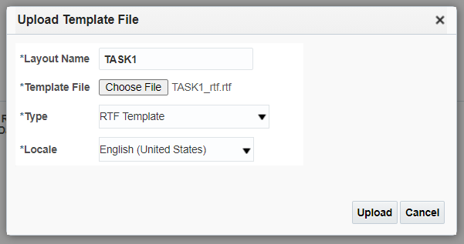
Upload the RTF template in create report page.

Slide 12
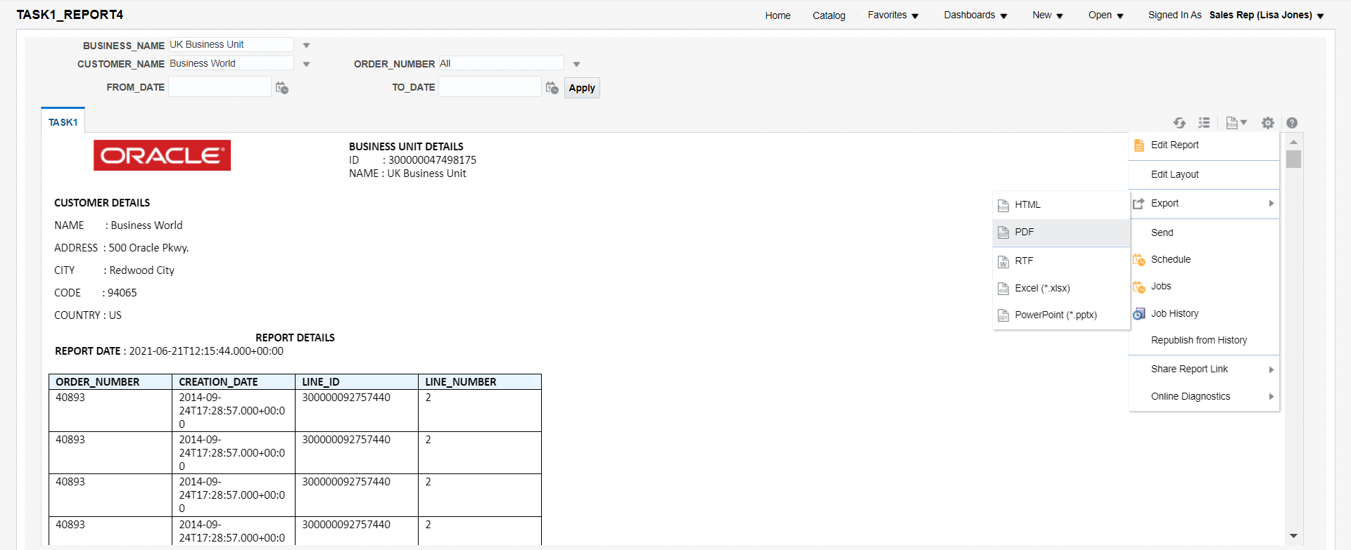
Save the layout and Report.
Change the parameters and export as PDF format.

Slide 13
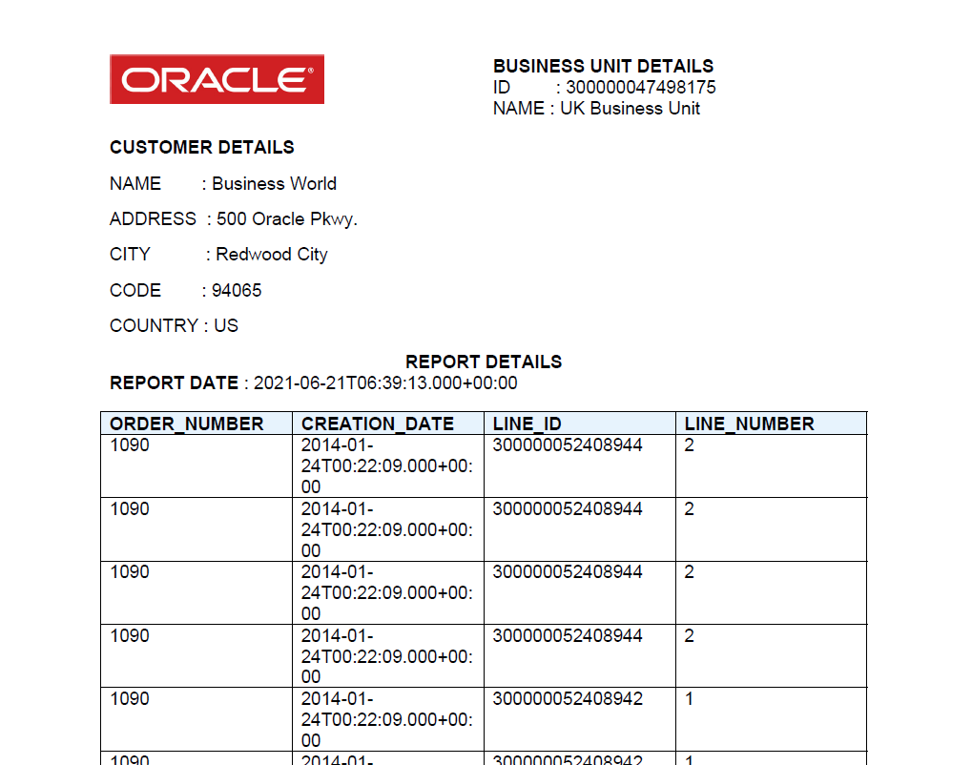
Report will be downloaded.

Slide 14
END

