Slide 1
TASK 1
BI REPORT
MULTIPLE LAYOUTS

Slide 2
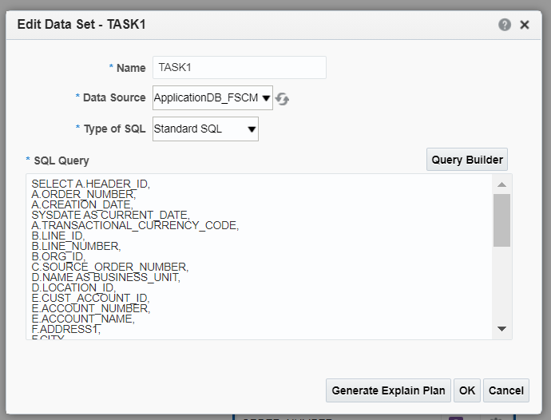
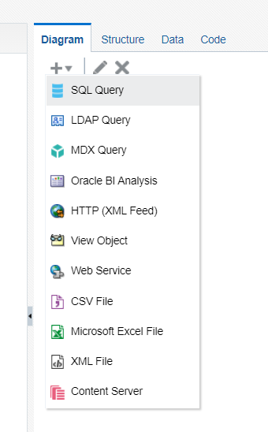
NAVIGATION - BI REPORTS
Go to instance --> Browse Catalog --> New --> Data Model
Create a sql query data set.
Type the query for the data set.

Slide 3
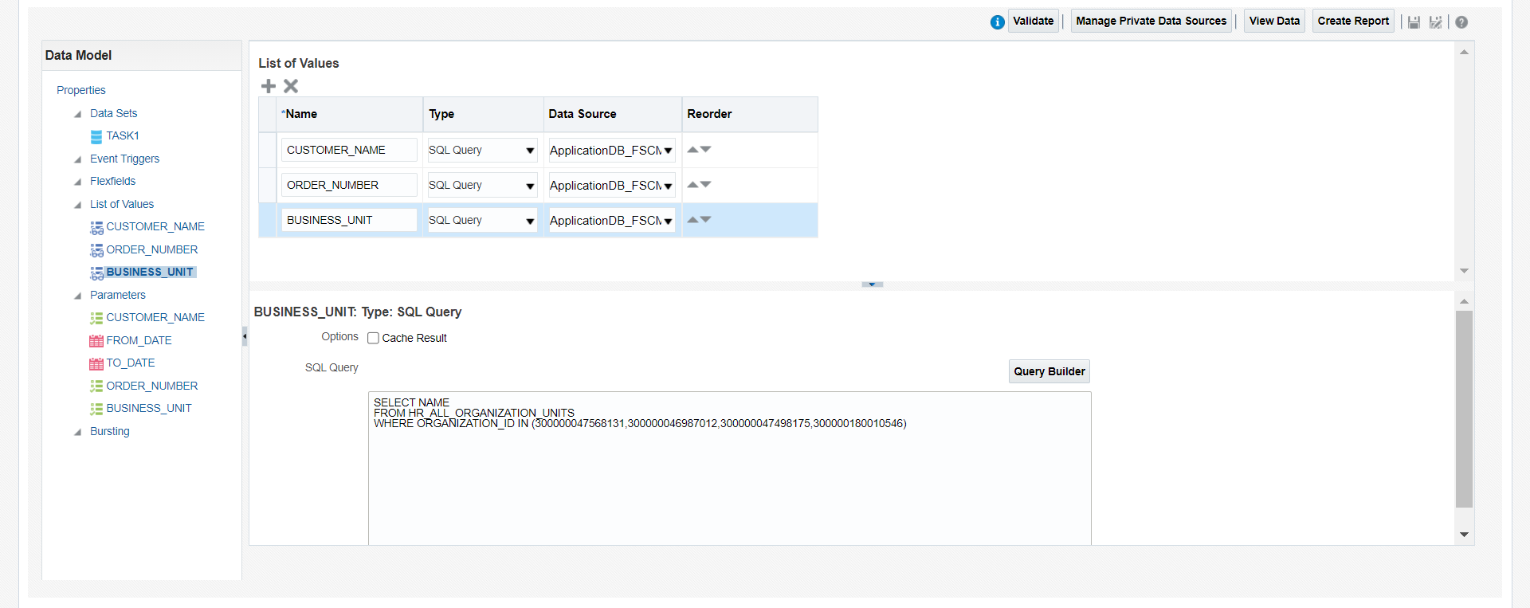
Create list of values for the corresponding parameters created in the data set.

Slide 4
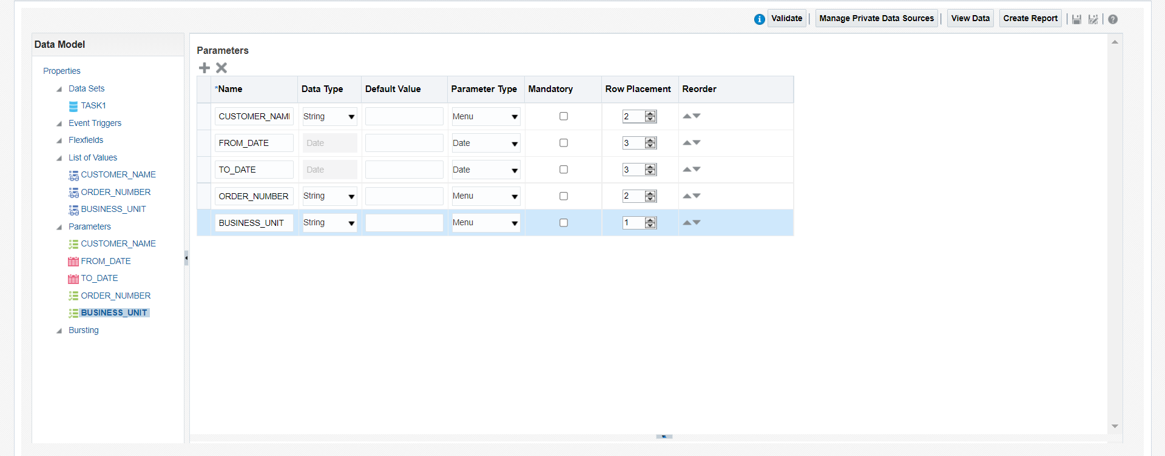
Set the parameter type and row placement in parameters.

Slide 5
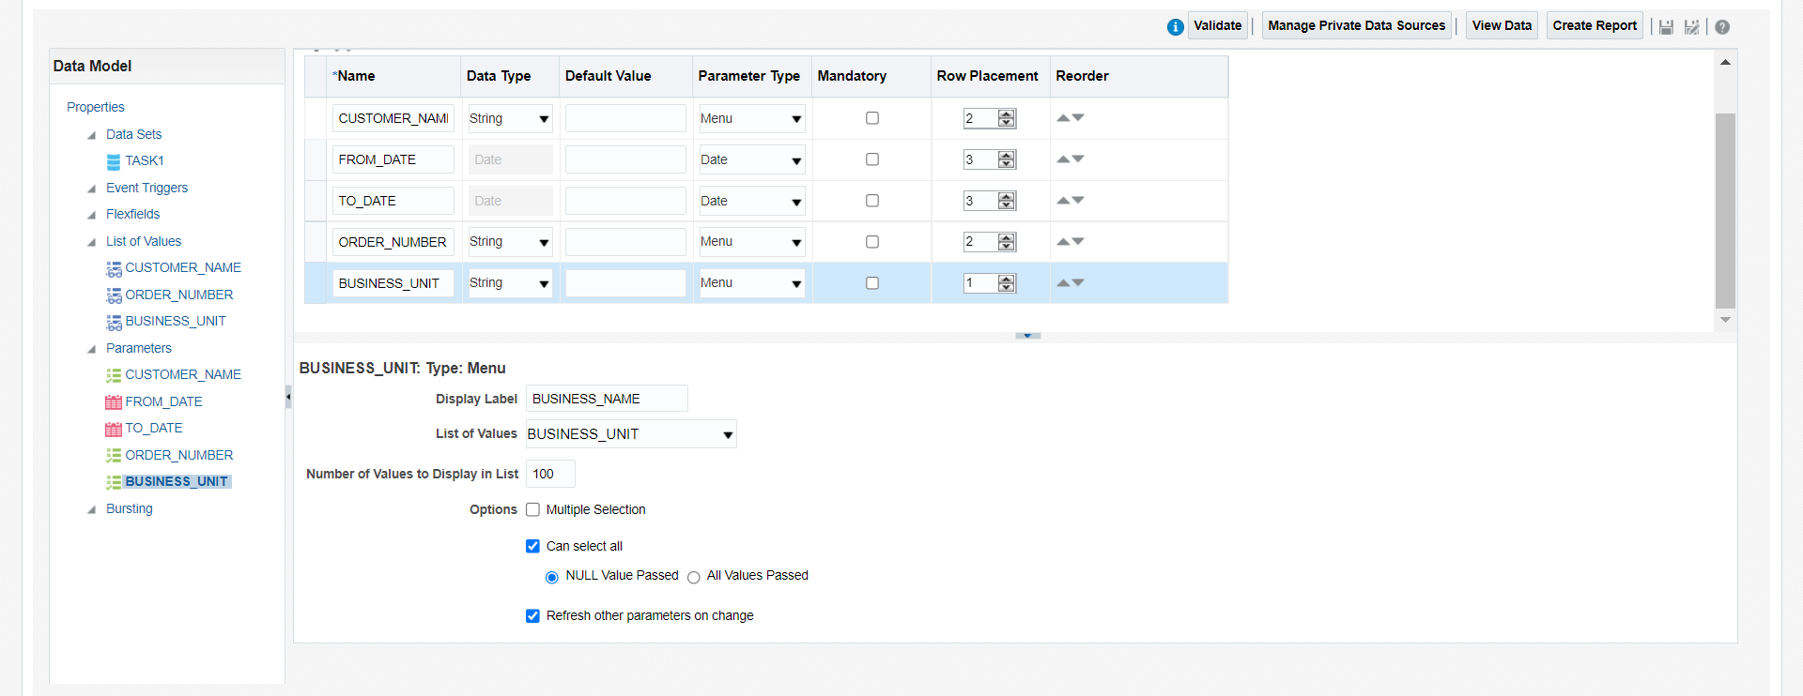
Map the correspondinfg List Of values for the parameters.
Check the “Refresh other parameter on range” for the dependency parameter.

Slide 6
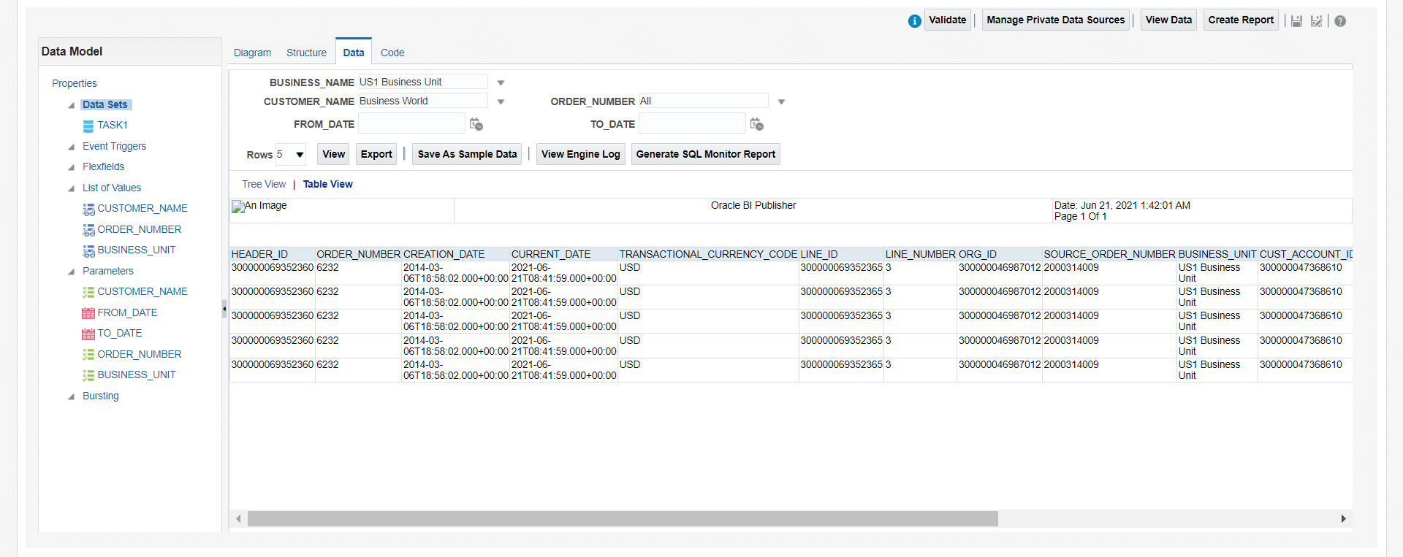
Change the parameters values and click on view --> table view.
Click save as sample data and save the Data model and click on the export button to download the XML file.

Slide 7
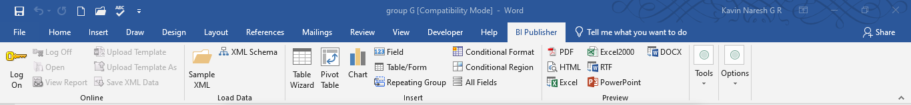
Open BI publisher in word and load the XML file in sample XML data.
Design a table for columns and insert the parameters from the field menu.

Slide 8
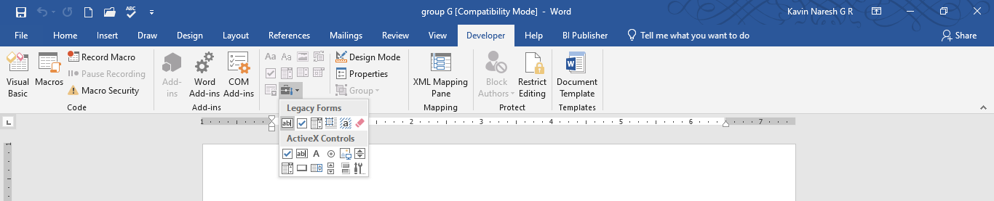
Enabling the developer option by clicking Word option --> Customize Ribbon and check developer option in
main tabs.
Create a legacy form for the end if statement.

Slide 9
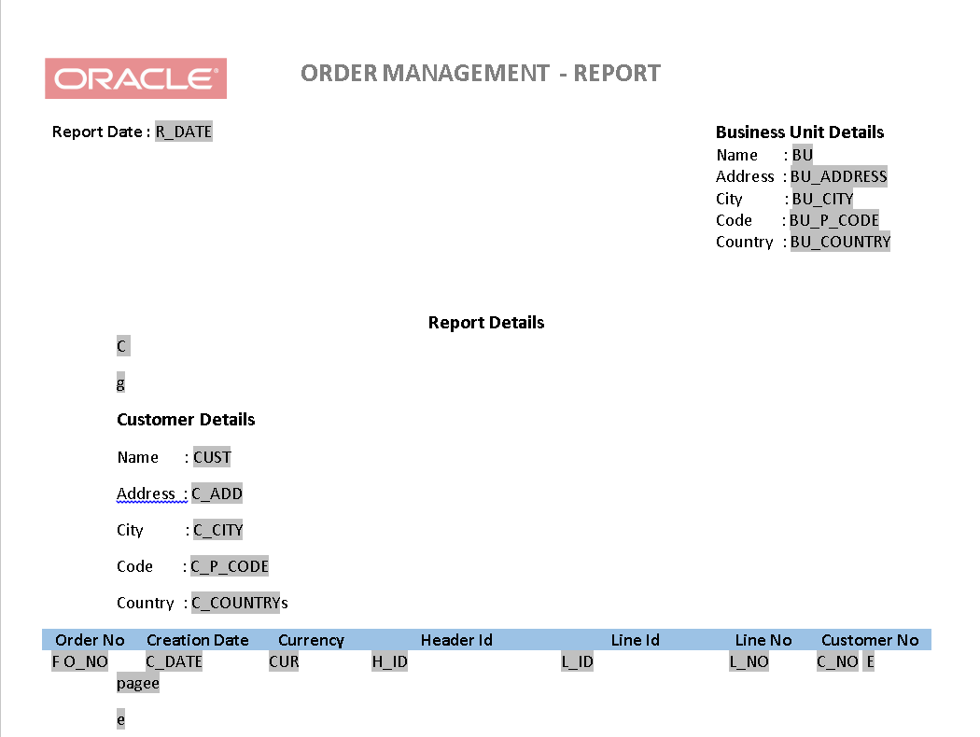
Give the If condition for the Business Unit by double click on the Group by header.
Group by condition for the customer legacy form and page split legacy for all tables.

Slide 10
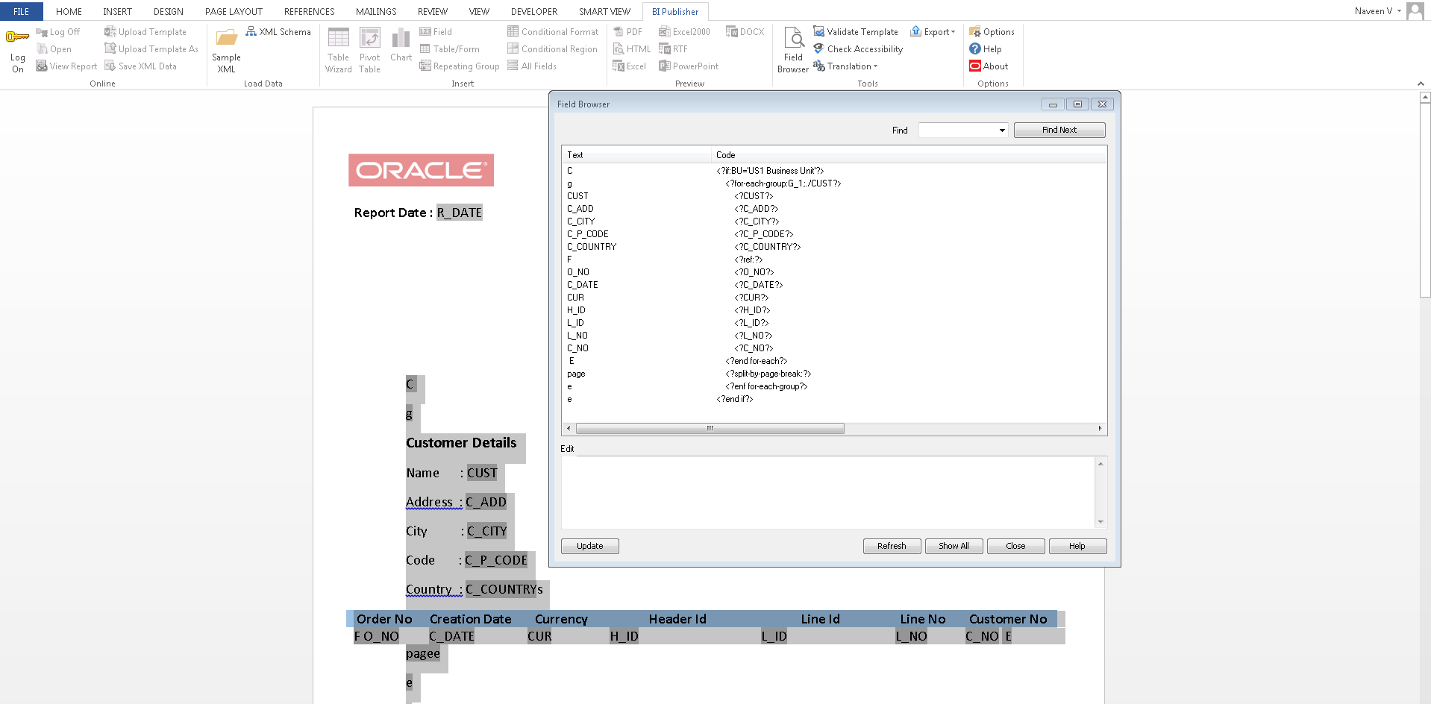
Select the fields and click field browser to view and edit the commands.

Slide 11
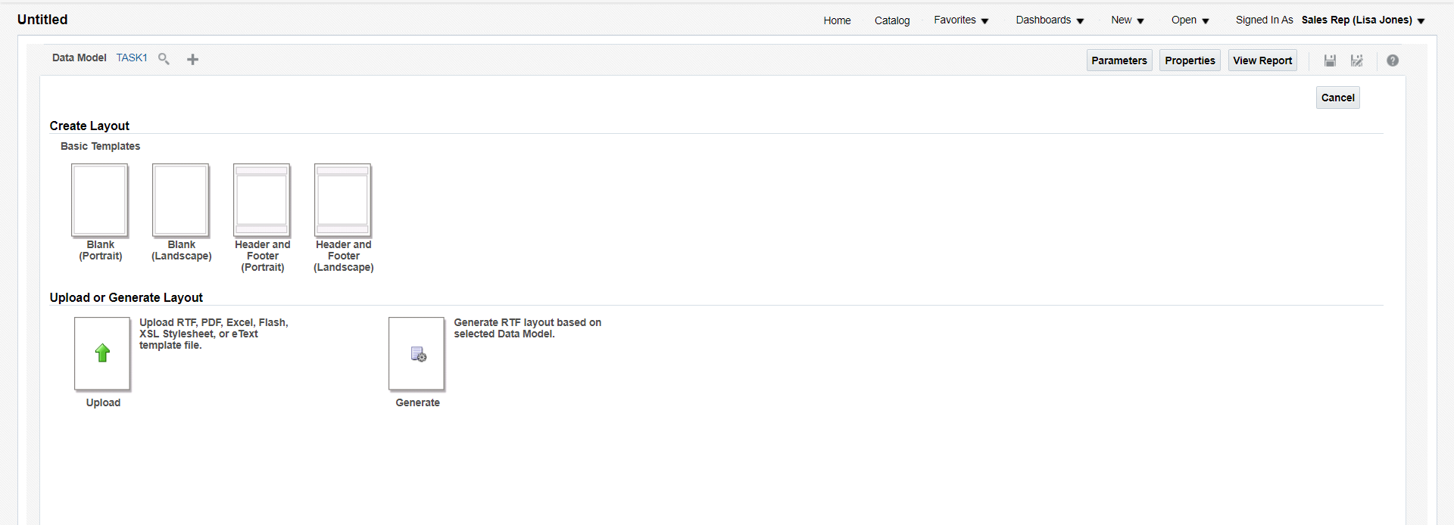
Create table for various BU and save the template as RTF file.
Click New --> Report and map the Data model.

Slide 12
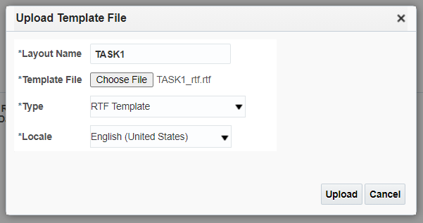
Upload the RTF template in create report page.

Slide 13
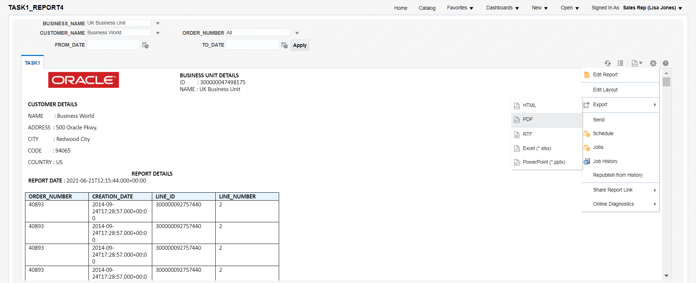
Save the layout and Report.
Change the parameters and export as PDF format.

Slide 14
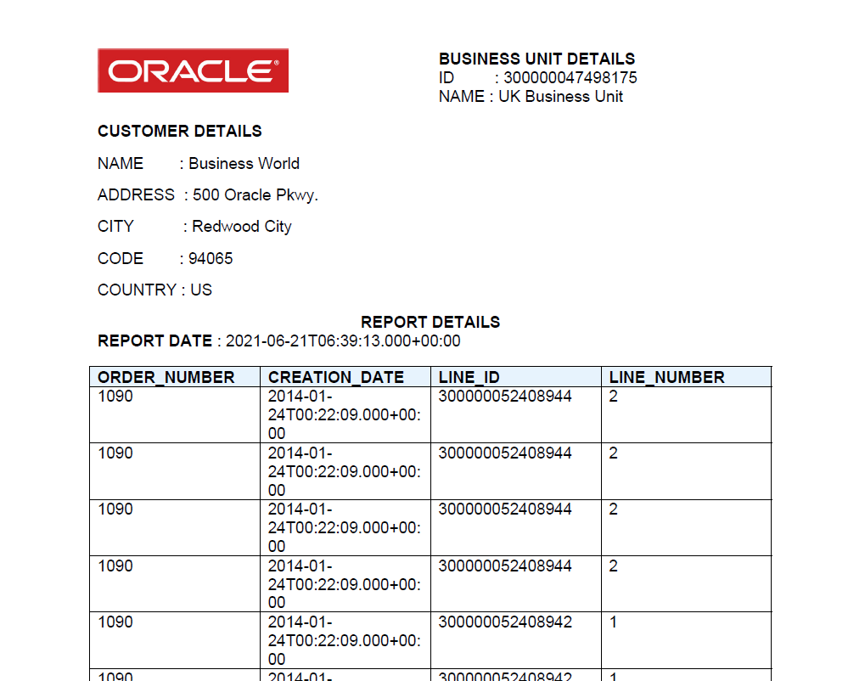
Report will be downloaded with multiple pages for multiple customers.

Slide 15
END

