Slide 1
TASK 5
BI REPORT
BURSTING

Slide 2
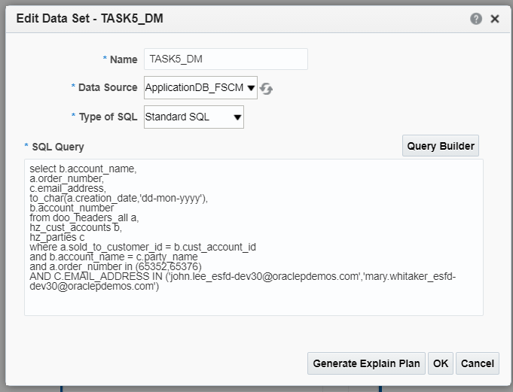
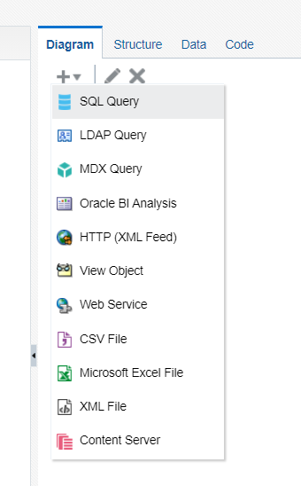
NAVIGATION - BI REPORTS
Go to instance --> Browse Catalog --> New --> Data Model
Create a sql query data set.
Type the query for the data set.

Slide 3
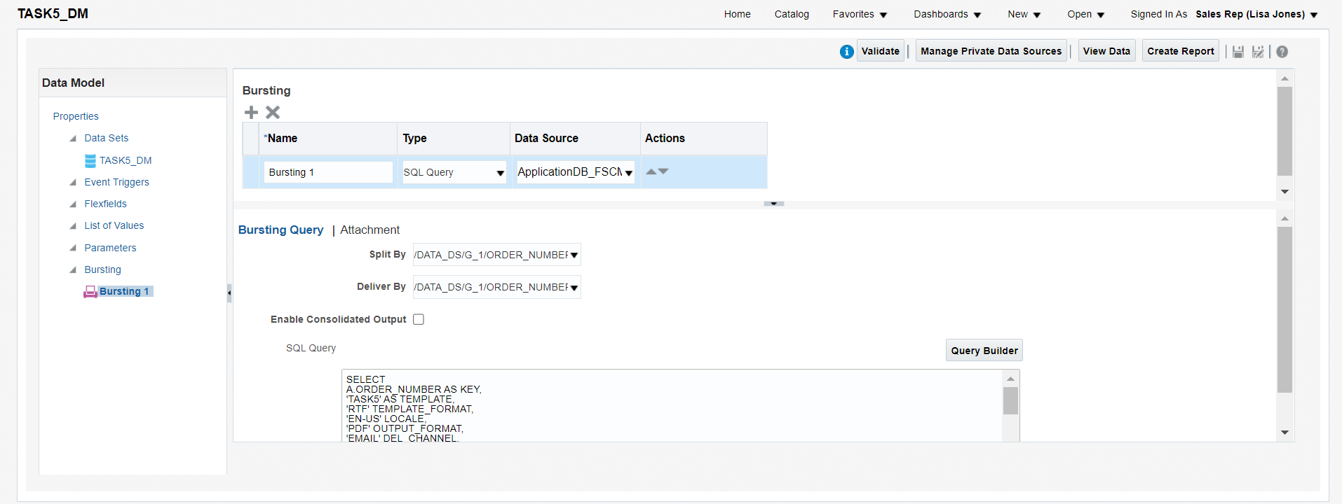
Create a bursting and type the query for the bursting.
Select the Split by and Deliver by values.

Slide 4
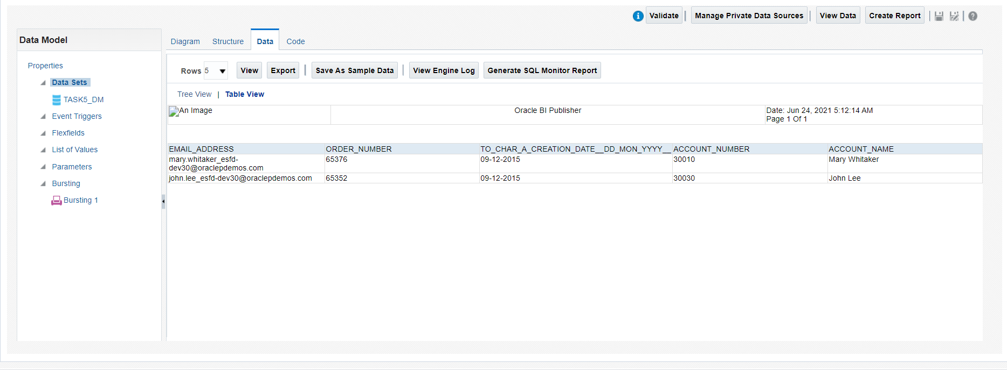
View the data model.
Save the data model with sample data.

Slide 5
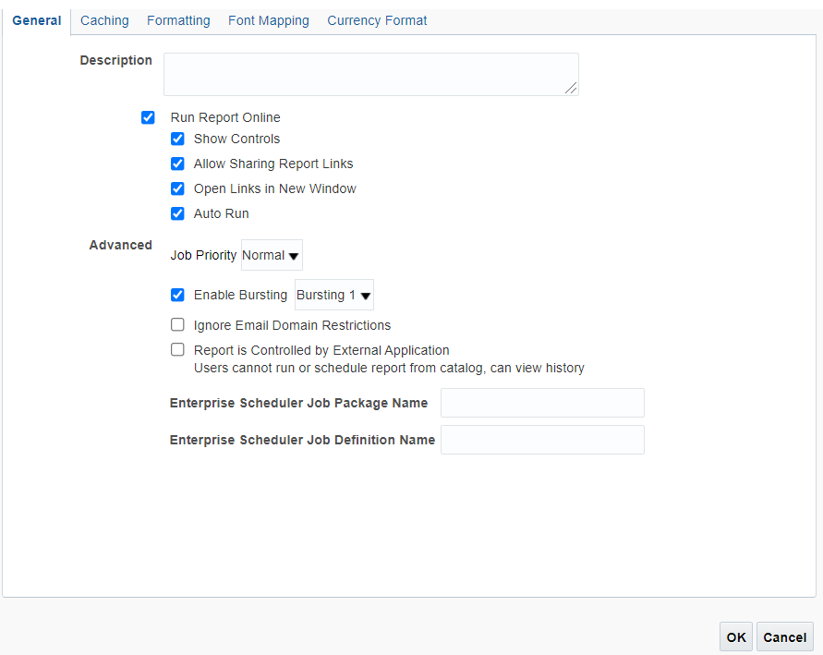
Click create report and map the data model and generate the rtf template.
Save the layout and enable the bursting in properties of layout page.

Slide 6
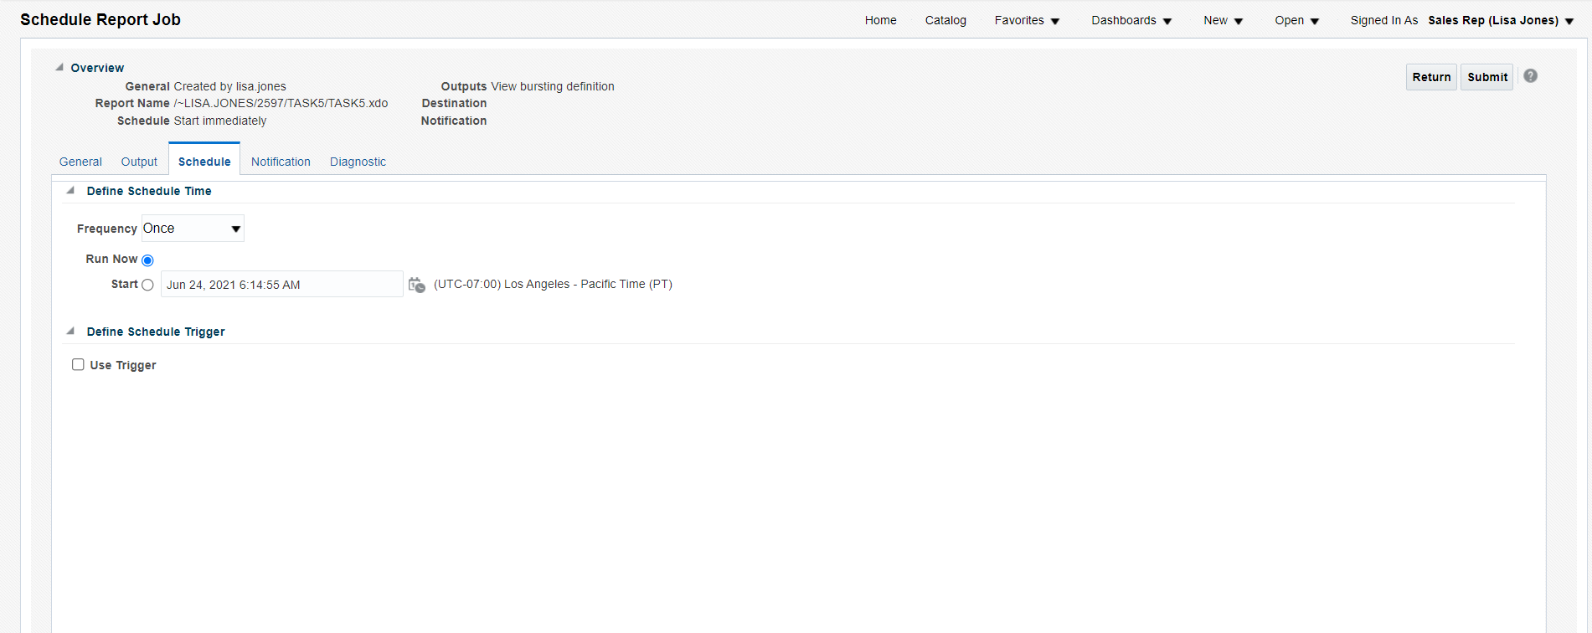
Save the report and go to Catalog --> Report --> more --> Schedule.
Click Submit and Enter the job name.
The job is submitted.

Slide 7
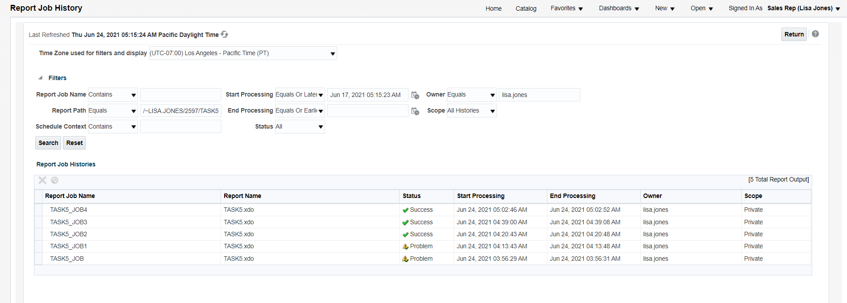
Click return and go to report --> more --> history.
Click on your job name after the status get Success.

Slide 8
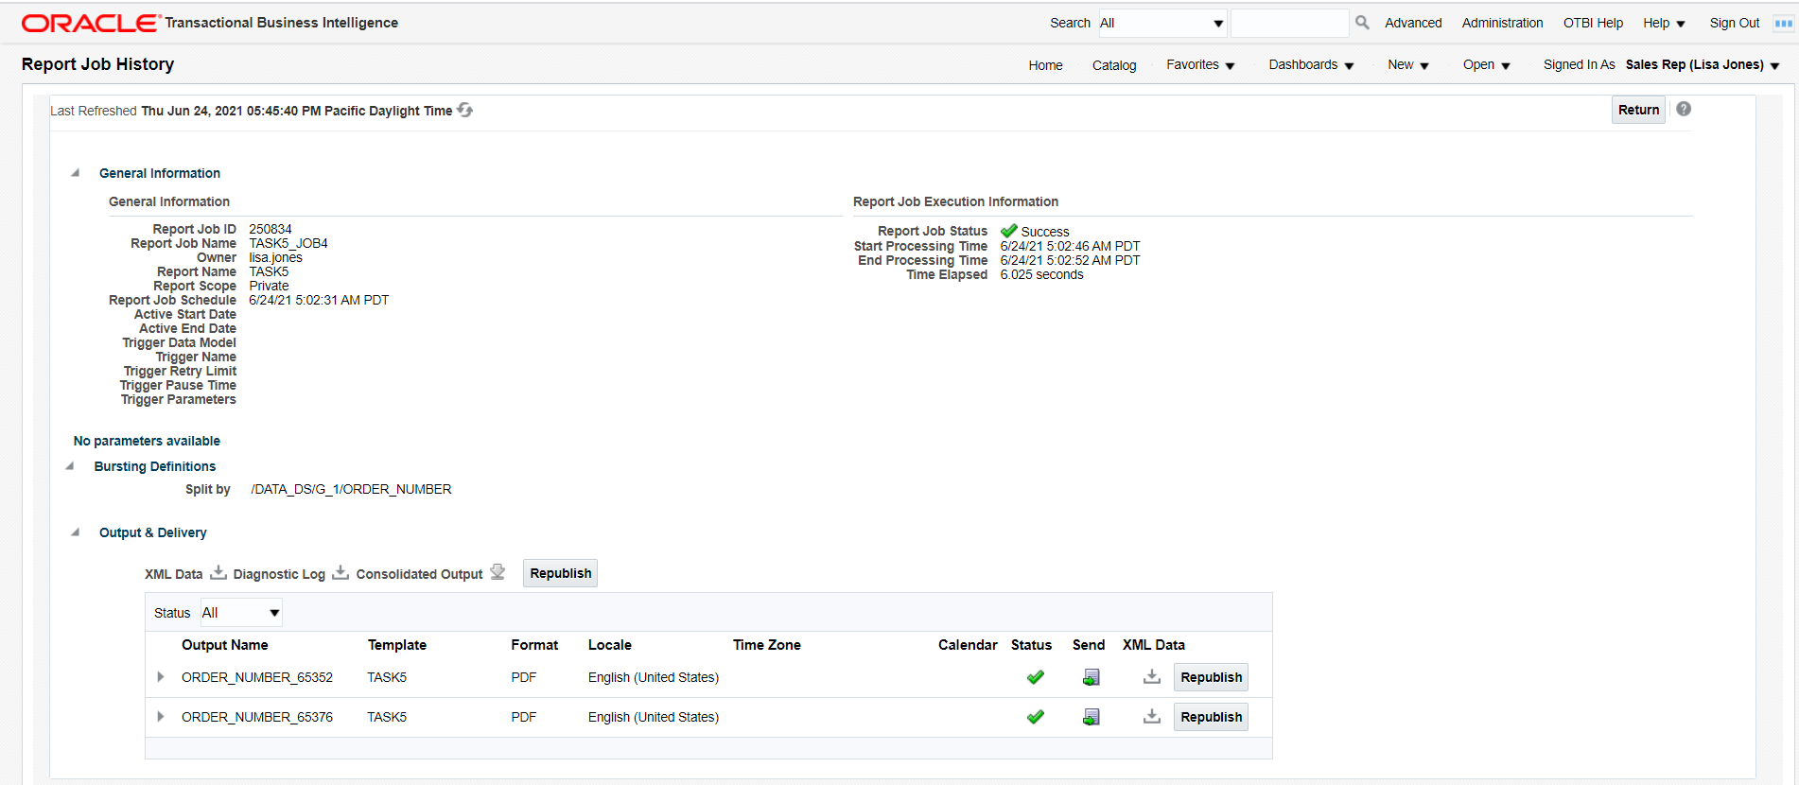
Your report will be splitted and sent to various mail address.

Slide 9
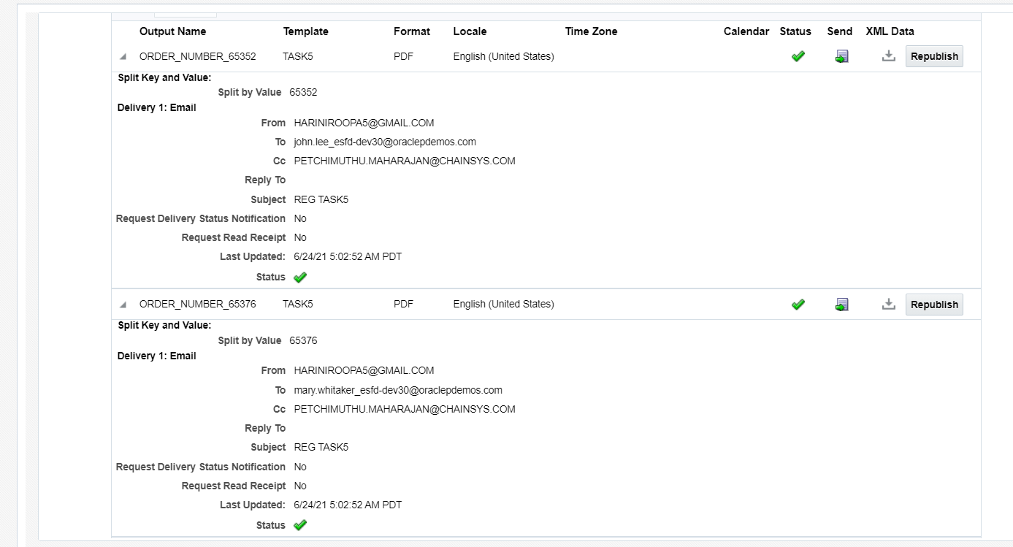
The bursting result will be shown as follows.

Slide 10
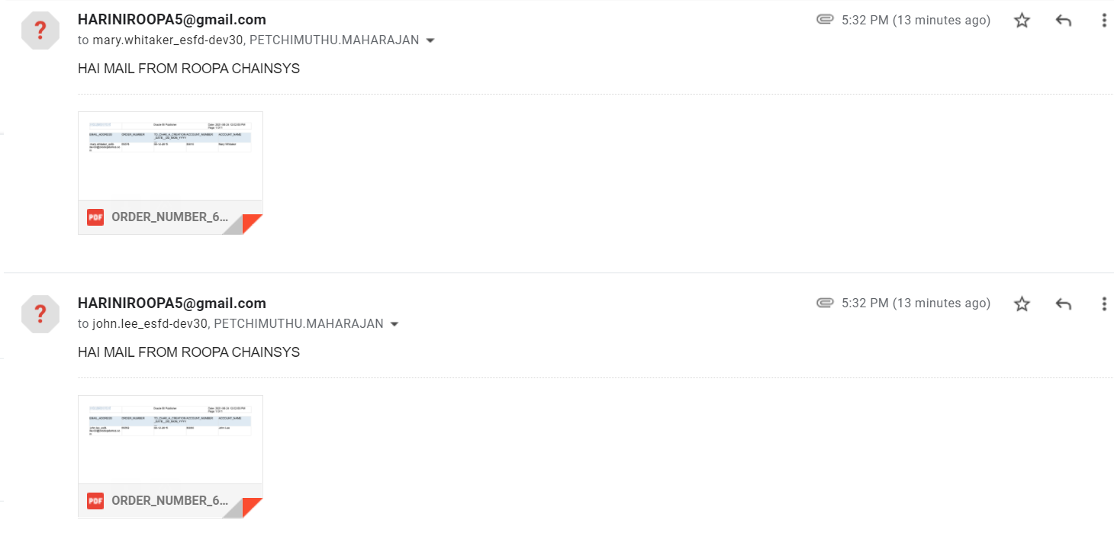
Mail will be received like this.
Here this is cc address for both receipents.

Slide 11
END

