Slide 1

Data pipeline for Trajectory Data Visualization
Mongkhontham Mahawang 600611031

Slide 2

Introduction
Notes:
Bangkok-metropolis-huge population- comewith traffic congestion

Slide 3
Hypothesis of Metro Provider
“Metropolitan Train System can help to decrease Traffic density”
Notes:
Metro provide- hypothesis
Metro=decrease density of traffic

Slide 4
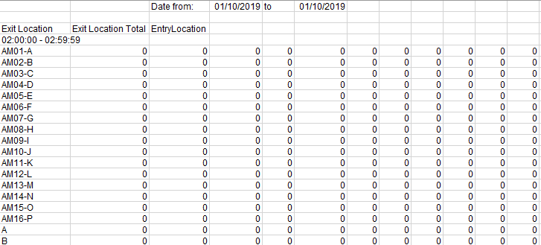
Manual Transform
Aggregate data
O-D Matrix
Transactional Data
Analysis Process
Visualization
Notes:
Traditional ways to perfor manalysis
To study hypothesis = need analyze data from metro
But come in matrix cannot perform yet
Manual transform and aggregate

Slide 5


Extract
O-D Matrix
Transform
Visualization
Load Into Database
Data Pipeline
Notes:
Aims to create pipeline that can
Extract Transform And load data to database and use that to create visualization
Visualization using transactional data
ทำ visualize จากของที่ได้เพื่อดูว่า ข้อมูลที่ผ่าน pipeline มันใช้งานได้จริง

Slide 6
Project Scope
O-D matrix report from 34 stations in 24 hours
Design the Predefined Schema
Talend Data pipeline can perform ETL from
O-D matrix to transactional data
Heatmap Visualization in Power BI

Slide 7
Tools And Technologies
Microsoft Excel : To read the raw data and output data. Also, to do the basic task of preparation process.
Google Colab : To develop the python programs.
Talend Open Studio for Data integration: ETL tool use to create pipeline
Power BI: Software to create visualization

Slide 8

Related Knowledge

Slide 9
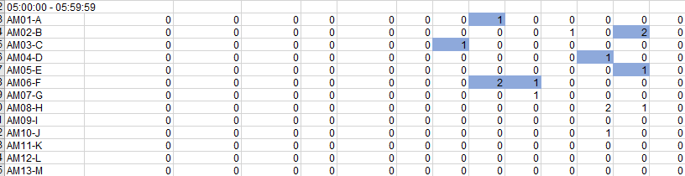
O-D Matrix Data
Notes:
Report file that need to be blinded station name blinded
Contain 24 tables of matrix each one for 1 hours
No any null or missing values

Slide 10
ETL
Extract
Transform
Load
Notes:
ETL is a process
To per form 3 task extract data from source clean out don’t need
Transoform the form of data to desired data
Load transformed data to database warehouse or lake

Slide 11
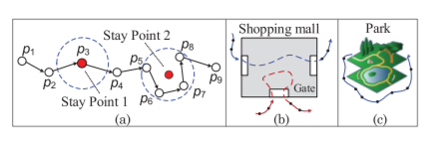
Trajectory Data
Notes:
Is data that from moving object Plane Phone animal
Have location and time
Transactional data will have location add to it to create visualization

Slide 12

Methods

Slide 13
Pre-defined Schema
Origin & Destination Coordinates
Notes:
In order to create heatmap add 2 columns for

Slide 14
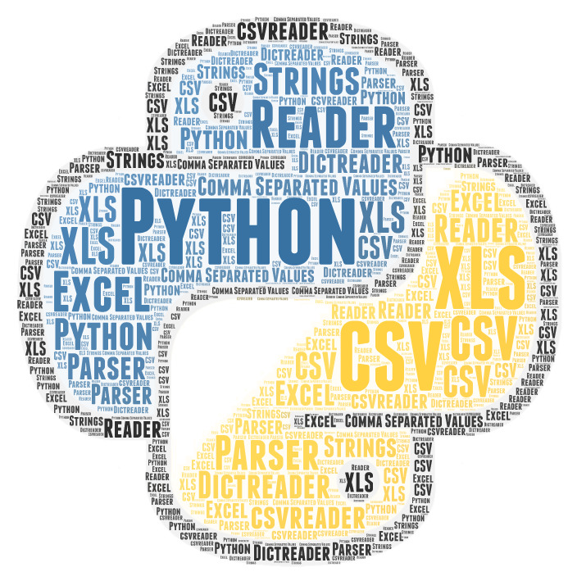

Python Code
This Photo by Unknown Author is licensed under CC BY-SA
This Photo by Unknown Author is licensed under CC BY-SA
Notes:
Write python program to perform extract code
Using pandas to hhandel excel file
And .csv to write output file

Slide 15
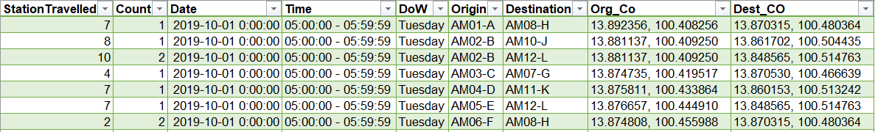
Python Transactional data
Notes:
Get the result transactional data like schema

Slide 16
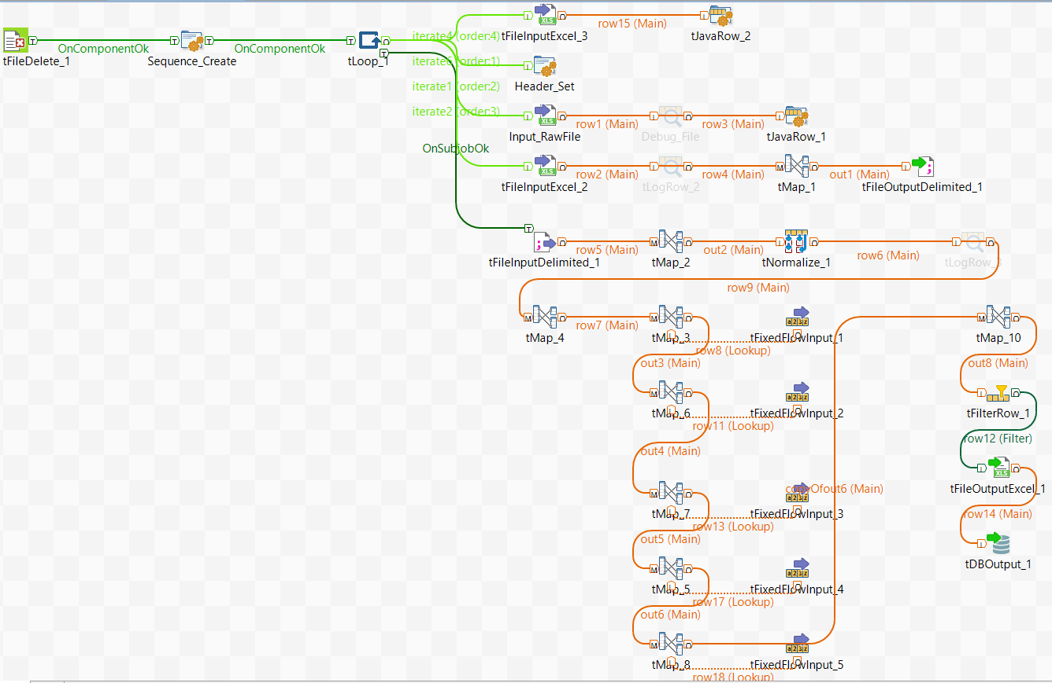
Move to Talend
Notes:
Show talend เลย อธิบายใน talend เลย

Slide 17
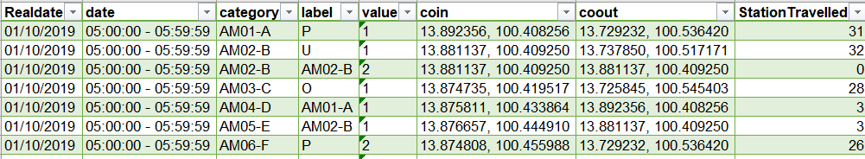
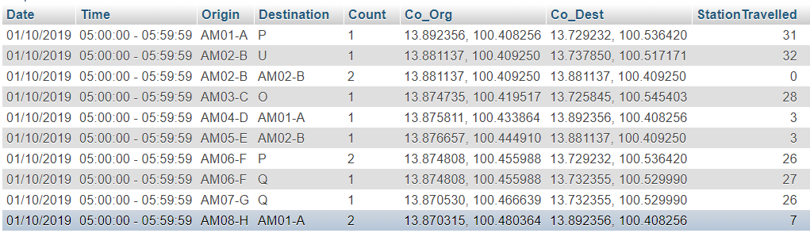
Result from Talend

Slide 18
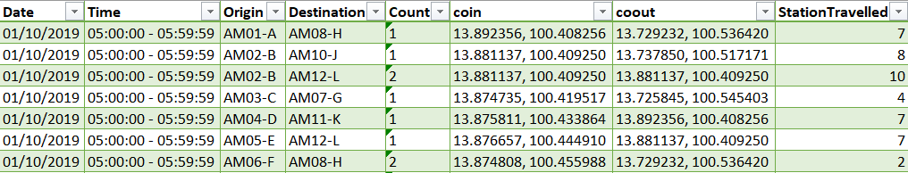
Result comparison of Talend and Python code
Notes:
Above = python
Below= talend
No date of week

Slide 19

Visualization In Power BI
Notes:
Show Visualization in power bi

Slide 20
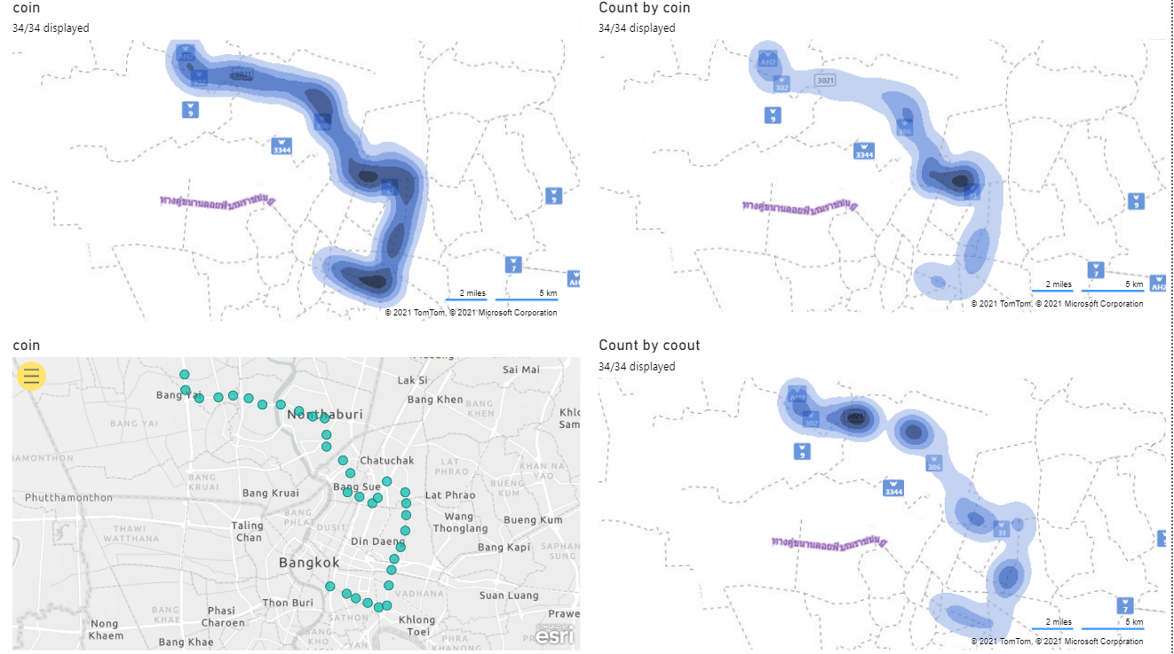

Slide 21
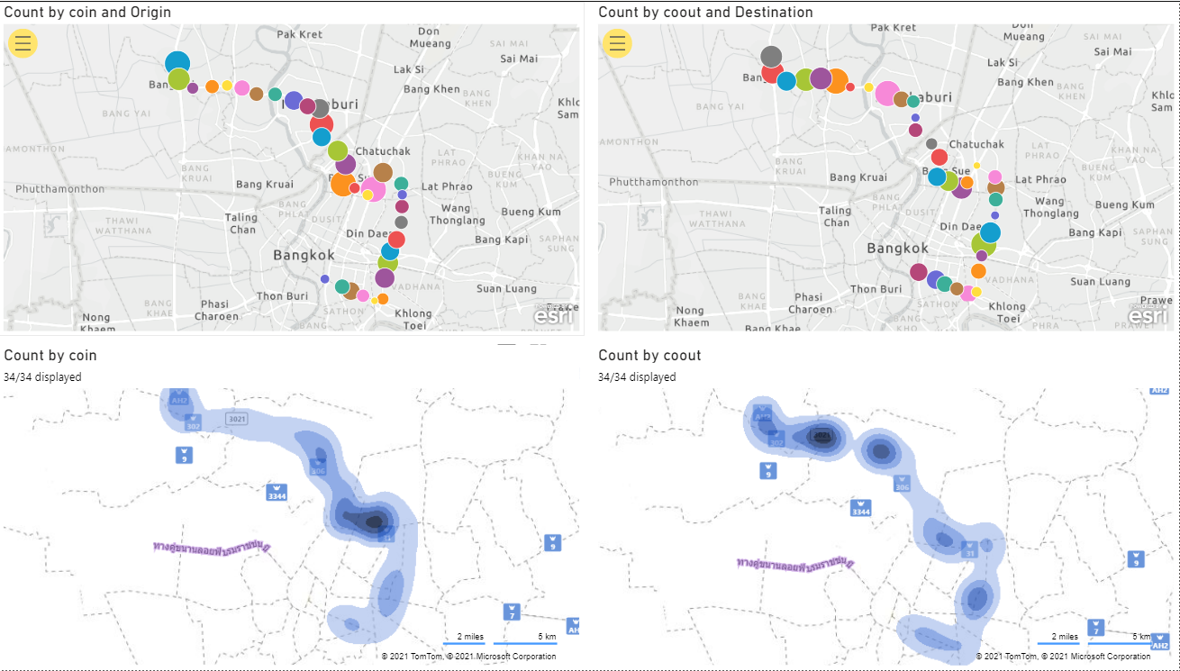

Slide 22
Conclusion
Can create automate ETL Data pipeline To use with O-D matrix.
The result from Pipeline mostly accurate to predefined schema.
To create Pipeline, need to have knowledge in field of Data Science.
It is an adaptation of multiple knowledges to create pipeline.

Slide 23
Problems
Tool to use (Talend) is not familiar.
The knowledge about tools Is hard to find.
Spend too much time to learn to create pipeline with Talend components.
Raw data is in form that needs owner of it to explain at first.
Lack of knowledge about java to work on Talend which is Eclipse base tool.
1 feature To transform date of week still not work.

Slide 24
Future Plan
Fix Date of Week generate.
Add data quality component.
Develop to reduce estimation time.
Make a manual of the Pipeline
Notes:
Data quality accuracy,consistency of diff data set,duplicate percentage
test

