Slide 1
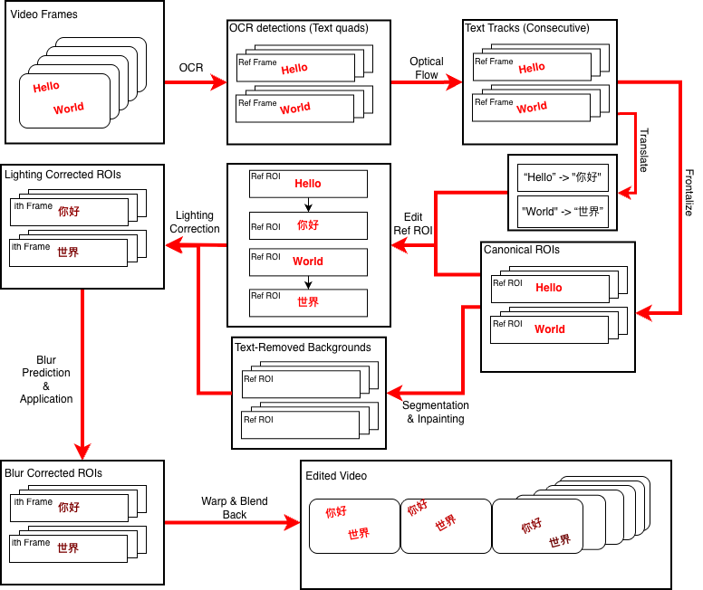

x
Project Title: An Exciting Project with Even More Exciting Results
Add your logos here
+ remove this box
Optional QR Code
+ remove this box
Author Author, Author Author, Author Author, Author Author, and Author Author
[Footer: links, additional logos...
QR codes etc., remove box if not needed]
MASTER'S IN PROFESSIONAL COMPUTER SCIENCE

Slide 2
x
Project Title: An Exciting Project with Even More Exciting Results
Add your logos here
+ remove this box
Optional QR Code
+ remove this box
Author Author, Author Author, Author Author, Author Author, and Author Author
SECTION TITLE
SECTION TITLE
Some text and visuals here …
Some text and visuals here …
SECTION TITLE
SECTION TITLE
Some text and visuals here …
Some text and visuals here …
[Footer: links, additional logos...
QR codes etc., remove box if not needed]
MASTER'S IN PROFESSIONAL COMPUTER SCIENCE

