Slide 1
Skincare Tool Guide
Justin_huang@perfectcorp.com
8/29/2022

Slide 2
3 Main steps
Install Python 3.9
Install libraries with pip3 command
Launch the code

Slide 3
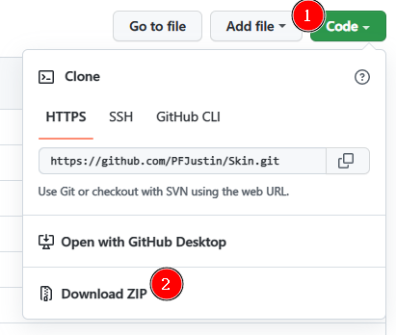
Step 1: Install Python
Go to https://github.com/PFJustin/Skin
Click on “Code” – “Download ZIP”

Slide 4
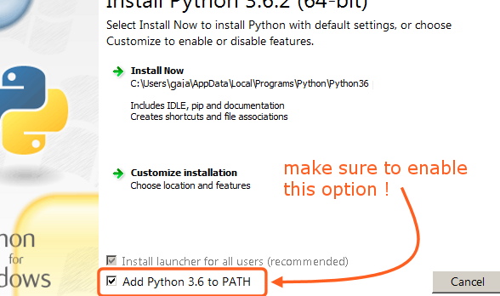
Windows Install
Unzip Python.zip from Pre_Install folder
Install Python.exe
Make sure to tick both boxes

Slide 5
Mac Install
Download .pkg install file from below url:
Install downloaded file
https://www.python.org/downloads/release/python-3913/

Slide 6

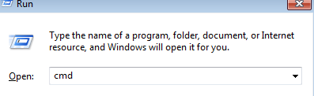
Step 2 – Install lib (Win)
1: Open terminal
2: type ‘cmd’ and hit enter key
3: Type code(next page) one by one. After you see ‘Successfully…’ Then you can input the others.

Slide 7

Input below – pip3 install …
pip3 install PyQt5
pip3 install requests
pip3 install jsbeautifier
pip3 install python-qnotifications
Example:

Slide 8
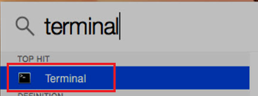
Step 2 – Install lib (Mac)
Open ‘Terminal’
Type code(next page) one by one. After you see ‘Successfully…’ Then you can input the others.

Slide 9
Input below – pip3 install…
pip3 install PyQt5
pip3 install requests
pip3 install jsbeautifier
pip3 install python-qnotifications

Slide 10
Step 3 - Launch (Windows)
Method 1 (Faster)
Double click on ‘mian.py’
Method 2 (Recommend)
See next page

Slide 11
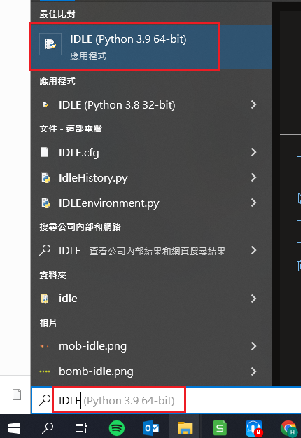
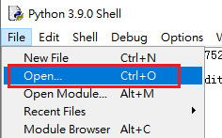

Method 2 - Running with debug window
1:
Search and start up ‘IDLE’
2:
Open main.py file
3:
Click on Run Module
If app crashed for unknown reason, please provide the log from IDLE Shell.

Slide 12
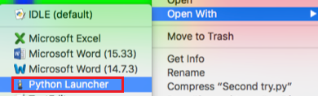
Step 3 - Launch (Mac)
Method 1 (Faster)
Right click on main.py, click on Open With
Select Python Launcher
Method 2 (Recommend)
See next page

Slide 13

Method 2 - Running with debug window
Double click main.py. By default should opens up with IDLE
Follow the step 2 from page 10
If you have other IDE installed, such as Xcode. Do the following:
Right click on main.py
Select Open With – IDLE
Follow the step 2 from page 10
If app crashed for unknown reason, please provide the log from IDLE Shell.

