Slide 1
Towards AI-Complete Question Answering : A Set of Prerequisite Toy Tasks
2022.09.08
Hyun Seop Yoon
Thesis Seminar

Slide 2
Overview
What is BabI task?
introduced in 2014 / presented in ICLR 2015
Argue for the usefulness of a set of proxy tasks that evaluate reading comprehension via question answering.
Aim to classify the tasks into skill sets, so that researchers can identify, rectify the failing of their systems.
(no task-specific engineering). Because the task are built to make a standard, also milestone for building AI model that understands human language.
Performing well on all of them is a pre-requisite for any system aiming at understanding language and able to reason

Slide 3
Limitation in AI understanding
Model with high capacity and representation power(CNNs,RNNs,LSTMs) and lots of data(supervised, semi-supervised, unsupervised) have resulted many breakthrough
However the model and learning algorithms rely heavily on big data statistics, especially labeled data.
⇒ Reasoning is still limited, especially in Q&A systems
Embedding-based model of (Bordes et al. EMNLP14)
Q: What country was Slovakia?
A:austria, A:czech_republic
A: czechoslovakia

Slide 4
Approchments of synthetic data
Though simple models and a lot of data trump more elaborate models based on less data(Halevy et al., 2009), but are far from being a model that truly understands text.(Yao et al., 2014), Berant et al. (2014)
AI reasearch become stuck in local minima problem, which means the model is not heading to the ultimate goal of AI Model
The synthetic task covers the ultimate goal: Evaluating performance of an agent in general dialogue, while dissolving into relatively simple tasks in AI field, called question answering(QA)
Since The QA covers wide range of cognitive capability, enabling researcher to test different ability of learning algorithms, under a common framework

Slide 5
Success in Artificial Problem
Machine Learning
Clustering(Two moons and friends)
XOR(Neural Network) Minsky & Papert, 1969; Rumelhart et al., 1985)
Regression, Classification(# in UCI) (Bache & Lichman, 2013)
Artificial Intelligence
SHRLDU(Block world)(Terry Winogran, 1971)
- Basic Nuance(pre, post relationship among words)
- Combination of location, direction

Slide 6
Artificial task for learning for AI : QA
It is crucial to build learning algorithm and training condition at the same speed
QA-based strategies
Difficulty of definition of questions
Unambiguously answerable by adult human(or children)
Still require some thinking
⇒ No system has yet been clearly identified capabilities and limitation
⇒ No proposal of improvement and modifications
New learning algorithms = Creations of new training conditions are mandatory

Slide 7
Drawback of Artificial Data and Looking forward
Artificial data can have a probability of overfitting, since the task does not fully apply the real world.
So to eventually scale up to real language
No model should be tailored for a task alone, nor for the tasks only.
⇒ The task is a sample guideline, which upgraded version should keep this in mind
Models should be able to learn new things incrementally and faster
The simulation should be parameterized to ramp up complexity, create more tasks.

Slide 8
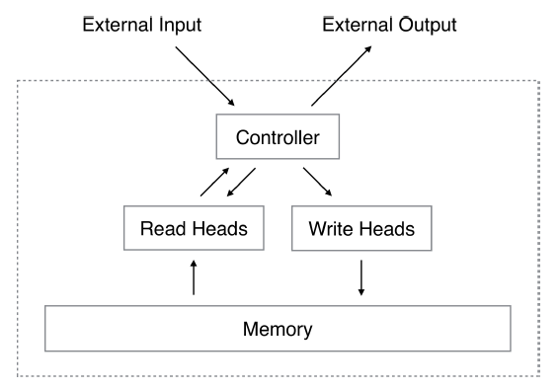
Recent approach and Follow-up ideas
Shapeset
Following steps → Improved to answer Questions
Sequences
Basic tasks(Copying, Sorting, Associative recall, Dynamic n-grams)
Neural Turing Machine(Grave et al. 14)
→ Neural Network using explicit memory, compared to implicit memory in LSTM, RNN
2. Stack-augmented RNNs, Weston et al. (2014)
→ Stacked RNNs which enable to cope with long sequential data.

Slide 9
Ability - Tasks
The goal is to categorize different kinds of questions into skills sets, which become tasks.
While the analysis of performance: failure or success of a system on any of them can unequivocally provide feedback on its capabilities.
Motivate new algorithm design that alleviate the weaknesses
One task - One Ability each

Slide 10
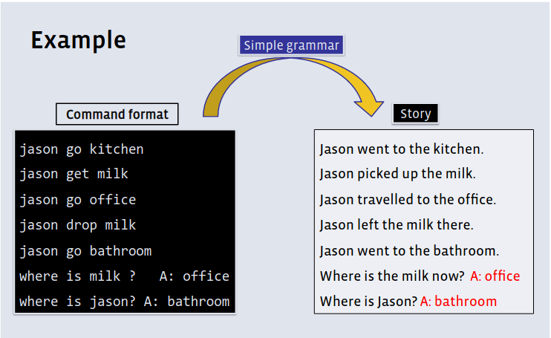
Ability - Tasks
Monitoring cognitive capability can be assumed by using command-answer system so called “Text-Adventure-Games”
The system enables to create a learning environments about cognitive competence, which are closely-related to the meaning of ‘learning from scratch’
The system creates a simulated world, like text-adventure games. each sentences are produced with a simple grammer. The advantages of following
Difficulty/Complexity is controlled
Training and Evaluation data are provided
Evaluation through question answering is easy to overlook the process
http://www.thespermwhale.com/jaseweston/babi/abordes-ICLR.pdf

Slide 11
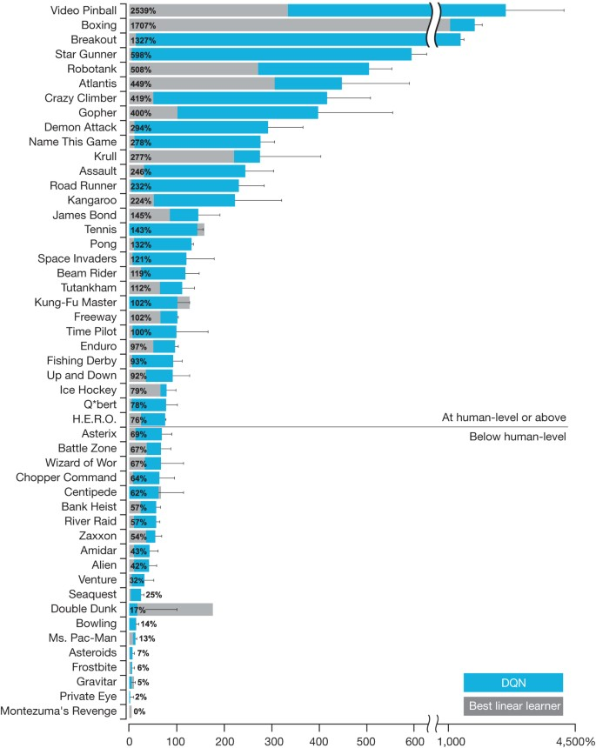
Why game?
Old games offer a great variety of controlled environments
https://www.cs.toronto.edu/~vmnih/docs/dqn.pdf

Slide 12
Tasks
Single supporting Facts
- The task is to find out the single supporting fact in order to provide the answer.
- Answer was previously given, and the size of fact cannot be bigger than two.
- Typical question type is to find out the location of Agent
John travelled to the office.
Daniel travelled to the office.
Where is Daniel? office
Two Supporting Facts
John is in the playground.
John picked up the football.
Bob went to the kitchen.
Where is the football? playground
- This is slightly harder task of single supporting facts.
- Two supporting facts have to be chained in order to answer the question
Three Supporting Facts
John picked up the apple.
John went to the office.
John went to the kitchen.
John dropped the apple.
Where was the apple before the kitchen? office
- Finding three supporting detail is mandatory for model to derive answer.

Slide 13
Tasks
Two Argument Relations: Subject vs Object
The office is north of the bedroom.
The bedroom is north of the bathroom.
The kitchen is west of the garden.
What is north of the bedroom? office
What is the bedroom north of? bathroom
- Solving problem about differentiating and recognize subject and object
- Linguistically have problem among this.
- Seems like this is a counter-example of bag-or words
- Not a semantic approach of directional analysis
→ Relational expression are not 100% S-O structure. Able to catch Idiom about direction?
John moved to the playground.
Daniel went to the bathroom.
John went back to the hallway.
Is John in the playground? no
Is Daniel in the bathroom? yes
Yes/No Questions
- Simplest case, examining whether the model can revise answer about True, False question.
Counting
- Evaluating ability of simple counting: Number of certain property
Daniel picked up the football.
Daniel dropped the football.
Daniel got the milk.
Daniel took the apple.
How many objects is Daniel holding? two

Slide 14
Tasks
Positional Reasoning
Quite similar task compare to T4, but more focused on predicate itself
(e.g. A be to the right of the B)
The triangle is to the right of the blue square.
The red square is on top of the blue square.
The red sphere is to the right of the blue square.
Is the red sphere to the right of the blue square? yes
Is the red square to the left of the triangle? yes
Reasoning about Size
The trophy doesn’t fit in the brown suitcase because
it’s too big.
What is too big?
the trophy
the suitcase
- This task is inspired by Winograd schema(Levesque AAAI11)
- T3 and T6 are prerequisites.
- Task about reasoning about Relative Size
cf. Winograd Schema Challenge
Alternative to the Turing Test
Pair of sentences that differ only in one or two words and that contain a referential ambiguity
The ambiguity can be resolved in opposite directions in two sentences
The answer is obvious to the human reader, but cannot easily be founded using selectional restrictions or statistical technique.

Slide 15
Tasks
Path finding
- This task gives location of each object, and required to find the path between locations: give directions sequences.
- Have to find way that is the most effective, since the task requires search
The kitchen is north of the hallway.
The bathroom is west of the bedroom.
The den is east of the hallway.
The office is south of the bedroom.
How do you go from den to kitchen? west, north
How do you go from office to bathroom? north, west

Slide 16
Simulation
Simulated world is composed of entities of various types(locations, object, persons, etc)
Simple automated grammer(Verb synonym)
150 words, 4 actors, 6 locations, and 3 objects per task
Entities have internal states: location, mental state of actors, properties
Location
: Have to correspond with nearby surroundings
Actors
: Pre-specified rules based on common sense control their behaviour
: Actions enforce coherence in the simulation
Random Valid Actions
: Each task has limitation of actions

Slide 17
Simulation control panel
Symbols
Can the system switch to the other language?
And other simpler symbolic systems?
(added) Any better symbolic system that has function of symbol system? (e.g sudo code)
⇒ Used other language, shuffled English letters
Memory
How far should one remember?
Is an external source of knowledge necessary?(Memory Network)
⇒ Added irrelevant facts, which assess maximum of memory, but exact number of data is not shown.
⇒ Able to use external resources(common sense) in order to solve the task

Slide 18
Results
Linguistics
How is reasoning altered by ambiguities?
(added) How can model distinguish differences between ambiguities? (Semantic, Syntactic, Lexial, Anaphoric,Ellipsis)
Phase Embedding
⇒ T20 examines the most simple(sometimes cannot get credit from linguists) type of anaphoric task, but still cannot cover whole concept of coreference, which need to adapt a real coreference dataset.
⇒ T13 seems to cover the coreference when the pronoun can refer to multiple actors, but this task checks same linguistic ability compared with T20. Seems to analyze more about how NLP model cope with linguistic concept.
⇒ T14 mentions that the task examine understanding of time expression, but the concept ‘time’ should be more precise. The total concept should be an ‘aspect’ and special time period should check under time schema, especially boundedness, durational/punctual, telic/atelic,, and so on

Slide 19
Results
Reasoning
How many facts should be chained together?
T8 is related to a QA task related to database search, which can be considered as a ability to make a query
e.g
- Intersection: Who is in the park carrying food
- Union: Who has milk or cookies
- Set difference: Who is in the park apart from Bill?

Slide 20
Dataset
format
example: Task 13: Compound Coreference
1 Sandra travelled to the kitchen. 2 Sandra travelled to the hallway. 3 Mary went to the bathroom. 4 Sandra moved to the garden. 5 Where is Sandra? Garden 4
ID text
ID text
ID text
ID question[tab]answer[tab]supporting_fact ID.
...
1 Sandra travelled to the kitchen.
2 Sandra travelled to the hallway.
3 Mary went to the bathroom.
4 Sandra moved to the garden.
5 Where is Sandra? Garden 4
ID : Number of the sentence
text: Storyline text
supporting_fact ID: ID that the answer clue be located
Sentence 1 to 4 are storyline texts, while sentence 5 is the question, answer, supporting_fact ID.
The correct answer of question is located between two [tab],\t .
The researcher can infer the clue of the question, by peeking supporting_fact_ID.
The storyline text be usually made up with 15~20 sentences, often inserted with questions.
Noticable fact is that the question answer clue does not locate right before the question, but the whole storyline.
Question answering machine has to consider whole text in order to make a right answer.
https://www.kaggle.com/datasets/roblexnana/the-babi-tasks-for-nlp-qa-system

Slide 21
Dataset
format
example: Task 13: Compound Coreference
1 Sandra travelled to the kitchen. 2 Sandra travelled to the hallway. 3 Mary went to the bathroom. 4 Sandra moved to the garden. 5 Where is Sandra? Garden 4
ID text
ID text
ID text
ID question[tab]answer[tab]supporting_fact ID.
...
1 Sandra travelled to the kitchen.
2 Sandra travelled to the hallway.
3 Mary went to the bathroom.
4 Sandra moved to the garden.
5 Where is Sandra? Garden 4
ID : Number of the sentence
text: Storyline text
supporting_fact ID: ID that the answer clue be located
Sentence 1 to 4 are storyline texts, while sentence 5 is the question, answer, supporting_fact ID.
The correct answer of question is located between two [tab],\t .
The researcher can infer the clue of the question, by peeking supporting_fact_ID.
The storyline text be usually made up with 15~20 sentences, often inserted with questions.
Noticable fact is that the question answer clue does not locate right before the question, but the whole storyline.
Question answering machine has to consider whole text in order to make a right answer.
Code
https://github.com/BSPL-KU/bspl-ku.github.io/blob/d6f7ae43aa8d8ca7060f0126b0adaec75e7feb34/bAbi_preprocessing.ipynb
https://github.com/BSPL-KU/bspl-ku.github.io/blob/d6f7ae43aa8d8ca7060f0126b0adaec75e7feb34/bAbi_preprocessing.ipynb
https://www.kaggle.com/datasets/roblexnana/the-babi-tasks-for-nlp-qa-system

Slide 22
Experiment
Comparing methods via task solving
N-gram classifier (weak)
LSTMs (weak)
MenNN (strong)
extensions of MN(AM,NG,NONLINEAR) (strong)
structured SVM (external resources)
Weakly supervised models → given question answer pairs at training time
Strongly supervised models → give a set of supporting facts
Methods in the last external resources track can use labeled data from other sources

Slide 23
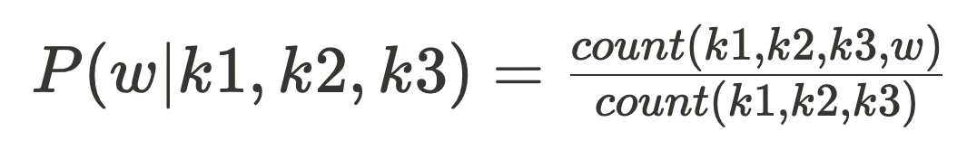
Methods
N-gram classfier (Richardson et al. (2013)
SLM, if the sentence is k1,k2,k3 and the word to predict is w,MenNN (strong)
Bag-of-N-grams for all sentences in the story that share at least one word with the question
Learn a linear classifier to predict the answer
MenNN
Controller NN performs inference over stored previous statements
I: (input feature map) – convert input sentence x to an internal feature representation I(x).*
G: (generalization) – update the current memory state m given the new input: mi = G(mi,I(x),m), ∀i.
O: (output feature map) – compute output o given the new input and the memory: o =O(I (x), m).
R: (response) – finally, decode output features o to give the final textual response to the user: r = R(o).

Slide 24
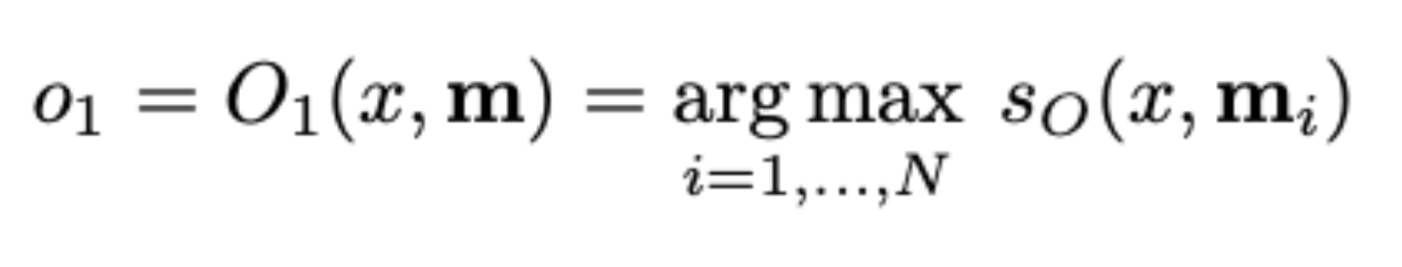
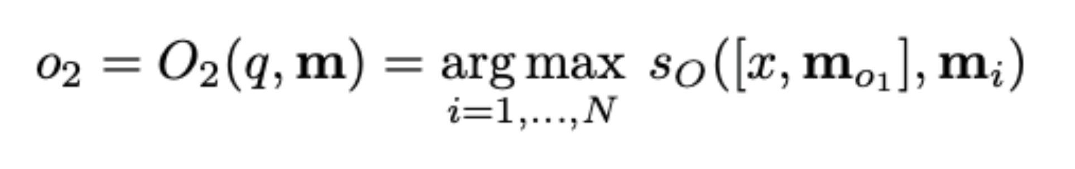
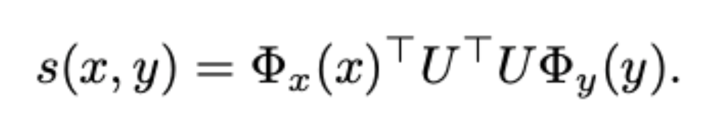
Methods
MenNN
finding the first supporting fact with match score with the question
find the second supporting fact with both question and first fact
Matching function consists of → Mapping the bag-of words for the question and fact into embedding by summing word embedding

Slide 25
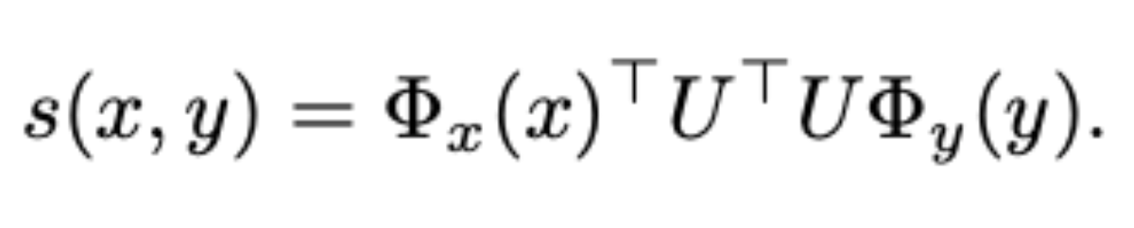
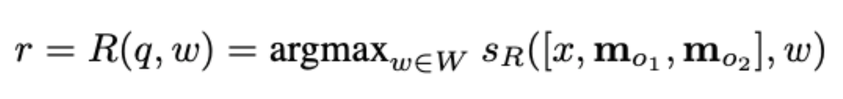
Methods
MenNN
U = n * D matrix where D is the number of features and n is the embedding dimension
PHI function map the original text to D-dimensional feature space
Response function consider RNNs, setup limit response to be a single word by ranking them.
Response function consider RNNs, setup limit response to be a single word by ranking them.

Slide 26
Methods
Adaptive memories
Infer more than 2, model predict inference or “stop” class(scoring a special fact m0)
i=1
oi =O(x,m)
while oi ̸= m∅ do
i←i+1
oi = O([x,mo1,...,moi−1],m)
end while
N-grams
Bag of 3-grams

Slide 27
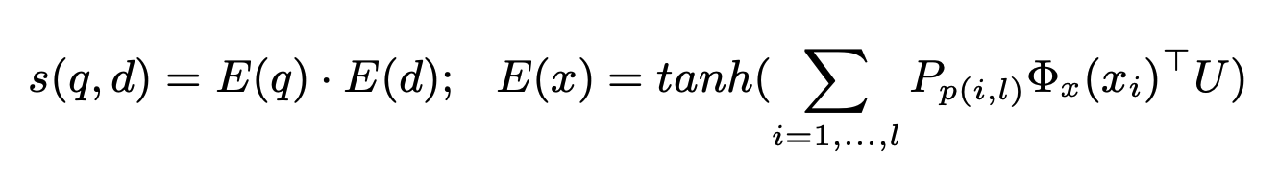
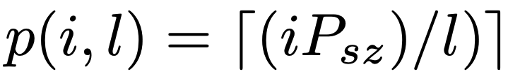
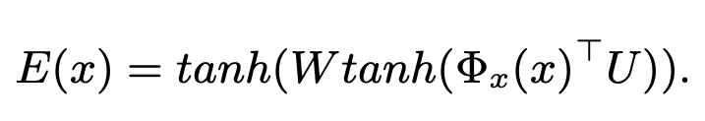
Methods
Nonlinearity
NN approach called multilinear map in order to solve problem of data size while using N-grams
2 layer of NN with tanh nonlinearity
i is the position of the word in a sentence of length l, and for each position employ a n*n matrix P_p(i,l)
Nonlinear embedding, in order to assess the performance of nonlinear map that fail modelling
W is a n × n matrix.

Slide 28
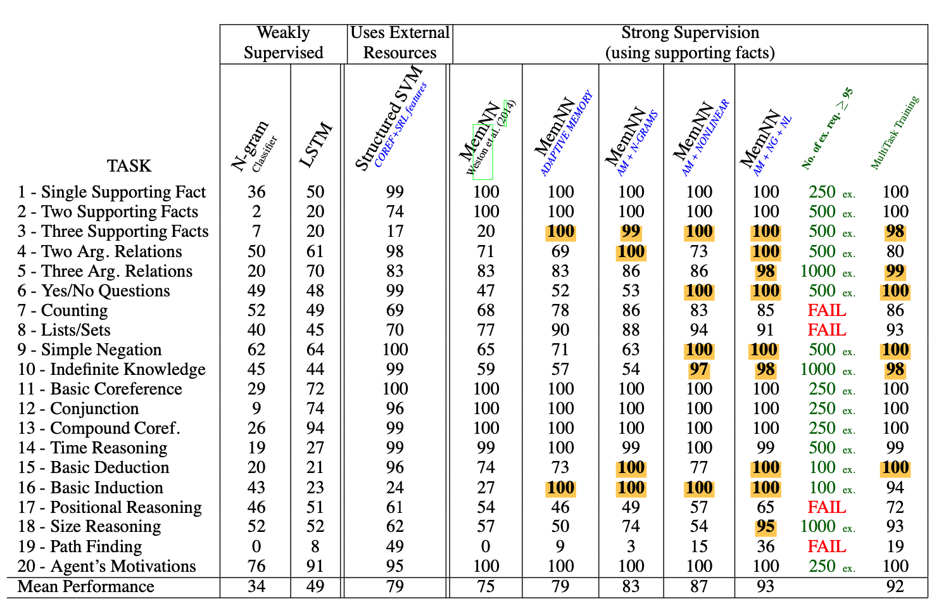
Dashboard
Each task 1000 questions for training and testing each, 95% above accuracy score is considered as “PASS”
Highlighted numbers indicate tasks where extension of MenNN pass while origininal MemNN don’t
Green colour indicate amount of training data for each task to pass, FAIL means need more than 1000
Multitask Training column gives accuracy of training all data at once

Slide 29
Result
Standard MemNN outperforms N-gram and LSTM, but still fail at some tasks(because of insufficient modeling power)
AM outperforms in T3, T16, T8, T19 → use AM in combination with subsequent model
N-gram and SVM itself does not show any noticeable result(external resource does not stand out its effect)
AM + NG + NL MemNN shows desirable to perform well on task, while using fewist number of examples, but still lack general search algorithms

Slide 30
Discussion
Prerequisite set
If any learner fails on these tasks, they will fail on real-world tasks too.
→ Is it still necessary condition?
Flexible framework
Simulation-based approach provide flexibility to detect and combine patterns in symbolic sequences(by removing lexical variability and so on)
Testing learning methods
The tasks are not a substitue for real data but a complement which are designed as a test-bed for learning methods

Slide 31
Impact
Has influence on development of MemN2N, Dynamic Memory Network, Neural Reasoner

