Slide 1
UCB - CS189 Introduction to Machine Learning Fall 2015 Lecture 4: Learning as Risk Minimization
Isabelle Guyon
ChaLearn

Slide 2
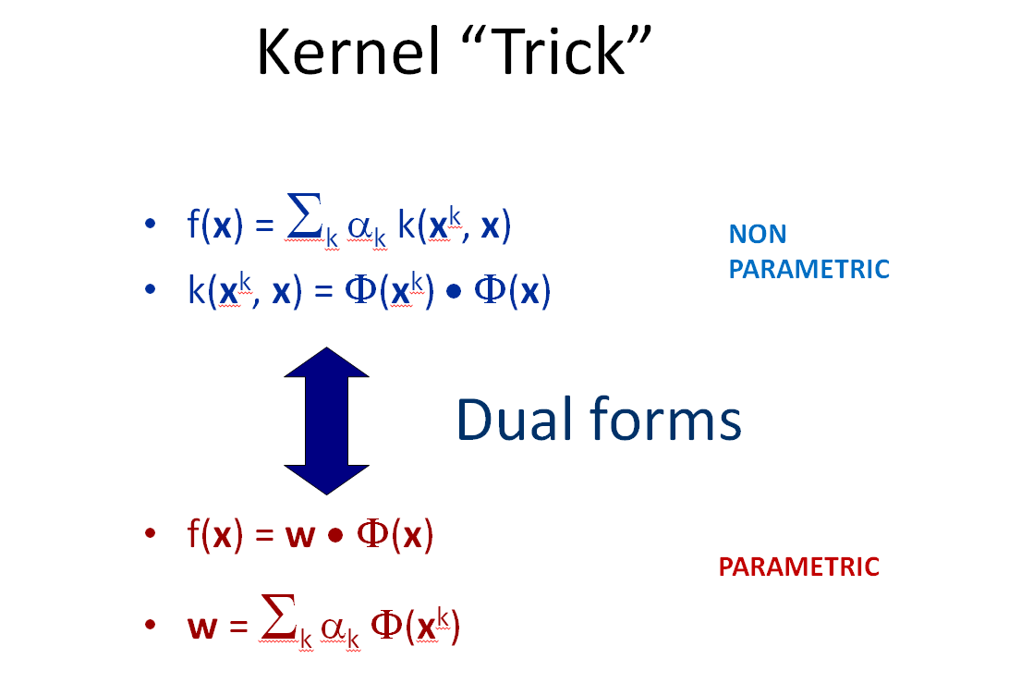
Come to my office hours… Wed 2:30-4:30 Soda 329
Last time

Slide 3
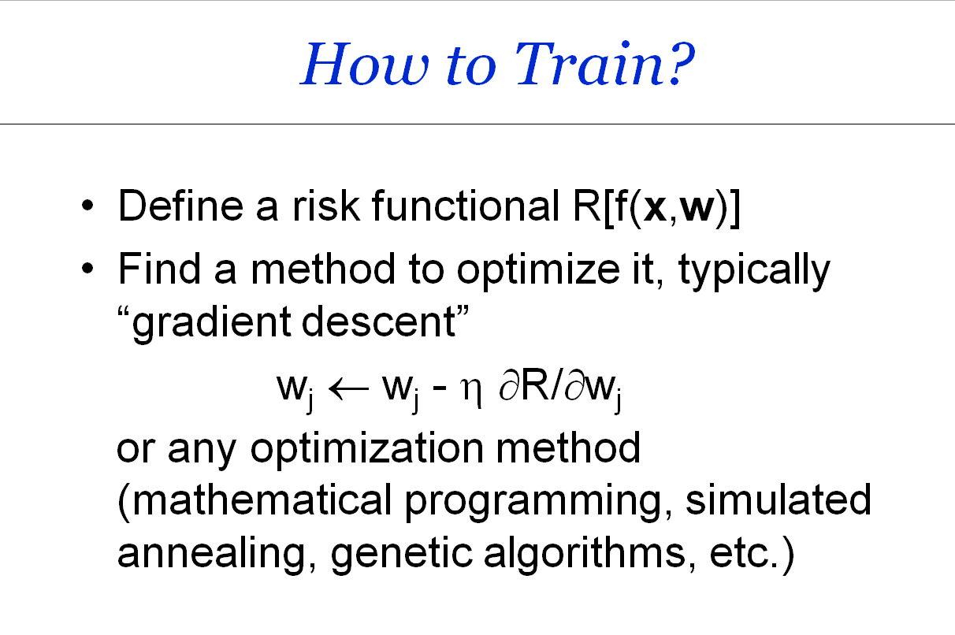
Come to my office hours… Wed 2:30-4:30 Soda 329
Today

Slide 4
Machine Learning (reminder)
Learning machines include:
Linear discriminant
Kernel methods
Neural networks
Learning is tuning:
Parameters (weights w or α, threshold b)
Hyperparameters (basis functions, kernels, number of units)

Slide 5
Conventions
d
X={x^{k}_{i}}
y ={y^{k}}
x^{k}
N
α
w

Slide 6
Math prerequisites
Derivative and variation
Slope and derivative
Derivative chain rule
Gradient
Taylor series
Hessian

Slide 7
What is a Risk Functional?
A function of the parameters w of your learning machine f(x, w), assessing how much it is expected to fail on a given task.
R[f(x,w)]
Parameter space (w)
w*

Slide 8
Examples of risk functionals
Also called “objective functions” or “cost functions”
Classification:
Error rate: (1/N) Σ_{k=1:N} 1( sgn(f(x^{k})) ≠ y^{k} )
Regression:
Mean square error: (1/N) Σ_{k=1:N} ( f(x^{k}) - y^{k} )²
0/1 loss
square loss

Slide 9
Examples of risk functionals
Also called “objective functions” or “cost functions”
Classification:
Error rate: (1/N) Σ_{k=1:N} 1( sgn(f(x^{k})) ≠ y^{k} )
Regression:
Mean square error: (1/N) Σ_{k=1:N} ( f(x^{k}) - y^{k} )²
0/1 loss
square loss

Slide 10
How to Train?
Define a risk functional R[f(x,w)]
Find a method to optimize it, typically “gradient descent”
w_{i} ← w_{i} - η ∂R/∂w_{i}
w ← w - η ∇_{w}R ∇_{w}R =[∂R/∂w_{i}]
or any optimization method (mathematical programming, simulated annealing, genetic algorithms, etc.)

Slide 11
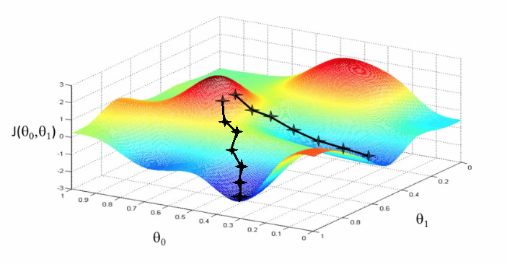
Gradient descent falls into local minima…
R[w1, w2]
w2
w1
is the learning rate of gradient step.

Slide 12
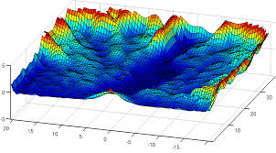
… finding the global optimum can be hard …
R[w1, w2]
w2
w1

Slide 13
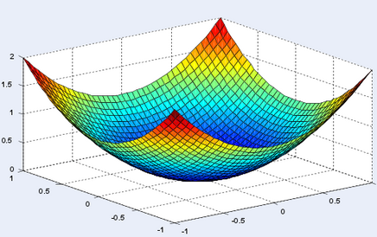
… except if the risk functional is convex!
R[w1, w2]
w1
w2

Slide 14
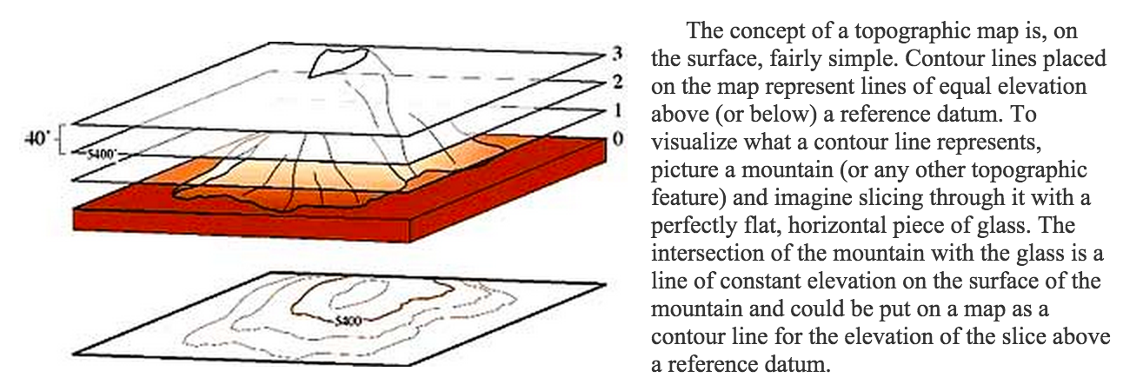
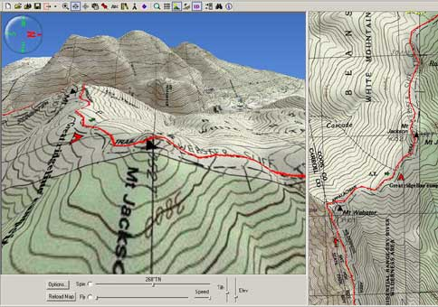
Contour maps
http://geology.isu.edu/geostac/Field_Exercise/topomaps/topo_map.htm
http://www.nationalgeographic.com/adventure/images/02_06/Appalachian_TOPO_5.jpg

Slide 15
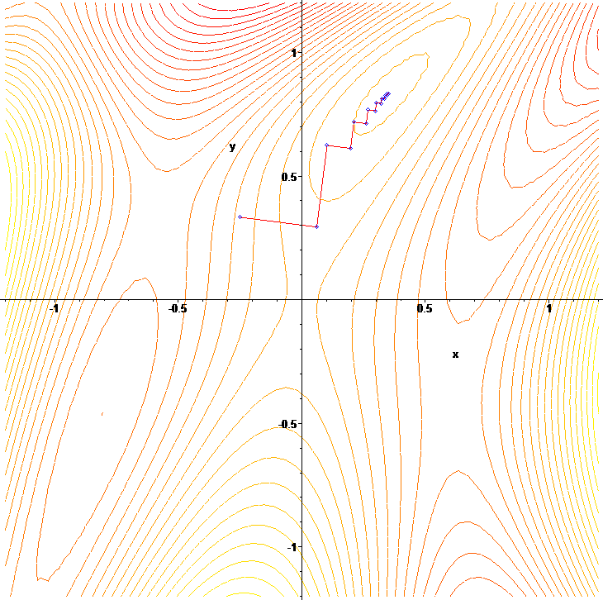
Learning rate η
w2
w ← w - η ∇_{w}R
η too small: many steps needed to converge.
η too large: zigzags.
η optimal to second order:
w ← w - H⁻¹ ∇_{w}R
Newton’s method
H = [∂²R/∂w_{i}∂w_{j} ]
Hessian
Contours
R[w1, w2]=cte
w1
Picture from Wikipedia

Slide 16
The gradient is a linear operator
R[w] = (1/N) Σ_{k=1:N} L( f(x^{k}, w), y^{k} )
True gradient:
w_{i} ← w_{i} - η ∂R/∂w_{i}
w ← w - η ∇_{w}R ∇_{w}R =[∂R/∂w_{i}]
Stochastic gradient:
w_{i} ← w_{i} - η ∂L/∂w_{i}
w ← w - η ∇_{w}L ∇_{w}L =[∂L/∂w_{i}]
∇_{w} R[w] = (1/N) Σ_{k=1:N} ∇_{w} L( f(x^{k}, w), y^{k} )

Slide 17
The gradient is a linear operator
R[w] = (1/N) Σ_{k=1:N} L( f(x^{k}, w), y^{k} )
True (total) gradient:
w_{i} ← w_{i} - η ∂R/∂w_{i}
w ← w - η ∇_{w}R ∇_{w}R =[∂R/∂w_{i}]
Stochastic gradient:
w_{i} ← w_{i} - η ∂L/∂w_{i}
w ← w - η ∇_{w}L ∇_{w}L =[∂L/∂w_{i}]
∇_{w} R[w] = (1/N) Σ_{k=1:N} ∇_{w} L( f(x^{k}, w), y^{k} )
The total gradient is the average over the gradients of single samples, but…

Slide 18
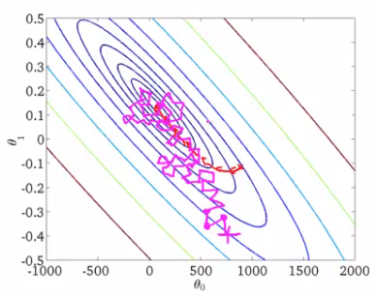
Stochastic gradient: one example at a time
w ← w - η ∇_{w}L
The average of stochastic steps is different from the true gradient if we recompute the gradient after every mini step.
Contours
R[w1, w2]=cte
w2
w1
Picture from holehouse.org
Possible recipe (Bottou, 2010):
Shuffle examples randomly
Fix the learning rate (~t^{-a} 0.5≤a≤1; Xu, 2010, Bach, 2015; experiment on data subset)
Average of w(t) to smooth the result (Polyak, Juditsky, 1992)
One pass only for “big data”

Slide 19
The risk is the sum of “losses”
R[f] = (1/N) Σ_{k=1:N} L( f(x^{k}), y^{k} )
L( f(x), y ) = 1(sgn(f(x))≠y) = 1( yf(x)<0 ) zero-one loss
L( f(x), y ) = ( f(x) - y )² = ( yf(x) - 1 )² square loss
with y=±1
Losses are conveniently expressed as a function of the “functional margin” z = y f(x)
L( f(x), y ) = 1( z<0 ) zero-one loss
L( f(x), y ) = ( z - 1)² square loss

Slide 20
The risk is the sum of “losses”
R[f] = (1/N) Σ_{k=1:N} L( f(x^{k}), y^{k} )
L( f(x), y ) = 1(sgn(f(x))≠y) = 1( yf(x)<0 ) zero-one loss
L( f(x), y ) = ( f(x) - y )² = ( yf(x) - 1 )² square loss
with y=±1
Losses are conveniently expressed as a function of the “functional margin” z = y f(x)
L( f(x), y ) = 1( z<0 ) zero-one loss
L( f(x), y ) = ( z - 1)² square loss

Slide 21
The risk is the sum of “losses”
R[f] = (1/N) Σ_{k=1:N} L( f(x^{k}), y^{k} )
L( f(x), y ) = 1(sgn(f(x))≠y) = 1( yf(x)<0 ) zero-one loss
L( f(x), y ) = ( f(x) - y )² = ( yf(x) - 1 )² square loss
with y=±1
Losses are conveniently expressed as a function of the “funtional margin” z = y f(x)
L( f(x), y ) = 1( z<0 ) zero-one loss
L( f(x), y ) = ( z - 1 )² square loss

Slide 22
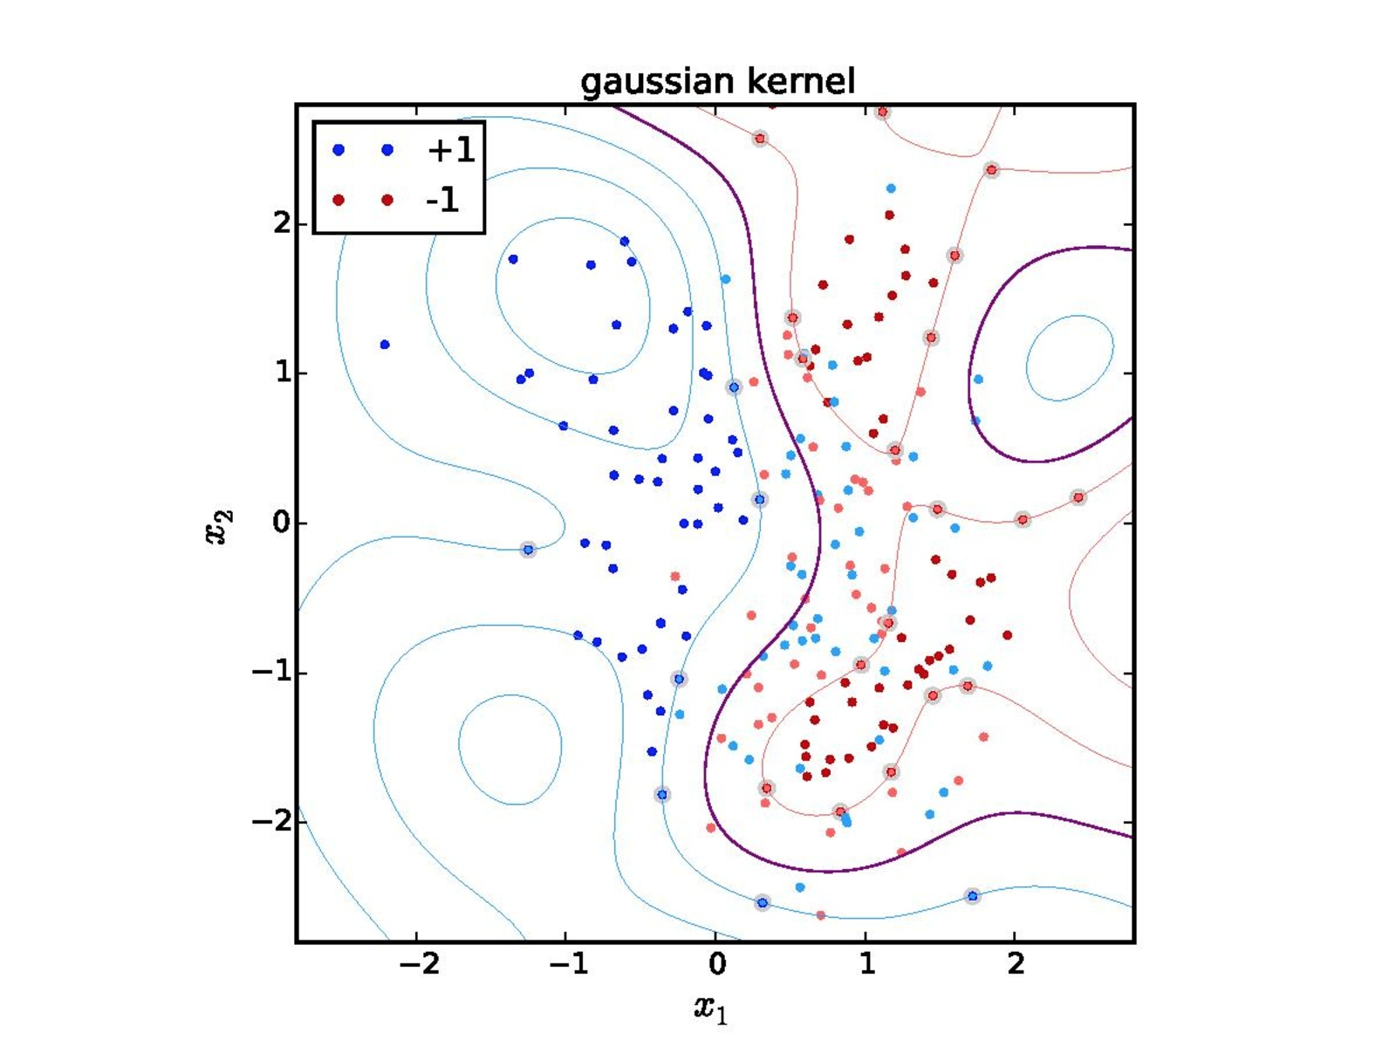
“Functional margin” z = y f(x)
Contours of f(x) in x space.
f(x) = 2
f(x) = 1
f(x) = -3
f(x) = 0
f(x) = -1
f(x) = -2
Picture from Wikipedia

Slide 23
Loss Functions
The risk is the average of the loss.
L(f(x), y)
Decision boundary
Margin
Adaboost loss e^{-z}
logistic loss log(1+e^{-z})
square loss (1- z)²
Hinge loss max(0, 1-z)
Perceptron loss max(0, -z)
0/1 loss
z=y f(x)
missclassified
well classified
Notes:
The loss measures the discrepancy between the target value y and the value f(x) estimated by the model. It is connected to the “noise model”.

Slide 24
Dual learning machines
PARAMETRIC
NON PARAMETRIC
f(x) = Σ α_{k} k(x^{k}, x)
k(x^{k}, x) = Φ(x^{k}).Φ(x)
Dual Hebb’s rule
α_{k} ← α_{k} + y_{k}
Potential Function algorithm
α_{k} ← α_{k} + y_{k} if y_{k}f(x^{k})<0
(Aizerman et al 1964)
Dual minover
α_{k} ← α_{k}+ y^{k} for min y_{k}f(x^{k})
f(x) = w • Φ(x)
Hebb’s rule
w ← w + y_{k} Φ(x^{k})
(Hebb 1949)
Perceptron algorithm
w ← w + y_{k} Φ(x^{k}) if y_{k}f(x^{k})<0
(Rosenblatt 1958)
Minover (optimum margin)
w ← w + y_{k} Φ(x^{k}) for min y^{k}f(x^{k})
(Krauth-Mézard 1987)
w = Σ α_{k} Φ(x^{k})
k
k
(ancestor of SVM)

Slide 25
Dual learning machines
PARAMETRIC
NON PARAMETRIC
f(x) = Σ α_{k} k(x^{k}, x)
k(x^{k}, x) = Φ(x^{k}).Φ(x)
Potential Function algorithm
α_{k} ← α_{k} + y_{k} if y_{k}f(x^{k})<0
(Aizerman et al 1964)
Dual minover
α_{k} ← α_{k}+ y^{k} for min y_{k}f(x^{k})
Dual LMS
α_{i} ← α_{i} + η (y_{i} - f(x^{k}))
f(x) = w • Φ(x)
Perceptron algorithm
w ← w + y_{k} Φ(x^{k}) if y_{k}f(x^{k})<0
(Rosenblatt 1958)
Minover (optimum margin)
w ← w + y_{k} Φ(x^{k}) for min y^{k}f(x^{k})
(Krauth-Mézard 1987)
LMS regression
w ← w + η (y_{k}- f(x_{k})) Φ(x^{k})
w = Σ α_{k} Φ(x^{k})
k
k
(ancestor of SVM 1992,
similar to kernel Adatron, 1998,
and SMO, 1999)

Slide 26
Exercise: Gradient Descent
Linear discriminant f(x) = Σ_{i} w_{i} x_{i}
Functional margin z = y f(x), y=±1
Compute ∂z/∂w_{i}
Derive the learning rules Δw_{i}=-η ∂L/∂w_{i} corresponding to the following loss functions:
SVC loss L=max(0, 1-z)
Adaboost loss L=e^{-z}
square loss L=(1- z)²
Perceptron loss L=max(0, -z)
logistic loss L=log(1+e^{-z})

Slide 27
Example: the Perceptron algorithm
Rosenblatt, 1957
f(x) = Σ_{i} w_{i} x_{i}
z = y f(x) = Σ_{i} w_{i} y x_{i}
∂z/∂w_{i} = y x_{i}
L_{perceptron} = max(0, -z)
Δw_{i} = -η ∂L/∂w_{i}
= -η ∂L/∂z . ∂z/∂w_{i}
Δw_{i} =
Like Hebb’s rule but for misclassified examples only.
L(f(x), y)
Decision boundary
Perceptron loss max(0, -z)
z=y f(x)
missclassified
0
well classified
η y x_{i}, if z<0 (misclassified example)
0 otherwise

Slide 28
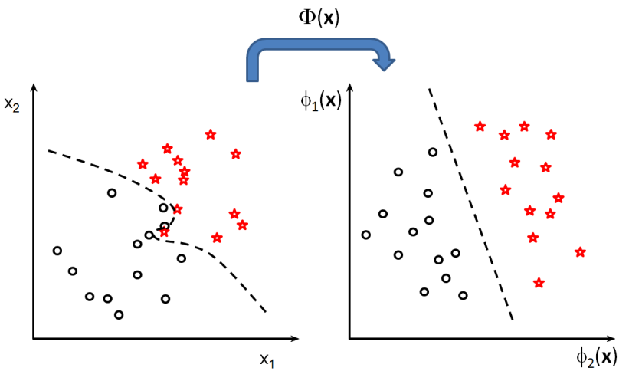
Example: the Perceptron algorithm
Rosenblatt, 1957
f(x) = Σ_{i} w_{i} Φ_{i} (x)
z = y f(x) = Σ_{i} w_{i} y Φ_{i} (x)
∂z/∂w_{i} = y Φ_{i} (x)
L_{perceptron} = max(0, -z)
Δw_{i} = -η ∂L/∂w_{i}
= -η ∂L/∂z . ∂z/∂w_{i}
Δw_{i} =
Like Hebb’s rule but for misclassified examples only.
η y Φ_{i} (x), if z<0 (misclassified example)
0 otherwise

Slide 29
Dual algorithm: Potential function learning algorithm
Perceptron: Δw_{i} = η y x_{i}, if z<0, 0 otherwise
For example x^{k}:
Δw = η y^{k} x^{k}, if z<0, 0 otherwise
w = Σ_{k} α_{k} x^{k} , Δw = Δα_{k} x^{k}
Δα_{k} = η y^{k}
Aizerman, Braverman, Rozonoer, 1964
Note: the Δα
is different when
∂L/∂α is computed directly.

Slide 30
Linearly separable?
Yes
No
x₂
x₂
x₁
x₁
Notes:
Which one is best : linear or non-linear
The decision comes when we see new data
Very often the simplest model is better
This principle is implemented in Learning Theory

Slide 31
Large margin
x₂
x₂
x₁
x₁
Notes:
Which one is best : linear or non-linear
The decision comes when we see new data
Very often the simplest model is better
This principle is implemented in Learning Theory

Slide 32
Large margin Perceptron
L_{perceptron} = max(0, -z)
L_{hinge} = max(0, 1 - z)
Δw_{i} =
w must be normalized to give the scale!
L(f(x), y)
Decision boundary
Perceptron loss max(0, -z)
Hinge loss max(0, 1-z)
1
z=y f(x)
missclassified
0
well classified
y x_{i}, if z < 1 (misclassified or within margin)
0 otherwise

Slide 33
Optimum margin
Large margin
Optimum margin
x₂
f(x) = 0
x₂
f(x) = 0
w
w
f(x) = 1
f(x) = M
f(x) = -1
f(x) = -M
x₁
x₁
ǁwǁ = 1
M_{opt} = argmax_{w} (min_{k}(y^{k}f(x^{k}))
Notes:
Which one is best : linear or non-linear
The decision comes when we see new data
Very often the simplest model is better
This principle is implemented in Learning Theory

Slide 34
Optimum margin Perceptron
(Minover, Krauth-Mézard 1987)
L_{perceptron} = max(0, -z)
L_{hinge} = max(0, 1 - z)
Δw_{i} z=y f(x)
w must be normalized to give the scale!
L(f(x), y)
Decision boundary
Perceptron loss max(0, -z)
Hinge loss max(0, 1-z)
1
z=y f(x)
missclassified
0
well classified
y x_{i}, only for min(z)
0 otherwise

Slide 35
Optimum margin Perceptron
(Minover, Krauth-Mézard 1987)
L_{perceptron} = max(0, -z)
L_{svc} = max(0, 1 - z)
Δw_{i} = Δα_{k} =
w must be normalized to give the scale!
L(f(x), y)
Decision boundary
Perceptron loss max(0, -z)
SVC loss max(0, 1-z)
1
z=y f(x)
missclassified
0
well classified
y x_{i}, for min(z) η y^{k}, for min(z)
0 otherwise 0 otherwise

Slide 36
Linear optimum margin classifier
x₂
f(x) > 0
f(x) = 0
x = [x₁, x₂]
f(x) < 0
x₁
f(x) = Σ_{i} w_{i} x_{i} + b
Vapnik, 1962

Slide 37
Kernel “Trick”
f(x) = Σ_{k} α_{k} k(x^{k}, x)
k(x^{k}, x) = Φ(x^{k}) • Φ(x)
f(x) = w • Φ(x)
w = Σ_{k} α_{k} Φ(x^{k})
Δα_{k =} η y^{k}, for min(z),
0 otherwise
Dual forms
Δw = η y Φ(x), for min(z),
0 otherwise

Slide 38
Non-linear optimum margin classifier
x₂
f(x) > 0
f(x) = 0
x = [x₁, x₂]
f(x) < 0
x₁
f(x) = Σ_{k} α_{k} k(x_{k}, x) + b
SVM, Boser-Guyon-Vapnik, 1992

Slide 39
Fit / Robustness Tradeoff
x₂
x₂
x₁
x₁
Notes:
Which one is best : linear or non-linear
The decision comes when we see new data
Very often the simplest model is better
This principle is implemented in Learning Theory

Slide 40
Fit / Robustness Tradeoff
x₂
x₂
x₁
x₁
Notes:
Which one is best : linear or non-linear
The decision comes when we see new data
Very often the simplest model is better
This principle is implemented in Learning Theory

Slide 41
Summary
The risk is a function to evaluate LM performance.
The risk can be optimized with training examples using gradient descent.
Stochastic gradient mean updates are performed one example at a time.
Perceptron update rules are the same Hebb’s rule: Δw = η y Φ(x), and Δα_{k =} η y^{k}, with some conditions on the functional margin z = y f(x):
z < 0 (regular perceptron)
z < 1 (large margin Perceptron)
min (z) (optimum margin Perceptron)

Slide 42
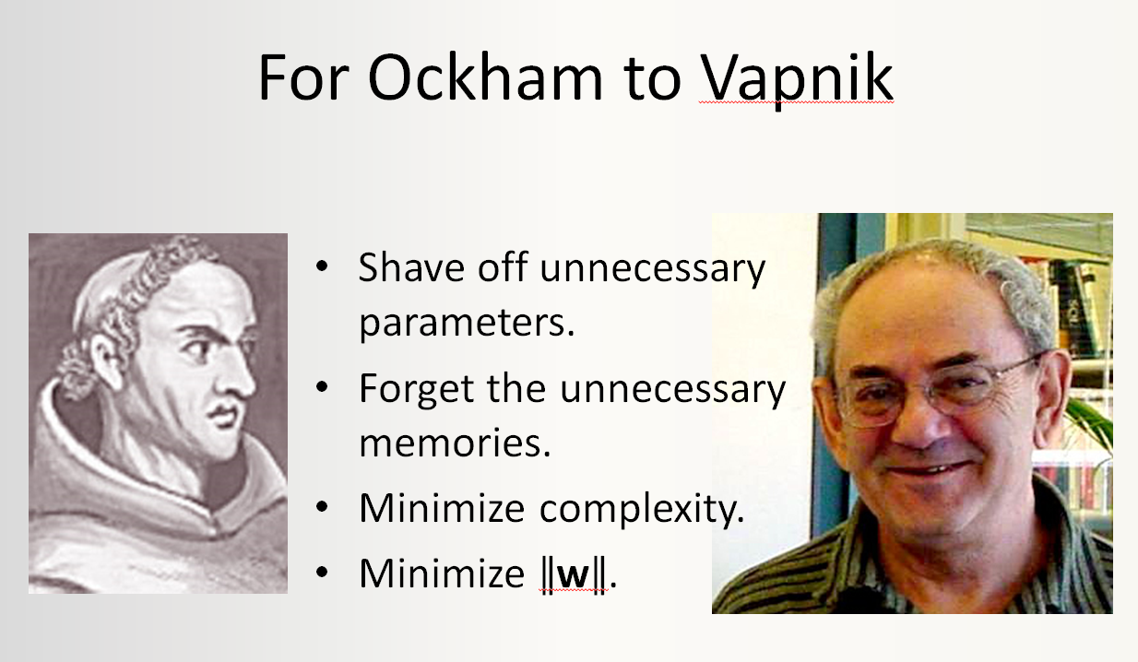
Come to my office hours… Wed 2:30-4:30 Soda 329
Next time

