Slide 1
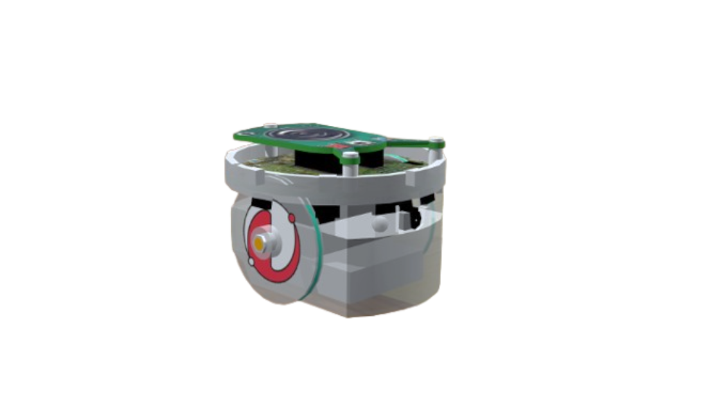
Comparative Evaluation of
Autonomous Service Robot in Restaurant Environments
Introduction to Intelligent Robotics · Checkpoint
Catarina Fernandes · Leonor Baía · Pedro Ferreira

Slide 2



Project Overview
Goal
Platform
Environment
Task
Study how environmental knowledge affects performance of autonomous waiter robots
e-puck robot with LiDAR sensor + wheel encoders in Webots simulation
Restaurant with 6 tables, 4 chairs each table, 4 walls, 4 corner plants and robot’s base — modelled in Blender, exported to Webots
Receive table request
navigate to table
serve (2s)
return to base

Slide 3
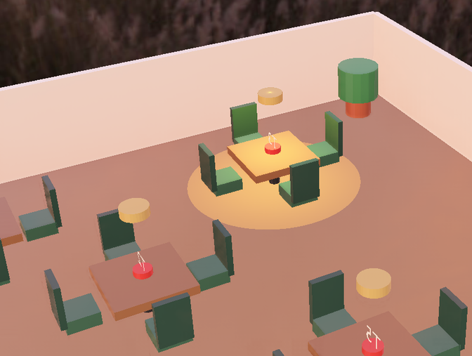
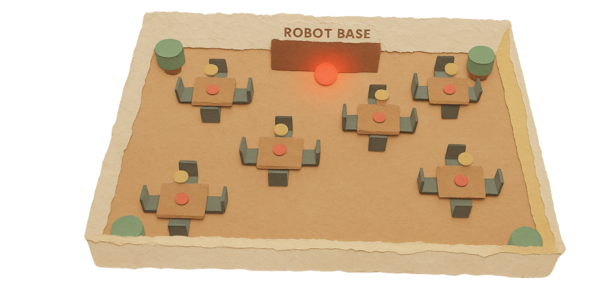
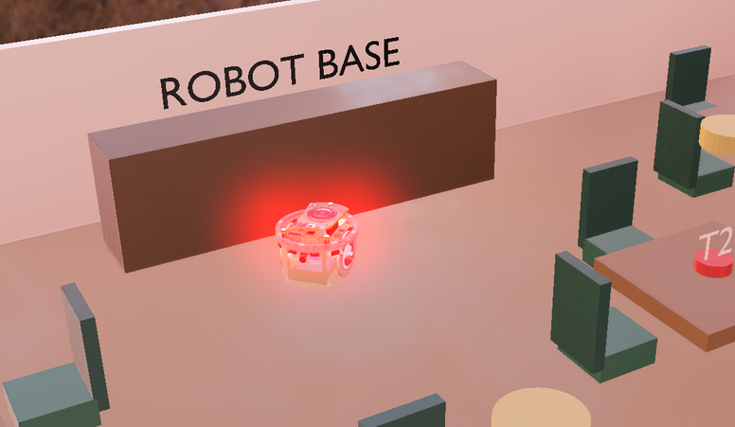
Simulation Enviroment

Slide 4
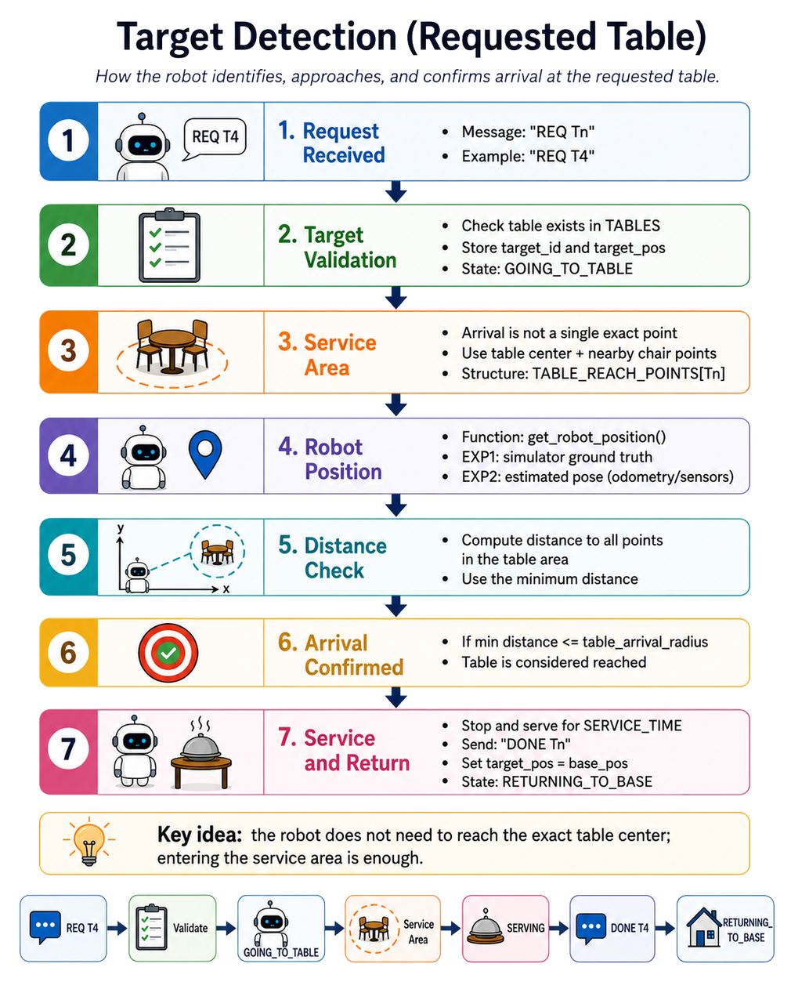
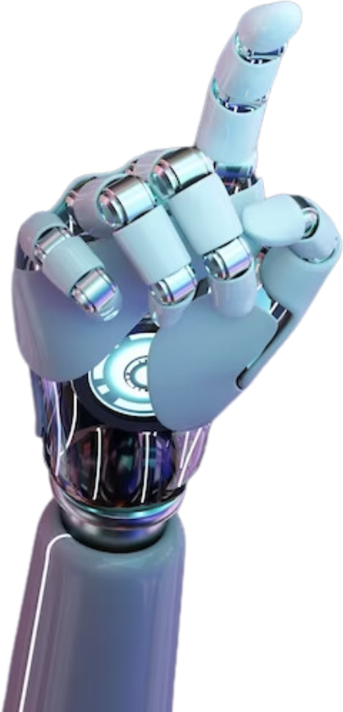
Table request system & target identification logic

Slide 5
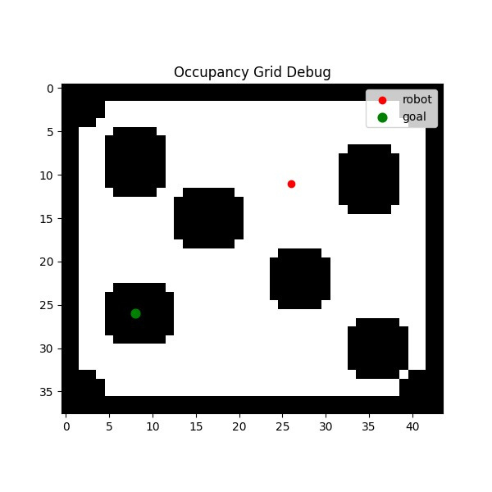
Experience 1:
Static Environment with Known Map
1. Pre-built occupancy grid of the restaurant with obstacle inflation (1 cell)
A* path planning on the known map
Multiple reachable goal candidates per table → robot selects the shortest valid path
Automatic free-cell projection → invalid/occupied goals are corrected to nearby free cells
Waypoint-based path following with heading control
Reactive obstacle recovery for emergency avoidance
Request cycle: receive request → plan → navigate → serve (2s) → return to base

Slide 6
Experience 1:
Static Environment with Known Map
VIDEOOOOOOOOOOOOOOOOOOOOOOOOOOOOO

Slide 7
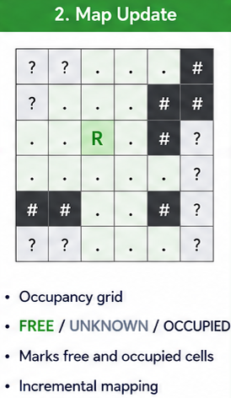
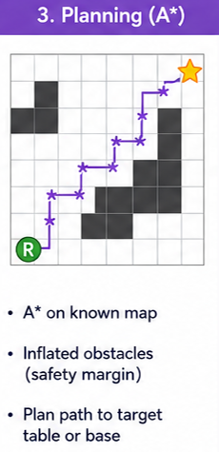
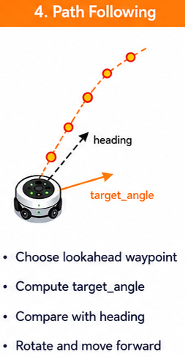
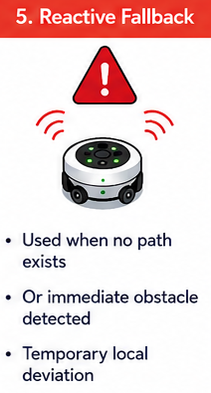
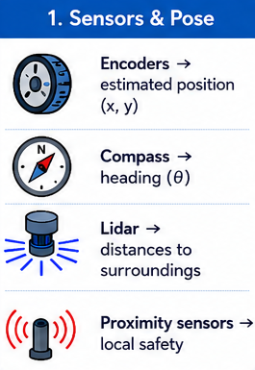
Experience 2:
Static Environment with Unknown Map

Slide 8
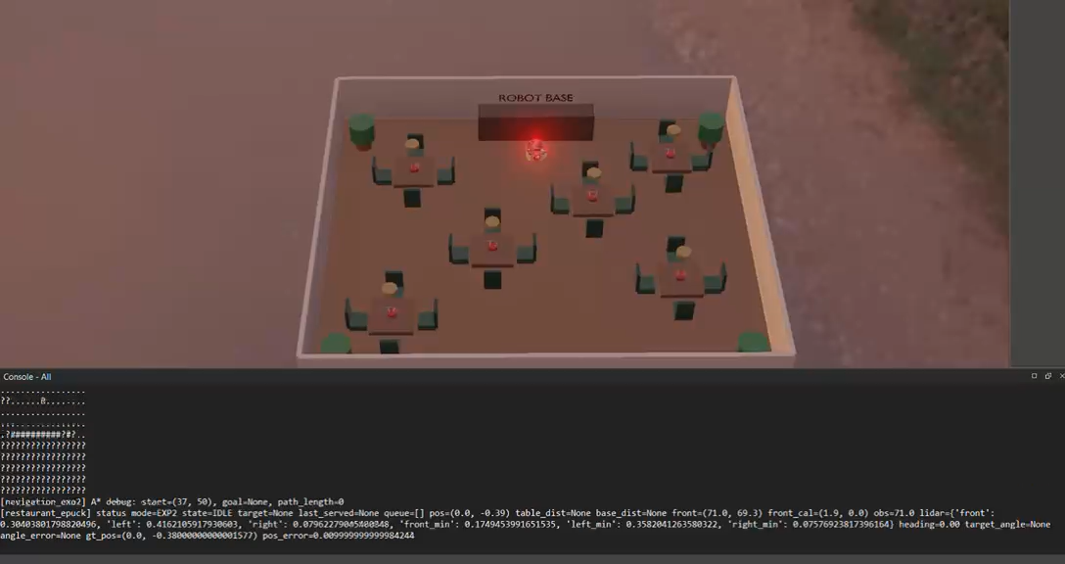
Experience 2:
Static Environment with Unknown Map

Slide 9


Next Steps & Questions
Done:
Questions:
Next:
Completed restaurant environment in Webots
Service policy should change from FIFO to Nearest-first?
Compare EXP1 vs EXP2 in multiple runs
Request/call mechanism for the tables
Apply a new heuristic when, in experiment 2, the robot does not know the A* path?
Introduce dynamic obstacles
Do EXP 3 Dynamic Environment with Known Map and EXP 4 Dynamic Environment with Unknown Map
First version of the known-map navigation approach and of the unknown-map robot
Performance metrics
Calculate new metrics and produce final videos

