Slide 1


.
.
{
}
CleverDict
CleverDict

Slide 2




Slide 3


CleverDict

Slide 4

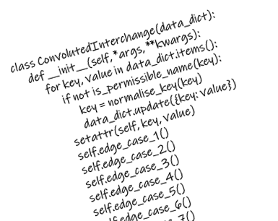
class ConvolutedInterchange(data_dict):
def __init__(self, *args, **kwargs):
for key, value in data_dict.items():
if not is_permissible_name(key):
key = normalise_key(key)
data_dict.update({key: value})
setattr(self, key, value)
self.edge_case_1()
self.edge_case_2()
self.edge_case_3()
self.edge_case_4()
self.edge_case_5()
self.edge_case_6()
self.edge_case_7()
CleverDict
We need a way to use JSON,
Python dicts and .attributes
interchangeably…
CleverDict

Slide 5
