Slide 1

Bank of CLI
Patrick Guinn
9/25/26

Slide 2
Content overview
Company Name
1
2
3
Tech Stack
ERD
OOP Design
4
5
6
DAO Pattern
Key Decisions
Features

Slide 3

Tech Stack
Language: Java 17
Build Tool: Maven
Database: PostgreSQL 18 (via Docker)
Testing: JUnit 5 + Mockito
Logging: SLF4J + Logback
Version Control: Git & GitHub

Slide 4
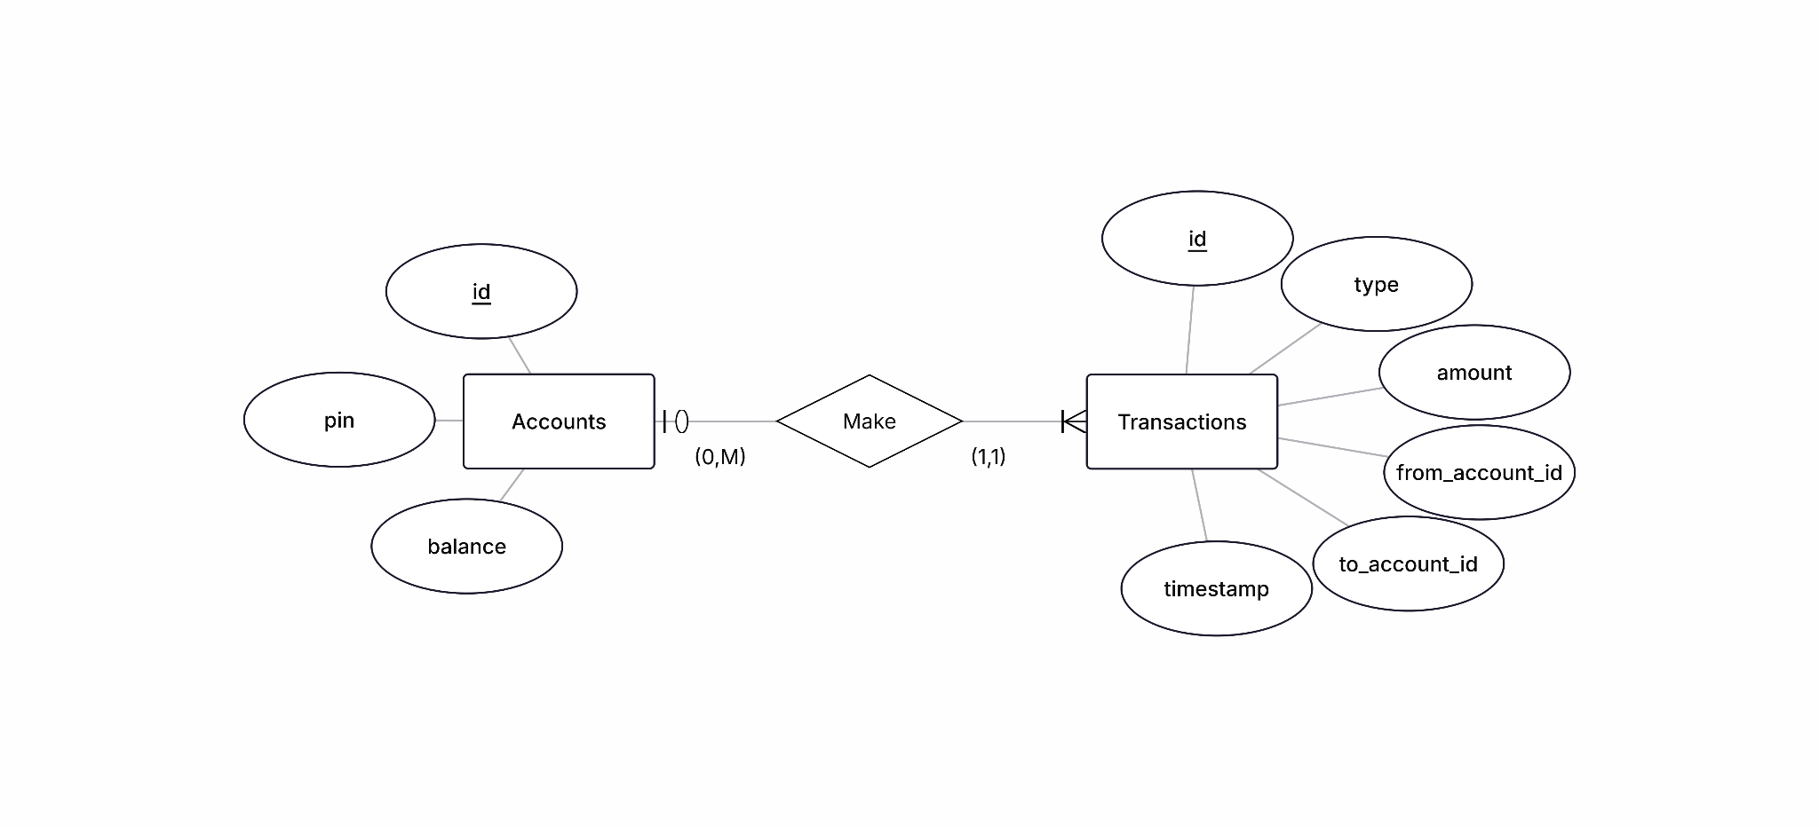
ERD

Slide 5
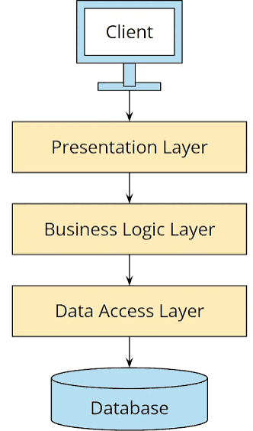
Three Layer Architecture
public class Main {
public static void main(String[] args) {
AccountService accountService = new AccountService(
new AccountRepositoryImpl(),
new TransactionRepositoryImpl()
);
ConsoleUI consoleUI = new ConsoleUI(accountService);
consoleUI.run();
}
}
Layers: API Business Data Access

Slide 6
Feature Explained: Login
ConsoleUI.java
JDBC
Model
Business
Data
Access
Logging
Custom
Exception
private void handleLogin() {
System.out.print("Enter account ID: ");
Integer accountId = readAccountId();
if (accountId == null) return;
System.out.print("Enter PIN: ");
String pin = scanner.nextLine().trim();
try {
currentAccount = accountService.login(accountId, pin);
System.out.println("Login successful. Welcome back!");
} catch (AccountNotFoundException | InvalidPinException e) {
System.out.println("Login failed: " + e.getMessage());
} catch (SQLException e) {
System.out.println("Service unavailable. Please try again later.");
}
}

Slide 7
Feature Explained: Login
AccountService.java
public Account login(int accountId, String pin) throws SQLException {
try (Connection conn = ConnectionManager.getConnection()) {
return login(conn, accountId, pin);
} catch (SQLException e) {
logger.error("Database error during login for account {}: {}", accountId, e.getMessage());
throw e;
}
}
Account login(Connection conn, int accountId, String pin) throws SQLException {
Account account = accountRepository.findById(conn, accountId)
.orElseThrow(() -> {
logger.error("Login failed: no account found with id {}", accountId);
return new AccountNotFoundException("No account found with id " + accountId);
});
// Future improvement would include evaluating a hashed pin rather than string
// evaluation as implemented below
if (!account.getPin().equals(pin)) {
logger.error("Login failed: incorrect PIN entered for account {}", accountId);
throw new InvalidPinException("Incorrect PIN for account " + accountId);
}
logger.info("User successfully logged into account {}", accountId);
return account;
}
JDBC
Model
Business
Data
Access
Logging
Custom
Exception

Slide 8
Feature Explained: Login
AccountRepositoryImpl.java
JDBC
Model
Business
Data
Access
Logging
Custom
Exception
@Override
public Optional<Account> findById(Connection conn, int id) throws SQLException {
try (PreparedStatement statement = conn.prepareStatement(SQL_FIND_BY_ID)) {
statement.setInt(1, id);
try (ResultSet resultSet = statement.executeQuery()) {
if (resultSet.next()) {
Account account = new Account (
resultSet.getInt("id"),
resultSet.getString("pin"),
resultSet.getBigDecimal("balance")
);
return Optional.of(account);
}
}
}
return Optional.empty();
}

Slide 9
Unit Testing and Logging
Company Name
⏰ Demo Time!

Slide 10
Thanks!
Any questions?🤔

