Slide 1

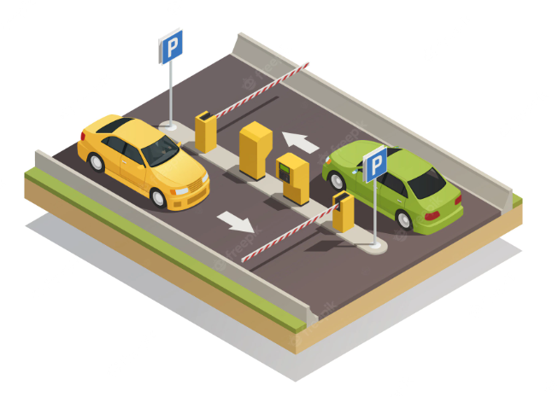
ONLINE PARKING PORTAL
Guided By
Prof. Nishant Sir
Prof. Prajakta Mam

Slide 2
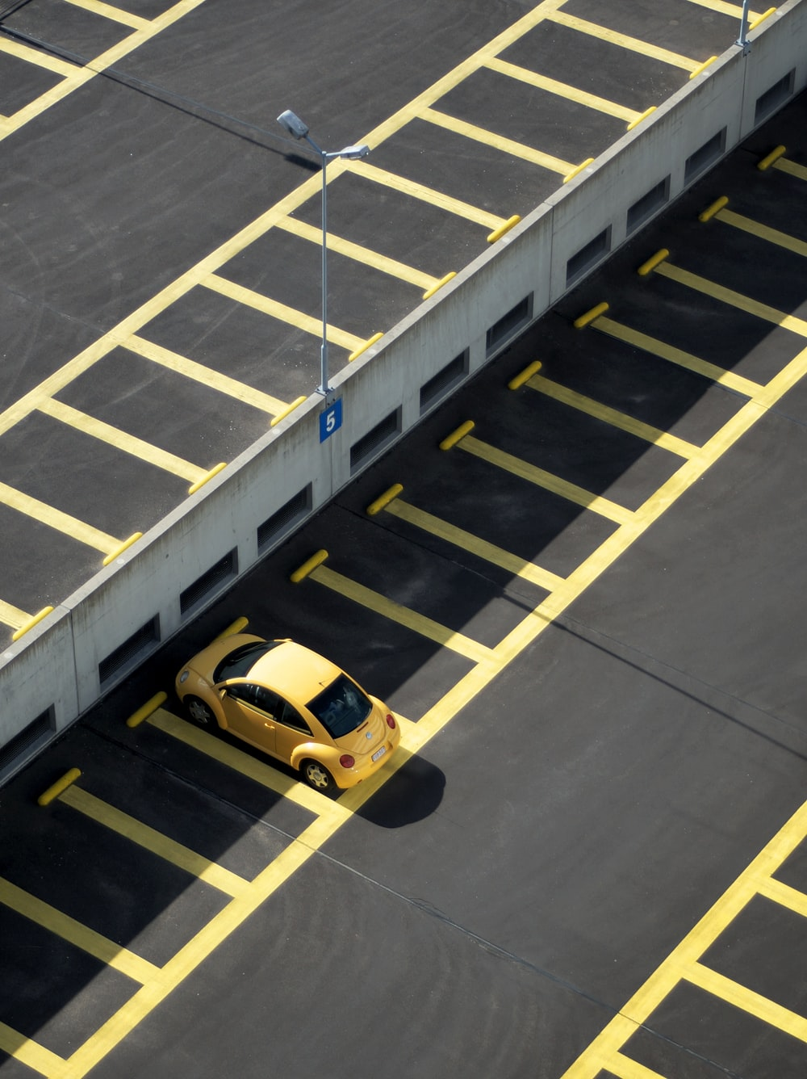
INTRODUCTION : What is the project & why this project
. A parking lot or car park is a dedicated cleared area that is intended for parking vehicles
Parking now-a-days is a problem in every big city, it consumes a lot of time to find the right place to park.
Shopping malls, sports stadiums, megachurches, and similar venues often feature parking lots over large areas.
This project is about mobile management of parking areas.
It overcomes the problem of finding a parking space in commercial areas that unnecessary consumes time.
This system assist the user to find and book the space online for parking and it will help the management to reduce the parking issue and also increase their revenue.
This system will save the user time in search of parking areas and reduce the need of human resources in order to manage parking space.

Slide 3
EXISTING SYSTEM & PROPOSED SYSTEM
Existing System :
In the existing Online Parking Reservation systems, domestic and local level parking areas are not covered also parking for various vehicles are not preferred. So this makes the current system trivial and incomplete.
Proposed System:
The proposed Online Parking Reservation system provides a smarter way for customer to select parking location, parking duration, extend parking duration. It also provides parking reservation for various types of vehicles under one parking portal.

Slide 4
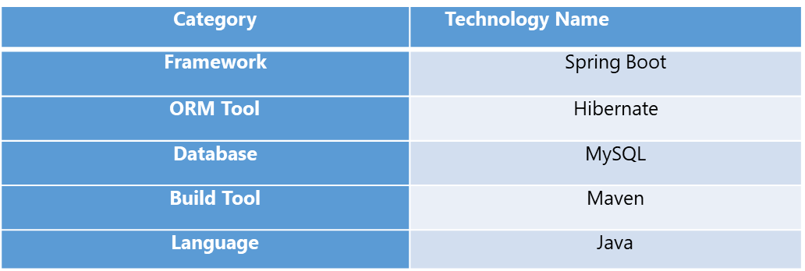
PROJECT TECHNOLOGY STACK
Backend Technologies :
Frontend Technologies :
Category | Technology Name
Framework | ReactJs
Language | HTML, CSS, Javascript

Slide 5
PROJECT FLOW DIAGRAM: USE CASE Diagram
Use Case
Diagram

Slide 6
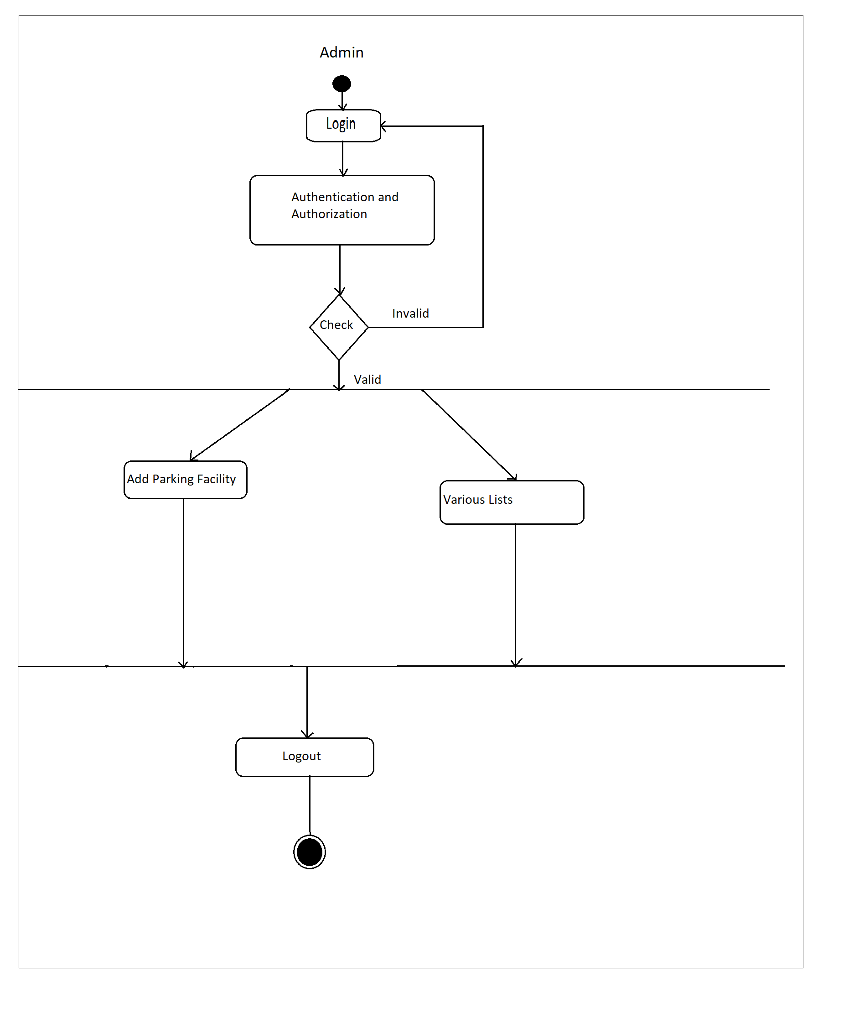
PROJECT FLOW DIAGRAM: Admin Activity Diagram

Slide 7
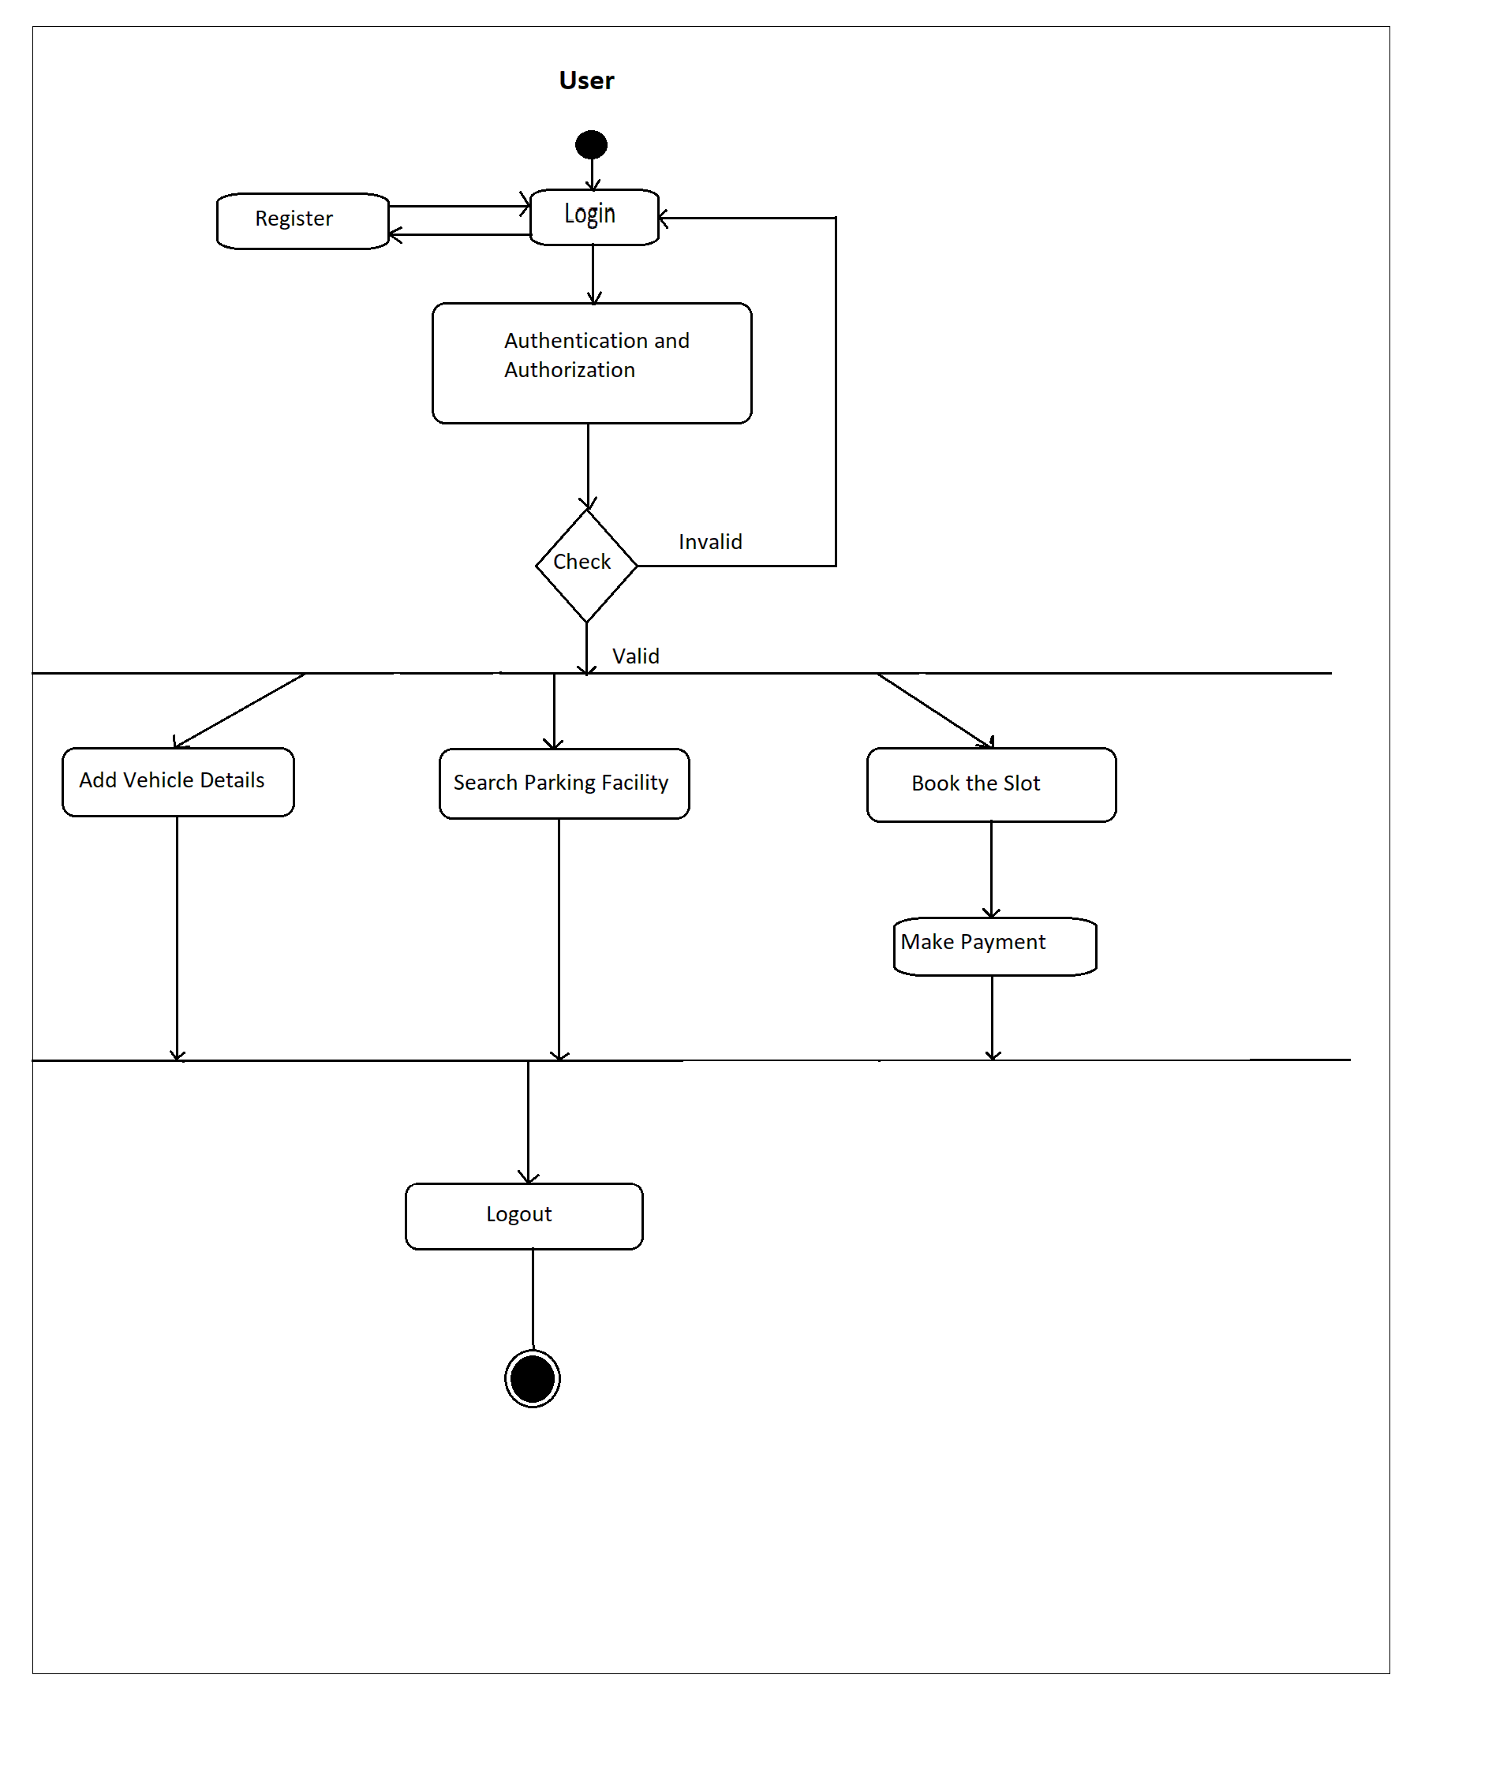
PROJECT FLOW DIAGRAM: User Activity Diagram

Slide 8
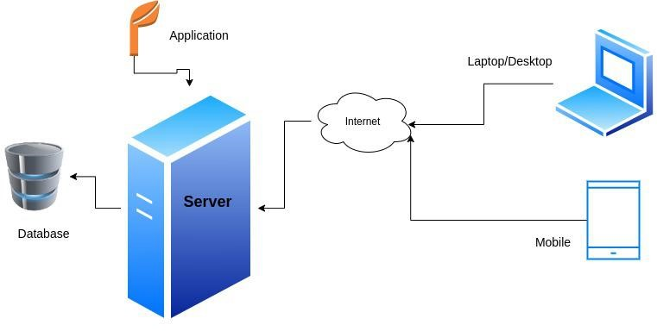
PROJECT FLOW DIAGRAM: Architecture Diagram

Slide 9
PROJECT FLOW DIAGRAM: Data Flow Diagram (DFD)
Data Flow Diagram

Slide 10
PROJECT FLOW DIAGRAM: Entity-Relationship Diagram
E-R Diagram

Slide 11
TEAM MEMBER AND THEIR RESPONSIBILITIES
210930920002 -- Akash Tiwari V. --(Frontend)
210930920019 -- Phapale Kajal B. --(Backend)
210930920020 -- Kanse Akshay B. --(Backend)
210930920042 -- Rathod Shital S. --(Frontend)
210930920043 -- Rathod Vekateshkumar P. --(Backend)

Slide 12
FUTURE SCOPE
Implementation of Live Location
App Development.

Slide 13
Thank You!

