Slide 1





Automated Web Scraping and Archiving
- Momik Shrestha(180608)
- Shreeju Pradhan(180622)

Slide 2
Introduction to Team
Shreeju Pradhan
-Front-end + Responsiveness
Momik Shrestha
-Back-end + Web scraper

Slide 3
Introduction to Project
Our project involves the creation of system that is the co-existence of two different “sub-systems”, thus it can be divide into two major phases:
Creating a Web scraper
The scraper will scrape different online news websites and stored necessary data in a database.
Creating Web application
The website will display necessary information by using the data previously stored by the scraper. The website was made using HTML, CSS,PHP & JS with no added frameworks.

Slide 4
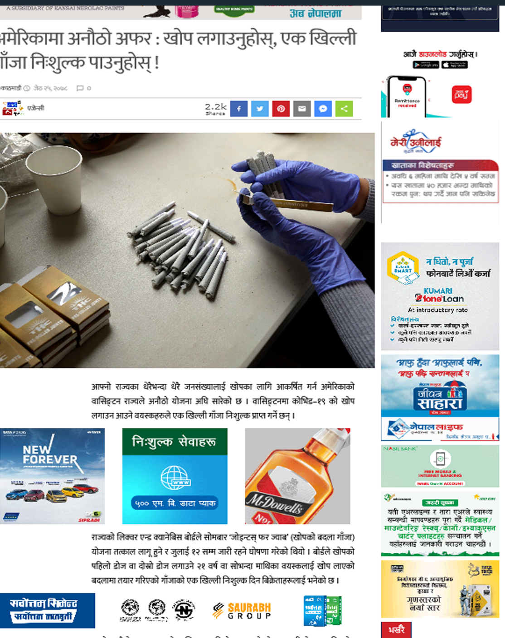

Problem Statement
1. The litter
There is more unrelated things than actual news.

Slide 5
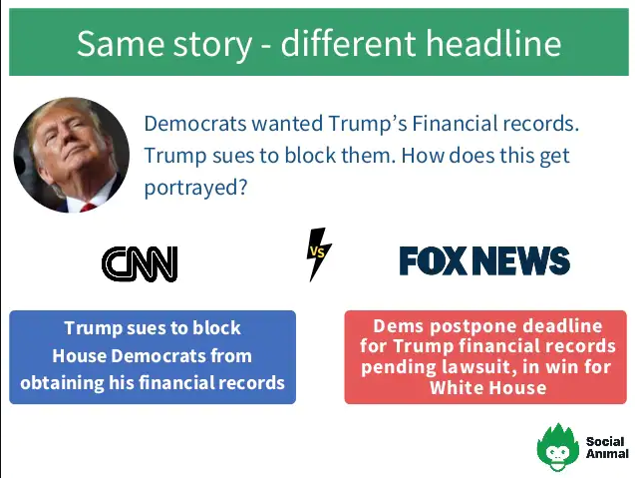
Problem Statement
2. The narrative
There exists narrative bias in the Nepali media, newspapers and news sites will tend to publish articles leaning towards their political preference without maintaining un-biasness.
Example: Fox news and CNN narrative control

Slide 6
Objectives
The objectives of this project can be divided into 2 categories:
Project Objectives
-To create a web scraper that scrapes two different websites and stores into a database,
-To create a web application utilizes the stored scrape data,
-To successfully manage a database that consists of huge amount of data.
Academic (personal) Objectives
-To develop our web development skills,
-To learn about the concepts of web scrapers and web scraping,
-To implement things learnt in previous semesters.

Slide 7
Architectural Design
Application Layer
Database
Web Scraper
Scraped Data DB
Web browse/ client
Internet
Web Application
User Info DB

Slide 8
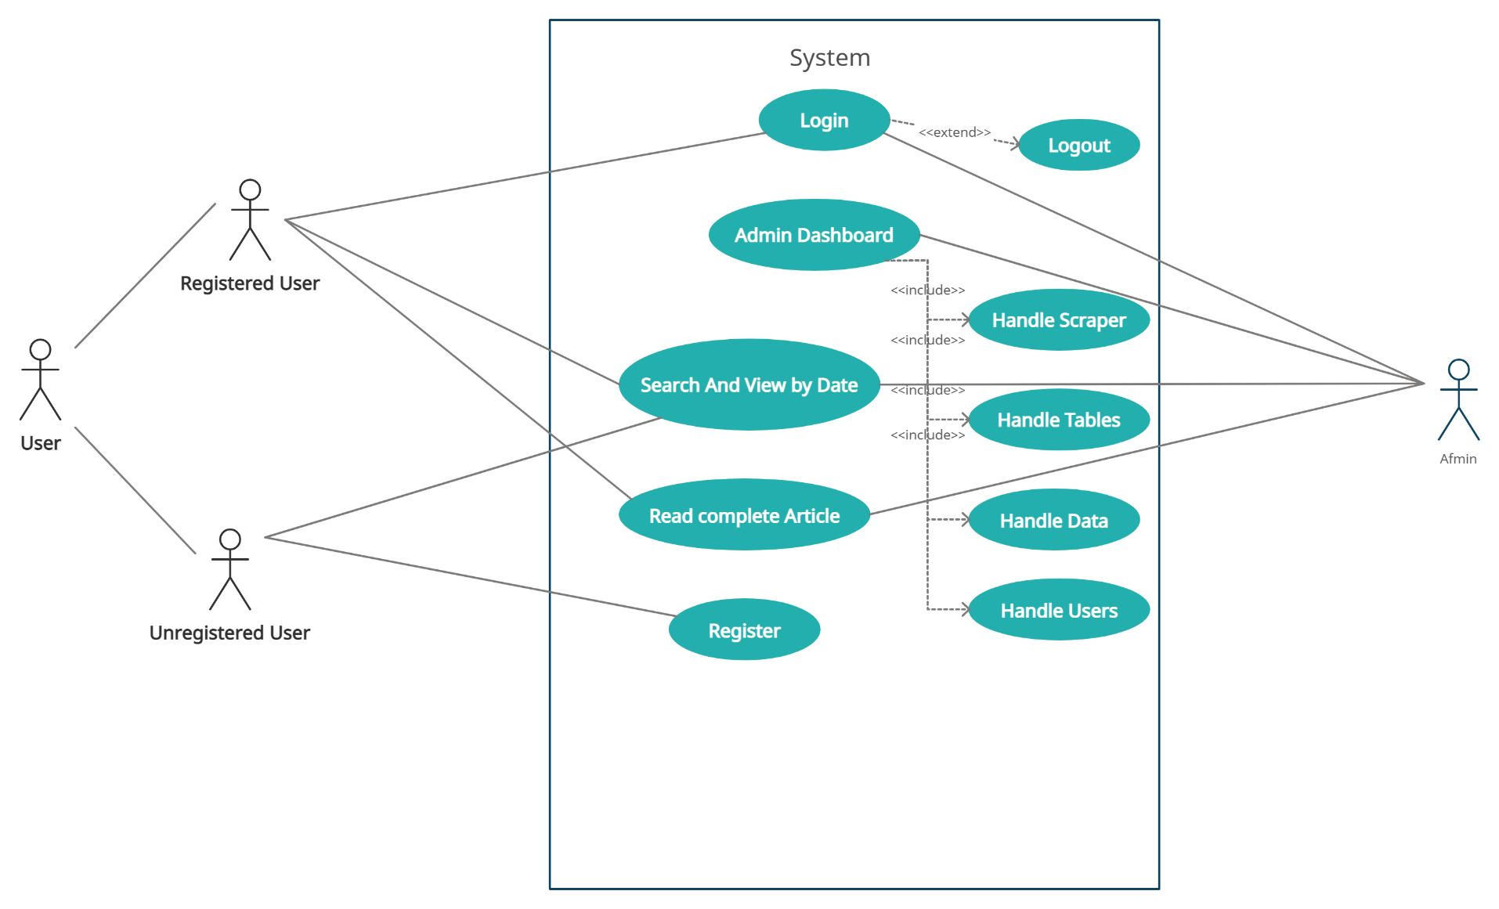
Use case diagram

Slide 9
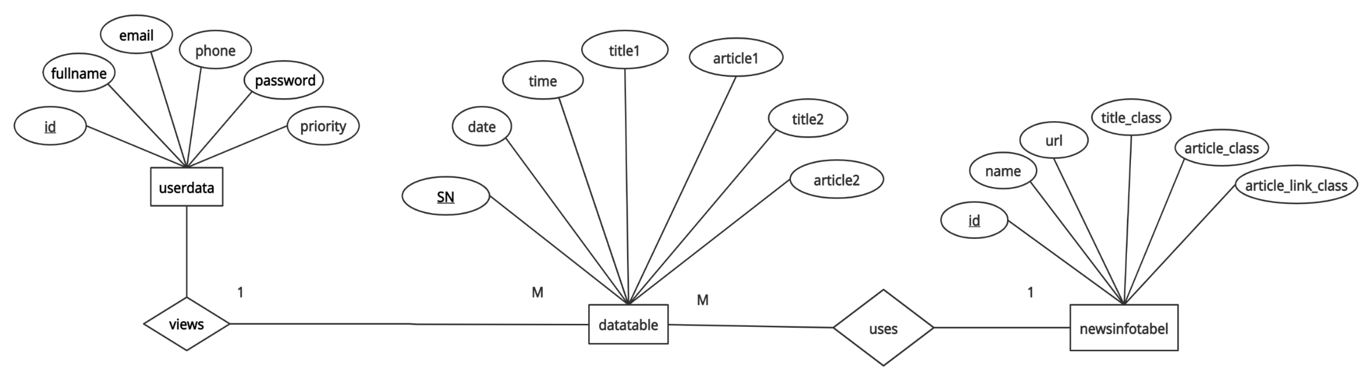
ER diagram

Slide 10
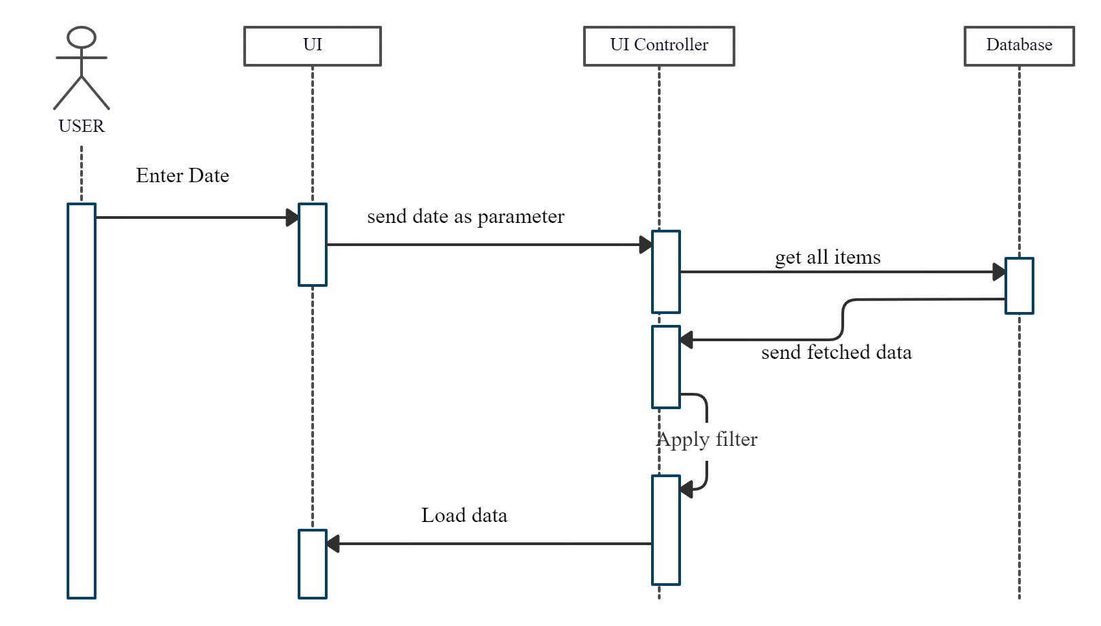
User interaction sequence diagram

Slide 11
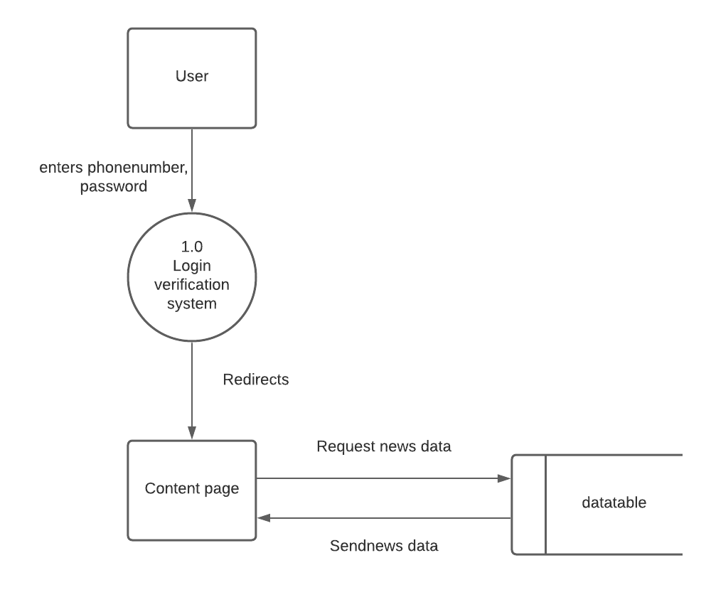
DFDs
1. User DFD

Slide 12
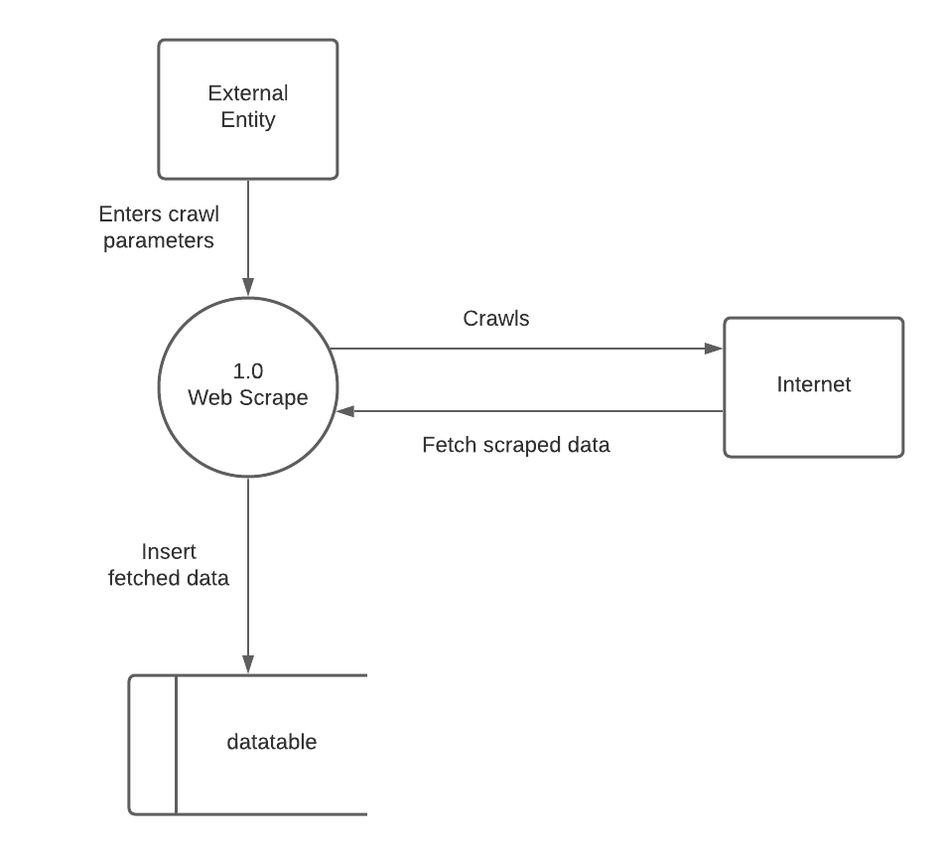
2.Scraper DFD

Slide 13
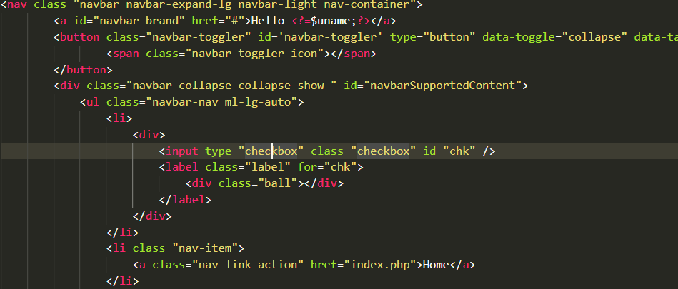

Code Snippets
Nav Partials

Slide 14
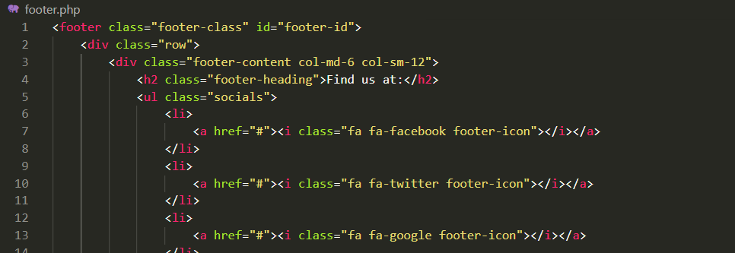

Footer partials

Slide 15
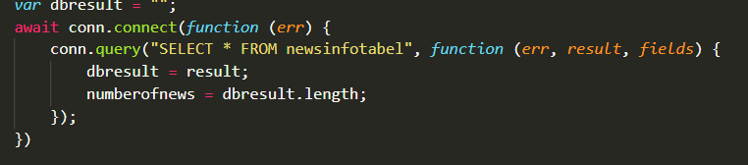
Retrieve crawl parameters

Slide 16
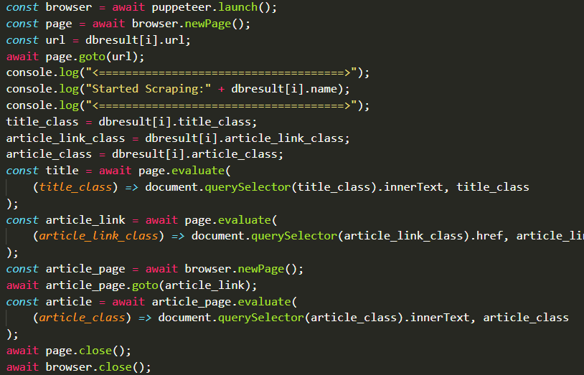
Scrape script

Slide 17
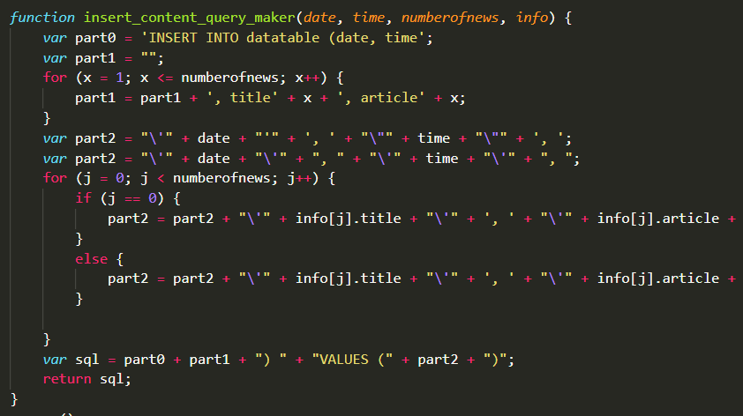
Insert query

Slide 18
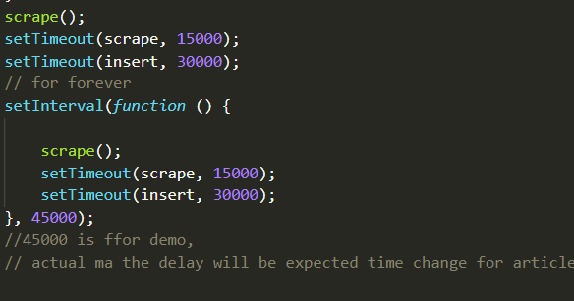
Looping

Slide 19
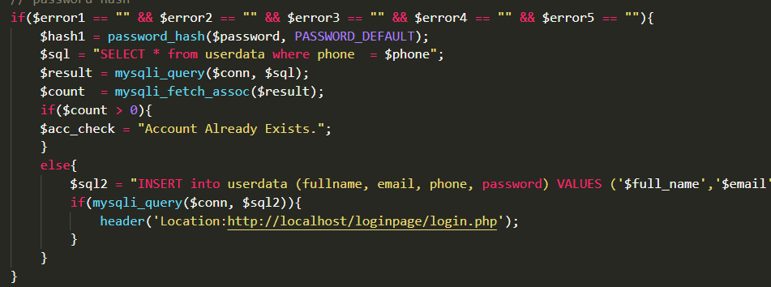
Password Hashing

