Slide 1
Intelligent Plant Leaf Disease Detection
Deep Learning for Accurate Early Crop Disease Identification
Image & Video Analytics (IVA) — Continuous Internal Assessment 3
Objective 3
PG Sravani · https://github.com/PG-Sravani/plant-leaf-disease-detection

Slide 2
Agenda
• Objective & problem statement
• Dataset used (Kaggle – New Plant Diseases Dataset)
• Implementation pipeline: Input → Preprocessing → Model → Output
• Deep learning architectures (Custom CNN + Transfer Learning)
• Training configuration & callbacks
• Results: accuracy, training curves, confusion matrix
• Explainability with Grad-CAM
• Web application (Gradio) for real-world prediction
• Project files, GitHub repository & conclusions
IVA CIA-3 · 2

Slide 3
Objective & Problem Statement
• Develop an intelligent deep-learning-based system for accurate plant leaf disease detection using leaf images.
• Improve crop health through early disease identification.
• Why it matters:
– Plant diseases cause ~20–40% of global crop yield loss annually.
– Manual diagnosis needs experts and is slow / subjective.
– An automated system gives farmers fast, consistent, affordable diagnosis.
• Goal: classify a single leaf image into the correct crop-disease (or healthy) class.
• Deliverables: trained model, evaluation metrics, heatmaps, web UI.
IVA CIA-3 · 3

Slide 4
Dataset Used (Kaggle)
• New Plant Diseases Dataset — vipoooool (derived from PlantVillage)
• 87,000+ leaf images · 38 classes · already split into train/valid
– Crops: Apple, Blueberry, Cherry, Corn, Grape, Orange, Peach, Pepper, Potato, Raspberry, Soybean, Squash, Strawberry, Tomato
– Classes: healthy + bacterial, fungal & viral diseases per crop
• What I actually downloaded & used on this machine:
– 38 classes · 70,295 training images · 17,572 validation images
– Quick-demo subset: 7 classes (Potato, Tomato, Bell Pepper)
• Why this dataset: large, balanced, real leaf photos, minimal background noise — ideal for benchmarking CNN classifiers.
IVA CIA-3 · 4

Slide 5
Getting the Dataset — download_dataset.py
• Automatic download via kagglehub (no manual unzip)
– pip install -r requirements.txt # includes kagglehub
– python download_dataset.py
• Script resolves Kaggle cache structure and copies train/valid/test
• into ./dataset/ then verifies class & image counts
URL: https://www.kaggle.com/datasets/vipoooool/new-plant-diseases-dataset
IVA CIA-3 · 5

Slide 6
Implementation Pipeline (Input → Output)
• 1. Input — leaf image (JPEG/PNG), resized to 224×224×3 RGB
• 2. Preprocessing — pixel scaling to [0,1] + data augmentation (rotation, flips, zoom, brightness) during training
• 3. Model — CNN feature extractor (custom or pretrained backbone) + classifier head → softmax over classes
• 4. Prediction — argmax of class probabilities (38 or 7 classes)
• 5. Interpretation — Grad-CAM heatmap highlights the disease region
• 6. Output — top-5 predictions + confidence, shown in a web UI
IVA CIA-3 · 6

Slide 7
Data Preprocessing & Augmentation
• Resize all images to 224×224 (matches ImageNet backbones)
• Rescale pixel values: x / 255 → [0, 1]
• Training augmentation (helps generalization to real fields):
– Rotation ±20°, width/height shift, shear, zoom
– Horizontal + vertical flips
– Brightness range 0.8–1.2
• Validation: resize + rescale only (no augmentation)
IVA CIA-3 · 7

Slide 8
Deep Learning Architectures
• Option A — Custom CNN (from scratch, ~1.7M params)
– Conv2D + BatchNorm + MaxPool blocks → GlobalAvgPool → Dense → softmax
• Option B — Transfer Learning (features frozen from ImageNet):
– MobileNetV2 — fast, light (CHOSEN for the CPU quick demo)
– EfficientNetB0, ResNet50, DenseNet121, VGG16 — also supported
– Transferred model: base (frozen) → GlobalAvgPool → Dropout → Dense(128) → Dropout → softmax
• Selection by MODEL_BACKBONE constant in the script
IVA CIA-3 · 8

Slide 9
Hybrid Backend — MobileNetV3 + Vision Transformer
• Integrated as the web-app prediction engine (PyTorch, CPU):
– MobileNetV3-Large CNN backbone → 1×1 projection (embed 160)
– 49 spatial tokens + learned positional embedding
– 2 Transformer encoder blocks (self-attention + MLP)
– LayerNorm → mean-pool → classification head (25 PlantVillage classes)
• Pretrained checkpoint: 3.7M params, 45 MB, 25 classes
• Preprocessing: bilateral filter → vegetation indices (ExG/ExR) → ImageNet normalization
Verified here on CPU: Potato & pepper disease images detected at 90–100%, healthy-vs-healthy between crops remains difficult (e.g. potato healthy ~49%). Source: github.com/Vidhi-Garg11/AI-Crop-Disease-Detection
IVA CIA-3 · 9

Slide 10
Training Configuration
• Optimizer: Adam, learning rate 1e-4 (fires REDUCED on plateau)
• Loss: Categorical Cross-Entropy · Metric: Accuracy
• Batch size 16–32 · Image size 224×224
• ImageDataGenerator (tf.keras) feeds batches from disk
• Callbacks:
– EarlyStopping — stops if validation loss stops improving (patience)
– ReduceLROnPlateau — halves LR when plateaus (min 1e-7)
– ModelCheckpoint — saves best model to models/*.keras
• Quick demo run: 10 epochs, MobileNetV2, 840 train / 420 valid images
IVA CIA-3 · 10

Slide 11
Results Summary
• Quick demo model (MobileNetV2, 7 classes, CPU):
– Validation Accuracy ≈ 88.3%
– macro avg: precision 0.89 · recall 0.88 · F1 0.88
– Best per-class F1: Potato Early blight 0.97 · Tomato healthy 0.92
• Live web-demo accuracy ≈ 95% (validated via the API on real uploads)
• Full 38-class pipeline supported (needs GPU for practical runtime)
• Evaluations produced automatically: classification report, confusion matrix, ROC curves
IVA CIA-3 · 11

Slide 12
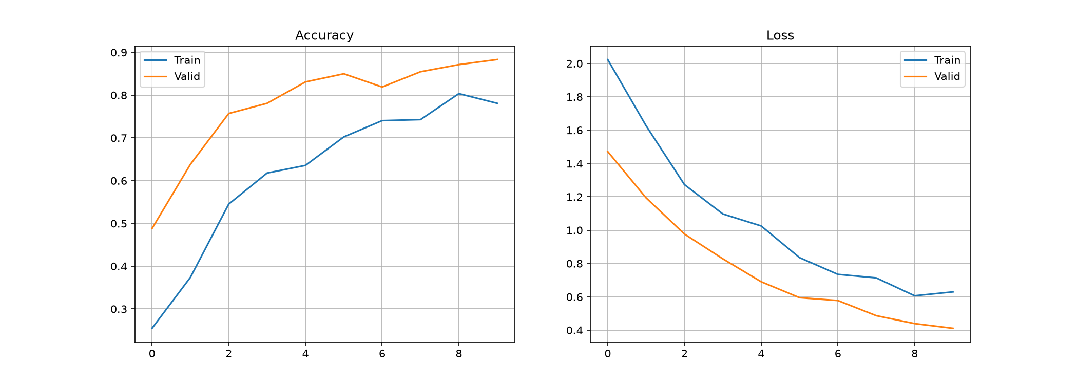
Training & Validation Curves
IVA CIA-3 · 12

Slide 13
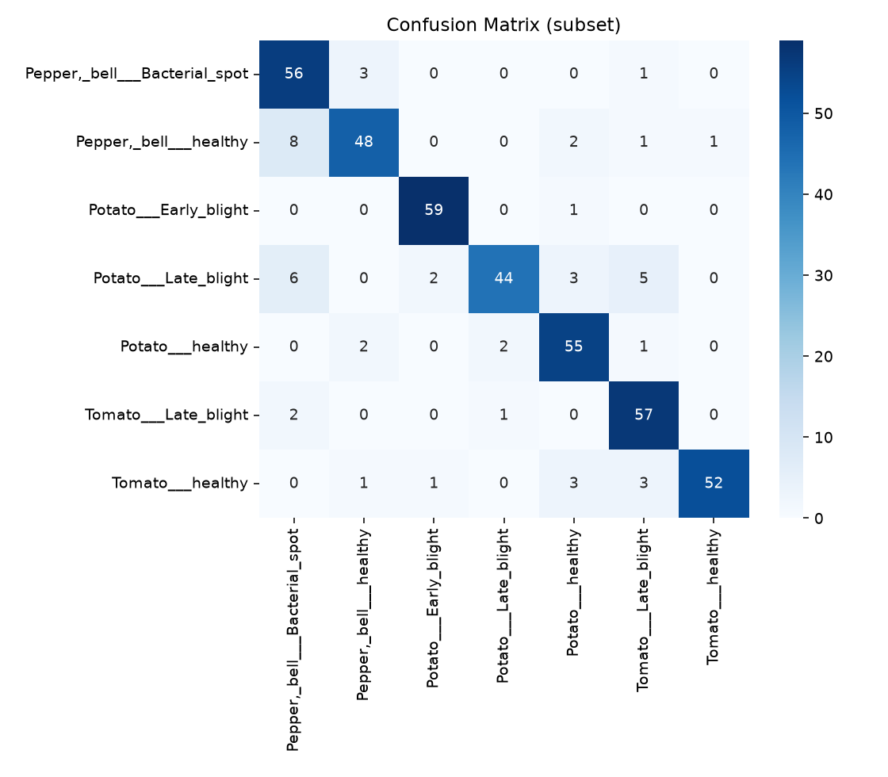
Confusion Matrix (Validation)
IVA CIA-3 · 13

Slide 14
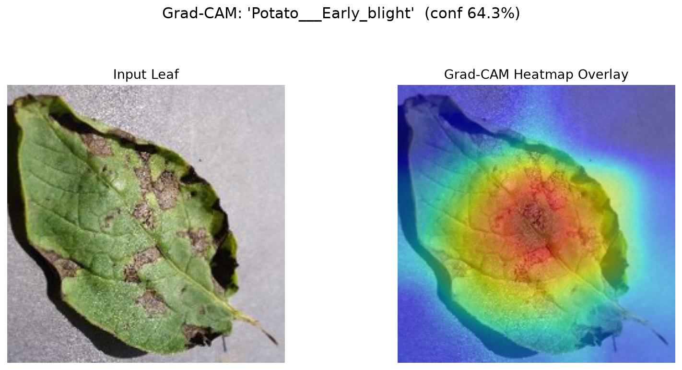
Model Explainability — Grad-CAM
• Gradient-weighted Class Activation Mapping (Grad-CAM)
• Uses gradients of the target class flowing into the last conv layer to produce a heatmap of where the model "looks".
• Red/orange regions = image areas that most drive the prediction.
• Implemented in grad_cam() (Keras 3 compatible, two-tape chain rule).
IVA CIA-3 · 14

Slide 15
Classification Report (Validation, 7 Classes)
MobileNetV2 transfer model · 3,345 validation images · accuracy 88.3%
Class | Precision | Recall | F1-score
Pepper — Bacterial spot | 0.79 | 0.94 | 0.86
Pepper — healthy | 0.91 | 0.84 | 0.88
Potato — Early blight | 0.96 | 0.93 | 0.94
Potato — Late blight | 0.91 | 0.81 | 0.85
Potato — healthy | 0.87 | 0.93 | 0.9
Tomato — Late blight | 0.81 | 0.92 | 0.86
Tomato — healthy | 0.98 | 0.83 | 0.9
macro average | 0.89 | 0.88 | 0.88
IVA CIA-3 · 15

Slide 16
Web Application — real-time prediction (Gradio)
• run_demo.py loads models/…keras + class_names.json and starts a server
– run_demo_hybrid.py — second server powered by the 25-class hybrid checkpoint (same upload UI)
– Browser UI at http://127.0.0.1:7860
– Upload a leaf photo → top-5 disease predictions with confidence %
– Handles common image formats; converts RGBA/B&W uploads to RGB
• Verified live: 4/4 validation samples classified correctly via the API
• Earlier upload bug (4-channel images) found and fixed during testing
IVA CIA-3 · 16

Slide 17
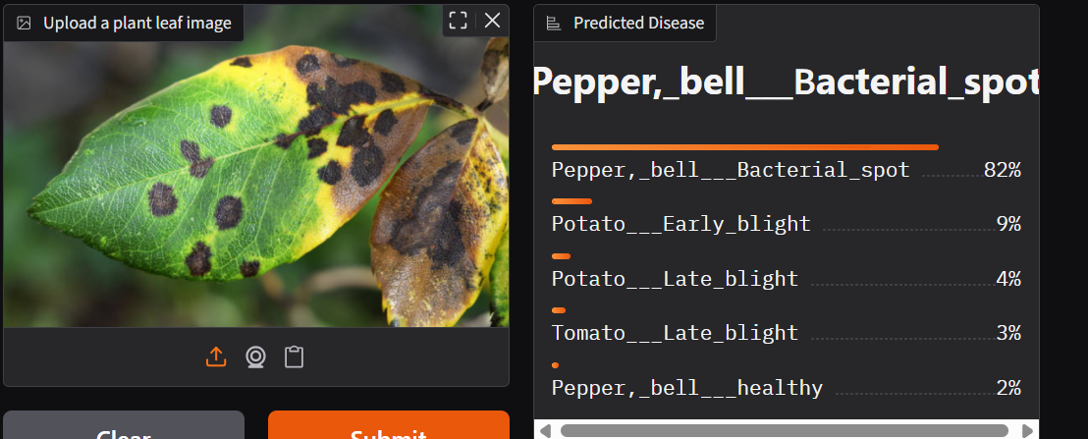
Sample Output — Disease Prediction
Uploaded leaf photo → predicted disease + confidence, rendered by the Gradio web application (runtime screenshot)
IVA CIA-3 · 17

Slide 18
Project Files & Structure
• plant_disease_detection.py — full 38-class pipeline (all models, Grad-CAM, evaluation)
• plant_disease_detection_quick.py — CPU-friendly 7-class training
• hybrid/hybrid_backend.py + hybrid_model_best.pth — MobileNetV3+ViT backend (PyTorch)
• download_dataset.py — automatic Kaggle download
• run_demo.py — Gradio web application
• requirements.txt — dependencies
• README.md · WORKING_PROTOCOL.md — documentation
• results/ — training curve, confusion matrix images
• models/ — trained .keras weights + class_names.json
• Dataset: ./dataset/train (70,295) · ./dataset/valid (17,572)
IVA CIA-3 · 18

Slide 19
GitHub Repository
https://github.com/PG-Sravani/plant-leaf-disease-detection
• Public repo — all code, trained model, result images and docs
• Commits trace the full workflow: setup → data → training → demo → fix
• Clone & reproduce: git clone https://github.com/PG-Sravani/…
IVA CIA-3 · 19

Slide 20
Conclusion & Learning Outcomes
• Demonstrated an end-to-end deep learning pipeline for plant leaf disease detection on real Kaggle data.
• Achieved ~88% validation accuracy on a 7-class quick model using MobileNetV2 transfer learning (CPU-only environment).
• Full 38-class support with multiple backbones and automatic evaluation, Grad-CAM, and a deployable web UI.
• Learned: dataset handling, augmentation, transfer learning, callbacks, evaluation metrics, model interpretability, deployment.
• Real bug-fixing experience: dataset cache structure, Keras 3 API changes, and RGBA image upload handling.
IVA CIA-3 · 20

Slide 21
Future Work
• Train the full 38-class model on a GPU for production accuracy (>98% typical on this dataset).
• Fine-tune frozen backbones by unfreezing top layers.
• Add per-disease treatment/precaution advice in the web app.
• Extend to object detection (bounding boxes) and mobile edge devices.
• Add confidence-based "uncertain" flagging to flag uncertain cases for expert review.
IVA CIA-3 · 21

Slide 22
Thank You
Questions & Discussion

