Slide 1

CITY CARE HOSPITAL
Hospital / Clinic Management System — DBMS Final Project
< Your Name > | Roll No. < ___ > | < Course / Semester >
Guided by < Teacher's Name > | 2026–27

Slide 2
Problem Statement & Objectives
Why this project exists
• Manual registers cause duplication, inconsistency and slow retrieval.
• Design a normalised relational database for a mid-size hospital.
• Build a simple software application over that database.
• 10 modules: patients, doctors, departments, rooms, appointments, admissions, prescriptions, medicines, billing, reports.
• Enforce integrity with keys and constraints; retrieve information with SQL.
• Make the database work visible through a live SQL Console.

Slide 3
Three-Tier Architecture
Frontend → Backend → Database
PRESENTATION index.html + app.js + styles.css (vanilla JS SPA)
| fetch('/api/...') → JSON
APPLICATION server.py — Python http.server REST API + sqlite3
| SQL statements with ? placeholders
DATA hospital.db — SQLite, 10 tables, views, triggers
• No external libraries, no internet, no API keys — runs on any lab PC.
• The frontend contains zero data; every value is an SQL result.
• Parameterised queries prevent SQL injection.

Slide 4
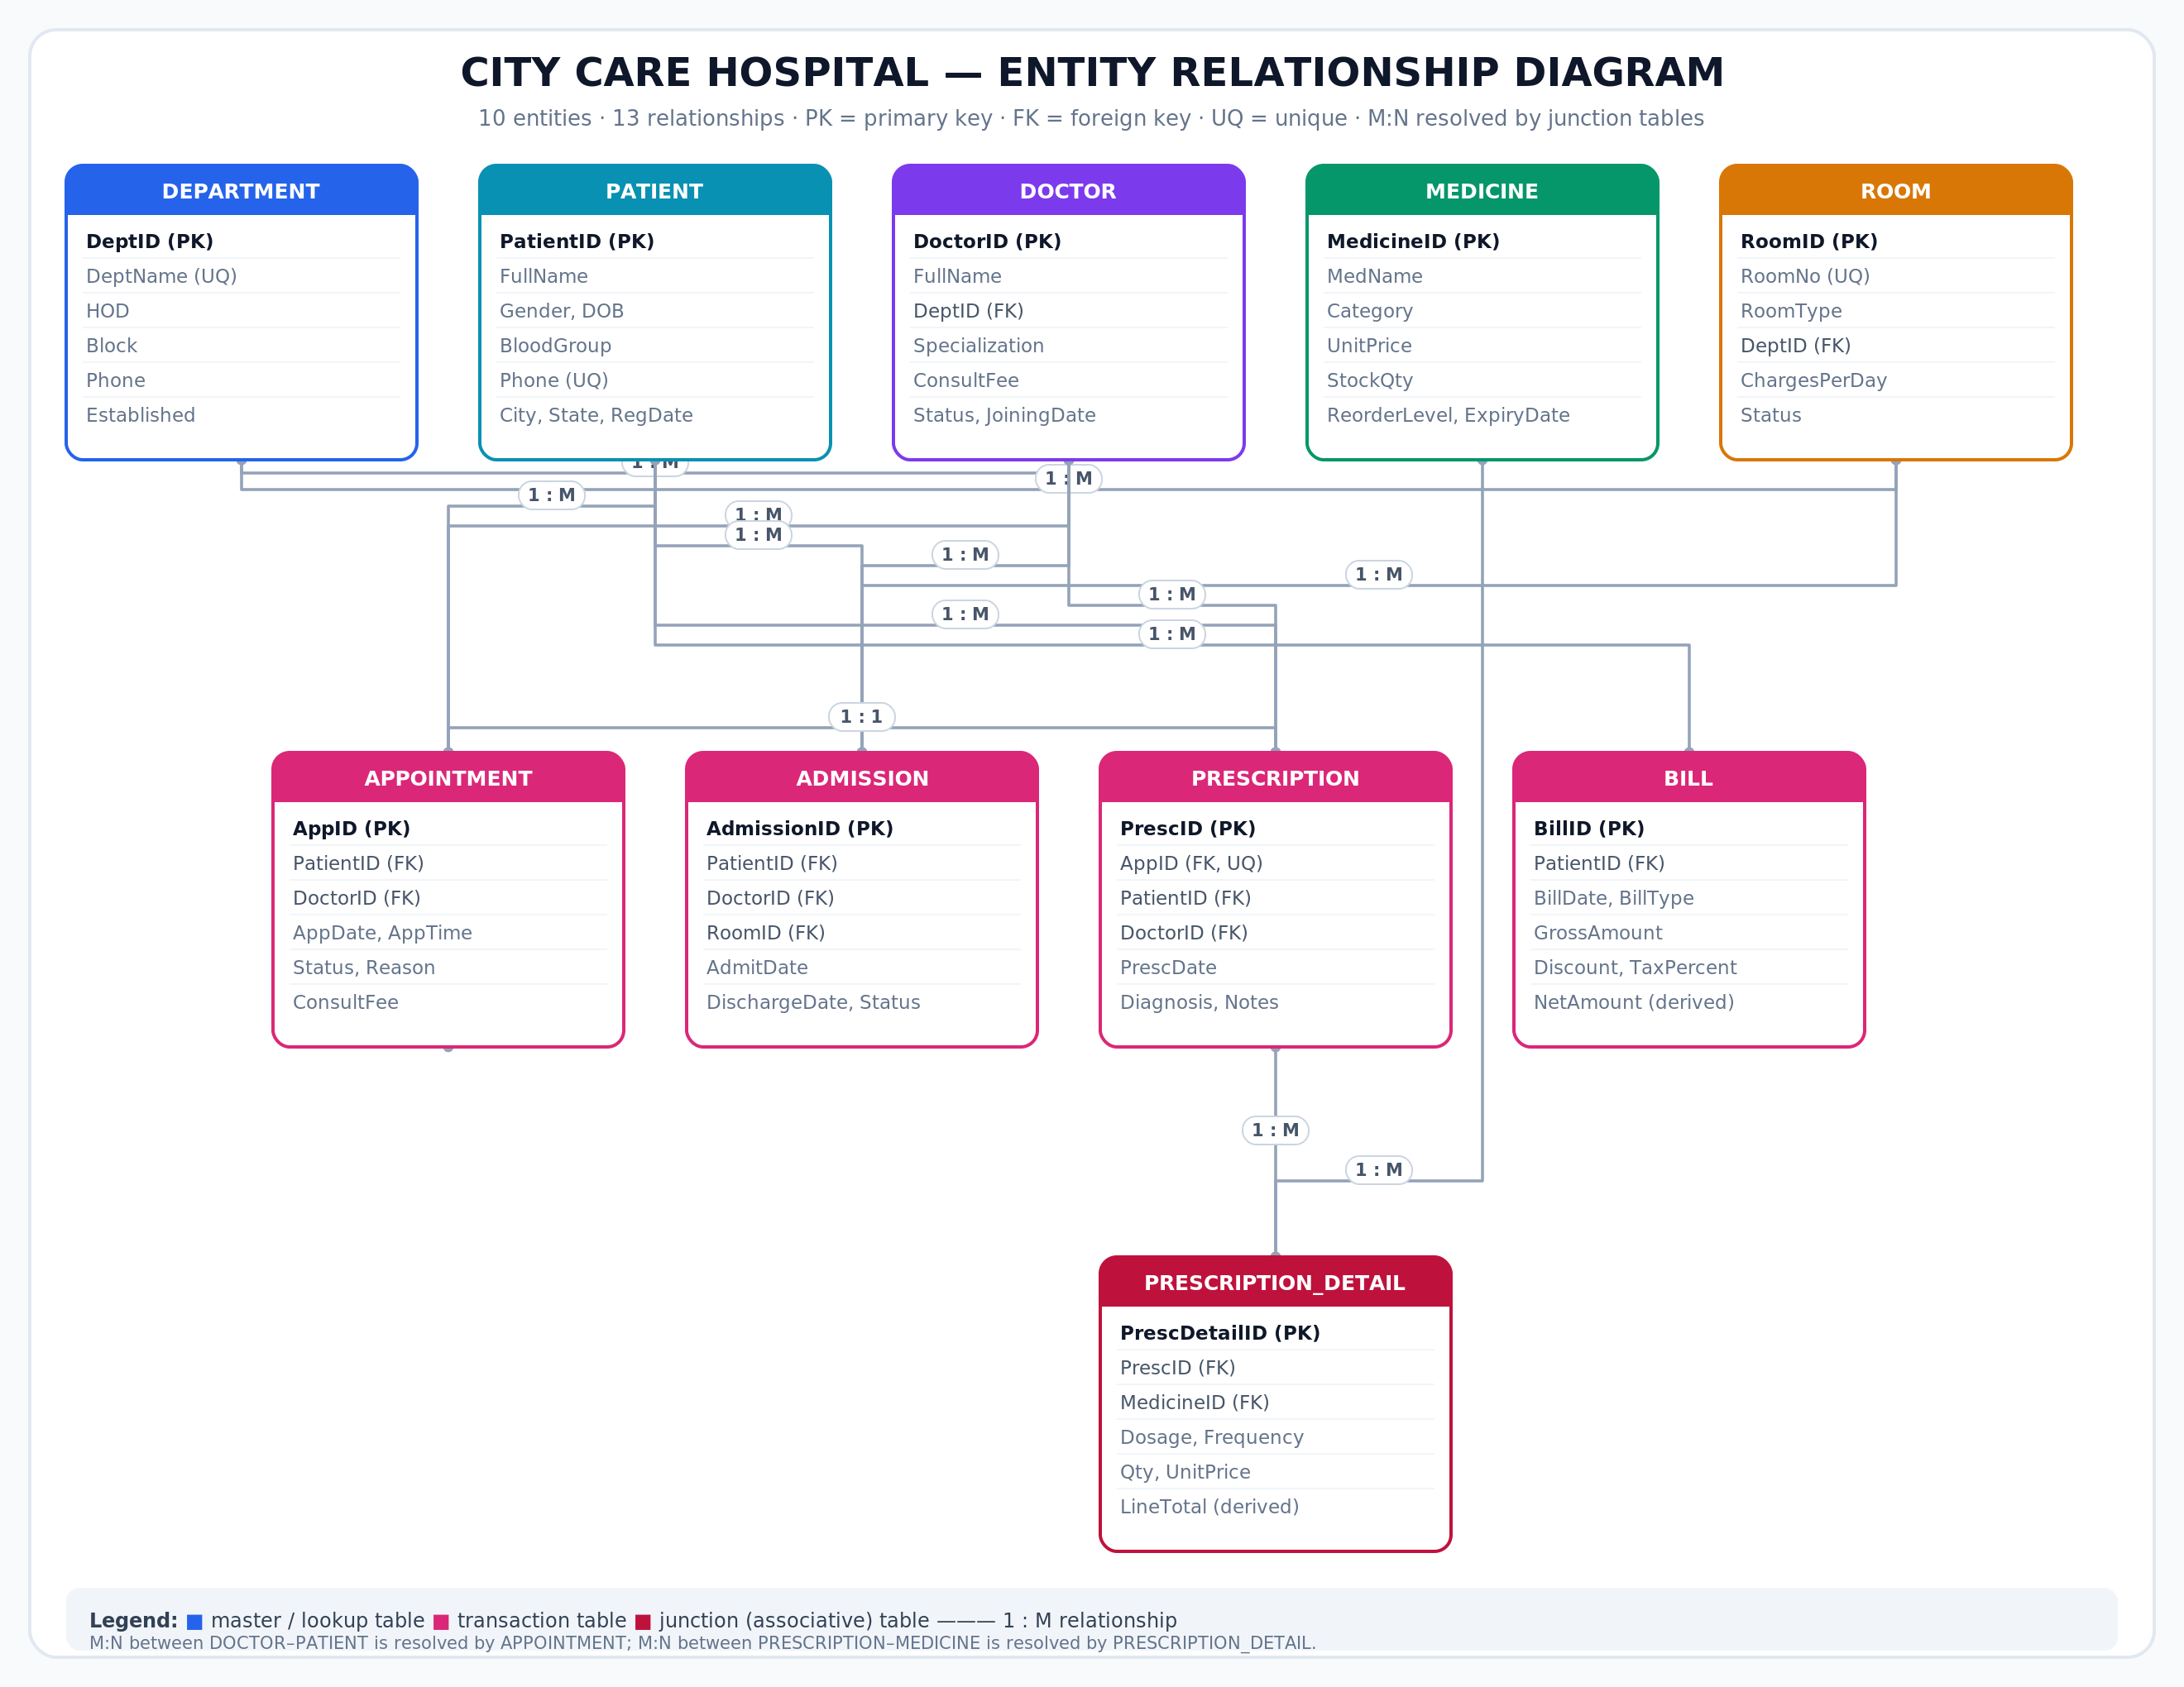
Entity Relationship Diagram
10 entities · 13 relationships
• 1:M : DEPARTMENT→DOCTOR, PATIENT→APPOINTMENT, …
• M:N : DOCTOR↔PATIENT via APPOINTMENT
• M:N : PRESCRIPTION↔MEDICINE via PRESCRIPTION_DETAIL
• Derived: BILL.NetAmount, LineTotal
• 13 foreign keys with ON DELETE / UPDATE rules

Slide 5
Relational Schema
Tables, keys and row counts
Table | Rows | Table | Rows
ADMISSION | 12 | MEDICINE | 22
APPOINTMENT | 183 | PATIENT | 30
BILL | 155 | PRESCRIPTION | 46
DEPARTMENT | 8 | PRESCRIPTION_DETAIL | 86
DOCTOR | 14 | ROOM | 15
• Every table has a PRIMARY KEY; 13 FOREIGN KEY relationships; CHECK + UNIQUE constraints.

Slide 6
Normalisation — 1NF to BCNF
Removing redundancy step by step
• 1NF — split repeating medicine columns into PRESCRIPTION_DETAIL; atomic values only.
• 2NF — composite key (PrescID, MedicineID): move MedName/Category (dependent on MedicineID only) into MEDICINE.
• 3NF — remove transitive dependency DoctorID → DeptID → DeptName by creating DEPARTMENT.
• BCNF — every determinant is a candidate key; no insertion/update/deletion anomalies.
• LineTotal and NetAmount are generated columns, never stored redundantly.

Slide 7
Key SQL Queries
From 36 verified queries
Q09 3-table join — appointment register
SELECT a.AppDate, p.FullName, d.FullName, dp.DeptName
FROM APPOINTMENT a JOIN PATIENT p ON a.PatientID=p.PatientID
JOIN DOCTOR d ON a.DoctorID=d.DoctorID
JOIN DEPARTMENT dp ON d.DeptID=dp.DeptID;
Q14 Correlated subquery — above department average
SELECT FullName FROM DOCTOR d WHERE ConsultFee >
(SELECT AVG(ConsultFee) FROM DOCTOR d2 WHERE d2.DeptID=d.DeptID);
Q18 4-table join through M:N junction — full prescription
FROM PRESCRIPTION pr JOIN PATIENT p JOIN DOCTOR d
JOIN PRESCRIPTION_DETAIL pd JOIN MEDICINE m ...
Q19 Top 5 medicines: GROUP BY medicine, SUM(Qty), ORDER BY, LIMIT 5
Q22 Monthly trend: strftime('%Y-%m',AppDate) + GROUP BY
Q32 Integrity audit: LEFT JOIN ... IS NULL + duplicate detection

Slide 8
Advanced Database Objects
Beyond basic CRUD
• VIEWS — v_doctor_schedule, v_available_rooms, v_patient_spend, v_doctor_revenue (Q25).
• TRIGGERS — auto-reduce medicine stock; set room status on admission / discharge.
• GENERATED COLUMNS — BILL.NetAmount, PRESCRIPTION_DETAIL.LineTotal.
• INDEXES — on appointment date, patient, bill patient+date, medicine, patient name.
• EXPLAIN QUERY PLAN (Q27) — proves idx_app_date is used instead of a full scan.
• TRANSACTIONS (Q28) — BEGIN / INSERT / INSERT / COMMIT, ROLLBACK on error.
• CONSTRAINTS — UNIQUE(DoctorID, AppDate, AppTime) prevents double booking.

Slide 9
Application Screens
Frontend proof of the database
• Dashboard — 5 KPI cards + 4 charts (all SQL aggregates).
• Patients / Doctors / Appointments / Billing / Pharmacy — joined, filterable tables.
• Beds / Rooms — current patient in each bed; live real-world date & time in the top bar of every page.
• Dark mode, three text sizes, coloured typography and a custom hospital logo.
• 3D rotating logo watermark behind every page (CSS preserve-3d) with on-screen controls.
• Book Appointment — transactional form with rollback on constraint violation.
• SQL Console ⭐ — 36-query bank, live editor, result grid, query plan, verify-all, reset.
• Schema page — live data dictionary from PRAGMA and sqlite_master.
• ER Diagram page — clean diagram only; normalisation is in the report.
• Every screen has a 'SQL behind this screen' panel.
• [ Paste Dashboard screenshot ] [ Paste SQL Console screenshot ]

Slide 10
Testing & Validation
36 / 36 queries pass
• T01 Duplicate PK → rejected T02 Orphan FK → rejected
• T03 Double booking → UNIQUE error + ROLLBACK
• T04 Trigger → medicine stock decreases automatically
• T05 ON DELETE CASCADE → prescription removed with appointment
• T06 Generated column → NetAmount computed correctly
• T07 Parameterised search → correct filtered rows
• T08 Q32 integrity audit → 0 orphans, 0 duplicate phones
• T09 'Verify all 36' → 36/36 PASS on a temporary DB copy
• T10 Reset → database rebuilt from schema.sql + seed.sql

Slide 11
Limitations & Future Scope
Honest evaluation
• Single-user desktop app; no login / role-based access control yet.
• SQLite chosen for portability; MySQL/PostgreSQL needed for high concurrency.
• No payment gateway, SMS/email alerts or insurance processing.
• Future: authentication, mobile app, PDF invoices, automated backups, analytics warehouse.

Slide 12
Conclusion
Thank you
• A complete, normalised relational database for hospital management was designed and implemented.
• 10 tables, 13 foreign keys, 3 views, 3 triggers, 6 indexes, 36 verified SQL queries.
• A working full-stack application proves every screen is driven by real SQL.
• The integrated SQL Console makes the database work directly demonstrable.
Questions?

