Slide 1
WILCOXON MANN-WHITNEY Test
A SIMULATION STUDY
Payel Ghosal

Slide 2
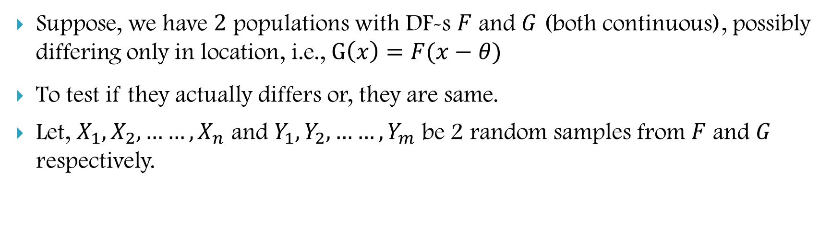
INTRODUCTION
Suppose, we have $2$ populations with DF-s $F$ and $G$ (both continuous), possibly differing only in location, i.e., $G\left(x\right)=F(x−θ)$
To test if they actually differs or, they are same.
Let, $X_{1}, X_{2},……,X_{n}$ and $Y_{1}, Y_{2},……, Y_{m}$ be 2 random samples from $F$ and $G$ respectively.

Slide 3
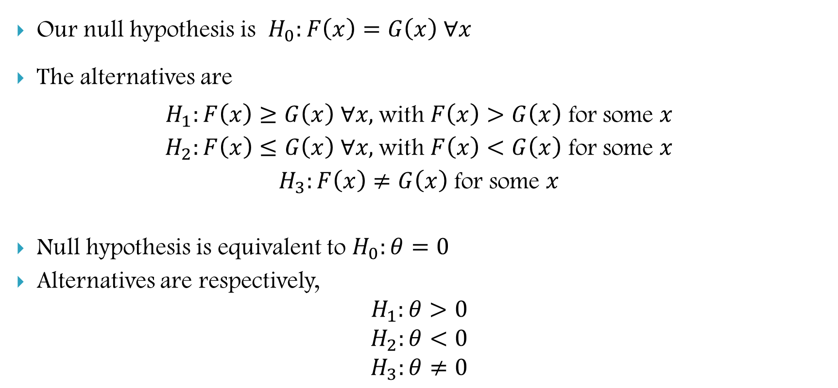
INTRODUCTION
Our null hypothesis is $H_{0}:F\left(x\right)=G\left(x\right) ∀x$
The alternatives are
$H_{1}:F\left(x\right)≥G\left(x\right) ∀x,$with $F\left(x\right)>G\left(x\right)$ for some $x$
$H_{2}:F\left(x\right)≤G\left(x\right) ∀x,$with $F\left(x\right)<G\left(x\right)$ for some $x$
$H_{3}:F\left(x\right)≠G\left(x\right)$ for some $x$
Null hypothesis is equivalent to $H_{0}:θ=0$
Alternatives are respectively,
$$H_{1}:θ>0$$
$$H_{2}:θ<0$$
$$H_{3}:θ≠0$$

Slide 4
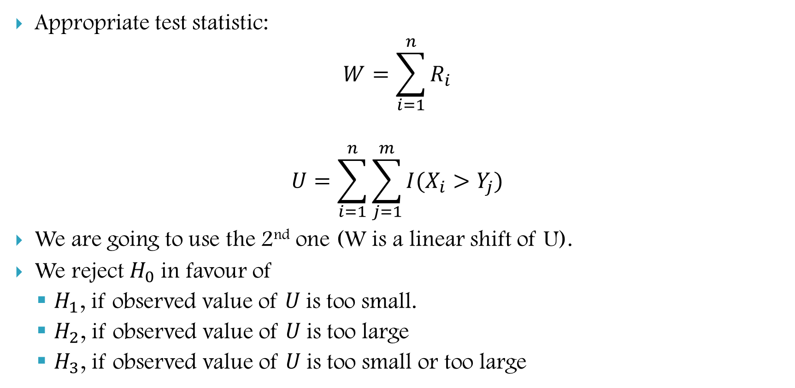
INTRODUCTION
Appropriate test statistic:
$$W=\sum_{i=1}^{n}{R_{i}}$$
$$U=\sum_{i=1}^{n}{\sum_{j=1}^{m}{I(X_{i}>Y_{j})}}$$
We are going to use the 2nd one (W is a linear shift of U).
We reject $H_{0}$in favour of
$H_{1}$, if observed value of $U$is too small.
$H_{2}$, if observed value of $U$is too large
$H_{3}$, if observed value of $U$is too small or too large

Slide 5
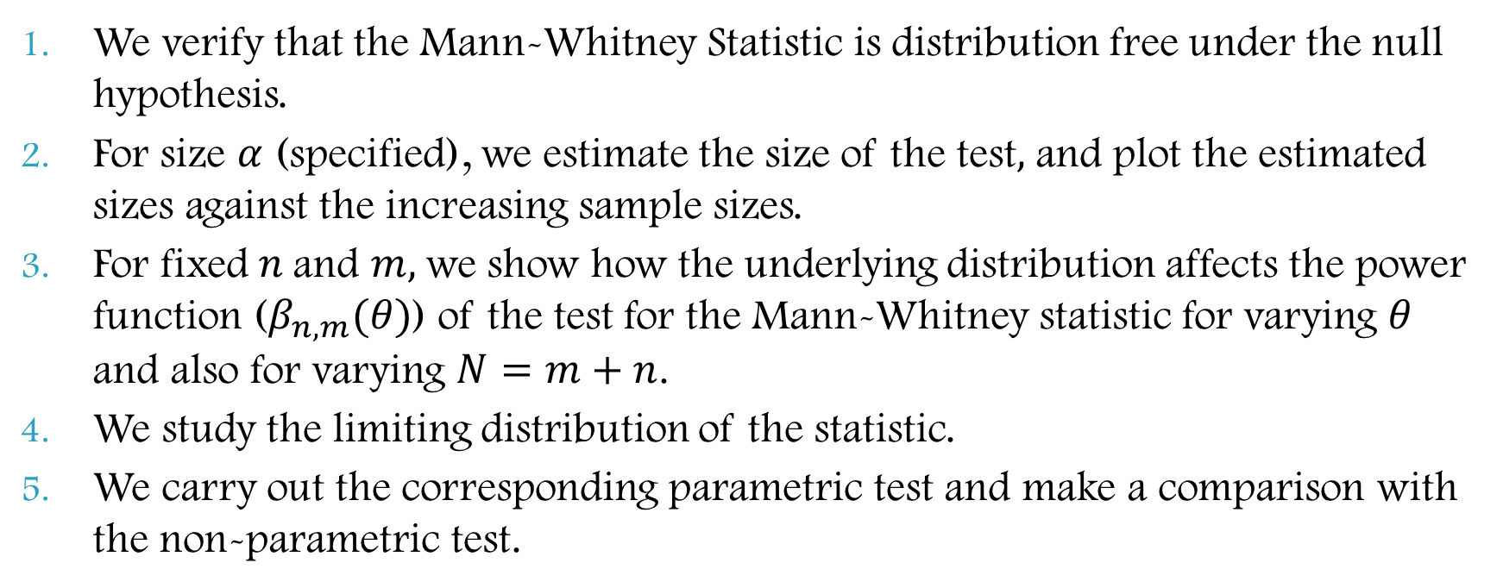
What we discuss here
We verify that the Mann-Whitney Statistic is distribution free under the null hypothesis.
For size $α$ (specified), we estimate the size of the test$,$ and plot the estimated sizes against the increasing sample sizes.
For fixed $n$and $m,$we show how the underlying distribution affects the power function ($β_{n,m}(θ)$) of the test for the Mann-Whitney statistic for varying $θ$ and also for varying $N=m+n$.
We study the limiting distribution of the statistic.
We carry out the corresponding parametric test and make a comparison with the non-parametric test.

Slide 6
DISTRIBUTION OF STATISTIC

Slide 7
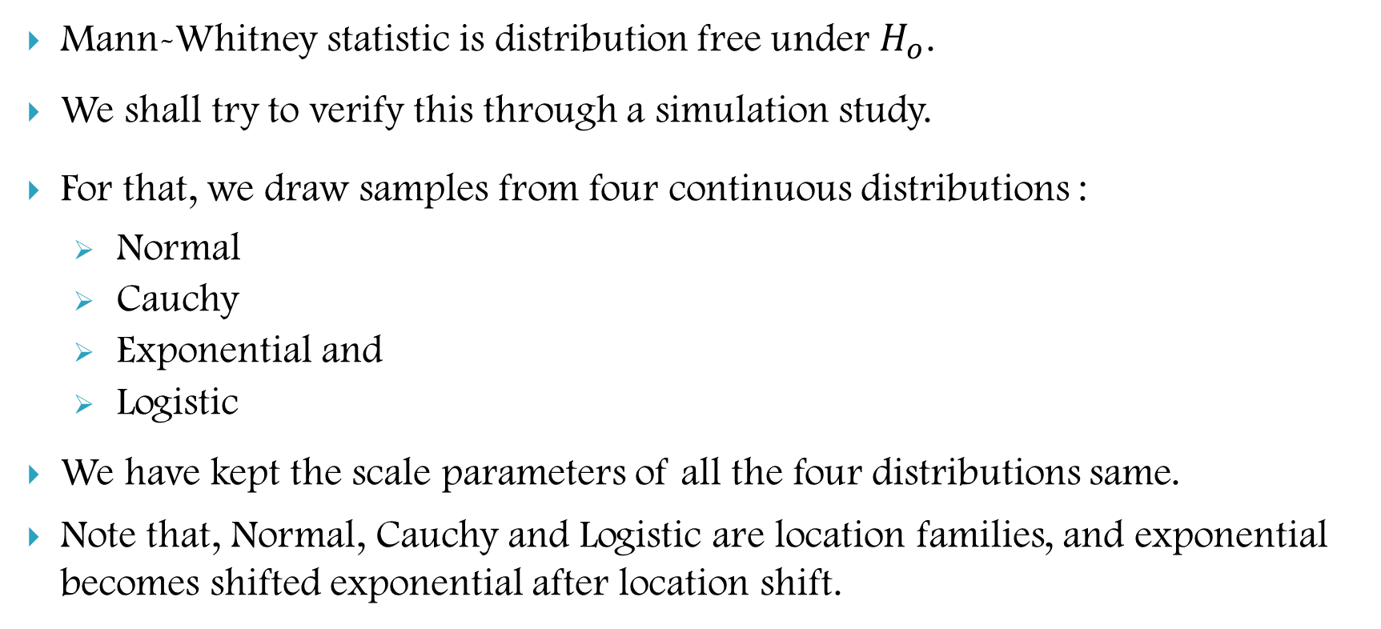
DISTRIBUTION FREE
Mann-Whitney statistic is distribution free under $H_{o}$.
We shall try to verify this through a simulation study.
For that, we draw samples from four continuous distributions :
Normal
Cauchy
Exponential and
Logistic
We have kept the scale parameters of all the four distributions same.
Note that, Normal, Cauchy and Logistic are location families, and exponential becomes shifted exponential after location shift.

Slide 8
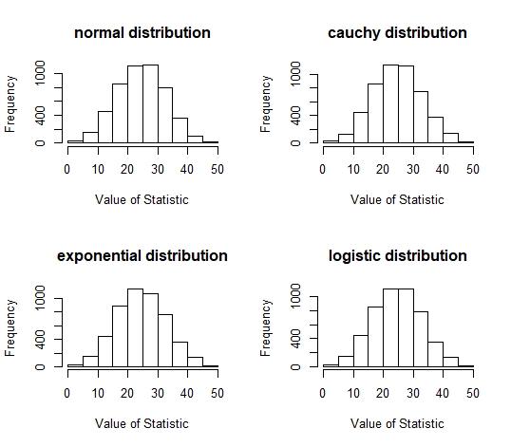
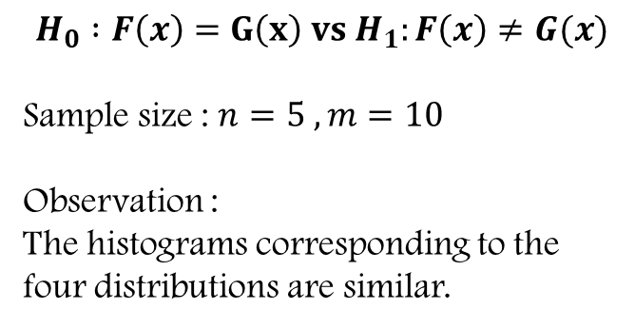
$$H_{0} :F\left(x\right)=G\left(x\right) vs H_{1}:F\left(x\right)≠G(x)$$
Sample size : $n=5 , m=10$
Observation :
The histograms corresponding to the four distributions are similar.

Slide 9
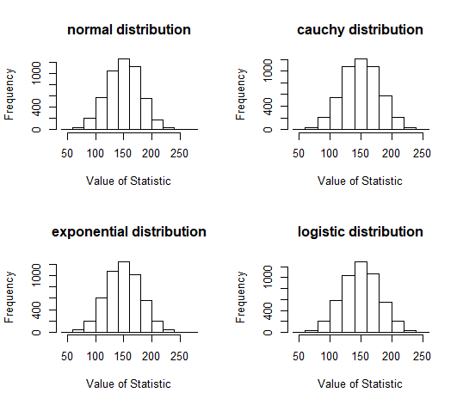
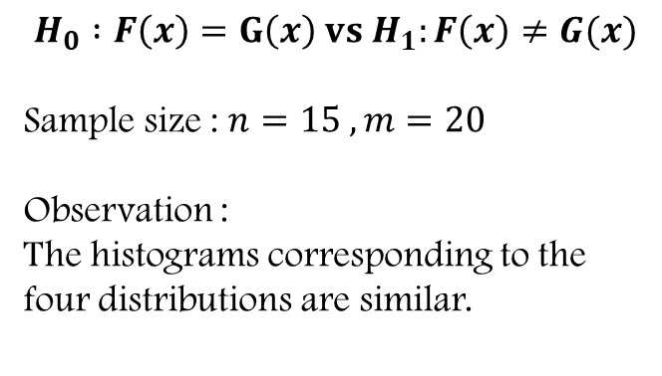
$$H_{0} :F\left(x\right)=G\left(x\right) vs H_{1}:F\left(x\right)≠G(x)$$
Sample size : $n=15 , m=20$
Observation :
The histograms corresponding to the four distributions are similar.

Slide 10
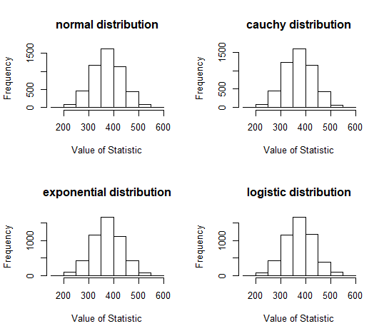
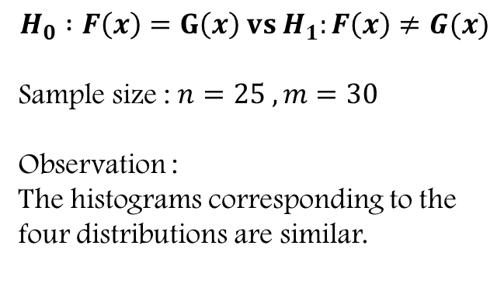
$$H_{0} :F\left(x\right)=G\left(x\right) vs H_{1}:F\left(x\right)≠G(x)$$
Sample size : $n=25 , m=30$
Observation :
The histograms corresponding to the four distributions are similar.

Slide 11
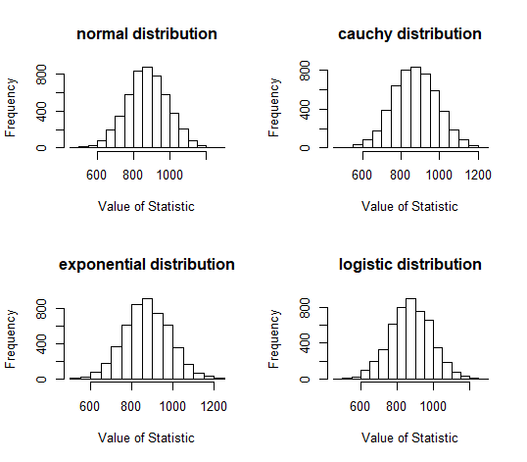
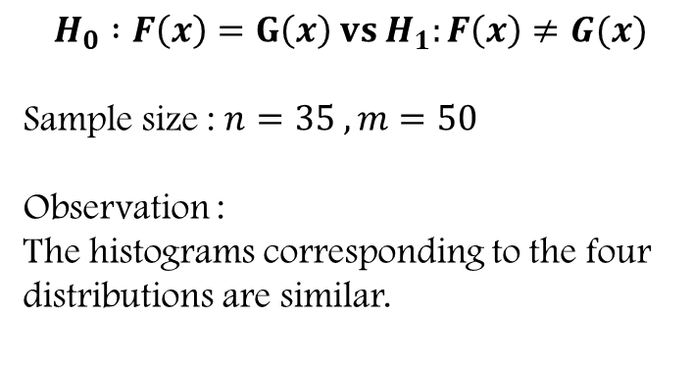
$$H_{0} :F\left(x\right)=G\left(x\right) vs H_{1}:F\left(x\right)≠G(x)$$
Sample size : $n=35 , m=50$
Observation :
The histograms corresponding to the four distributions are similar.

Slide 12
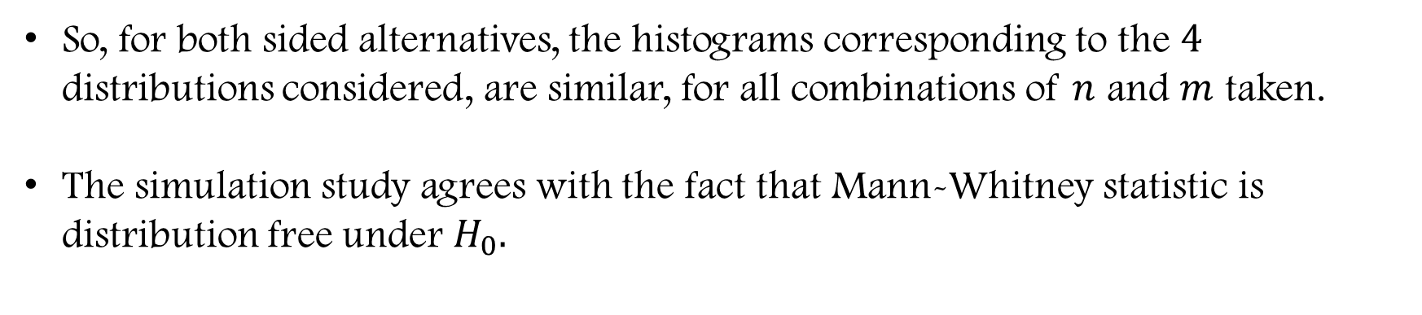
So, for both sided alternatives, the histograms corresponding to the $4$ distributions considered, are similar, for all combinations of $n$ and $m$ taken.
The simulation study agrees with the fact that Mann-Whitney statistic is distribution free under $H_{0}.$

Slide 13
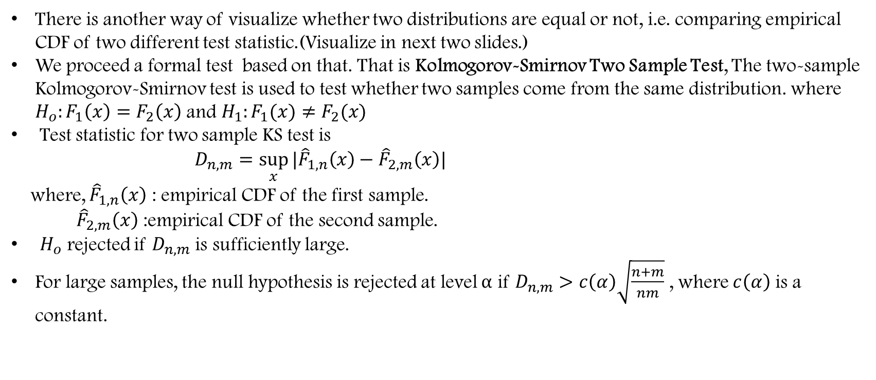
ANOTHER WAY OF VISUALIZATION OF DISTRIBUTION FREE CHARACTERISTIC
There is another way of visualize whether two distributions are equal or not, i.e. comparing empirical CDF of two different test statistic.(Visualize in next two slides.)
We proceed a formal test based on that. That is Kolmogorov-Smirnov Two Sample Test, The two-sample Kolmogorov-Smirnov test is used to test whether two samples come from the same distribution. where $H_{o}:F_{1}\left(x\right)=F_{2}\left(x\right)$ and $H_{1}:F_{1}(x)≠F_{2}(x)$
Test statistic for two sample KS test is
$D_{n,m}=\sup_{x}{|{\hat{F}}_{1,n}\left(x\right)−{\hat{F}}_{2,m}\left(x\right)|}$
where, ${\hat{F}}_{1,n}\left(x\right)$ : empirical CDF of the first sample.
${ \hat{F}}_{2,m}\left(x\right)$ :empirical CDF of the second sample.
$H_{o}$ rejected if $D_{n,m}$ is sufficiently large.
For large samples, the null hypothesis is rejected at level $α$ if $D_{n,m}>c\left(α\right)\sqrt{\frac{n+m}{nm}}$ , where $c\left(α\right)$ is a constant.

Slide 14
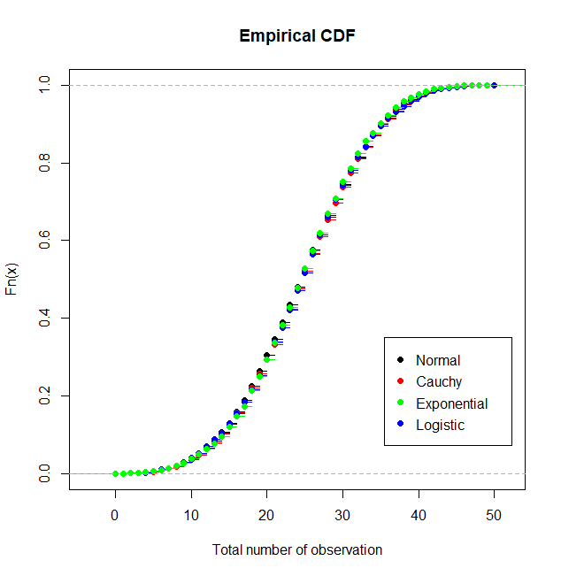
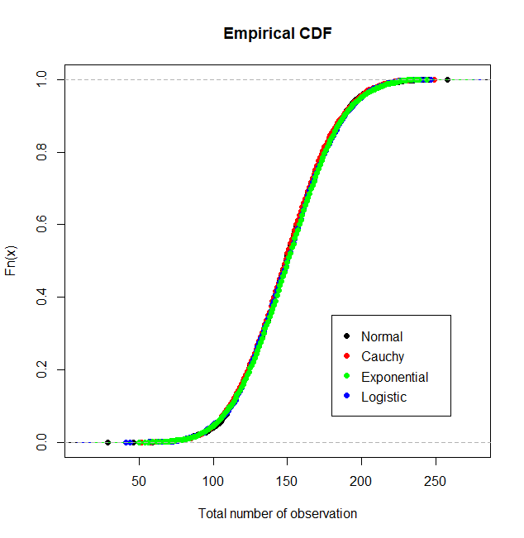
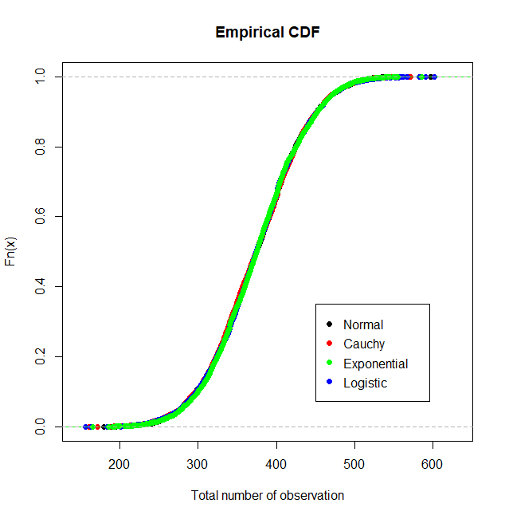
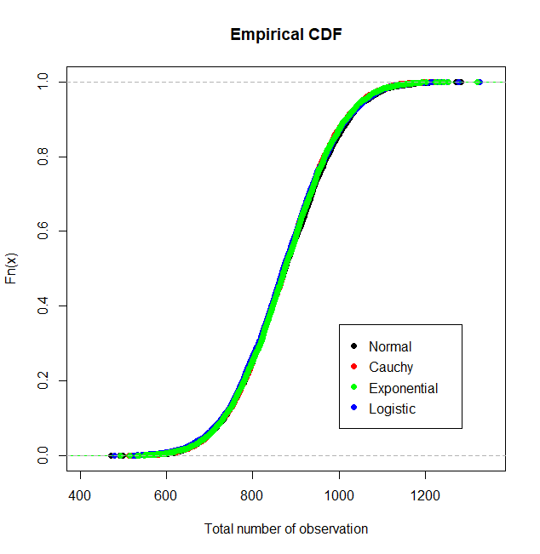




$$n=5,m=10$$
$$n=15,m=20$$
$$n=25,m=30$$
$$n=35,m=50$$

Slide 15
p-values for KOLMOGOROV-SMIRNOV TEST
SAMPLE SIZE | NORMAL vs CAUCHY | NORMAL vs EXPONENTIAL | NORMAL vs LOGISTIC | CAUCHY vs EXPONENTIAL | CAUCHY vs LOGISTIC | EXPONENTIAL vs LOGISTIC
n=5 m=10 | 0.836 | 0.992 | 0.864 | 0.836 | 0.527 | 0.877
n=15 m=20 | 0.998 | 0.352 | 0.511 | 0.327 | 0.123 | 0.987
n=25 m=30 | 0.694 | 0.610 | 0.975 | 0.877 | 0.822 | 0.776
n=35 m=50 | 0.135 | 0.135 | 0.694 | 0.259 | 0.170 | 0.511

Slide 16
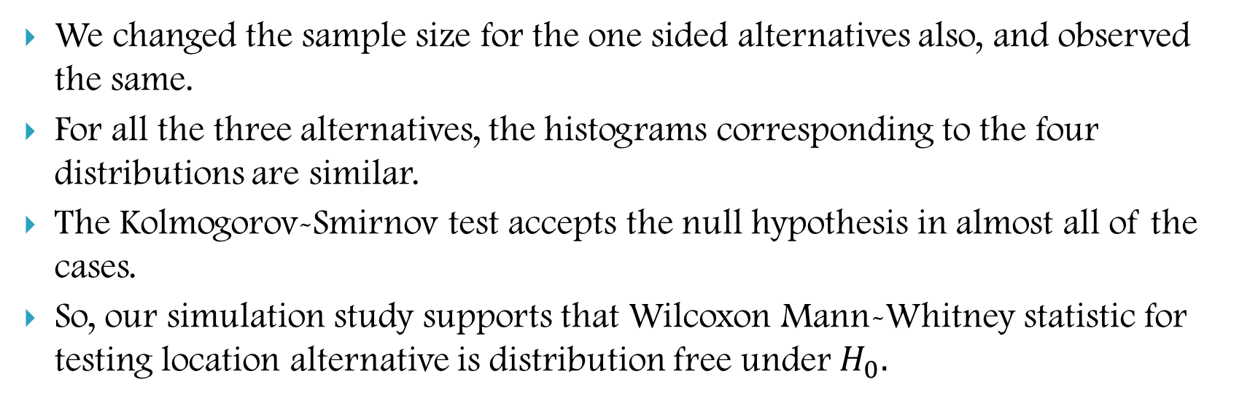
Observations :
We changed the sample size for the one sided alternatives also, and observed the same.
For all the three alternatives, the histograms corresponding to the four distributions are similar.
The Kolmogorov-Smirnov test accepts the null hypothesis in almost all of the cases.
So, our simulation study supports that Wilcoxon Mann-Whitney statistic for testing location alternative is distribution free under $H_{0}.$

Slide 17
PARAMETRIC COUNTERPART

Slide 18
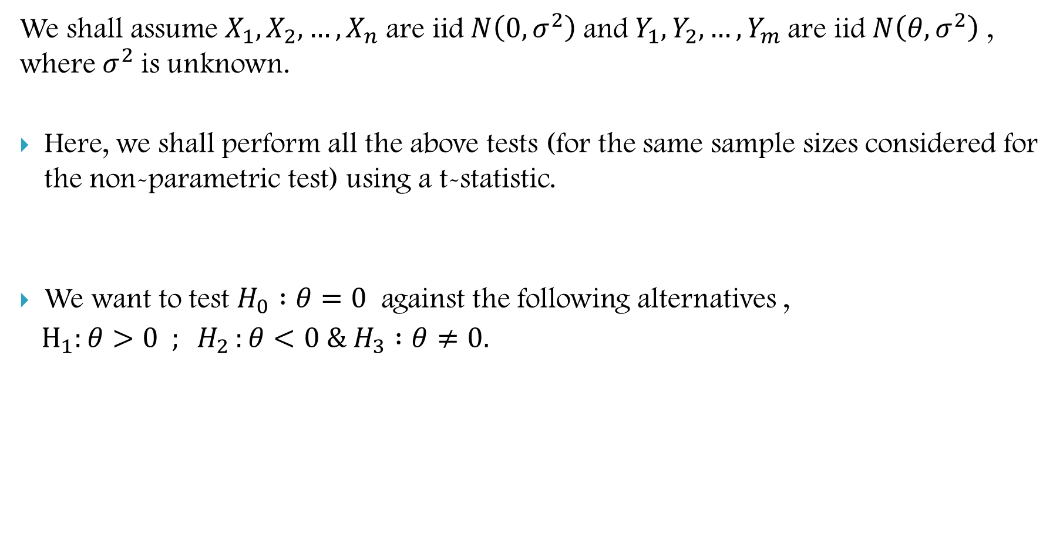
We shall assume $X_{1},X_{2},…,X_{n}$are iid$N\left(0,σ^{2}\right)$and $Y_{1},Y_{2},…,Y_{m}$are iid$N\left(θ,σ^{2}\right)$ , where $σ^{2}$is unknown.
Here, we shall perform all the above tests (for the same sample sizes considered for the non-parametric test) using a t-statistic.
We want to test $H_{0} :θ=0$ against the following alternatives ,
$H_{1}:θ>0 ; H_{2 }:θ<0 \& H_{3} :θ≠0.$

Slide 19
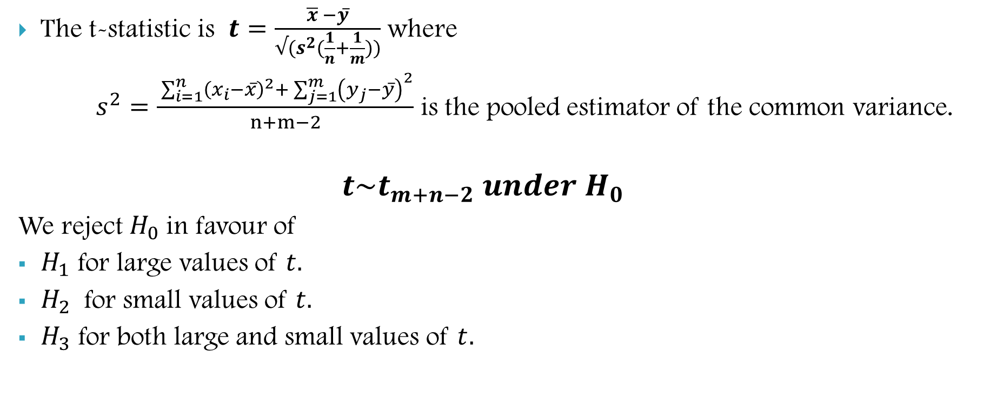
The t-statistic is $t=\frac{\overline{x} −y̅}{√(s^{2}(\frac{1}{n}+\frac{1}{m}))}$ where
$s^{2}=\frac{ \sum_{i=1}^{n}{{\left(x_{i}−x̅\right)}^{2}+ \sum_{j=1}^{m}{{\left(y_{j}−y̅\right)}^{2}}}}{n+m−2}$ is the pooled estimator of the common variance.
$$t\sim t_{m+n−2} under H_{0}$$
We reject $H_{0}$in favour of
$H_{1}$ for large values of $t.$
$H_{2}$ for small values of $t.$
$H_{3}$ for both large and small values of $t.$

Slide 20
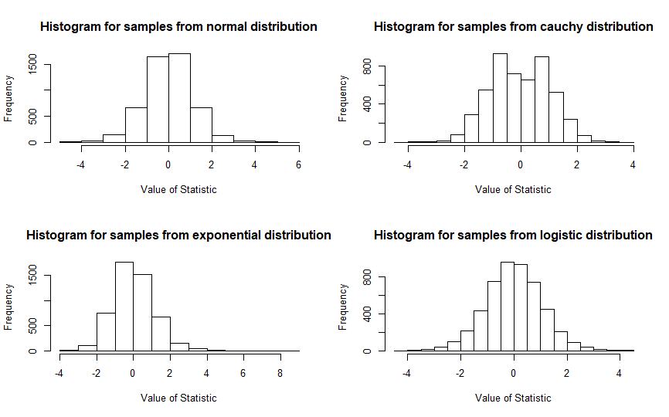
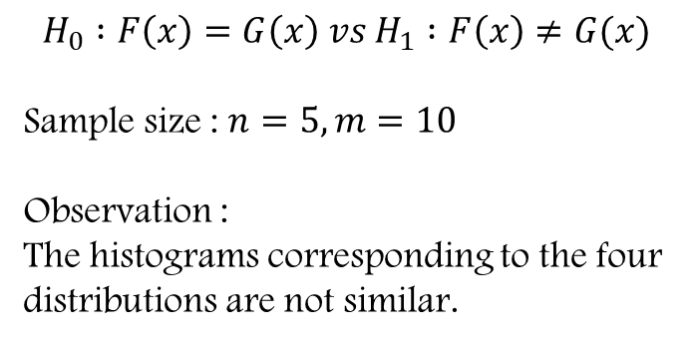
$$H_{0} :F\left(x\right)=G\left(x\right) vs H_{1} :F\left(x\right)≠G(x)$$
Sample size : $n=5, m=10$
Observation :
The histograms corresponding to the four distributions are not similar.

Slide 21
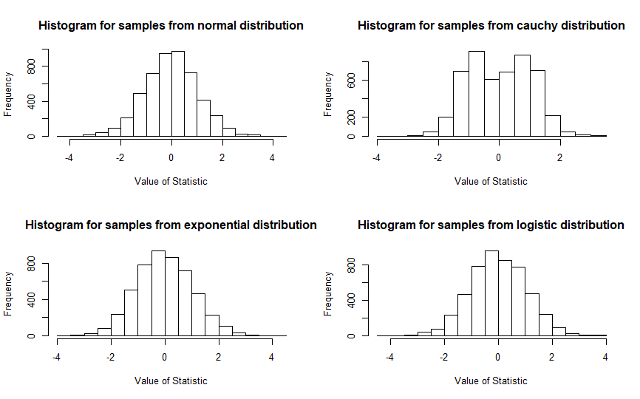
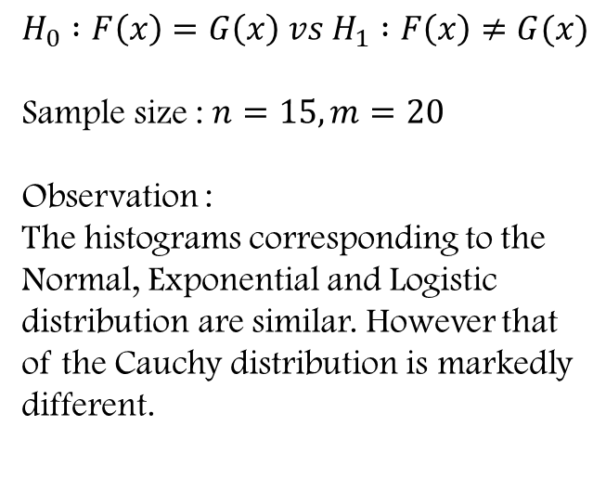
$$H_{0} :F\left(x\right)=G\left(x\right) vs H_{1} :F\left(x\right)≠G(x)$$
Sample size : $n=15, m=20$
Observation :
The histograms corresponding to the Normal, Exponential and Logistic distribution are similar. However that of the Cauchy distribution is markedly different.

Slide 22
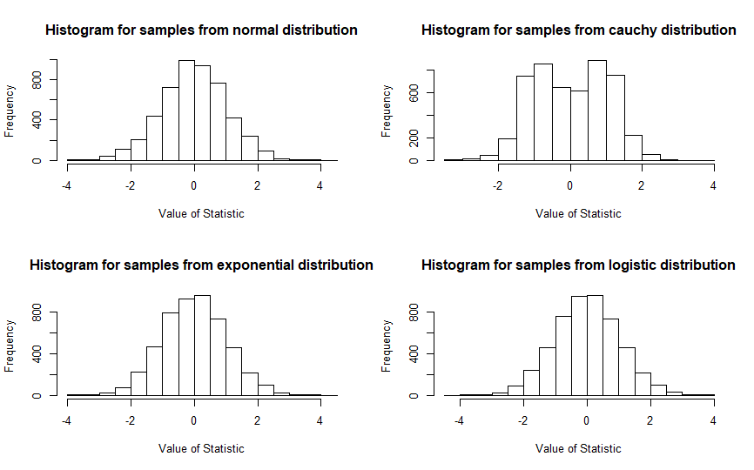
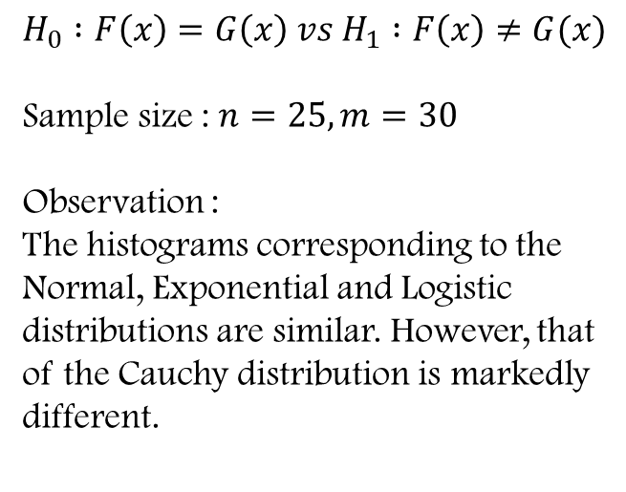
$$H_{0} :F\left(x\right)=G\left(x\right) vs H_{1} :F\left(x\right)≠G(x)$$
Sample size : $n=25, m=30$
Observation :
The histograms corresponding to the Normal, Exponential and Logistic distributions are similar. However, that of the Cauchy distribution is markedly different.

Slide 23
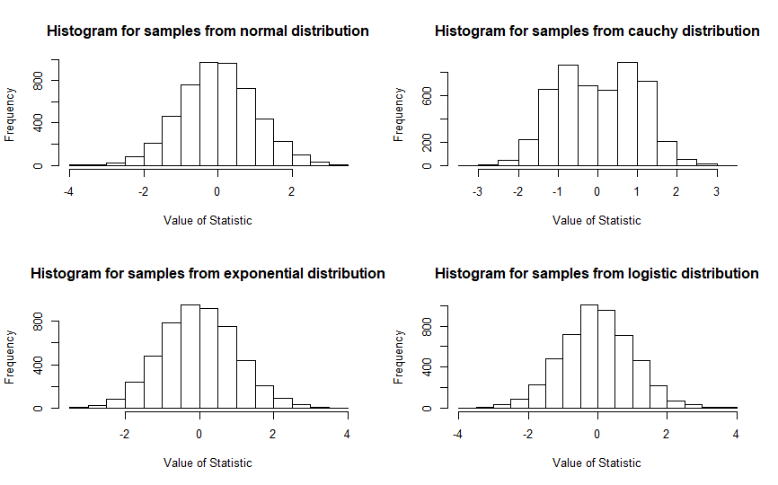
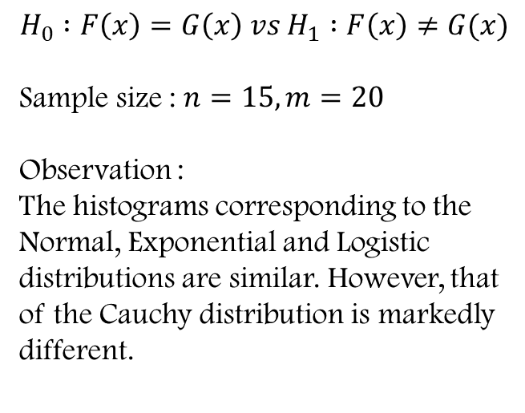
$$H_{0} :F\left(x\right)=G\left(x\right) vs H_{1} :F\left(x\right)≠G(x)$$
Sample size : $n=15, m=20$
Observation :
The histograms corresponding to the Normal, Exponential and Logistic distributions are similar. However, that of the Cauchy distribution is markedly different.

Slide 24
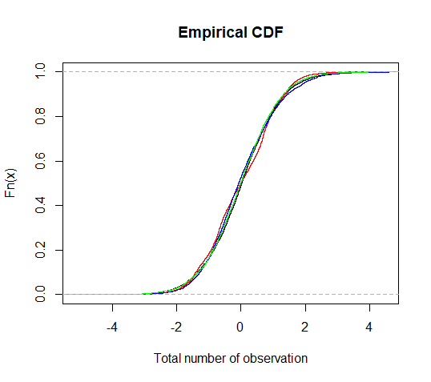
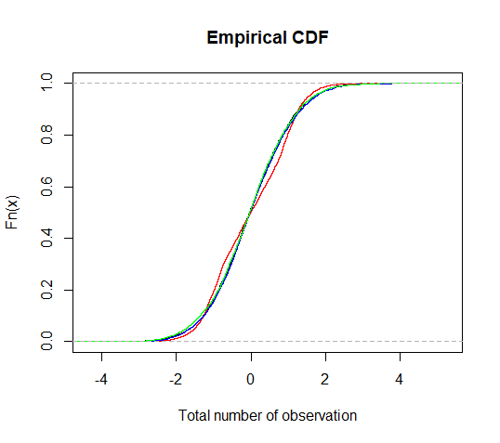
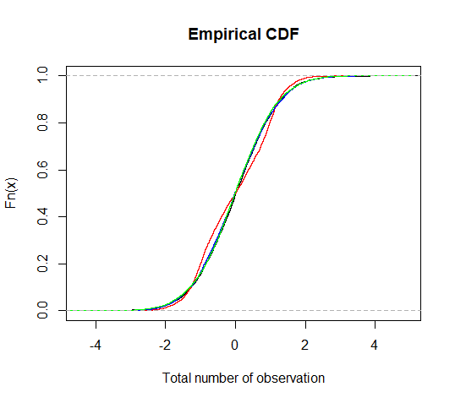
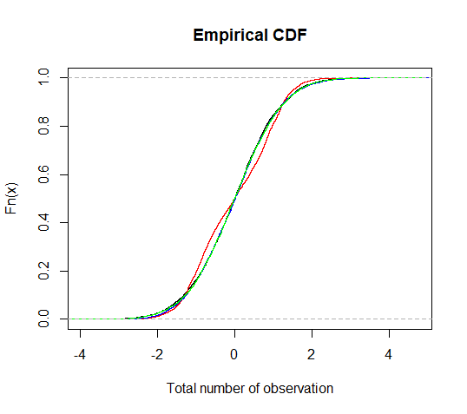



$$n=5,m=10$$
$$n=15,m=20$$
$$n=25,m=30$$
$$n=35,m=50$$

Slide 25
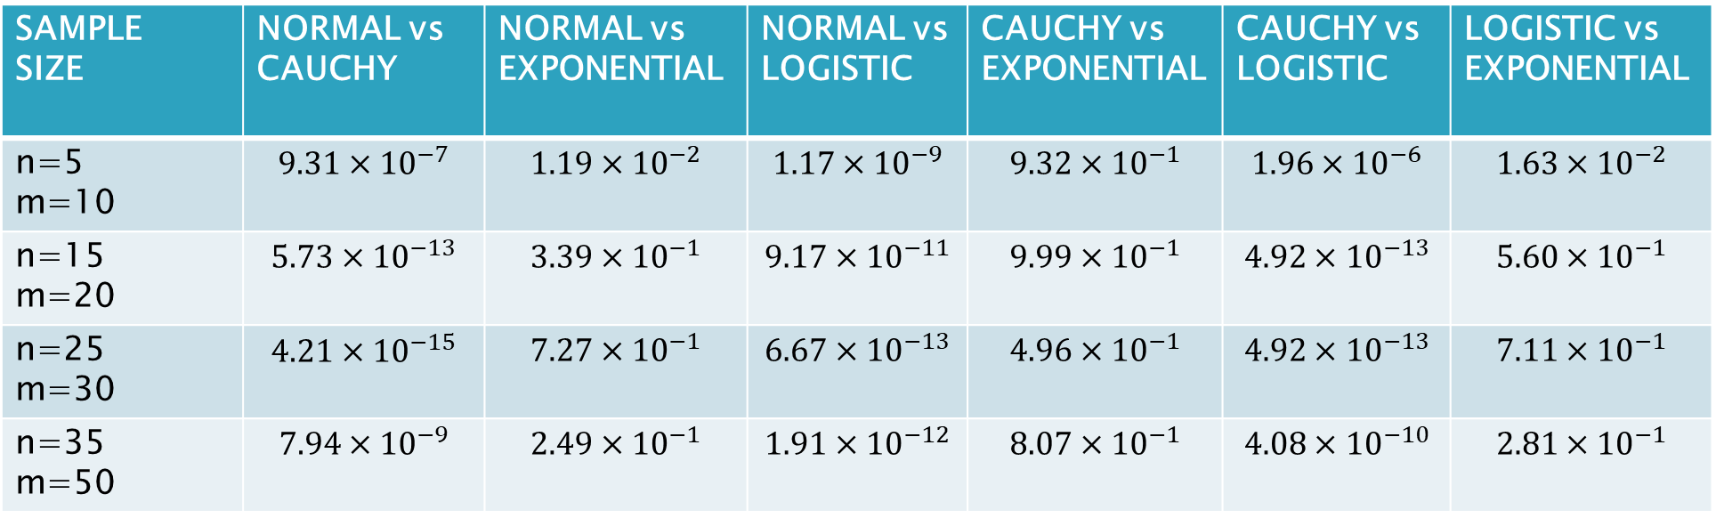
p-values for KOLMOGORV-SMIRNOV TEST
SAMPLE SIZE | NORMAL vs CAUCHY | NORMAL vs EXPONENTIAL | NORMAL vs LOGISTIC | CAUCHY vs EXPONENTIAL | CAUCHY vs LOGISTIC | LOGISTIC vs EXPONENTIAL
n=5 m=10 | $$9.31×{10}^{−7}$$ | $$1.19×{10}^{−2}$$ | $$1.17×{10}^{−9}$$ | $$9.32×{10}^{−1}$$ | $$1.96×{10}^{−6}$$ | $$1.63×{10}^{−2}$$
n=15 m=20 | $$5.73×{10}^{−13}$$ | $$3.39×{10}^{−1}$$ | $$9.17×{10}^{−11}$$ | $$9.99×{10}^{−1}$$ | $$4.92×{10}^{−13}$$ | $$5.60×{10}^{−1}$$
n=25 m=30 | $$4.21×{10}^{−15}$$ | $$7.27×{10}^{−1}$$ | $$6.67×{10}^{−13}$$ | $$4.96×{10}^{−1}$$ | $$4.92×{10}^{−13}$$ | $$7.11×{10}^{−1}$$
n=35 m=50 | $$7.94×{10}^{−9}$$ | $$2.49×{10}^{−1}$$ | $$1.91×{10}^{−12}$$ | $$8.07×{10}^{−1}$$ | $$4.08×{10}^{−10}$$ | $$2.81×{10}^{−1}$$

Slide 26
Observation :
In almost all of the cases, the Kolmogorov-Smirnov test rejects the null hypothesis in favour of the alternative hypothesis.
In some cases, the null hypothesis was accepted for Cauchy vs Exponential distributions, and Exponential vs Logistic distributions.

Slide 27
Limiting Distribution

Slide 28
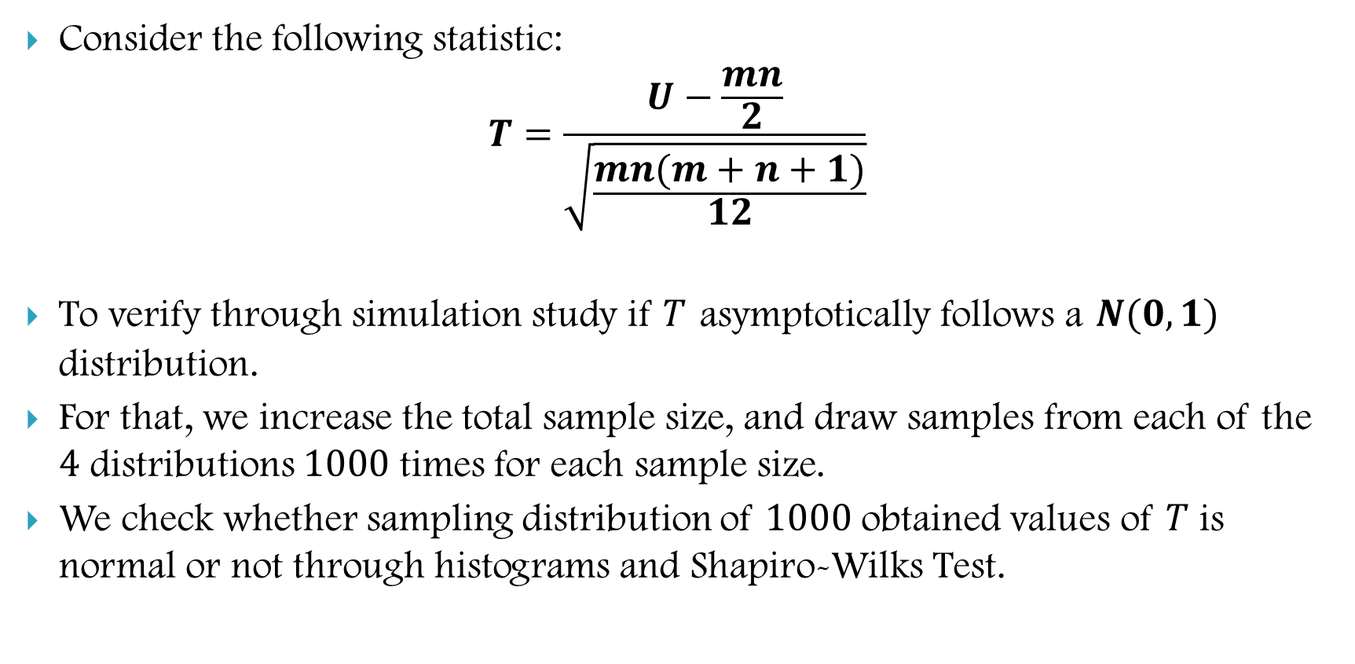
Non-Parametric Test
Consider the following statistic:
$$T=\frac{U−\frac{mn}{2}}{\sqrt{\frac{mn(m+n+1)}{12}}}$$
To verify through simulation study if $T$ asymptotically follows a $N(0,1)$ distribution.
For that, we increase the total sample size, and draw samples from each of the $4$ distributions $1000$ times for each sample size.
We check whether sampling distribution of $1000$ obtained values of $T$ is normal or not through histograms and Shapiro-Wilks Test.

Slide 29
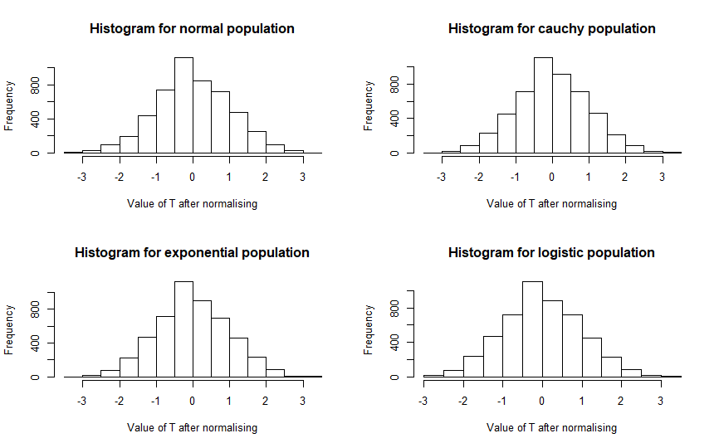
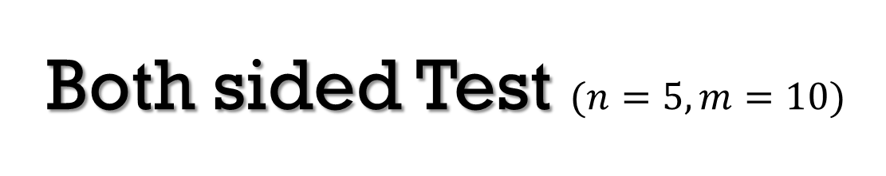
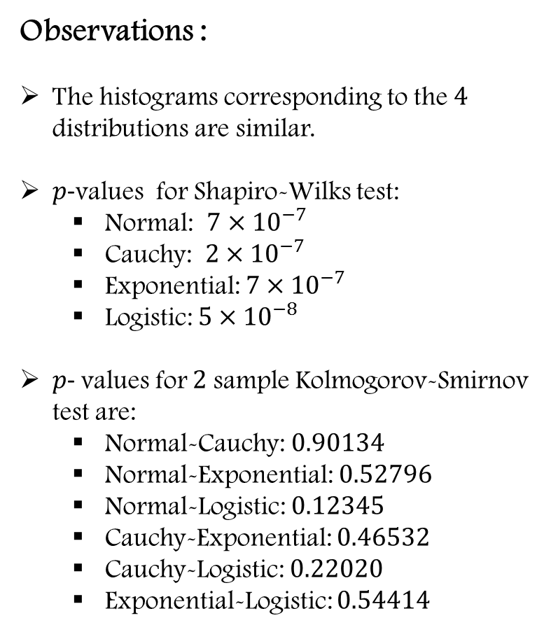
Both sided Test $(n=5,m=10)$
Observations :
The histograms corresponding to the $4$ distributions are similar.
$p$-values for Shapiro-Wilks test:
Normal: $7×{10}^{−7}$
Cauchy: $2×{10}^{−7}$
Exponential: $7×{10}^{−7}$
Logistic: $5×{10}^{−8}$
$p$- values for $2$ sample Kolmogorov-Smirnov test are:
Normal-Cauchy: $0.90134$
Normal-Exponential: $0.52796$
Normal-Logistic: $0.12345$
Cauchy-Exponential: $0.46532$
Cauchy-Logistic: $0.22020$
Exponential-Logistic: $0.54414$

Slide 30
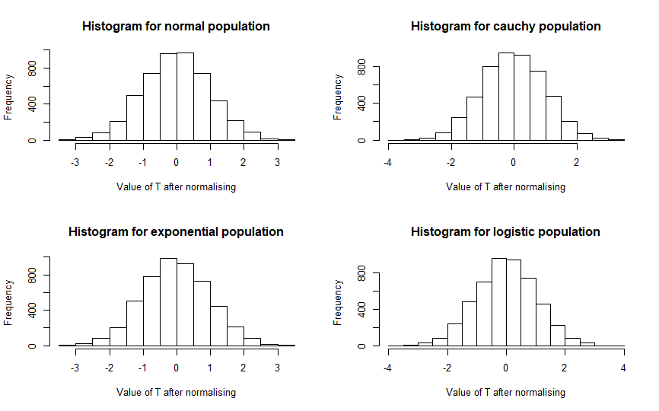
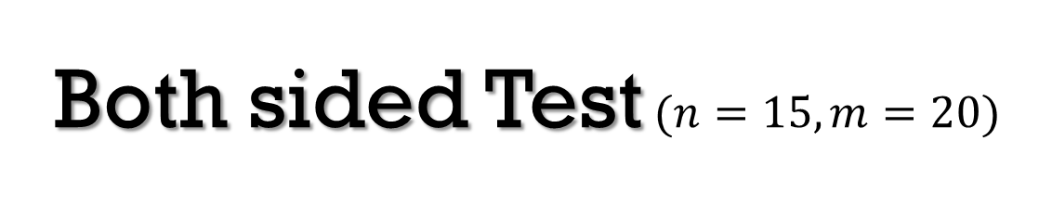
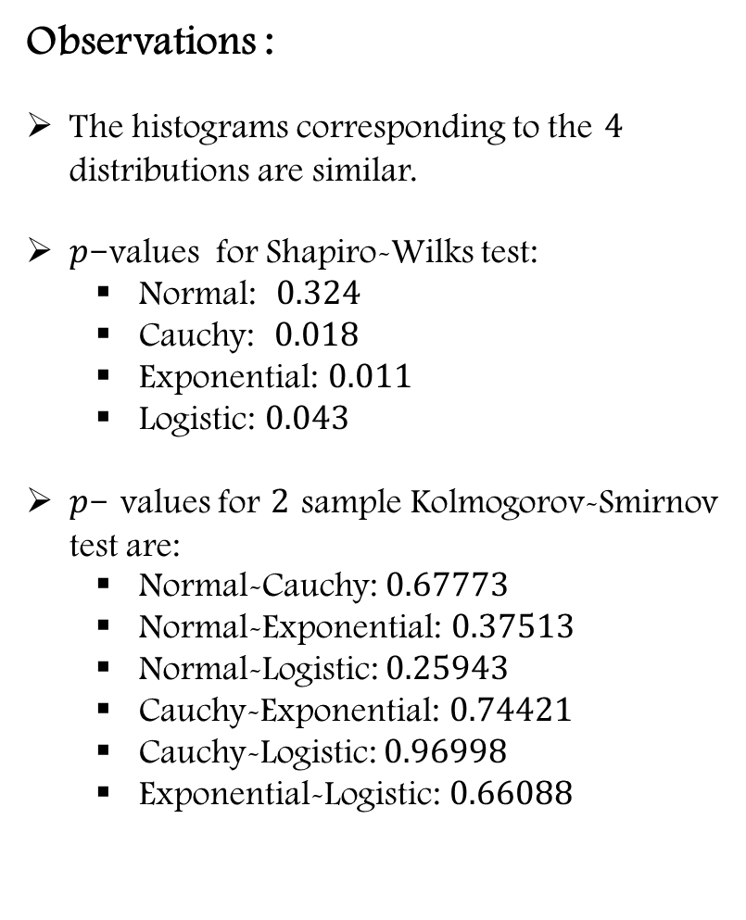
Both sided Test$(n=15,m=20)$
Observations :
The histograms corresponding to the $4$ distributions are similar.
$p$-values for Shapiro-Wilks test:
Normal: $0.324$
Cauchy: $0.018$
Exponential: $0.011$
Logistic: $0.043$
$p$- values for $2$ sample Kolmogorov-Smirnov test are:
Normal-Cauchy: $0.67773$
Normal-Exponential: $0.37513$
Normal-Logistic: $0.25943$
Cauchy-Exponential: $0.74421$
Cauchy-Logistic: $0.96998$
Exponential-Logistic: $0.66088$

Slide 31
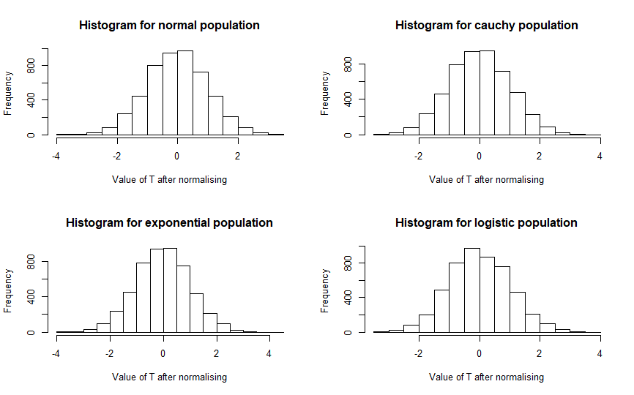
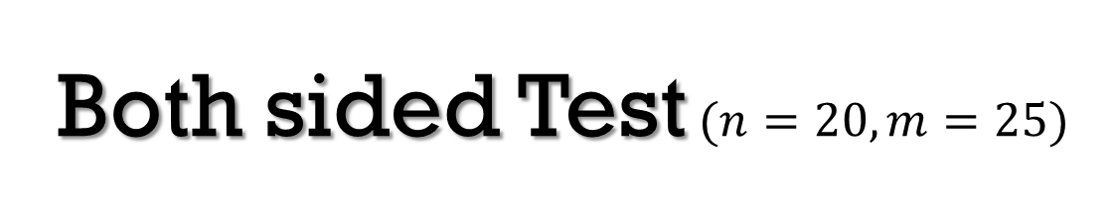
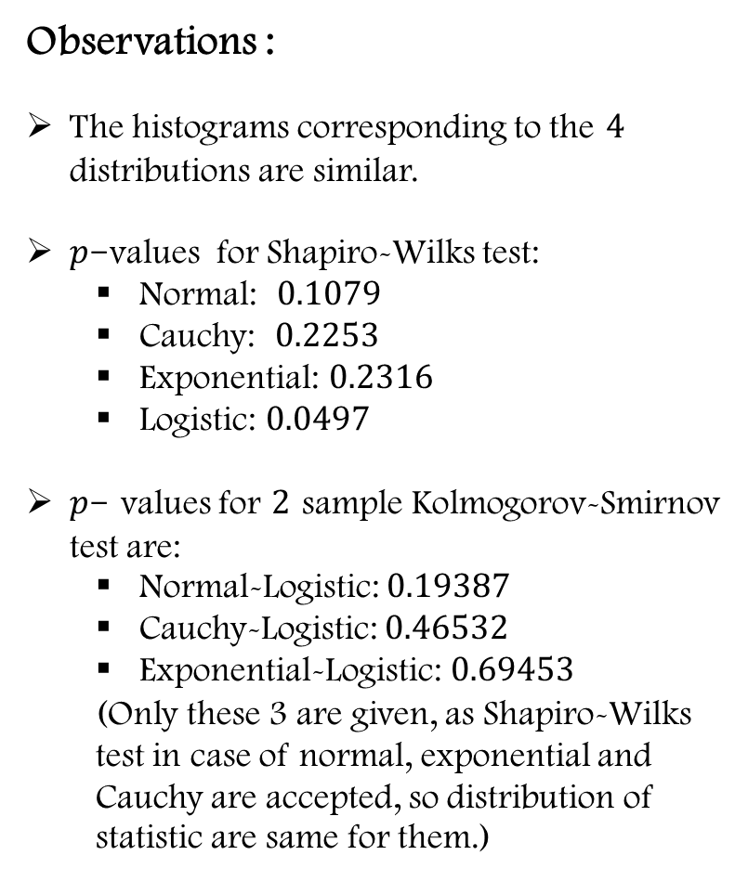
Both sided Test$(n=20,m=25)$
Observations :
The histograms corresponding to the $4$ distributions are similar.
$p$-values for Shapiro-Wilks test:
Normal: $0.1079$
Cauchy: $0.2253$
Exponential: $0.2316$
Logistic: $0.0497$
$p$- values for $2$ sample Kolmogorov-Smirnov test are:
Normal-Logistic: $0.19387$
Cauchy-Logistic: $0.46532$
Exponential-Logistic: $0.69453$
(Only these 3 are given, as Shapiro-Wilks test in case of normal, exponential and Cauchy are accepted, so distribution of statistic are same for them.)

Slide 32
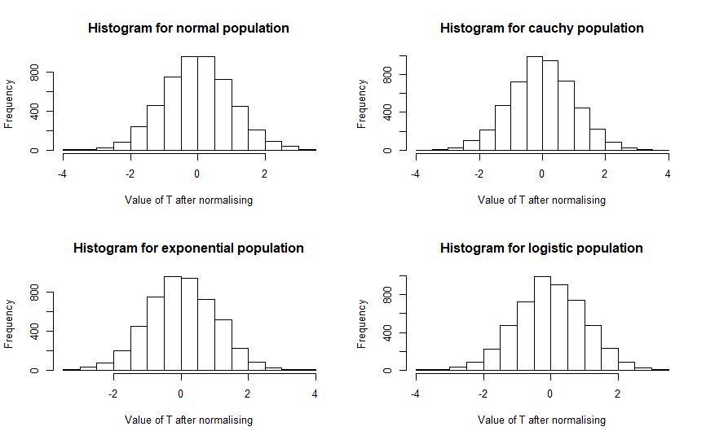
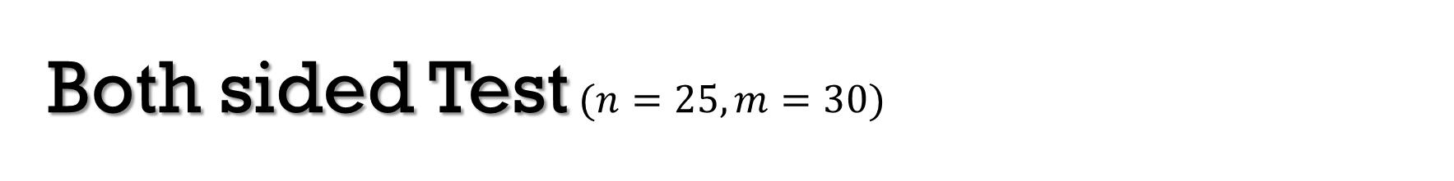
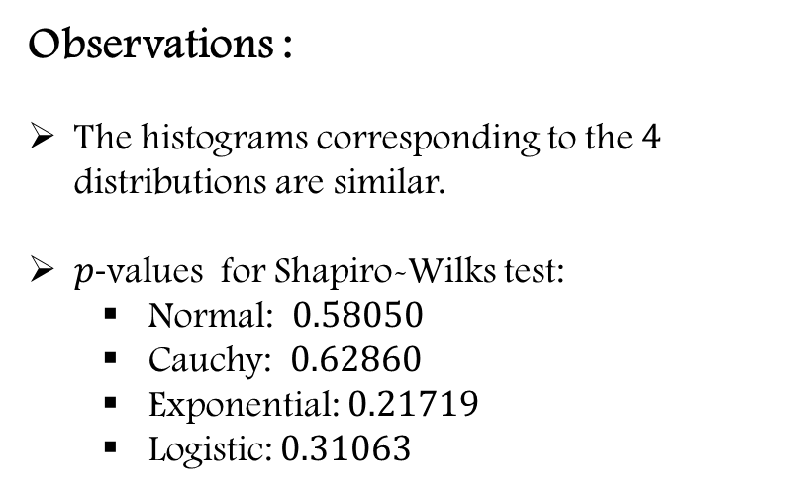
Both sided Test$(n=25,m=30)$
Observations :
The histograms corresponding to the $4$ distributions are similar.
$p$-values for Shapiro-Wilks test:
Normal: $0.58050$
Cauchy: $0.62860$
Exponential: $0.21719$
Logistic: $0.31063$

Slide 33
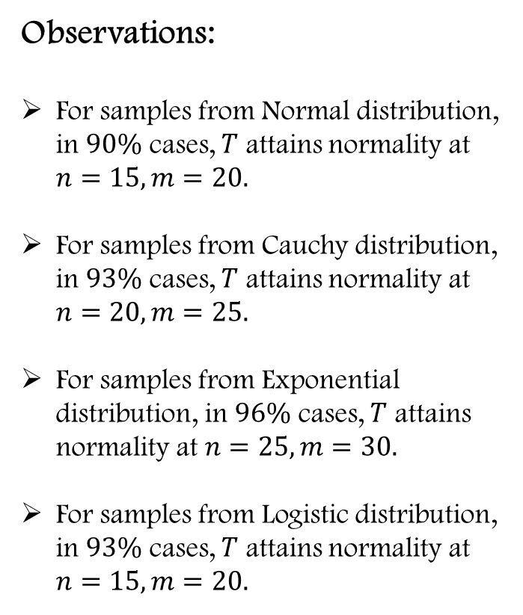
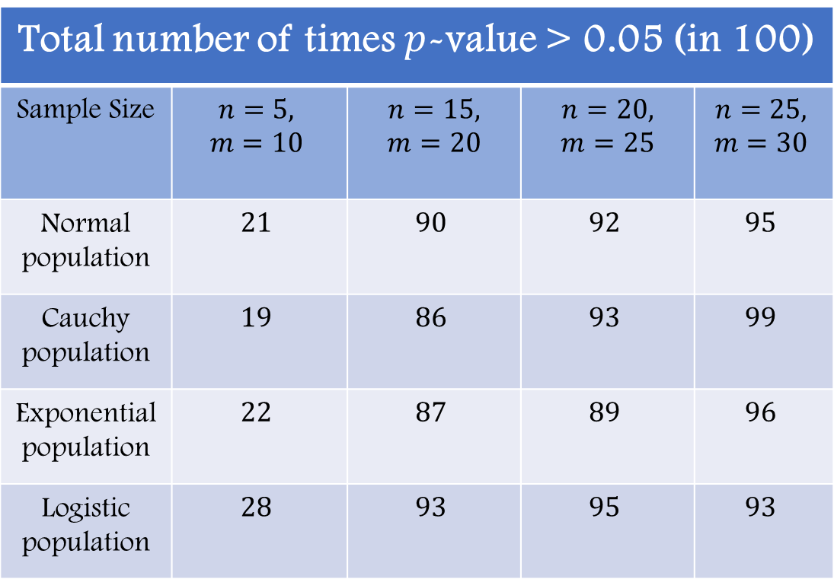
Observations:
For samples from Normal distribution, in $90\%$ cases, $T$ attains normality at $n=15, m=20.$
For samples from Cauchy distribution, in $93\%$ cases, $T$ attains normality at $n=20, m=25.$
For samples from Exponential distribution, in $96\%$ cases, $T$ attains normality at $n=25, m=30.$
For samples from Logistic distribution, in $93\%$ cases, $T$ attains normality at $n=15, m=20.$
Total number of times $p$-value > 0.05 (in 100)
Sample Size | $$n=5,$$ $$m=10$$ | $$n=15,$$ $$m=20$$ | $$n=20,$$ $$m=25$$ | $$n=25,$$ $$m=30$$
Normal population | $$21$$ | $$90$$ | $$92$$ | $$95$$
Cauchy population | $$19$$ | $$86$$ | $$93$$ | $$99$$
Exponential population | $$22$$ | $$87$$ | $$89$$ | $$96$$
Logistic population | $$28$$ | $$93$$ | $$95$$ | $$93$$

Slide 34

Parametric Counterpart
Consider the following statistic:
$$T_{p}=\frac{t}{\sqrt{\frac{m+n−2}{\left(m+n−2\right)−2}}}$$
To verify through simulation study if $T_{p}$ asymptotically follows a $N(0,1)$ distribution under $H_{0}:θ=0.$
For that, we increase the total sample size, and draw samples from each of the $4$ distributions $1000$ times for each sample size.
We check whether sampling distribution of $1000$ obtained values of $T_{p}$ is normal or not through histograms and Shapiro-Wilks Test.

Slide 35



Both sided Test$(n=5,m=10)$
Observations :
The histograms corresponding to the $4$ distributions do not seem to be similar.
$p$-values for Shapiro-Wilks test:
Normal: $1.415×{10}^{−7}$
Cauchy:$2.448×{10}^{−15}$
Exponential: $8.773×{10}^{−17}$
Logistic: $2.979×{10}^{−5}$
$p$- values for $2$ sample Kolmogorov-Smirnov test are:
Normal-Cauchy: $0.0906$
Normal-Exponential: $0.6434$
Normal-Logistic: $0.3591$
Cauchy-Exponential: $0.5621$
Cauchy-Logistic: $0.0388$
Exponential-Logistic: $0.0821$

Slide 36



Both sided Test$(n=15,m=20)$
Observations :
The histograms corresponding to the $4$ distributions do not seem to be similar.
$p$-values for Shapiro-Wilks test:
Normal: $0.611$
Cauchy:$4.01×{10}^{−26}$
Exponential: $1.93×{10}^{−4}$
Logistic: $0.163$
$p$- values for $2$ sample Kolmogorov-Smirnov test are:
Normal-Cauchy: $0.0098$
Normal-Exponential: $0.3591$
Normal-Logistic: $0.0014$
Cauchy-Exponential: $0.5352$
Cauchy-Logistic: $0.0017$
Exponential-Logistic: $0.1861$

Slide 37



Both sided Test$(n=25,m=30)$
Observations :
The histograms corresponding to the $4$ distributions do not seem to be similar.
$p$-values for Shapiro-Wilks test:
Normal: $0.173$
Cauchy:$3.57×{10}^{−29}$
Exponential: $0.503$
Logistic: $0.789$
$p$- values for $2$ sample Kolmogorov-Smirnov test are:
Normal-Cauchy: $0.0214$
Normal-Exponential: $0.0027$
Normal-Logistic: $0.0014$
Cauchy-Exponential: $0.5352$
Cauchy-Logistic: $0.0017$
Exponential-Logistic: $0.9841$
(From the $p$-values of Kolmogorov- Smirnov test, the statistic does not seem to be distribution free)

Slide 38


Observations:
For samples from Normal distribution, in $92\%$ cases, $T$ attains normality at $n=25, m=30.$
For samples from Cauchy distribution, even for large sample sizes like $n=40,m=50$, this percentage is about $2\%.$
For samples from Exponential distribution, in $90\%$ cases, $T$ attains normality at $n=25, m=30.$
For samples from Logistic distribution, in $93\%$ cases, $T$ attains normality at $n=25, m=30.$
Total number of times $p$-value > 0.05 (in 100)
Sample Size | $$n=5,$$ $$m=10$$ | $$n=15,$$ $$m=20$$ | $$n=25,$$ $$m=30$$
Normal population | 21 | 86 | 92
Cauchy population | 1 | 0 | 0
Exponential population | 1 | 81 | 90
Logistic population | 38 | 90 | 93

Slide 39
SIZE OF THE TEST

Slide 40

Size of the Non-Parametric Test
Here, we try to estimate size of the test and check(graphically) whether it asymptotically attains its level or not.
For that, we draw samples of different sizes from the $4$ distributions 10000 times, and test $H_{0}$ against all $3$alternatives fixing the level.
We estimate size of the test by the proportion of cases where test is rejected under $H_{0}:θ=0$
We increase the total sample size and plot the estimated sizes against the total sample sizes, and check whether they approach to the fixed level.

Slide 41




$$α=0.001$$
$$α=0.005$$

Slide 42




$$α=0.01$$
$$α=0.05$$

Slide 43




$$α=0.1$$
$$α=0.3$$
In all the cases, as the total sample size increases, the estimate of size of the test gets close to actual level .

Slide 44

Parametric Counterpart
We do the same here as Non-Parametric case.
We perform t-test for samples from the 4 distributions, for different levels and increasing sample sizes.
Size of the test is estimated by proportion of rejections under $H_{0}:θ=0.$
We plot the estimated sizes against the total sample size, and try to see whether it approaches to the fixed level as the total sample size increases.

Slide 45




$$α=0.001$$
$$α=0.005$$
In both cases, for samples from normal and logistic distribution, the estimate of size goes closer to the actual level than for sample from exponential distribution as total ample size increases and for samples from Cauchy distribution, the estimate does not at all go closer to the actual level.

Slide 46




$$α=0.01$$
$$α=0.05$$
Here also, we can see that in case of samples from Cauchy distribution, the estimate of size stays far away from the actual level even if we increase the total sample size and in rest of the cases, the estimate goes close to the actual level.

Slide 47




$$α=0.1$$
$$α=0.2$$
For samples from all $4$ distributions except for Cauchy, the estimate of size goes close to the actual level of the test as the total sample size increases.

Slide 48


Here also, we can observe that in case of samples arising out of normal, logistic and exponential distribution, the estimate of size gets close to the actual level as the total sample size increases, but for samples from Cauchy distribution, the estimate of size is always much more higher than actual level of the test.
Above observation supports the fact that the statistic is not distribution free.
The statistic performs perfectly when the sample arises out of a normal distribution.
We observe that, for samples from logistic and exponential distribution also, the estimate of size gets closer to actual level as the total sample size increases.
But, for sample from Cauchy distribution, the estimated size does not at all go close to the actual level of the test, so the distribution of the statistic deviates from normality very highly.
$$α=0.3$$

Slide 49
POWER FUNCTION

Slide 50


POWER FUNCTION ($β_{n,m}(θ)$)
Here we consider the power function for two-sided alternative.
$θ$ is location parameter and we vary $θ$ for fixed sample size $n$and $m.$
For fixed $n$and $m,$we show how the underlying distribution affects the power function of the test for the Mann-Whitney statistic when $θ$ is varying.
Here we show for the following distribution
Normal (Symmetric)
Cauchy (Symmetric, heavy tailed, moments do not exist)
Exponential (Positively Skewed)
Logistic (Symmetric, heavy tailed, moments exist)

Slide 51

Here we plot the power function of the Mann-Whitney Statistic against different values of the location parameter, where sample size is fixed.
Observations:
Exponential has more power than the other three distributions.
Normal has less power than exponential but for higher values of the parameter power plot moderately coincide with the exponential one.
Cauchy has the least power among the four distribution under consideration.
Logistic has moderately higher power than the Cauchy distribution and less power than the Normal distribution.

Slide 52

Power function of Mann-Whitney statistic under $H_{1}:F\left(x\right)≥G\left(x\right)$ or equivalently, $H_{1}:θ≤0$
Observation:
Same as previous but power of all the four plot is higher than the previous power plot of both sided alternative.

Slide 53


Power function of Mann-Whitney statistic under $H_{1}:F\left(x\right)≤G\left(x\right)$ or equivalently, $H_{1}:θ≥0$
Observation:
Same as previous.

Slide 54

Here we plot the power function of Mann-Whitney Statistic and corresponding Fisher t-statistic
Observation:
Power function of the t-statistic is moderately higher than Mann-Whitney statistic.
Here we have performed t-test, which is the MP test when sample actually comes from normal. So, parametric counter part has higher power as expected.

Slide 55

Observation:
Samples come from Cauchy population but we have used the t-statistic which makes normal assumption. So, the power gets decreased.
Since Mann-Whitney statistic does not require any distributional assumption, here power is more than t-test.

Slide 56

Observation:
We have used the t-statistic assuming the sample to be normal, but samples come from exponential population. So, the power gets decreased but not like Cauchy distribution.
Since Mann-Whitney statistic does not require any distributional assumption, here power is moderately higher than t-test.

Slide 57


Observation:
Here also, t-test has more power than Mann-Whitney test except for a neighborhood of $0.$
In a neighborhood of $0,$ both the power functions overlap, perhaps due to the fact that, Mann-Whitney is locally most powerful rank test for testing $H_{0}:θ=0,$when sample comes from logistic population.

Slide 58
ASYMPTOTIC BEHAVIOUR OF POWER FUNCTION

Slide 59


POWER FUNCTION ($β_{n,m}(θ)$)
Our case total sample size vary from 5 to 70 and $θ$is fixed.
Result :
$U_{n}$ is a test statistic for testing $H_{0} : F\left(x\right)=G\left(x\right),$ against $H_{1}:F\left(x\right)≥G(x)$ . So, we reject $H_{0}$ for large values of $U_{n}$ and satisfies the following
$U_{n} \underset{→}{p}μ_{G},$as $n → ∞$
$μ_{G}=μ_{0}$ $∀ G∈Ω_{0}$ and $μ_{G}>μ_{0}$ $∀ G∈Ω_{1}$
Suppose there is a constant $σ_{o}$ such that
$\sqrt{n}\left(\frac{U_{n}−μ_{o}}{σ_{o}}\right) \underset{→}{d}$ $N\left(0,1\right)$ $∀G∈Ω_{o}$
Then $∃$a sequence of critical values ${\left\{k_{n}\right\}}_{n≥1}$ such that $U_{n}$ is asymptotically size $α$ and $P_{G}\left(U_{n}≥k_{n}\right)→1$as $n →∞ ∀ G∈Ω_{1}$
From simulation study we explore this fact.
Here we also plot the parametric counterpart of power function and see the difference.

Slide 60




$$θ=1$$
$$θ=1$$

Slide 61




$$θ=2$$
$$θ=2$$

Slide 62



$$θ=3$$

Slide 63




$$θ=4$$
$$θ=4$$

Slide 64




$$θ=5$$
$$θ=5$$

Slide 65




$$θ=6$$
$$θ=6$$

Slide 66




$$θ=7$$
$$θ=7$$

Slide 67




$$θ=8$$
$$θ=8$$

Slide 68

CONCLUSION
Distribution free nature: We verify distribution free nature of Mann-Whitney test statistic under$H_{o}$ by plotting histograms and ECDF by taking samples from four different distributions. In both cases results are satisfactory. For formal testing we use two sample KS test and we see that gives higher $p$ – value. Same things are done for the parametric counterpart or Fisher t-test and we see that results are quite unsatisfactory.
Limiting distribution: Here we verify that whether asymptotic distribution of Mann-Whitney test statistic is normal or not. To visualise that we plot histogram of test statistic by taking samples from four different distribution. And for formal testing we use Shapiro-Wilks test and result is satisfactory. For parametric counterpart results are unsatisfactory for Cauchy distribution sample.
Size $α$ : For exact test: We see that for Mann-Whitney statistic, $p$ -value of test statistic under $H_{o}$ converge to $α$when we increase the sample size of sample from all four distribution. In case of parametric counterpart Cauchy distribution behave strangely.
For asymptotic test: Same things happens for both non-parametric and parametric.

Slide 69

CONCLUSION
Power function: For varying $θ$ and fixed sample size: Power function corresponding to Mann-Whitney statistic is above the power function corresponding to t-statistic in most of the cases, but for the sample from normal distribution exception occur.
For varying sample size and fixed $θ$ : For Mann-Whitney statistic power function converge to 1 as we increase sample size in all cases but in different increasing rate. In parametric counterpart we see that not all t-statistic power function converge to 1 as we increase sample size, e.g. where sample comes from Cauchy distribution.
So, Mann-Whitney test does not discriminate parent distribution of the sample but in many aspect of the test only convergence rates with respect to sample size and model parameter are different.
THANK YOU

