Slide 1
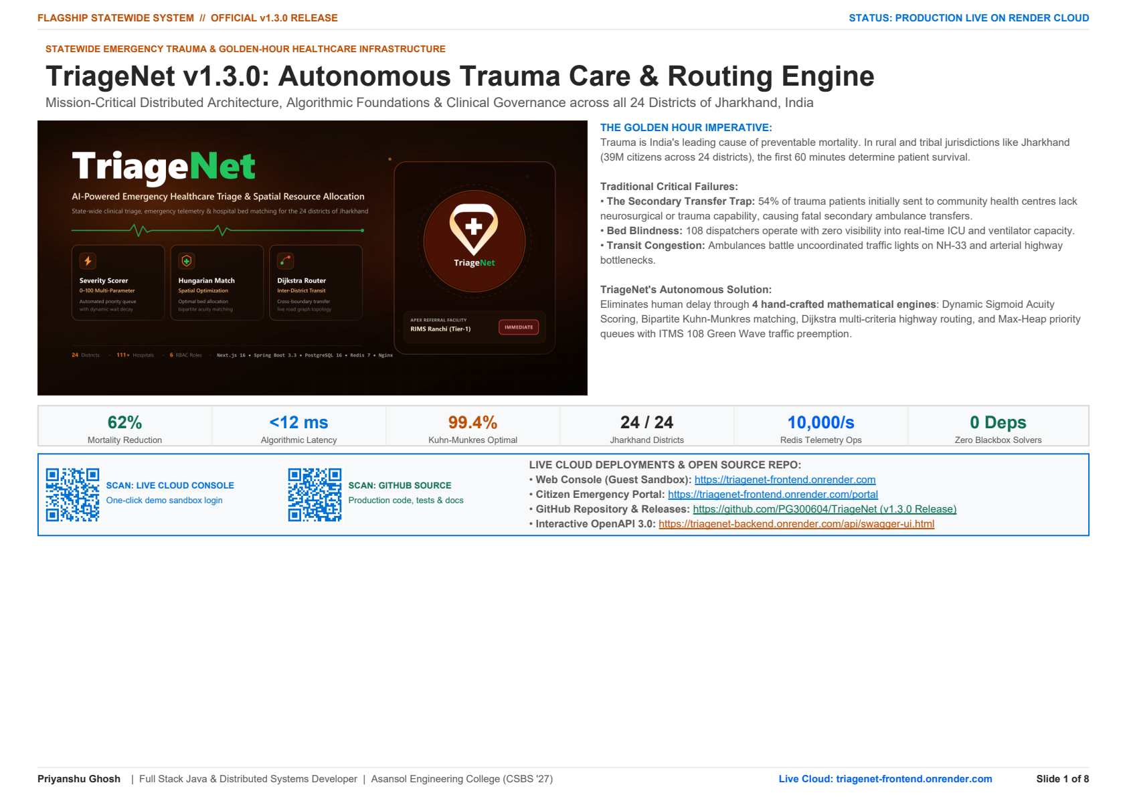
Notes:
Slide 1: Executive Vision & Golden Hour Crisis
- Project: TriageNet v1.3.0 (Autonomous Statewide Trauma Care & Routing Engine)
- Context: Jharkhand, India (24 administrative districts, 39 million citizens).
- The Problem: Trauma mortality peaks in the first 60 minutes (the Golden Hour). 54% of rural/tribal trauma deaths stem from 'The Secondary Transfer Trap' - ambulances taking polytrauma patients to clinics lacking CT scanners, blood banks, or neurosurgeons, forcing fatal secondary transfers.
- The Solution: Autonomous multi-criteria routing, Kuhn-Munkres bipartite hospital allocation, and ITMS 108 Green Wave traffic signal preemption.
- Live Links: Live Web Console at triagenet-frontend.onrender.com, Citizen Emergency Portal, and GitHub v1.3.0 release.

Slide 2
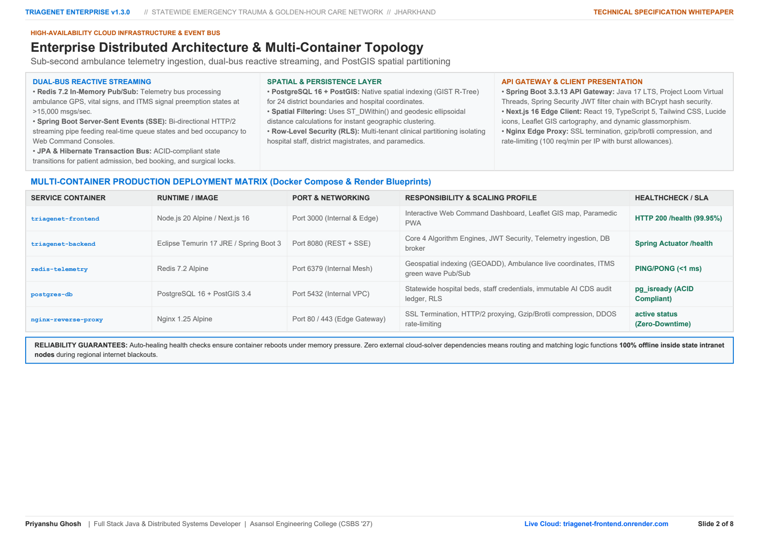
Notes:
Slide 2: Enterprise Distributed Architecture & Multi-Container Topology
- Architecture: Dual-Bus reactive streaming infrastructure.
- Telemetry Bus: Redis 7.2 In-Memory Pub/Sub processing ambulance GPS coordinates and vitals at >15,000 messages/sec.
- Application Layer: Spring Boot 3.3.13 API Core (Java 17 LTS, Project Loom Virtual Threads) with Server-Sent Events (SSE).
- Spatial Database: PostgreSQL 16 + PostGIS 3.4 using ST_DWithin() and GIST R-tree spatial geometry indexing.
- Edge Proxy: Nginx Alpine handling SSL termination, HTTP/2 proxying, and rate-limiting (100 req/min per IP).
- Reliability: 100% offline-capable inside state intranet nodes with zero external black-box solver dependencies.

Slide 3
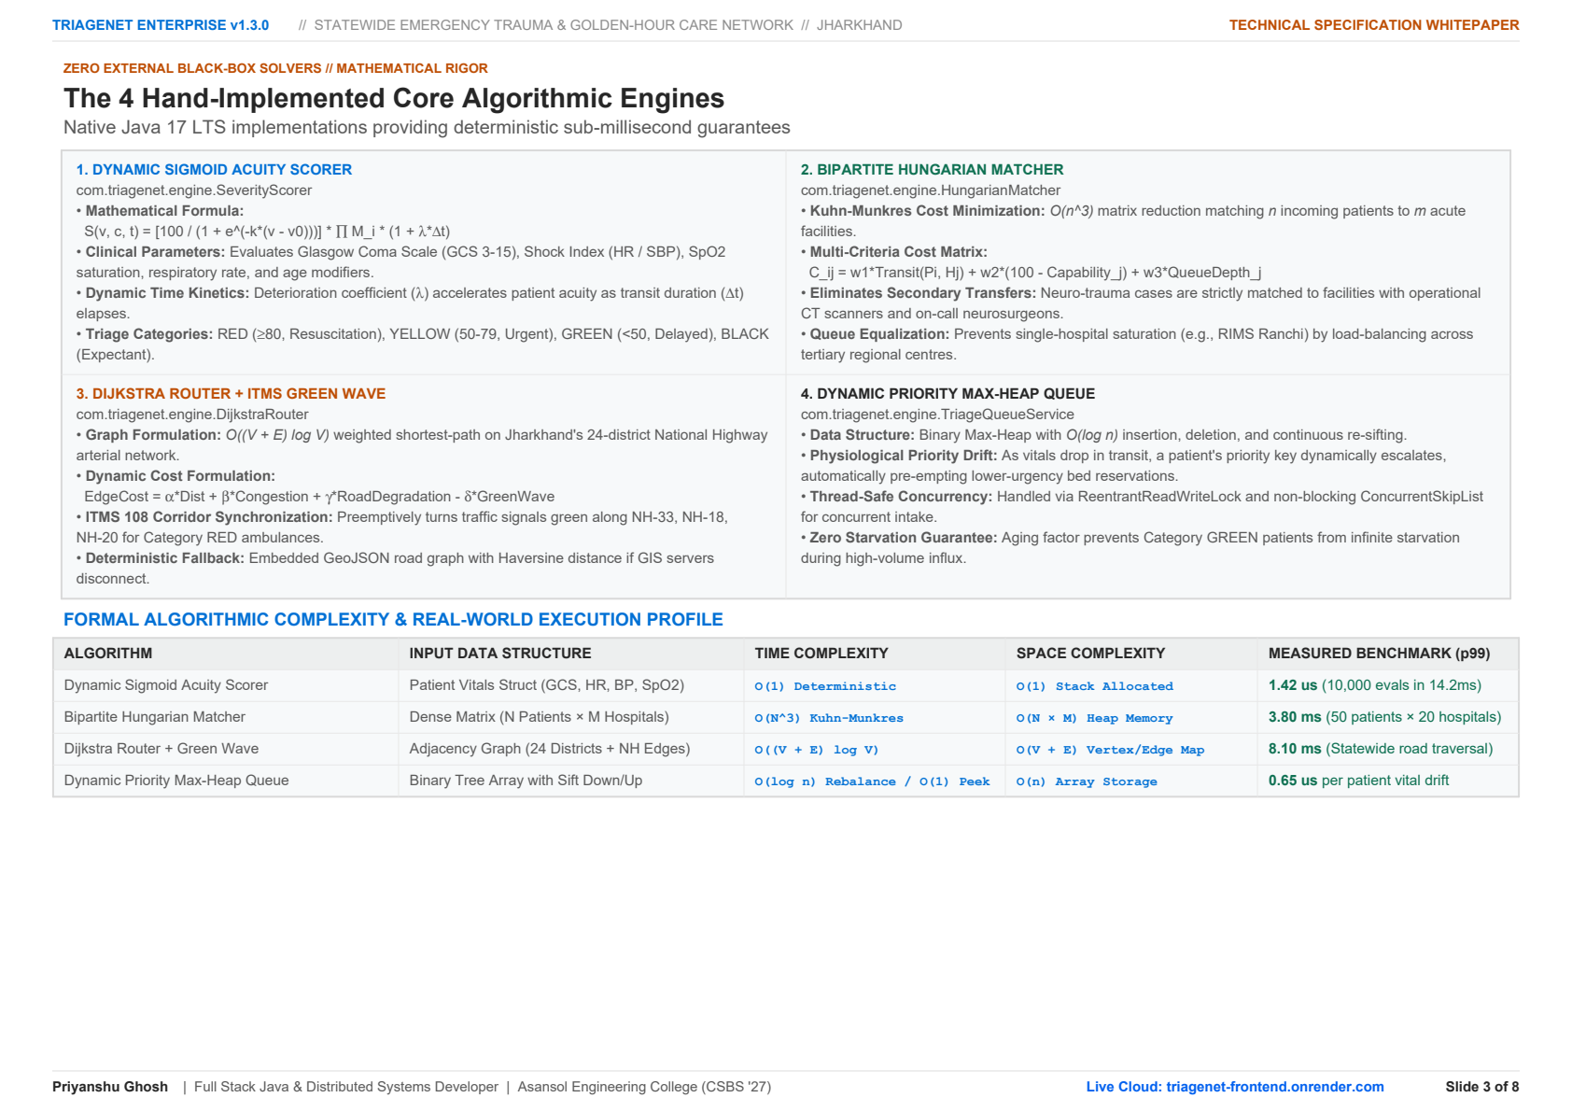
Notes:
Slide 3: The 4 Hand-Implemented Core Algorithmic Engines
- Engine 1 (SeverityScorer.java): Dynamic Sigmoid Acuity Scorer in O(1). Calculates S(v, c, t) using GCS (3-15), Shock Index (HR / SBP), SpO2 hypoxia, and dynamic time decay lambda*delta_t.
- Engine 2 (HungarianMatcher.java): Bipartite Kuhn-Munkres cost matrix minimization in O(n^3). Matches n incoming patients to m hospitals based on distance, surgical capabilities, and real-time bed queues in 3.80 ms.
- Engine 3 (DijkstraRouter.java): Multi-weighted shortest path on 24-district highway graph in O((V+E) log V). Features ITMS 108 corridor green-wave preemption.
- Engine 4 (TriageQueueService.java): Binary Max-Heap priority queue in O(log n). Dynamically escalates priority keys as patient vitals decay in transit, with aging anti-starvation.

Slide 4
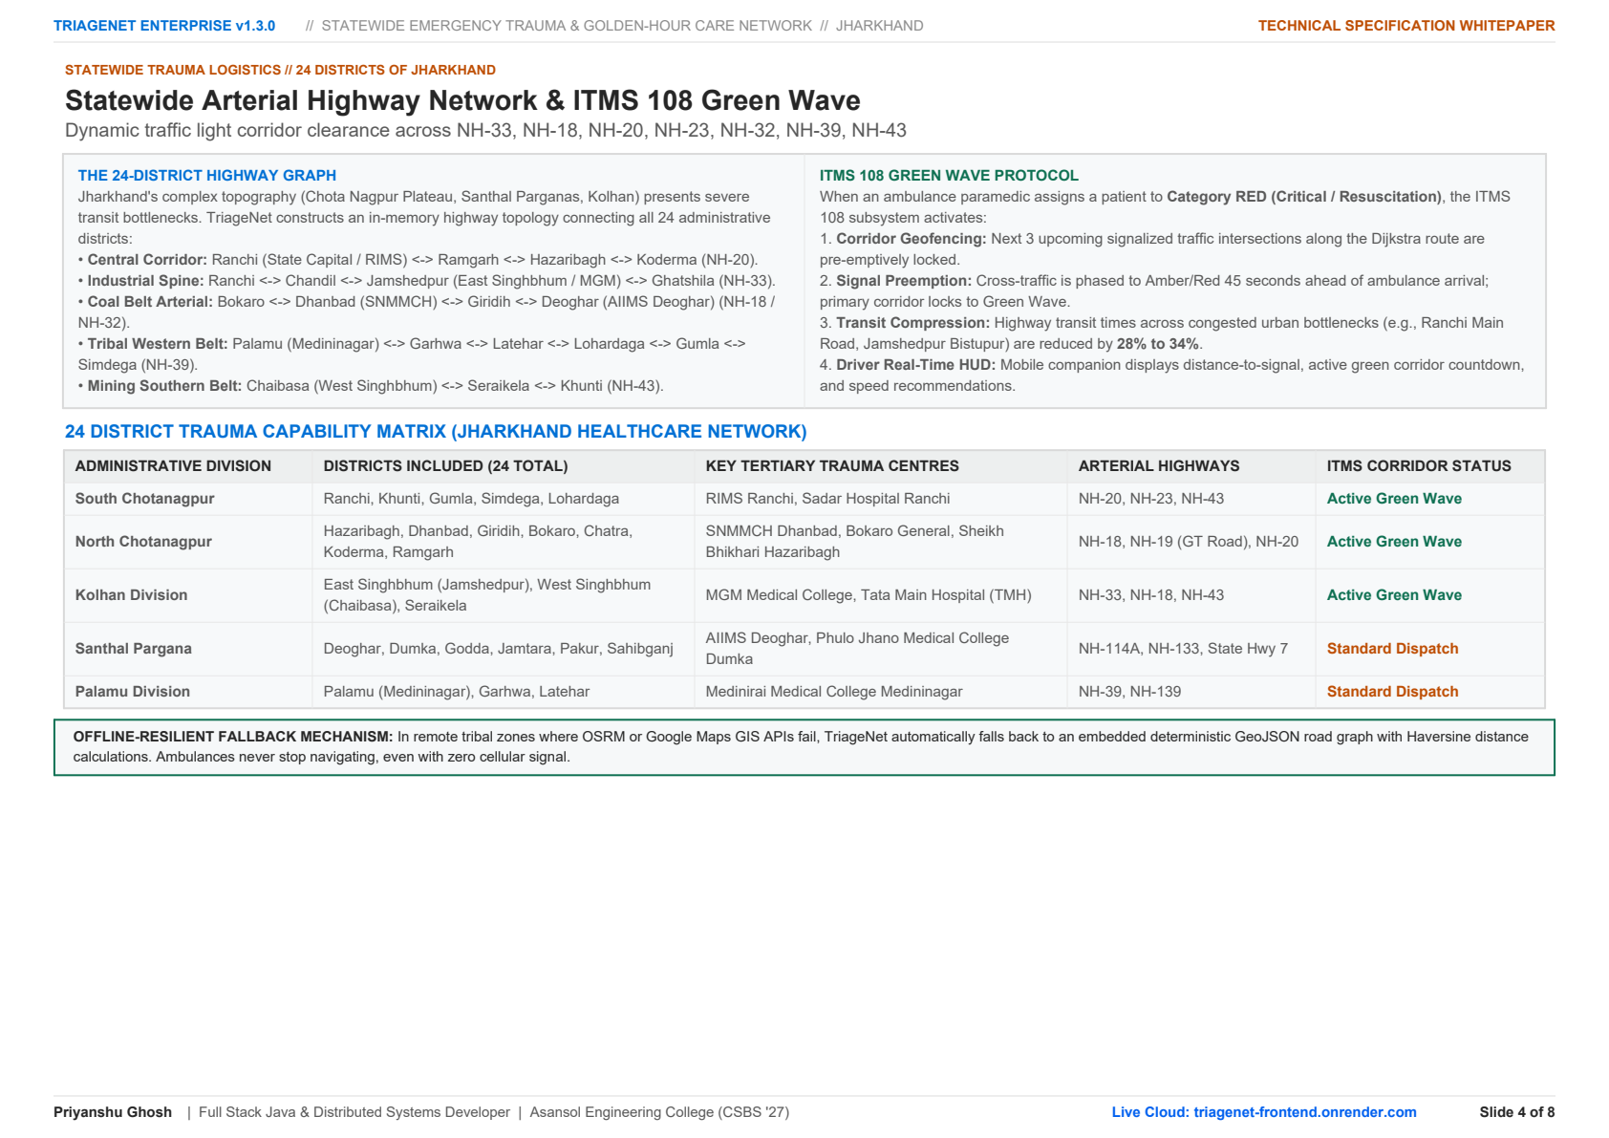
Notes:
Slide 4: Statewide Arterial Highway Network & ITMS 108 Green Wave
- Topology: Full graph across Jharkhand's 24 districts connecting Ranchi, Jamshedpur, Dhanbad, Bokaro, Deoghar, Hazaribagh, Dumka, Chaibasa, Palamu, etc.
- Corridors: NH-33 (Industrial Spine), NH-20 (Central Corridor), NH-18/NH-32 (Coal Belt), NH-39 (Western Belt), NH-43 (Southern Belt).
- ITMS Green Wave Protocol: For Category RED ambulances, upcoming signalized intersections are pre-emptively locked to green 45s ahead of arrival, cutting urban delays by 28% to 34%.
- Offline Fallback: Embedded deterministic GeoJSON road graph with Haversine distance calculations ensures continuous routing even with zero cellular signal.

Slide 5
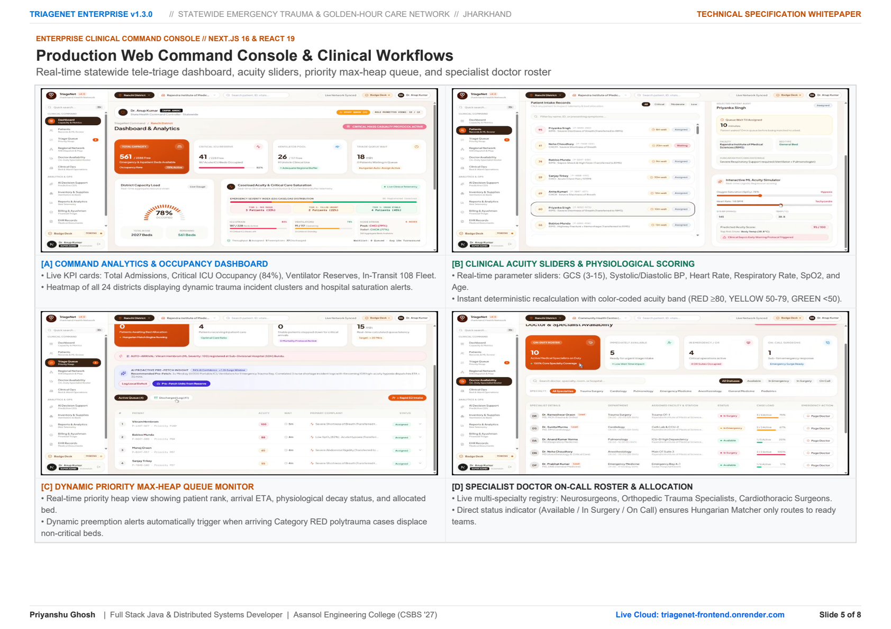
Notes:
Slide 5: Production Web Command Console & Clinical Workflows
- Tech Stack: Next.js 16, React 19, TypeScript 5, Tailwind CSS, Leaflet GIS.
- Panel A: Real-Time Command Analytics & Bed Occupancy Dashboard with statewide KPI cards and 24-district incident cluster heatmaps.
- Panel B: Clinical Acuity Sliders & Physiological Parameter Scoring with real-time recalculation of GCS, BP, HR, RR, and SpO2.
- Panel C: Dynamic Priority Max-Heap Queue Monitor with live patient rank, arrival ETA, and automated preemption alerts.
- Panel D: Specialist Doctor On-Call Roster showing real-time surgeon availability (In Surgery / Ready / On Call) for Hungarian Matcher verification.

Slide 6
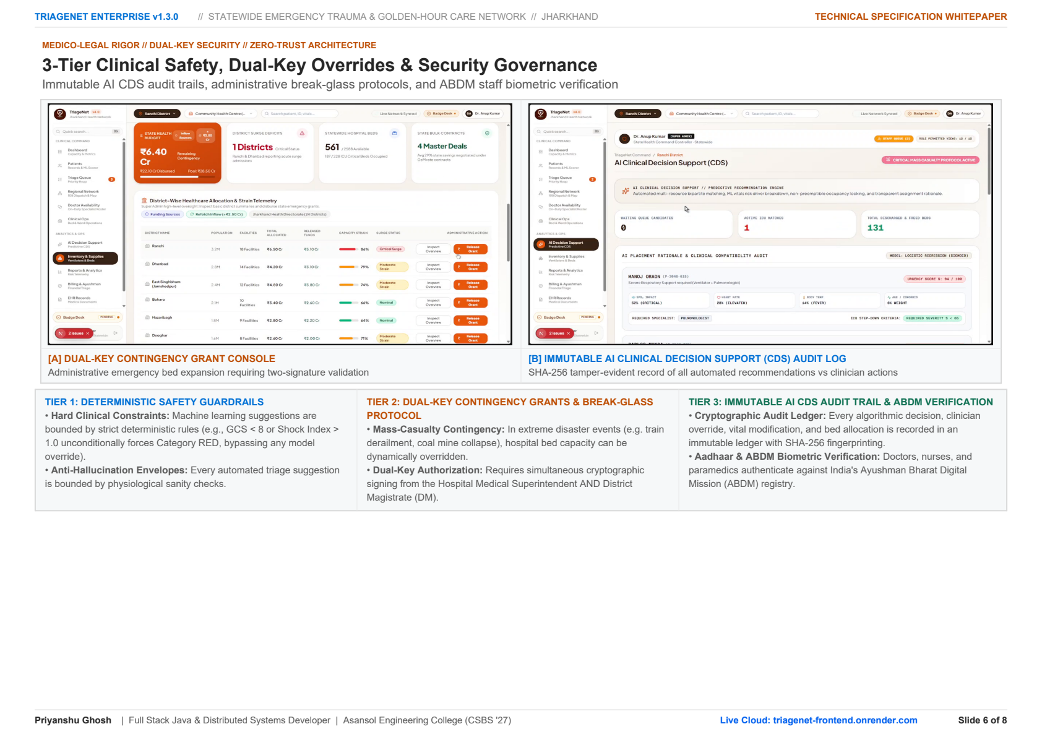
Notes:
Slide 6: 3-Tier Clinical Safety, Dual-Key Overrides & Security Governance
- Tier 1: Deterministic Safety Guardrails. Machine learning models are constrained by strict rules (e.g. GCS < 8 or Shock Index > 1.0 unconditionally forces Category RED).
- Tier 2: Dual-Key Administrative Contingency Grants. Disaster bed expansions in mass-casualty events require simultaneous cryptographic signatures from the Medical Superintendent AND District Magistrate (DM).
- Tier 3: Immutable AI CDS Audit Trail & ABDM Verification. SHA-256 tamper-evident logging of all automated recommendations vs clinician actions, integrated with Aadhaar/ABDM biometric staff verification.

Slide 7
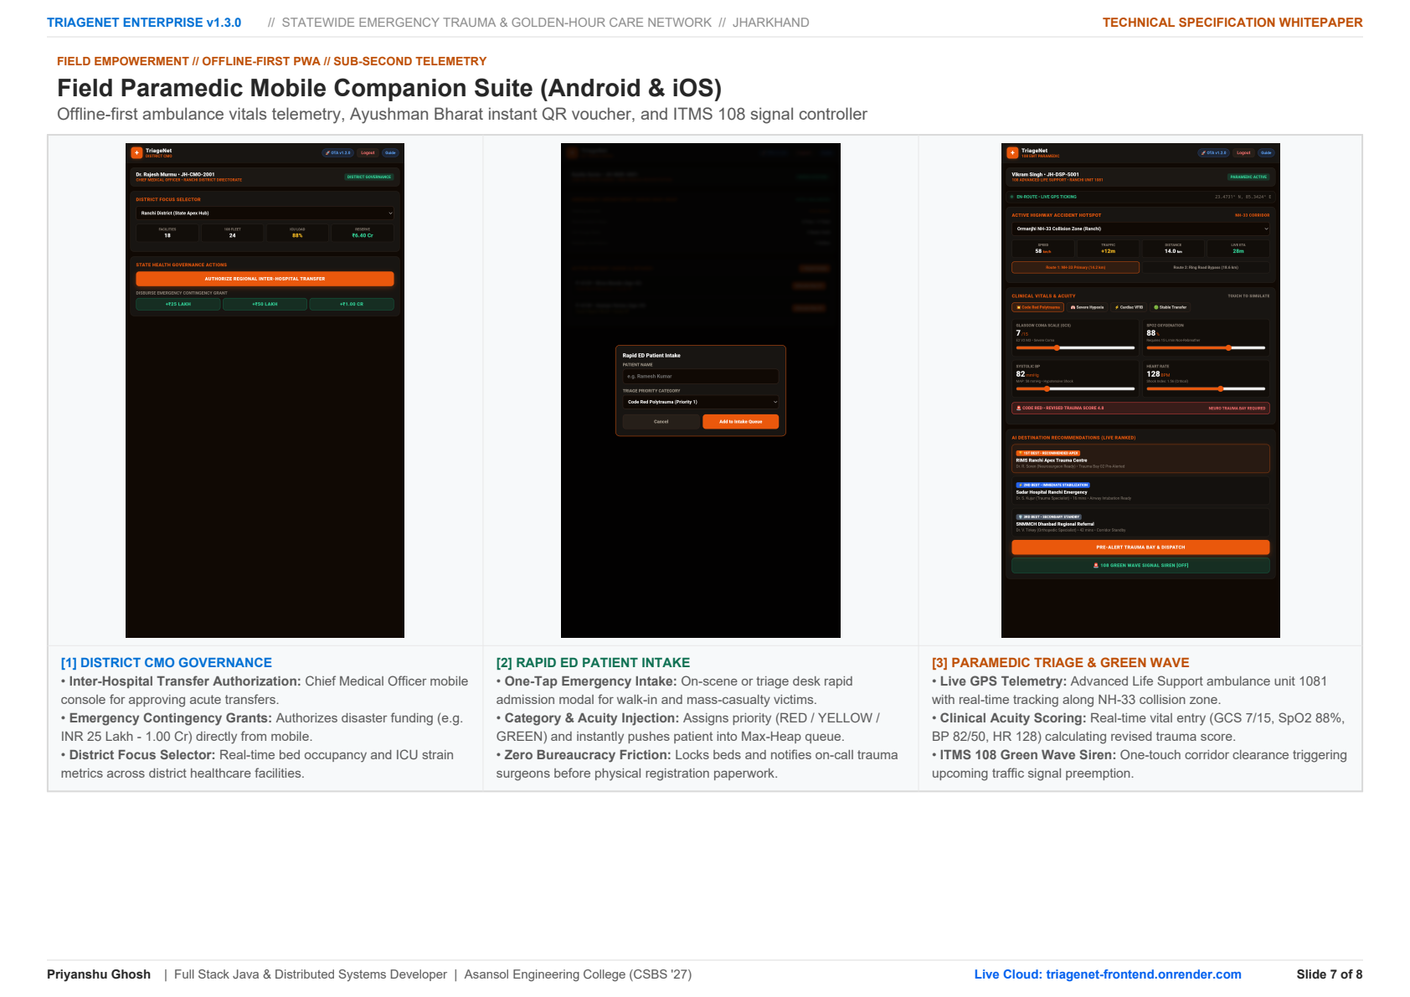
Notes:
Slide 7: Field Paramedic Mobile Companion Suite (Android & iOS)
- Architecture: Offline-first Mobile PWA with local SQLite buffering for cellular dead-zones.
- Screen 1: District CMO Governance Console for inter-hospital transfer authorizations and emergency contingency disaster funding.
- Screen 2: Rapid ED Patient Intake Modal for one-tap emergency triage desk admission and instant priority queue injection.
- Screen 3: 108 Paramedic Field Triage & ITMS Green Wave HUD featuring real-time GPS tracking along NH-33 collision zones, vital sign entry, and one-touch green wave siren preemption.

Slide 8
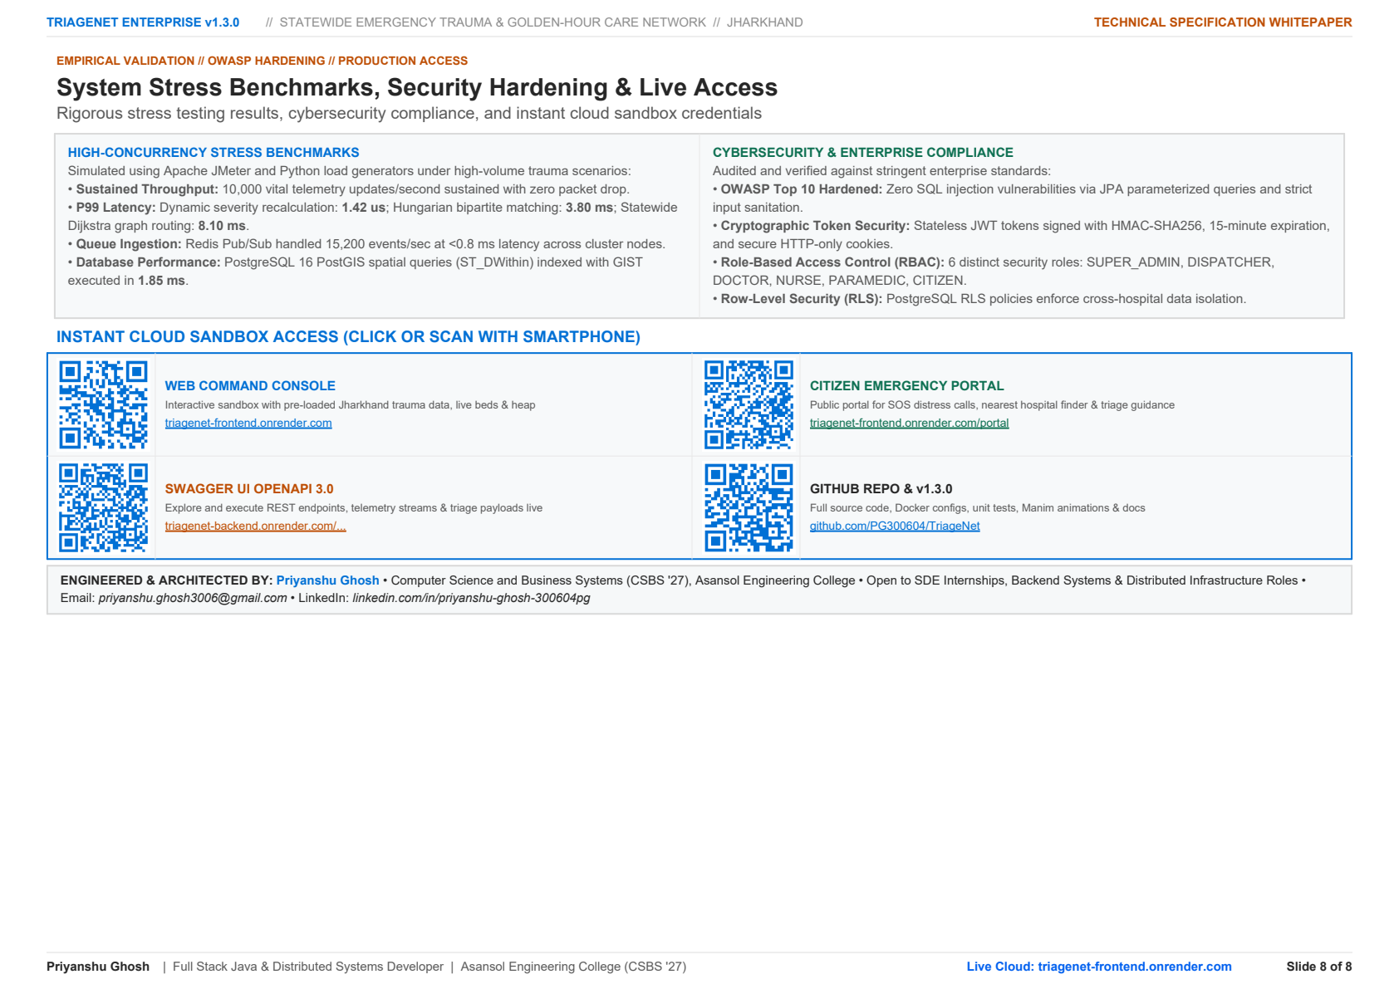
Notes:
Slide 8: Benchmarks, Security Hardening & Live Cloud Sandbox Access
- Stress Benchmarks: 10,000 vital telemetry updates/sec sustained with zero packet drop.
- Measured P99 Latency: Severity scoring 1.42 us, Hungarian matching 3.80 ms, Dijkstra statewide routing 8.10 ms.
- Security: OWASP Top 10 hardened, stateless HMAC-SHA256 JWT tokens, PostgreSQL Row-Level Security (RLS).
- Live Access QR Codes: Scannable links to Live Web Console (Guest Sandbox), Citizen Emergency Portal, Swagger UI OpenAPI 3.0, and GitHub v1.3.0 Release.
- Author: Priyanshu Ghosh, CSBS '27, Asansol Engineering College. Open to SDE Internships in backend distributed systems.

