Slide 1
IN(OUT)DOORS

Slide 2
Hello!
We are IN(OUT)Doors
And we would like to tell all of you about our new product

Slide 3
Problem
Having to get up to turn the lights or the ac on and off ?
There’s no need for that now.

Slide 4
Solution
Our website will let you switch the lights and the ac on and off from the comfort of your bed.

Slide 5
MILESTONES
We are planning to automate even more stuff around the house

Slide 6
How we are going to promote our site
Ads.
Sponsorships
Who are our customers ?
Anyone with a smartphone and access to the internet.

Slide 7
We have also prepared a small demo

Slide 8
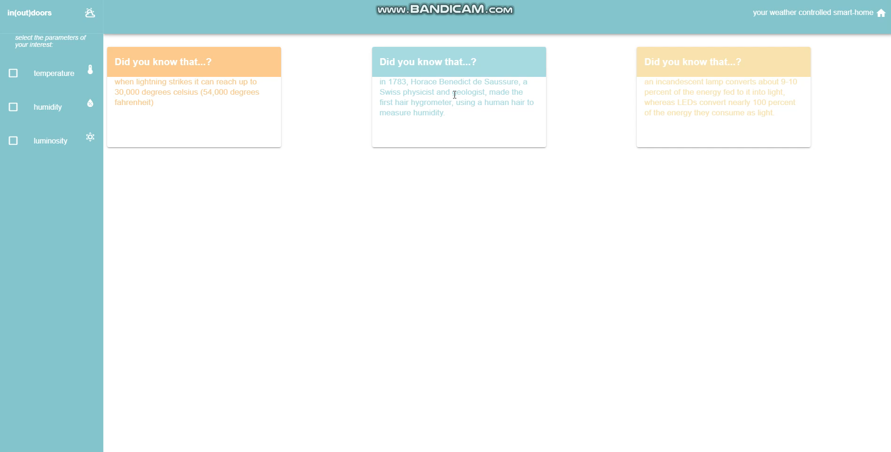

Slide 9
IN(OUT)DOORS TEAM
MATEI - 2nd year at Politehnica
RALUCA - 3rd year at Politehnica
GEORGE - 2nd year at ASE
ROXANA - 12th grade

Slide 10
Thanks!

