Slide 1
How to give a PhD/MsC/BsC Talk
The structure for all three is the same. The more experience, the more depth is expected.

Slide 2
A few words in the begining
This slide is not part of the structure, but introduceds important concepts
The structure for all three (BSc, MSc, PhD) is the same. The more advanced you are in your studies, the more depth is expected.
Expect questions while you talk. Especially if something is not clear.
Take these questions as a positive critique to improve your talk
When you give a talk, imagine the following scenario
You are in the same bus with a billionaire (e.g. Bill Gates, Tim Berners Lee). The trip takes 30 minutes and you want to convince the billionarie to invest into your thesis.
Your grade depends on a good talk. That involves
Good structure of the talk,
A clear, precise and concise presentation,
Clear language,
Content of your thesis is less important than the presentation itself.
Grades range from 1 to 5. 5 means you have to repeat the talk
We do not expect that your are passionated about your thesis and that is the only thing for you in live, but we expect that you do it on a professional level. Similar as your boss in industry will expect a professional level of work.
The number of questions after your talk, are inverse proporational to your grade
Grade = k*1/#Questions
➔ k=[5:10] depending on the complexity of the topic
➔ 0 Questions, no Grade
Reference work of others on the slide you talk about that work. No proper references ➔ Grade = 5

Slide 3
Agenda/Structure
Show the structure of your talk. Most often this will be
Motivation for my thesis
Related work
Challenges/Research Questions/Technical Questions
Methdology to solve the challenges/answer the questions
Experiments/Implementation Details
Discussion
Conclusion/Future Work
Don‘t spend too long explaining the outline

Slide 4
Motivation
Why is your work important?
Why should I borther listening to you for 30 minutes of my valuable time?
No motivation, no questions?

Slide 5
My thesis in a nutshell
Describe on one slide
the motivation of your thesis (why is this problem worth of attention?)
the main challenges you have handled (or you expect which occure)
the main result
Why? In one slide you can not go into details, but the audience will know the context.

Slide 6
Challenges/Research Questions
What detailed questions/challenges did you plan to solve?
What was the exact challenge/research question you solved?
Maximum 2-3 slides
Maximum 3-4 questions

Slide 7
Related Work
What did others do in the field? But only talk about related work, not about all work that has been done in the field.
What challenges have been already solved, which are still open?

Slide 8
Methodology
How did you answer your questions
Started implementing immediately
Did a data model, then implemented it
Did experiment 1 to answer question 1, than followed by experiment 2 etc.
Be precise, be concise!

Slide 9
Implementation/Experiments
Describe how you implemented the methodology
Software model, data model, implementation
Show experimental results
simulations
data analysis
Examples
demos

Slide 10
Discussion
Discussion is a critical, objective reflection of what you achieved.
Could you solve the challenge/answer the question? If yes, why. If no, why.
What worked well? Where did you have problems.
Be careful what you claim, most work does not solve a problem entirely, statements like „with my work I was able to overcome the Semantic Gap“ will make knowledgeable audience very suspicious.

Slide 11
Conclusion/Future Work
Summarize what you did for those that felt asleep although you did a great talk
Point to open issues
No open issues, points towards a trivial work.

Slide 12
The End – now enjoy the questions

Slide 13
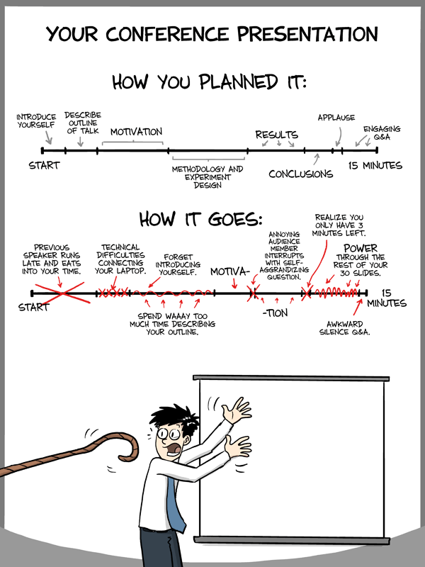
http://www.phdcomics.com/comics/archive.php?comicid=1553

