Slide 1
EduHub – A Multi-Institute Course Management Platform
Project Implementation PGCP-AC
Presenter : Group 06

Slide 2
1. Project Overview: Bridging the Educational Gap
Introducing EduHub
Centralized Portal: EduHub is designed to streamline course delivery, academic administration, and enrollment processes under a single Web-based platform.
Role-Based Security: Provides distinct, role-based workflows for students, institutes, and global administrators to maintain accountability and security.
Process Automation: Simplifies registrations, approvals, payments, enrolments, and course management.
Key Objectives & Value Proposition
Enhanced Accessibility: Students can discover, enroll in, and access courses anytime.
Scalable Platform: Supports multiple institutes with independent course and student management.
Trust & Transparency: Creates a trustworthy ecosystem via a robust admin audit trail where registrations, content uploads, and transactions are strictly monitored.
Modern Architecture: Developed using React, Spring Boot/.NET APIs, JWT Authentication, Gen-AI and Microservices.

Slide 3
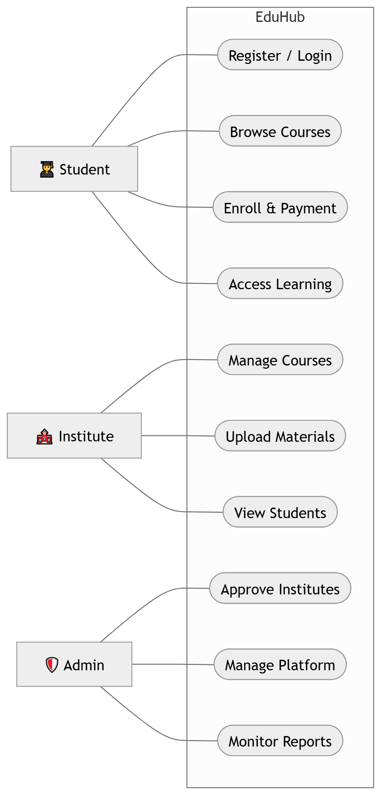
2. Users & Use Cases: The Student Journey
Users with details
Student:
Register/Login
Browse & search courses
Enroll and make payments
Access learning materials
Track progress & submit reviews
Institute:
Register for approval
Create & manage courses
Monitor enrolled students
View revenue
Admin:
Approve institutes
Manage students & courses
Monitor enrollments & payments
Earn commission on floating percent

Slide 4
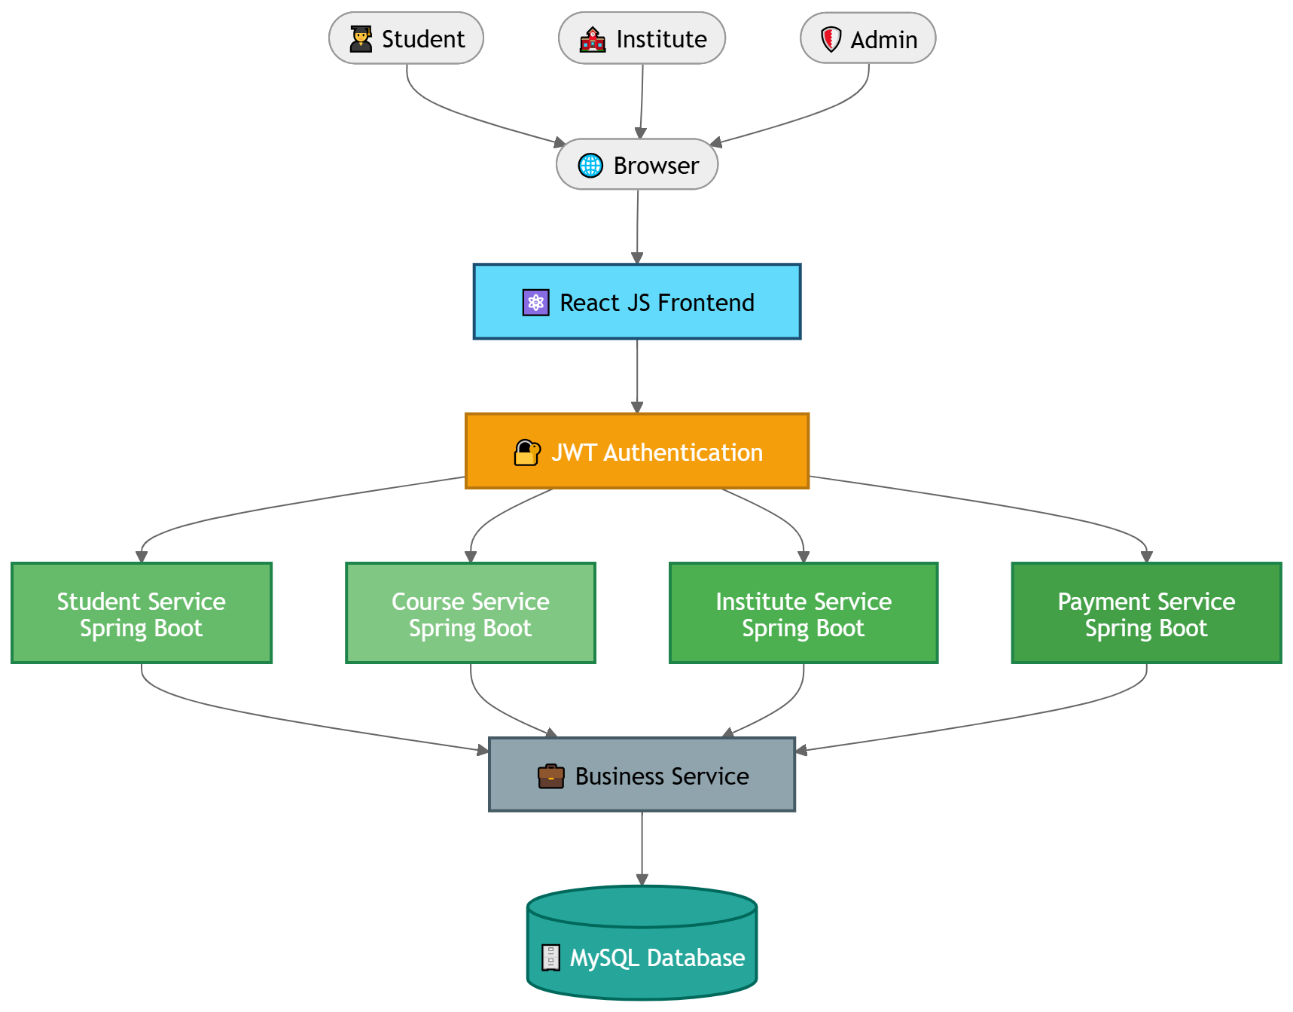
3. Project Architecture: Scalable Multi-Tier Model
System Layers & Structuring
Presentation Layer (Frontend): A responsive, single-page UI built for fast loading and dynamic navigation across desktops and mobile devices.
Application Layer (Backend API): Secure API endpoints managing business rules, payment gateways, and role verification tokens.
Data Storage Layer (Database): Relational databases storing structured user profiles, courses, transactions, and reviews.

Slide 5
4. Project Methodology: Iterative Agile Framework
PLAN & DESIGN
Phase 1: Planning & Design
Requirement Gathering
System Analysis
Use Case Identification
Database Design (ER Model)
Deliverables:
Software Requirement Specification (SRS)
System Architecture
Database Schema
INCREMENTAL BUILD
Phase 2: Development & Integration
React JS Frontend Development
Spring Boot REST APIs
JWT Authentication & Authorization
Database Integration (MySQL)
API Integration & Business Logic
AI Course Recommendations
Deliverables:
Functional Modules
Secure REST APIs
Responsive User Interface
POLISH & INTEGRATE
Phase 3: Testing & Deployment
Unit Testing
Integration Testing
System Testing
Bug Fixing & Optimization
Deliverables:
Stable Application
Tested Features
Deployment-ready System

Slide 6
5. Testing Approach
Test Scenarios
User Registration
Log in
Course Creation
Enrollment
Payment
Study Material Access
Admin Approval
JWT Authorization
Testing Type | Purpose
Unit Testing | Individual components
Integration Testing | APIs with Frontend
System Testing | Complete platform
Authentication Testing | JWT validation
UI Testing | Responsive interface

Slide 7
6. Future Extensions: Next-Gen Upgrades
Advanced Academic Features
Live Virtual Classrooms: Integrate live-chat rooms so educators can run classes directly from the platform.
Cryptographic Certifications: Issue secure, tamper-proof e-certificates of completion backed by digital signature authentication.
Platform Growth & Support
Mobile App Deployment: Porting current web experience to high-performance native iOS and Android modules.
Global Affiliate Ecosystem: Allow institutes to split revenue automatically, support international payments, and coordinate affiliate marketing.

Slide 8
7. Experience & Lessons Learnt: Key Takeaways
Technical Growth
Full-Stack Development: Enhanced practical knowledge of React JS, Spring Boot, ASP.NET Core, REST APIs, Gen-AI and MySQL by developing a complete multi-institute course management platform.
Secure Application Development: Learned the importance of JWT Authentication, role-based authorization, and secure API design to protect users and platform resources.
Scalable System Design: Gained experience in designing a modular architecture, separating frontend, backend services, and database for better scalability and maintainability.
Operational & Product Insights
Collaboration & Planning: Improved teamwork, requirement analysis, project planning, and task coordination throughout the development lifecycle.
Debugging & Testing: Strengthened debugging skills through unit testing, integration testing, bug fixing, and API validation.
Continuous Improvement: Recognized the importance of iterative development, user feedback, and performance optimization in delivering a reliable application.

Slide 9
Thankyou !!!
Presenter : Group 06

