Slide 1
Hackathon Project Final Presentation
March 27th, 2022
Longhorn Energy Club
Khushboo Agarwal, Christian Hurd, Morgan Nguyen, Benjamin Stormer
Jackson School of Geosciences, McKetta Department of Chemical Engineering, Hildebrand Department of Petroleum and Geosystems Engineering, Walker Department of Mechanical Engineering

Slide 2
Executive Summary
The Problem:
Determine the optimum drilling spot for 3 new wells to maximize production over the next two years
Our Approach:
Analyzed AI data to see reservoir depletion trends
Performed correlation analysis between features
Created a model using interpolation and linear regression to predict the optimum new well locations
What did we learn?
The lower zone generally has higher production
Some features (…) have a seemingly greater impact on production than others
Our Recommendation
Drilling the 3 new wells in the lower zone at XX, XX, and XX
Notes:
Add pictures of heat maps, add green map with AI depletion regions. Also show correlation and production wells, last one of 3 dots

Slide 3
Workflow
Visualizing known well production
Analyzing AI data
Synthesizing well log data
Determining correlations
Selecting relevant features
Creating a model
Predicting well production

Slide 4
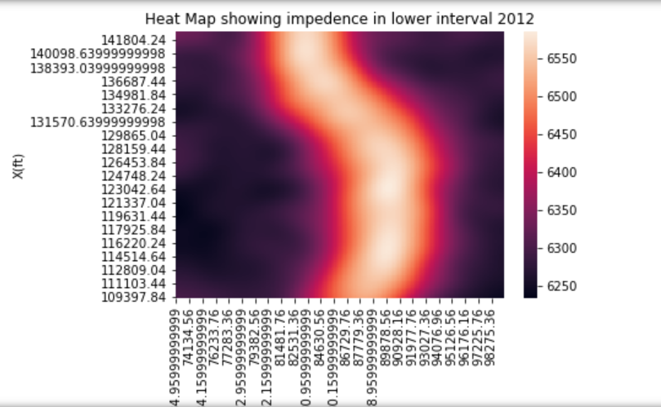
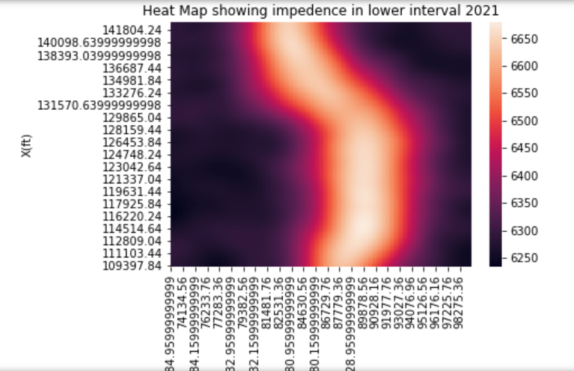
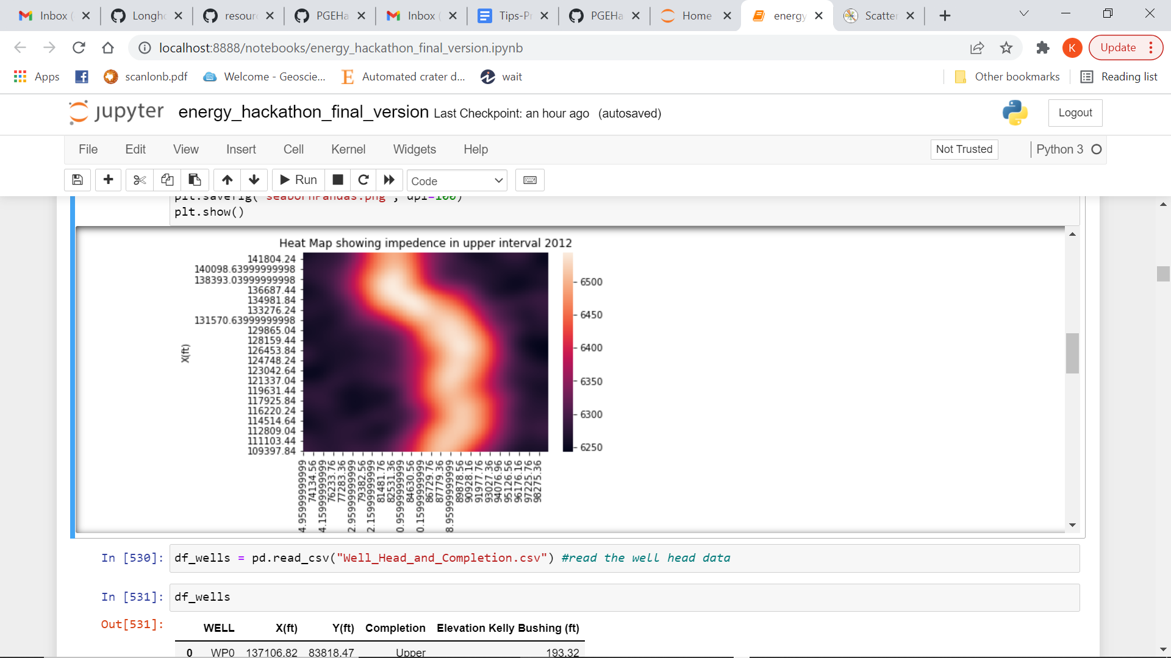
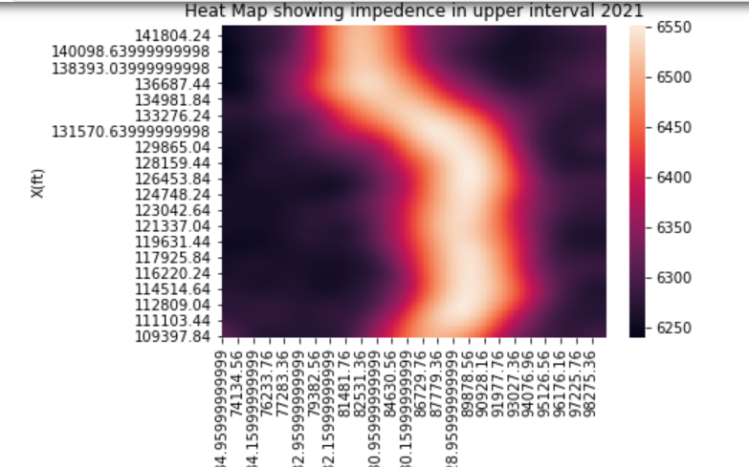
Impedance values for lower and upper interval

Slide 5
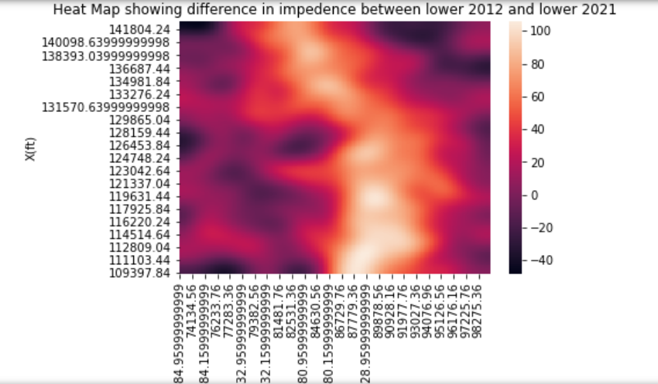
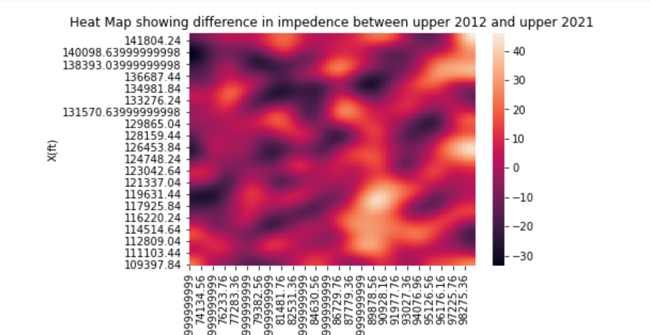
Comparing Impedance difference
The top map shows high impedance difference between 2012 and 2021 in the lower interval

Slide 6
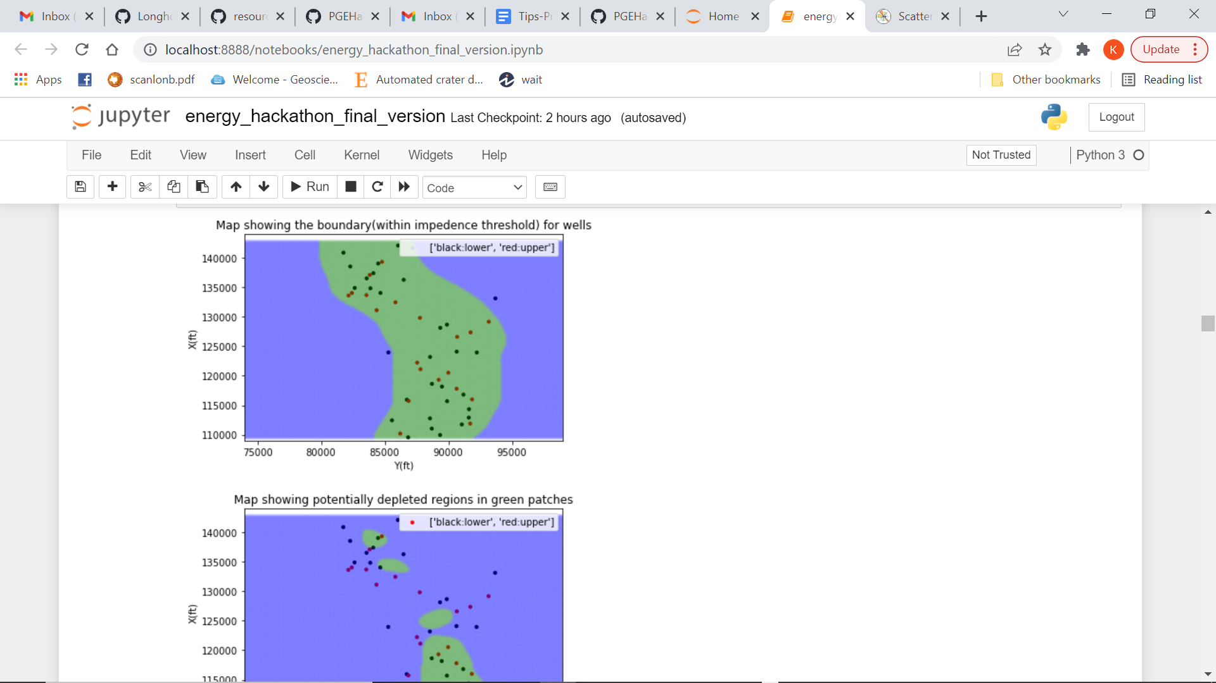
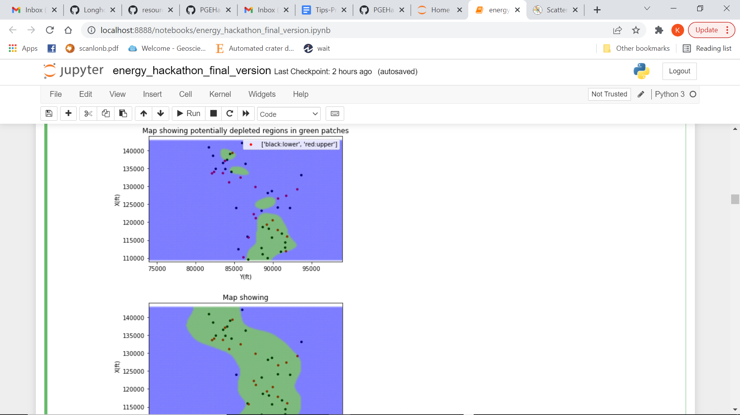
Potentially depleted wells in the Lower interval

Slide 7
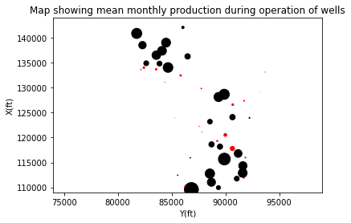
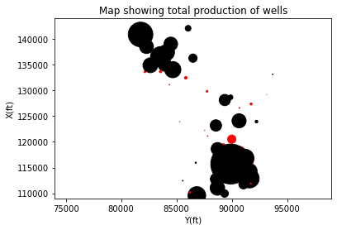
Oil Production Heat Map
Lower Zone generally has much greater production
True for monthly and total production
Bottom right area has more production
True for monthly and total production
Bottom right area appears to be more used
= Upper Zone
= Lower Zone

Slide 8
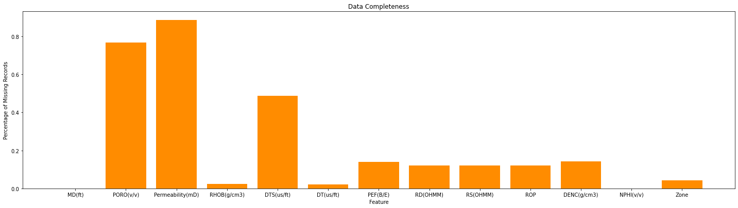
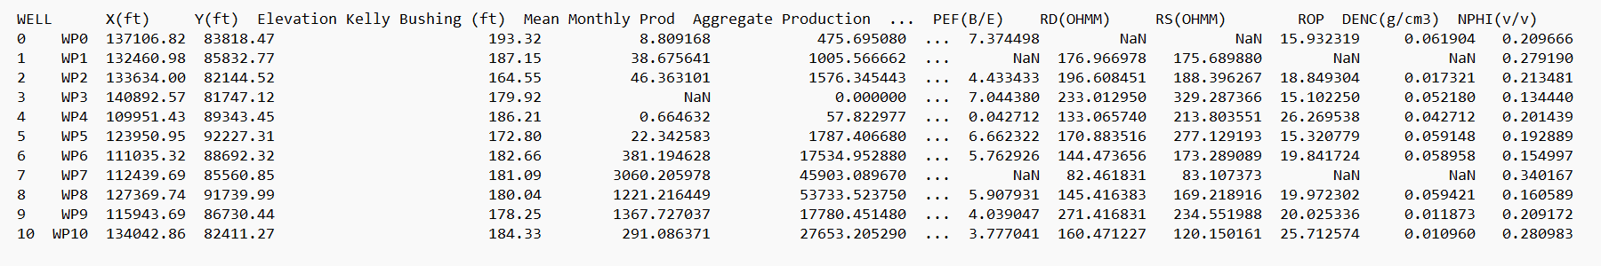
Synthesizing Well Log Data
Permeability and Porosity are largely missing
DTS and DENC have lots of data missing as well
Data table made with mean values for all 50 wells
Production and location data were added to well logs

Slide 9
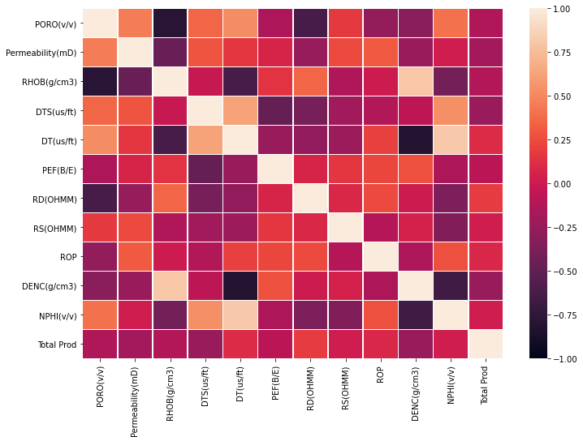
Bivariate Distribution of Features
Looked for features with high correlation to production
Features with lots of NaN values were ignored
Porosity, Permeability
Some features were redundant
RHOB and DENC

Slide 10
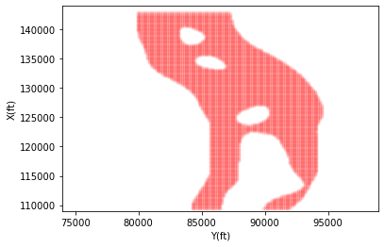
Developing Model
Performed linear regression to find regression coef.
2D interpolation
Divide AI map into upper and lower zones based on threshold values
Used maps to find potential well locations based on lower and upper intervals
Notes:
Showcase Interesting and Innovative Aspects of Your Workflow.
State and Defend Modeling Decisions
Discuss Critical Results and Learnings for Workflow Steps
Captions for all Figures
Concise Text on Slides to Explain the Main Points

Slide 11
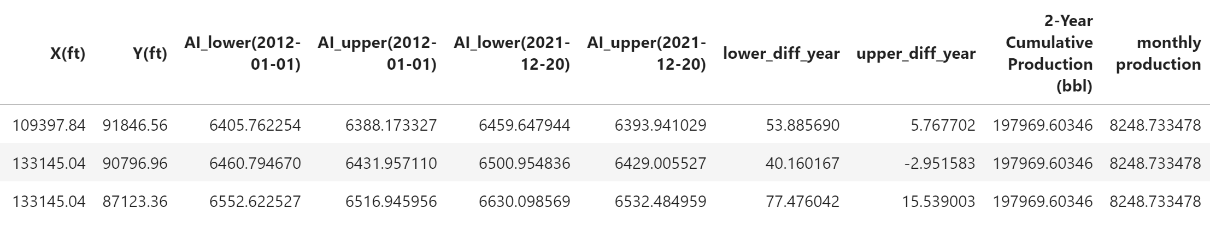

Results and Discussions

Slide 12
Feedback
We learned
How to develop a strategy for managing a large problem
How to synthesize large batches of data
How to stay focused for long stretches of time
We enjoyed
Learning from the different mentors
The complexity of the problem (partially due to lack of data)
The strong focus on collaboration
Next year could be improved by
A slightly longer timeframe
Allowing groups of up to 5

