Slide 1
Hackathon Project Final Presentation
March 27th, 2022
[Project Team]
[Team Members]
Team Members’ Departments and School
Note, you will have less than 10 minutes to present.

Slide 2
Executive Summary
1. What is the problem?
2. What did your team do to address the problem?
3. What did your team learn?
4. What does your team recommend going forward?

Slide 3
Workflow
Overview with Steps / Flow Chart

Slide 4
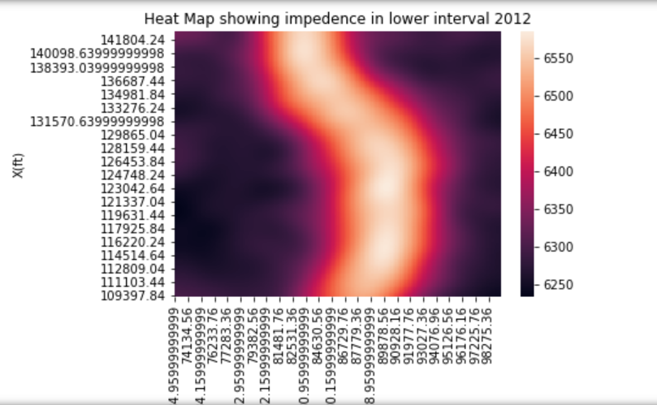
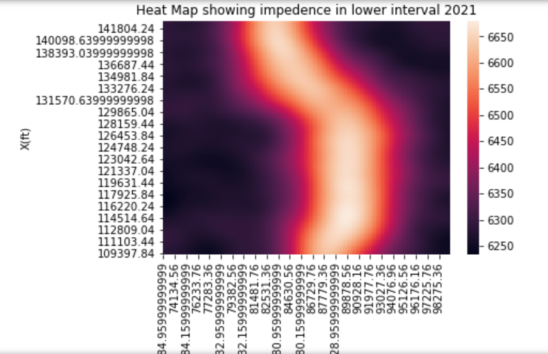
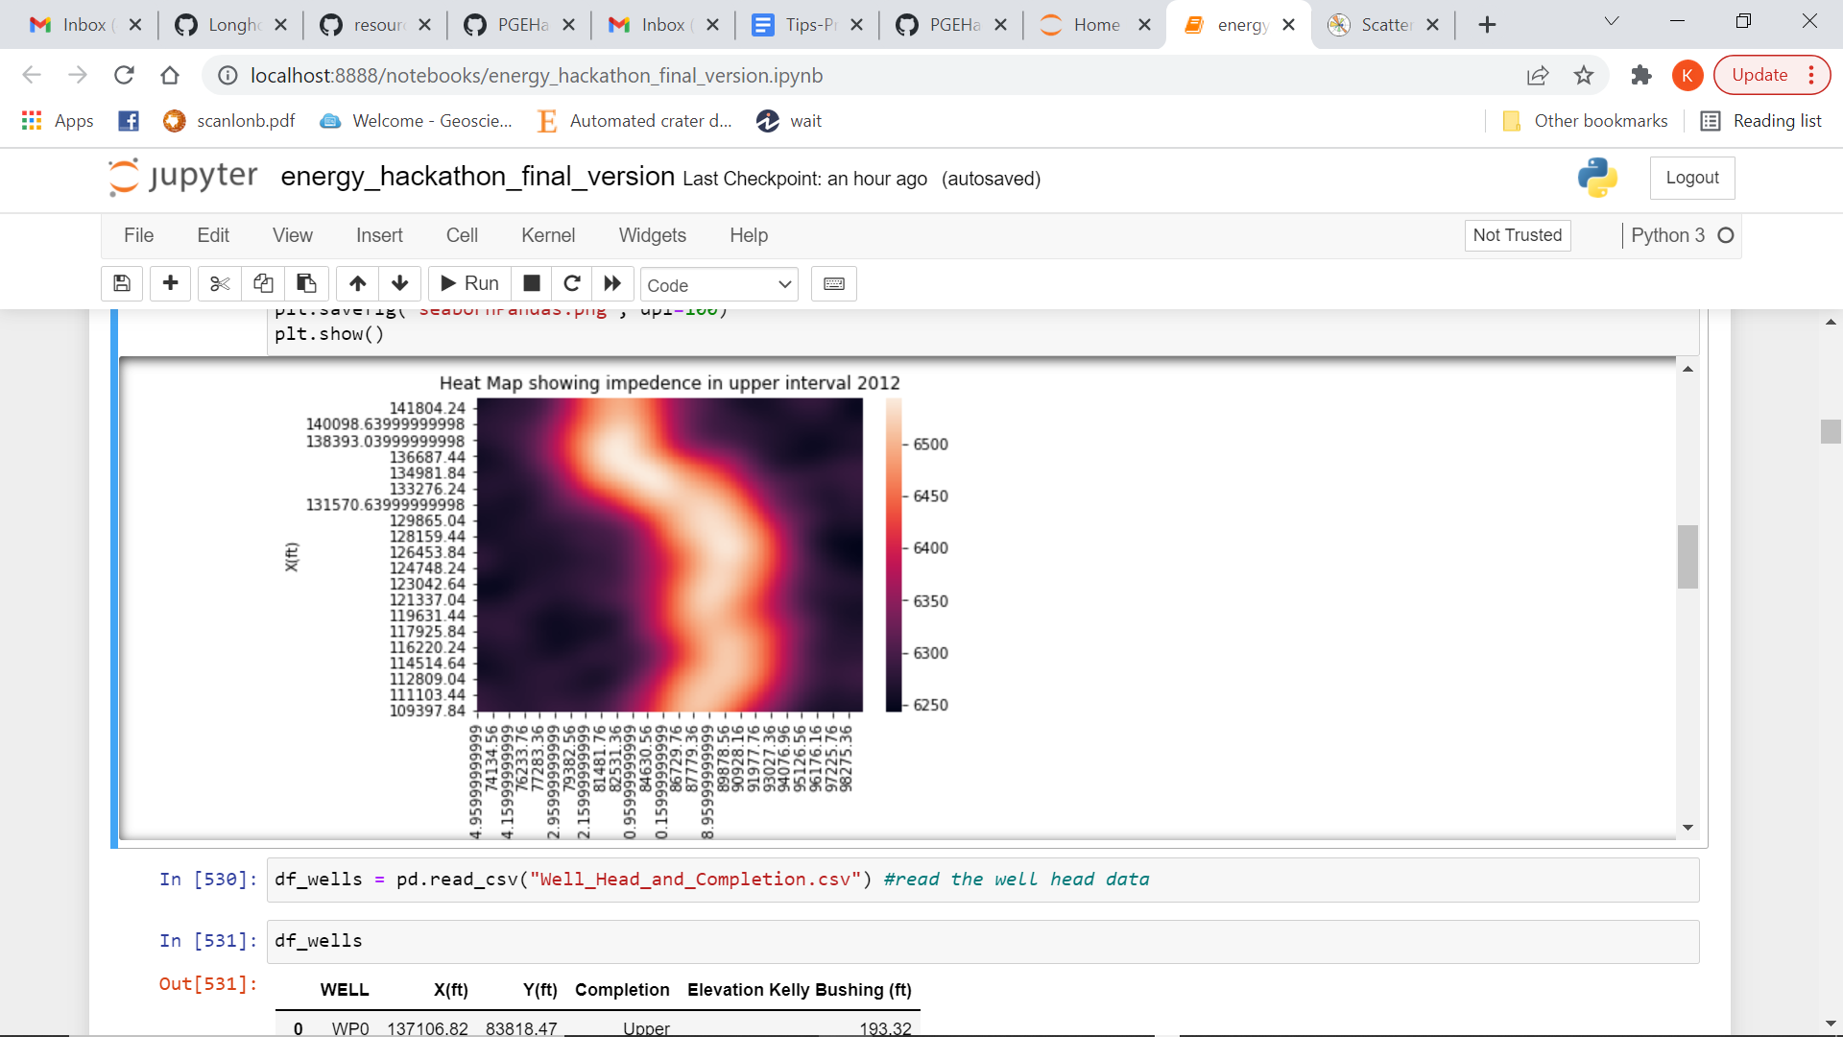
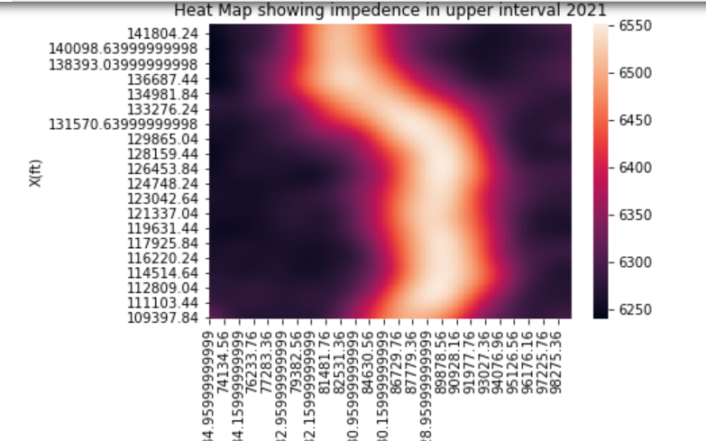
Impedence values for lower and upper interval

Slide 5
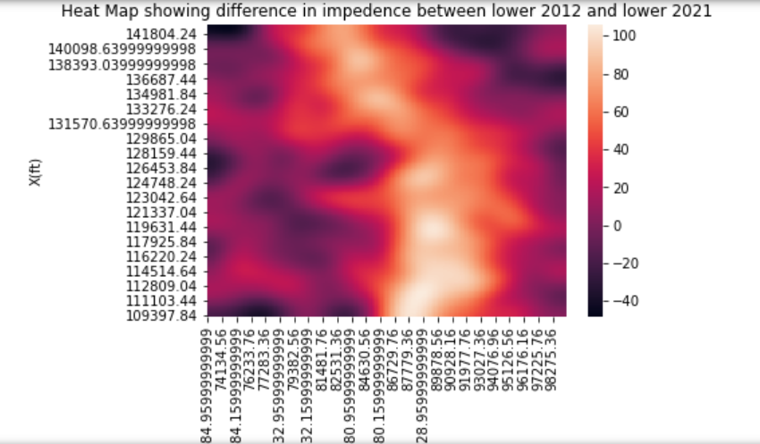
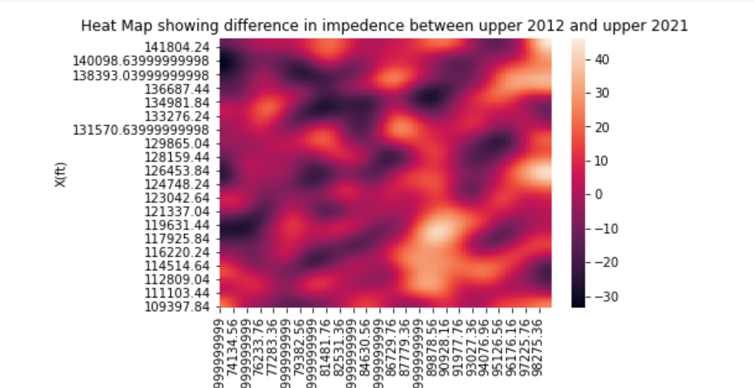
Workflow (Multiple Slides)
The top map shows high impedence difference between 2012 and 2021 in the lower interval

Slide 6
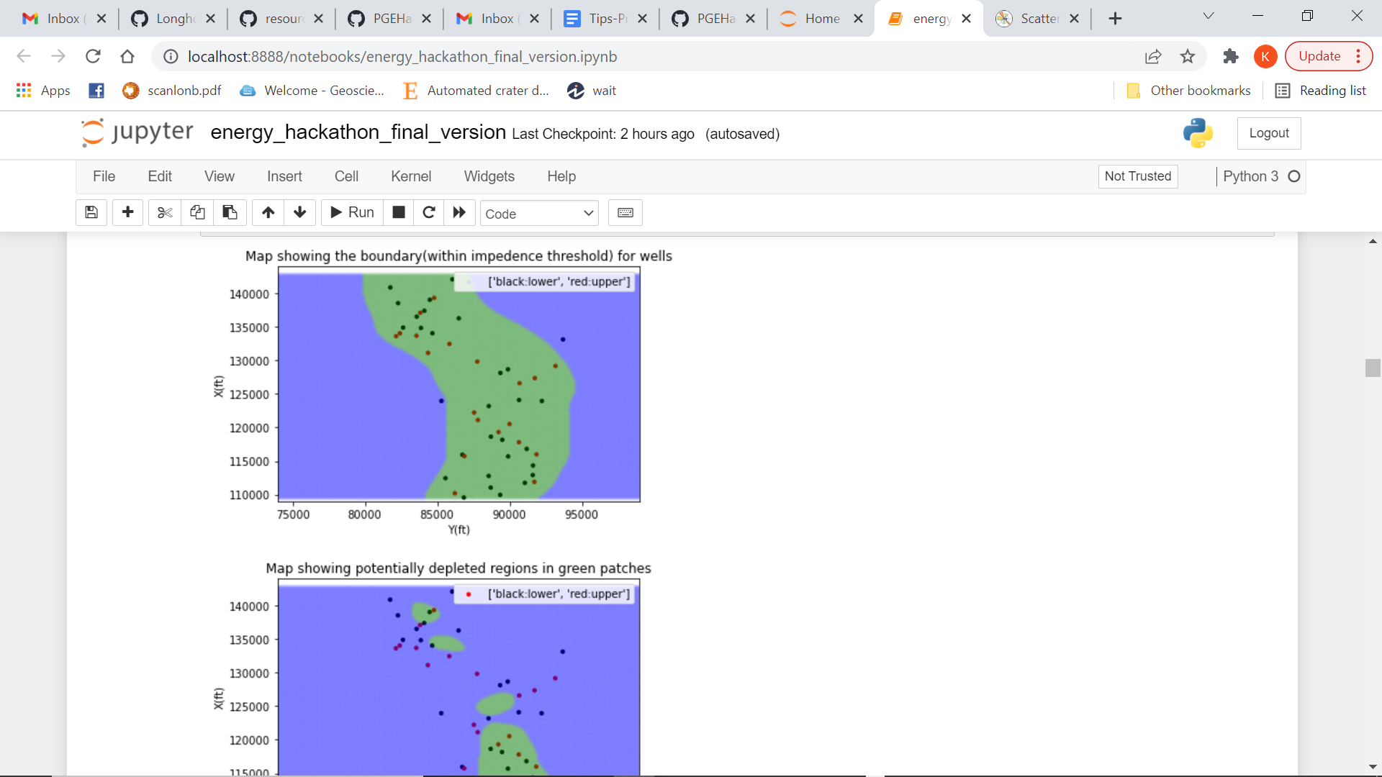
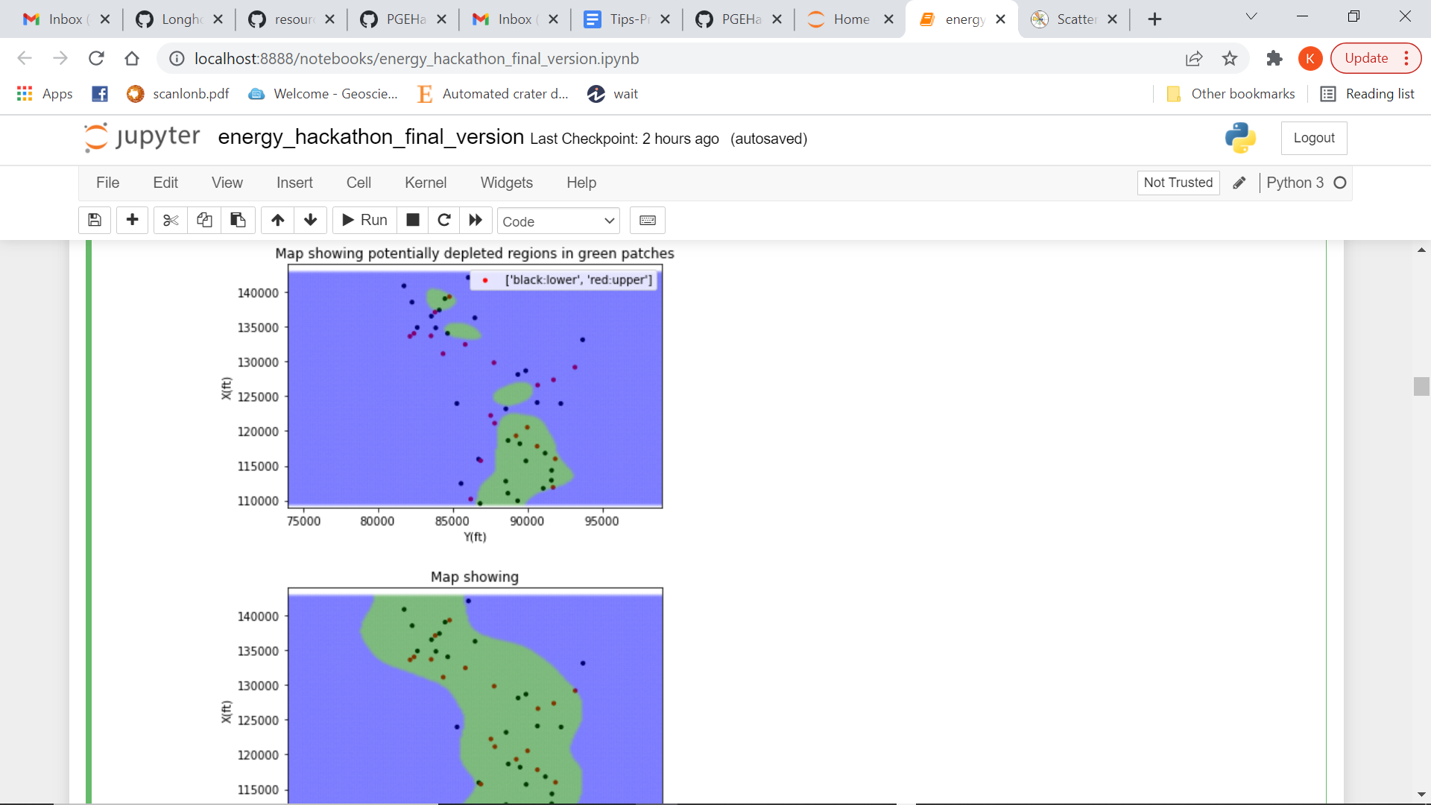
Potentially depleted wells in the Lower interval

Slide 7
Results and Discussions
Present your 3 infill well locations (location map) and predicted 2 year production for your wells.
Use table / map / distributions to communicate the model predictions, modeling tuning etc.

Slide 8
Feedback
What did your team learn?
What did your team like?
What could we do to improve next year?

