Slide 1
Hackathon Project Final Presentation
March 27th, 2022
Longhorn Energy Club
Khushboo Agarwal, Christian Hurd, Morgan Nguyen, Benjamin Stormer
Jackson School of Geosciences, McKetta Department of Chemical Engineering, Hildebrand Department of Petroleum and Geosystems Engineering, Walker Department of Mechanical Engineering

Slide 2
Executive Summary
The Problem:
Determine the optimum drilling spot for 3 new wells to maximize production over the next two years
Our Approach:
Analyzed AI data to see reservoir depletion trends
Performed correlation analysis between features
Created a model using interpolation and linear regression to predict the optimum new well locations
What did we learn?
The lower zone generally has higher production
Some features (…) have a seemingly greater impact on production than others
Our Recommendation
Drilling the 3 new wells in the lower zone at XX, XX, and XX
Notes:
Add pictures of heat maps, add green map with AI depletion regions. Also show correlation and production wells, last one of 3 dots

Slide 3
Workflow
Overview with Steps / Flow Chart
Examined AI Data (Data completeness too?)
Production heat map
3. Synthesized Well log data
4. Combined well log data with production ( Combine with 3)
5. Bivariate distribution with features (Mention data completeness?)
6. Selected features with strongest correlation to production (removed redundancies)
7. Created model

Slide 4
Workflow
Visualizing known well production
Analyzing AI data
Synthesizing well log data
Determining correlations
Selecting relevant features
Creating a model
Predicting well production

Slide 5
Examining AI Data
Notes:
Showcase Interesting and Innovative Aspects of Your Workflow.
State and Defend Modeling Decisions
Discuss Critical Results and Learnings for Workflow Steps
Captions for all Figures
Concise Text on Slides to Explain the Main Points

Slide 6
Oil Production Heat Map
Notes:
Showcase Interesting and Innovative Aspects of Your Workflow.
State and Defend Modeling Decisions
Discuss Critical Results and Learnings for Workflow Steps
Captions for all Figures
Concise Text on Slides to Explain the Main Points

Slide 7
Synthesizing Well Log Data
Notes:
Showcase Interesting and Innovative Aspects of Your Workflow.
State and Defend Modeling Decisions
Discuss Critical Results and Learnings for Workflow Steps
Captions for all Figures
Concise Text on Slides to Explain the Main Points

Slide 8
Bivariate Distribution of Features
Notes:
Showcase Interesting and Innovative Aspects of Your Workflow.
State and Defend Modeling Decisions
Discuss Critical Results and Learnings for Workflow Steps
Captions for all Figures
Concise Text on Slides to Explain the Main Points

Slide 9
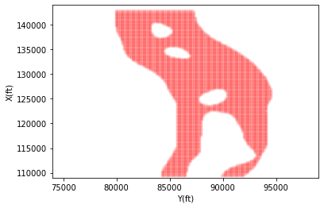
Developing Model
Performed linear regression to find regression coef.
2D interpolation
Divide AI map into upper and lower zones based on threshold values
Used maps to find potential well locations based on lower and upper intervals
Notes:
Showcase Interesting and Innovative Aspects of Your Workflow.
State and Defend Modeling Decisions
Discuss Critical Results and Learnings for Workflow Steps
Captions for all Figures
Concise Text on Slides to Explain the Main Points

Slide 10
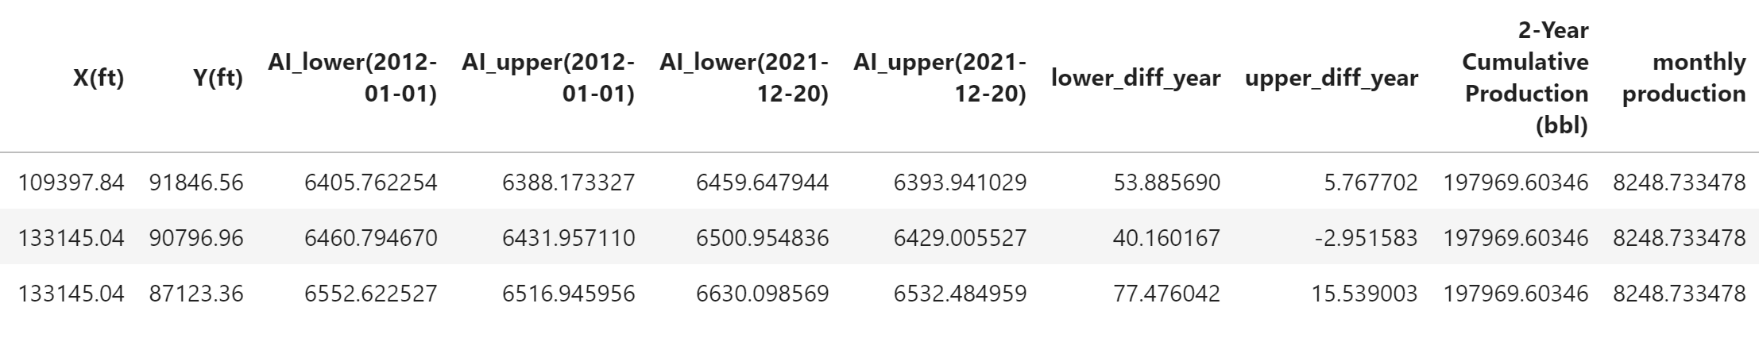

Results and Discussions

Slide 11
Feedback
What did your team learn?
What did your team like?
What could we do to improve next year?

