Slide 1
Hackathon Project Final Presentation
March 27th, 2022
Longhorn Energy Club
Khushboo Agarwal, Christian Hurd, Morgan Nguyen, Benjamin Stormer
Jackson School of Geosciences, McKetta Department of Chemical Engineering, Hildebrand Department of Petroleum and Geosystems Engineering, Walker Department of Mechanical Engineering

Slide 2
Executive Summary
The Problem:
Determine the optimum drilling spot for 3 new wells to maximize production over the next two years
Our Approach:
Analyzed AI data to see reservoir depletion trends
Performed correlation analysis between features
Created a model using interpolation and linear regression to predict the optimum new well locations
What did we learn?
The lower zone generally has higher production
Some features (…) have a seemingly greater impact on production than others
Our Recommendation
Drilling the 3 new wells in the lower zone at XX, XX, and XX
Notes:
Add pictures of heat maps, add green map with AI depletion regions. Also show correlation and production wells, last one of 3 dots

Slide 3
Workflow
Overview with Steps / Flow Chart
Examined AI Data (Data completeness too?)
Production heat map
3. Synthesized Well log data
4. Combined well log data with production ( Combine with 3)
5. Bivariate distribution with features (Mention data completeness?)
6. Selected features with strongest correlation to production (removed redundancies)
7. Created model

Slide 4
Examining AI Data
Notes:
Showcase Interesting and Innovative Aspects of Your Workflow.
State and Defend Modeling Decisions
Discuss Critical Results and Learnings for Workflow Steps
Captions for all Figures
Concise Text on Slides to Explain the Main Points

Slide 5
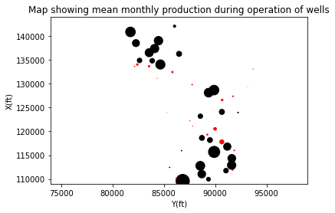
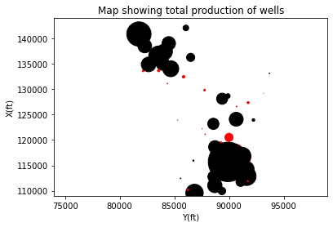
Oil Production Heat Map
Lower Zone generally has much greater production
True for monthly and total production
Bottom right area has more production
True for monthly and total production
Bottom right area appears to be more used
= Upper Zone
= Lower Zone
Notes:
Showcase Interesting and Innovative Aspects of Your Workflow.
State and Defend Modeling Decisions
Discuss Critical Results and Learnings for Workflow Steps
Captions for all Figures
Concise Text on Slides to Explain the Main Points

Slide 6
Synthesizing Well Log Data
Notes:
Showcase Interesting and Innovative Aspects of Your Workflow.
State and Defend Modeling Decisions
Discuss Critical Results and Learnings for Workflow Steps
Captions for all Figures
Concise Text on Slides to Explain the Main Points

Slide 7
Bivariate Distribution of Features
Notes:
Showcase Interesting and Innovative Aspects of Your Workflow.
State and Defend Modeling Decisions
Discuss Critical Results and Learnings for Workflow Steps
Captions for all Figures
Concise Text on Slides to Explain the Main Points

Slide 8
Developing Model
Notes:
Showcase Interesting and Innovative Aspects of Your Workflow.
State and Defend Modeling Decisions
Discuss Critical Results and Learnings for Workflow Steps
Captions for all Figures
Concise Text on Slides to Explain the Main Points

Slide 9
Results and Discussions
Present your 3 infill well locations (location map) and predicted 2 year production for your wells.
Use table / map / distributions to communicate the model predictions, modeling tuning etc.

Slide 10
Feedback
We learned
How to develop a strategy for managing a large problem
How to synthesize large batches of data
How to stay focused for long stretches of time
We enjoyed
Learning from the different mentors
The complexity of the problem (partially due to lack of data)
The strong focus on collaboration
Next year could be improved by
A slightly longer timeframe
Allowing groups of up to 5

