Slide 1
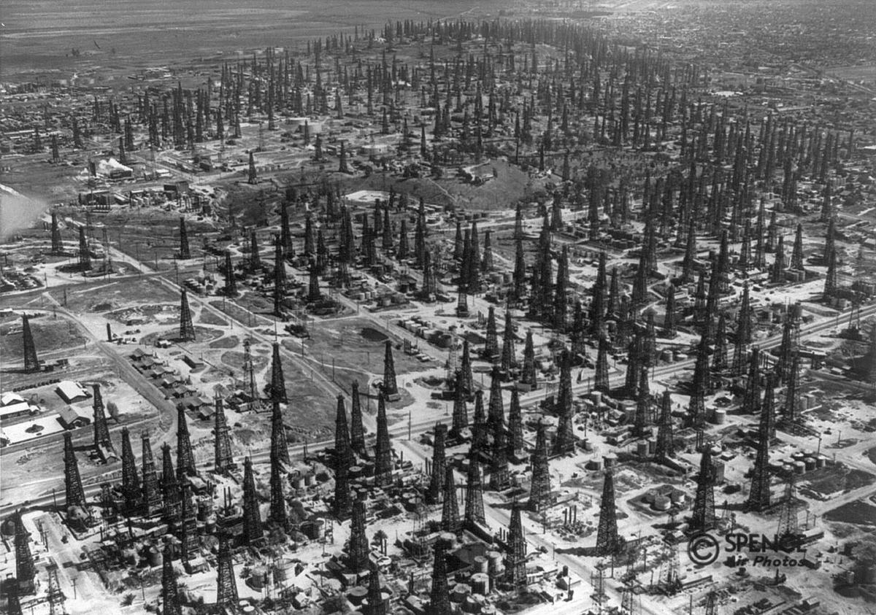
Hackathon Project Final Presentation
April 18th, 2021
Irvin Shen (ME), Jake Lockwood (PGE),
Sebastian Prez (PGE)
MOAR
DRILLING

Slide 2
Executive Summary
Our goal was to forecast production for 10 unproduced wells in a deepwater reservoir. We used production and petrophysical data from 73 existing wells in the same reservoir to predict 3 year cumulative production for the target wells.
This was accomplished by upscaling well data, quantifying features, and using a gradient boosted decision tree model to predict production.
Our 3-year cumulative production estimates have a mean absolute error near 20%.
Production of the 10 wells may commence immediately as global oil demand has returned and oil prices are predicted to rise.

Slide 3
Workflow
Overview with Steps / Flow Chart
EDA
Visualization
Statistical Analysis
Upscaling
Well Data Condensed
Model Building
Gradient Boosted Decision Tree
Uncertainty Analysis
Absolute Error
Bootstrap
P10, P50, P90
Quantification
Categorical to Numerical Data
Defining New Features

Slide 4
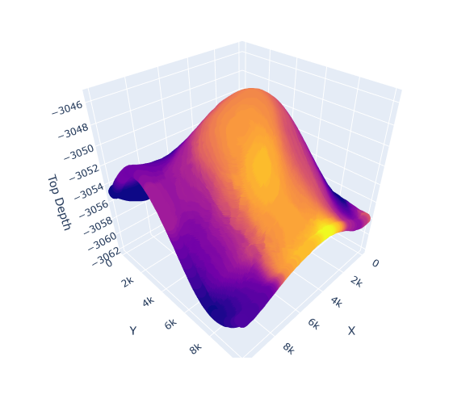

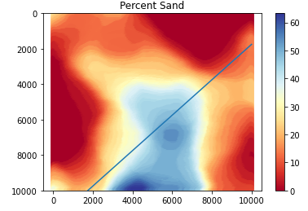
Workflow: EDA
Visualization of data
Summary statistics
3D interpretation of the reservoir
Visualization of fault and facies

Slide 5
Workflow: Quantification
Facies categories to numerical values
Fault quantification, two new features
Orthogonal distance to fault
Side of the fault (above or below)
1: above fault
0: below fault
Facies Type | Numerical Value
Shale | 0
Shaly Sandstone | 1
Sandy Shale | 2
Sandstone | 3
Table of numerical values for facies

Slide 6
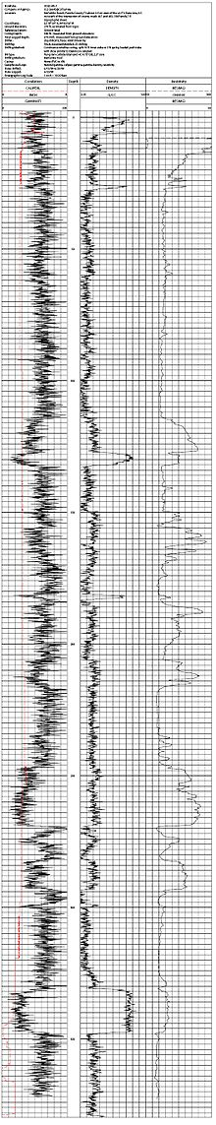
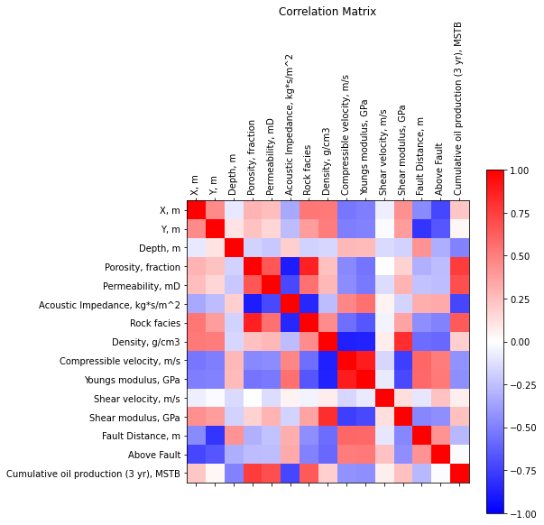
Workflow: Upscaling
Average for each well of:
Porosity
Permeability
Acoustic Impedance
Facies
Density
Young’s Modulus
Shear Modulus
Shear Velocity
Compressible Velocity
Correlation of response and explanatory features
Well log data

Slide 7
Workflow: Model Building
Gradient boosted decision tree model
Better accounts for binary nature of fault features
Gradient boosted
Iteratively training on its own results
Cut down on bias
Hand-built Ensemble model
Allows granular analysis of output
Ensemble modeling using bootstrapping and bagging allows a cutdown of the bias of any one model

Slide 8
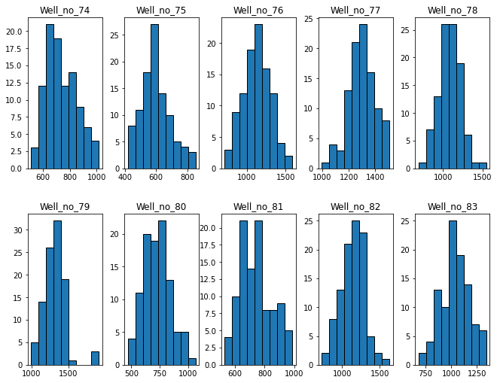
Workflow: Uncertainty Analysis
Histograms of production predictions for each target well.

Slide 9
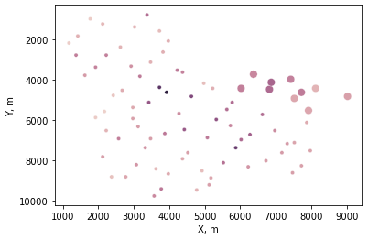
Results and Discussions
Percentile | Well_ID
 | Well_no_74 | Well_no_75 | Well_no_76 | Well_no_77 | Well_no_78 | Well_no_79 | Well_no_80 | Well_no_81 | Well_no_82 | Well_no_83
0.1 | 614 | 481 | 880 | 1175 | 908 | 1171 | 580 | 619 | 931 | 851
0.5 | 717 | 590 | 1137 | 1295 | 1092 | 1329 | 727 | 736 | 1148 | 1041
0.9 | 898 | 713 | 1346 | 1428 | 1243 | 1468 | 872 | 912 | 1314 | 1214

Slide 10
Feedback
What did your team learn?
How to apply a data driven approach to a real-world problem
Data cleaning and upscaling
Incorporation of many data types
What did your team like?
The real-world problem
What could we do to improve next year?
Different time of the year (end of Christmas break?)

Slide 11
MOAR
DRILLING

