Slide 1
Hackathon Project Final Presentation
January 22th, 2022
[Underdogs]
[Jacob Joseph, and Jonathan Thompson]
Team Members’ Departments and School
Note, you will have less than 10 minutes to present.

Slide 2
Executive Summary
1. What is the problem?
2. What did your team do to address the problem?
3. What did your team learn?
4. What does your team recommend going forward?

Slide 3
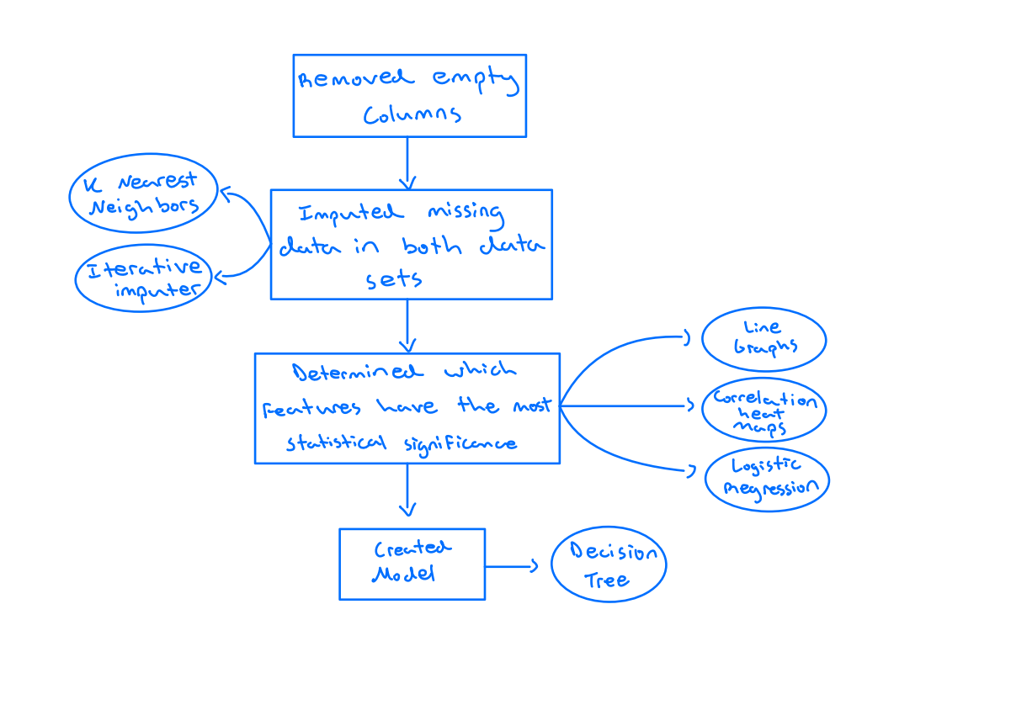
Workflow

Slide 4
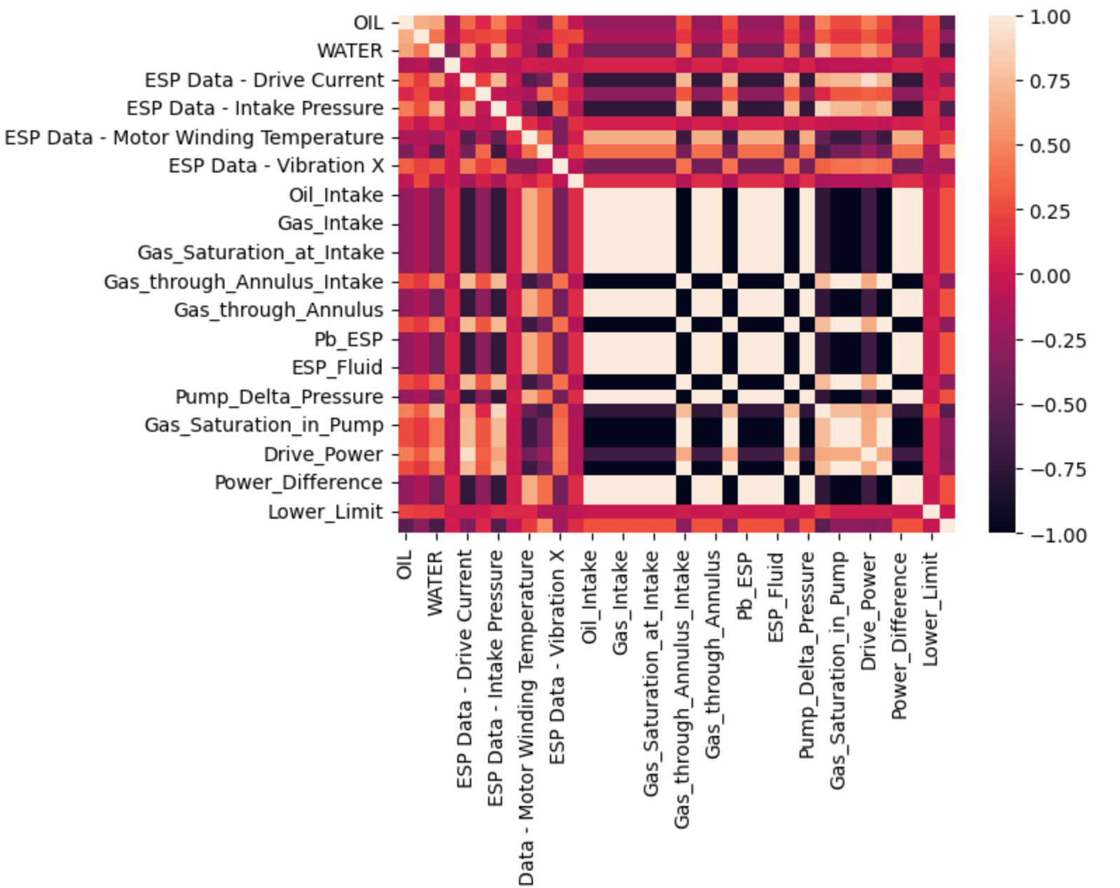
Workflow (Multiple Slides)

Slide 5
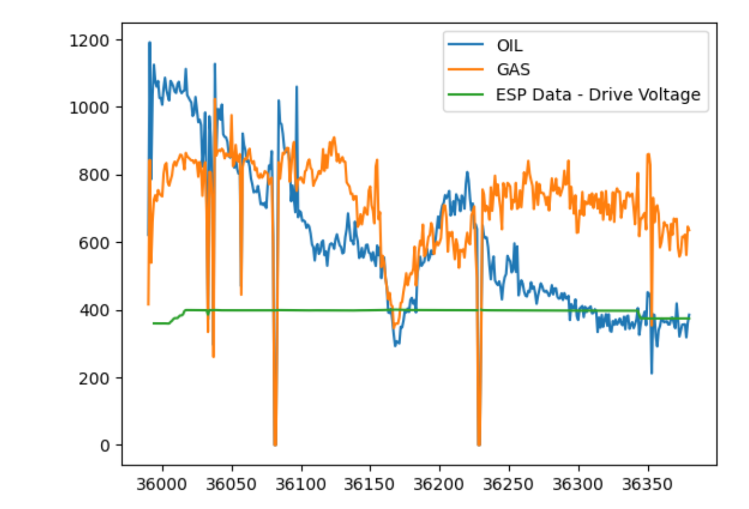
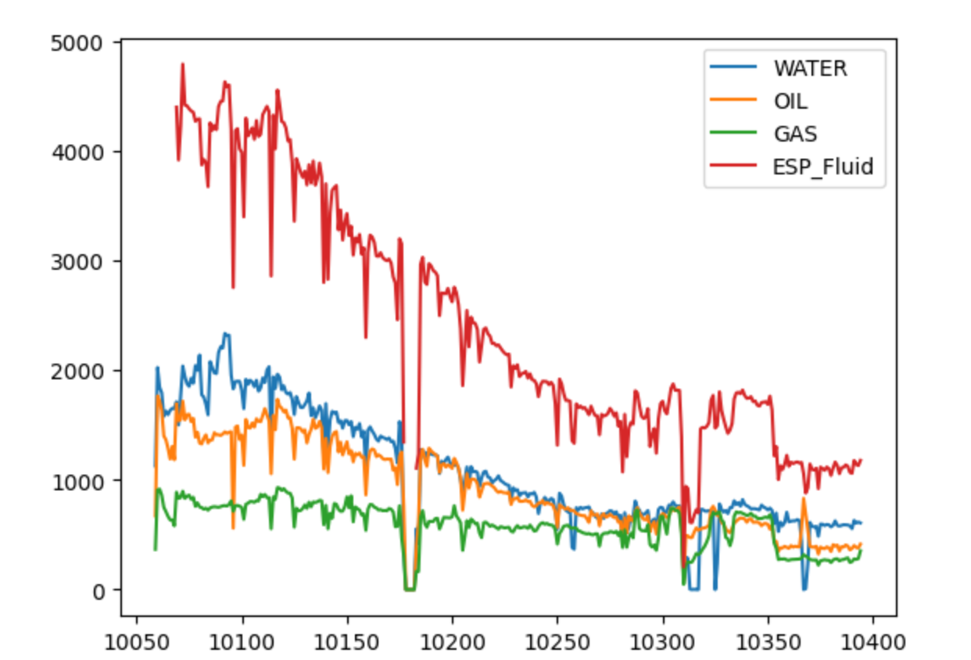

Slide 6


Slide 7
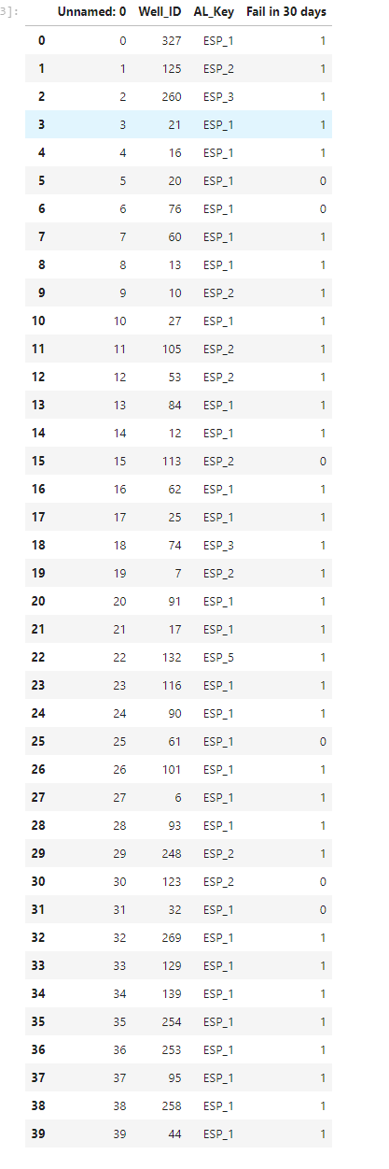
Results and Discussions
Recall the ESPs are listed in data/solution.csv
Use table, graphs to communicate the model predictions, modeling tuning, feature engineering and importance, etc.

Slide 8
Feedback
What did your team learn?
What did your team like?
What could we do to improve next year?

