Slide 1
Hackathon Project Final Presentation
January 21th, 2024
Bitumen Bandits
Akshay Vemulapalli, Austin Barthel, Gautam Narayan, Leonardo Di Mauro
Jackson School of Geosciences, Hildebrand Department of Petroleum Engineering, College of Natural Sciences, Department of Computer Science

Slide 2
Executive Summary
Problem:
- Goal: Predict average pump difference during drillout for 15 wells.
Team Approach:
- Developed Python-based data analytics and ML workflow.
- Utilized diverse data sources, performed feature engineering, etc.
- Selected, trained, and tuned robust ML models.
Key Learnings:
- Effective feature engineering addresses complex data scenarios.
- Domain expertise enhances prediction accuracy.
- Robust ML models effectively handle uncertainty.
Recommendations:
- Continue exploring diverse data sources.
- Refine feature engineering techniques.
- Sustain collaboration with domain experts.
- Regularly update ML models for increased robustness.

Slide 3
Workflow
Overview with Steps / Flow Chart
Feature Selection/Correlation Analysis
Model Training
Hyperparameter Tuning
Visual Correlation
Data Pre-Processing
Pearson Correlation Coefficient
Comparison of Multiple Models
Evaluation of Models using MSE and RSE
Tuning of tree depth
Tuning of seed

Slide 4
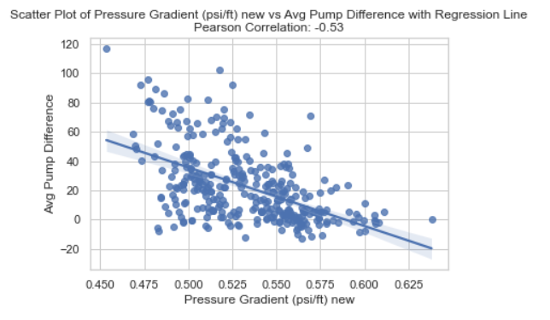
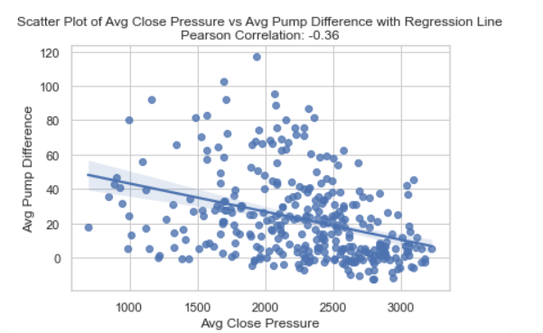
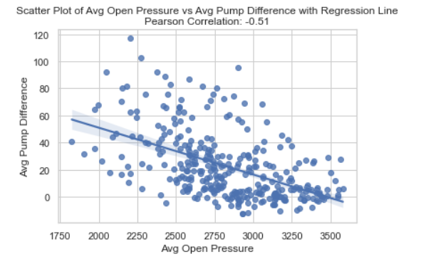
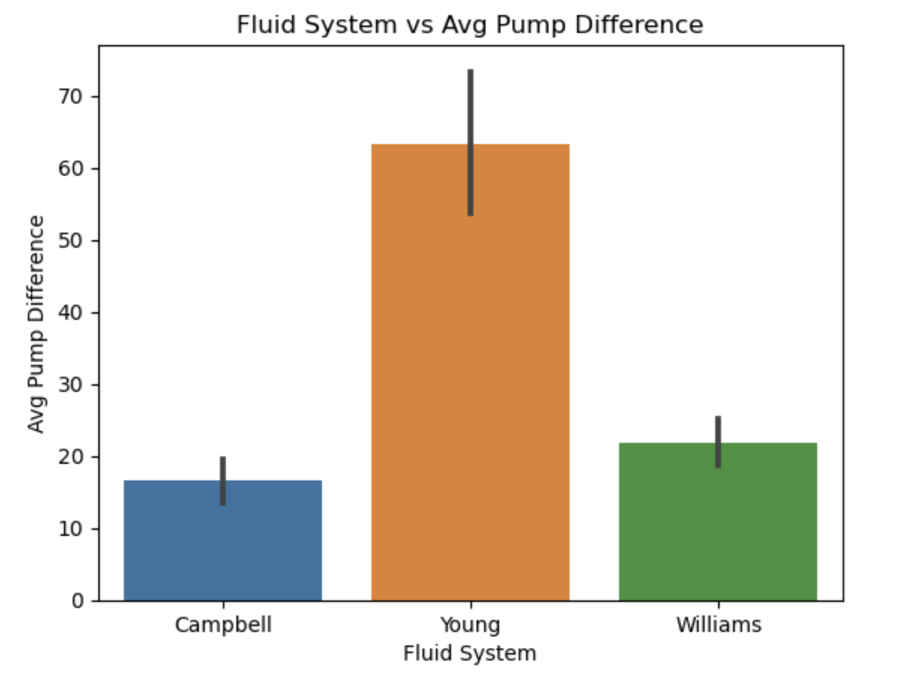
Visual Correlation Analysis

Slide 5
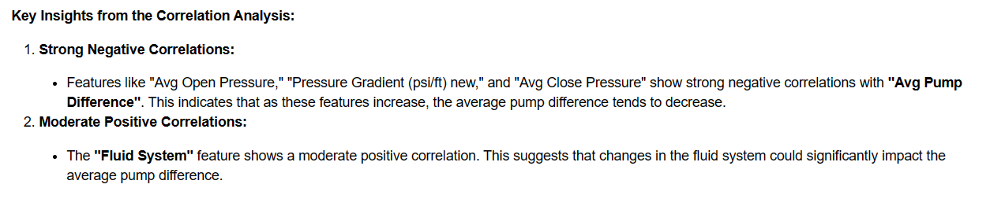
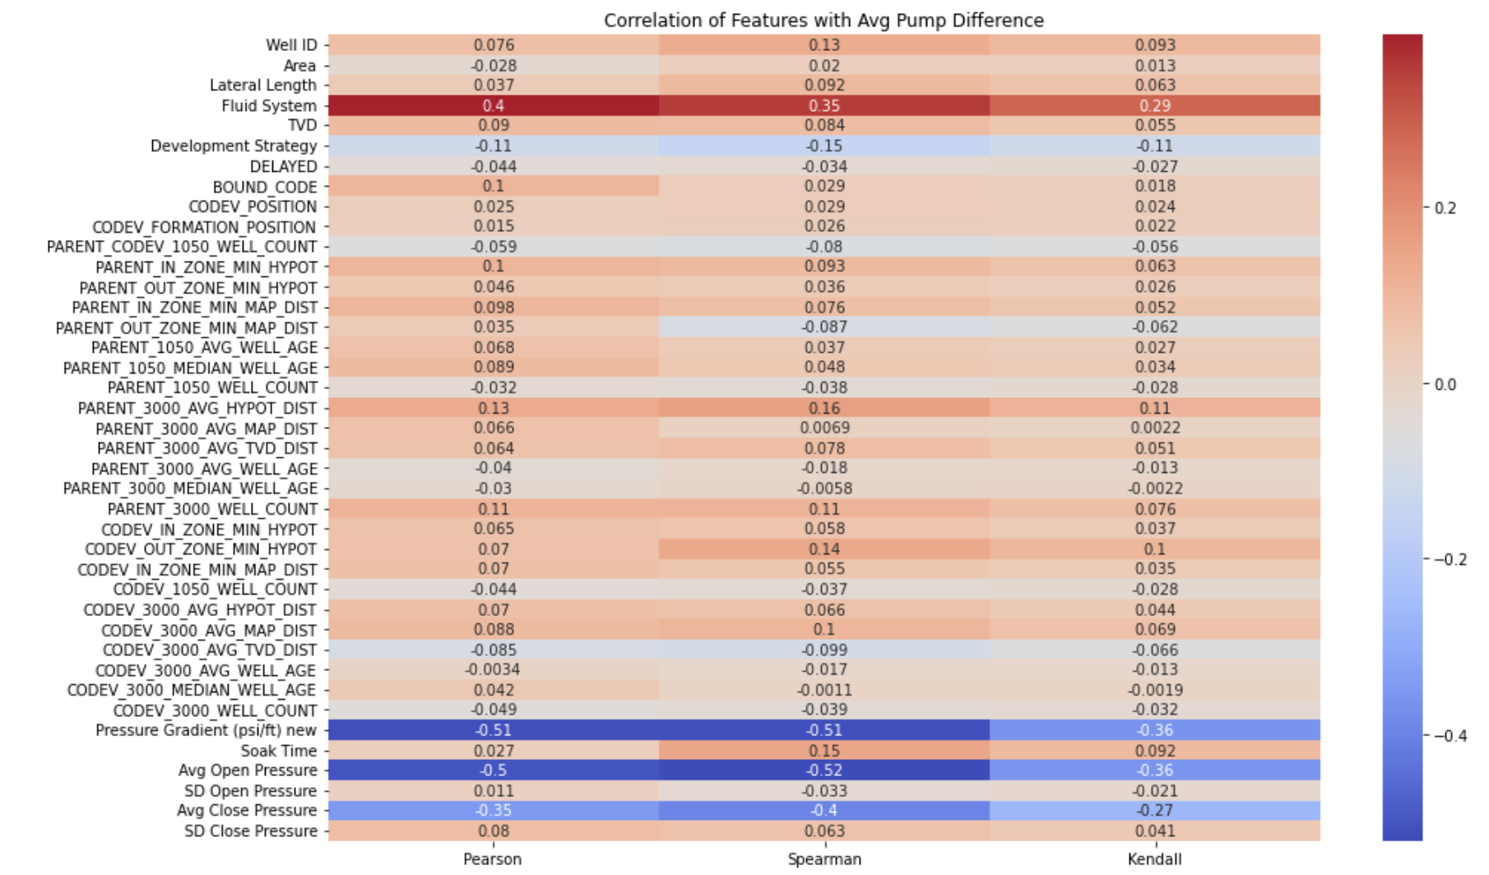
Non-Parametric Correlation Analysis

Slide 6

Choosing Our Model: Linear Regression vs. Random Forest
Random Forest consistently gave us a lower Average MSE than Linear Regression and GradientBoost did which is why we decided to use it.

Slide 7
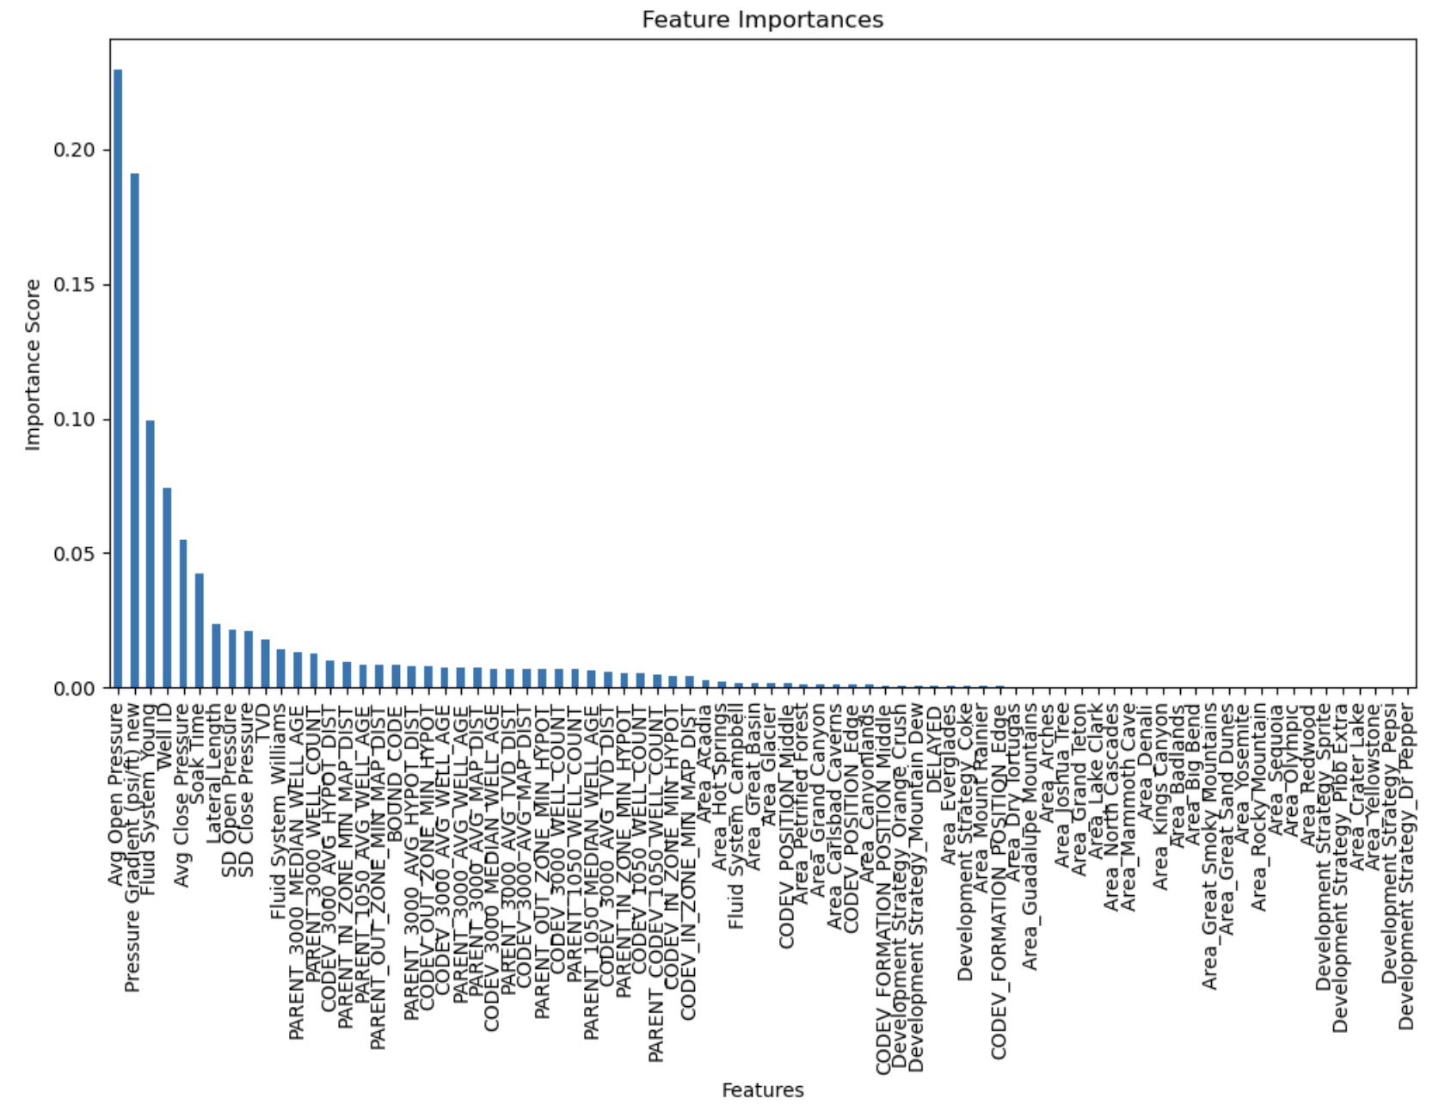
Feature Selection

Slide 8
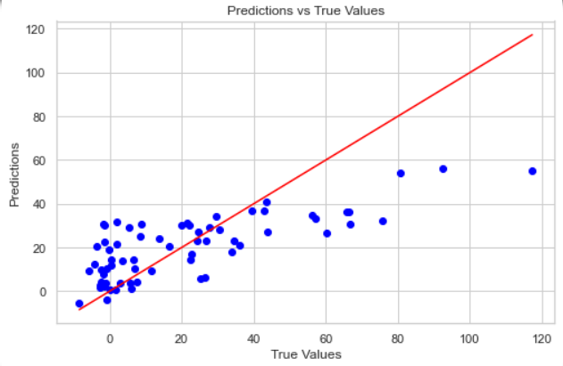
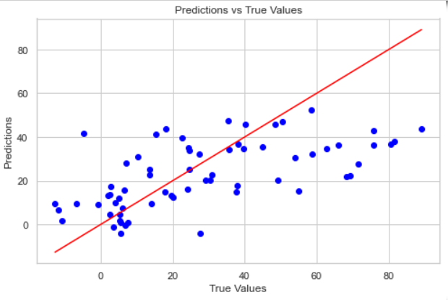
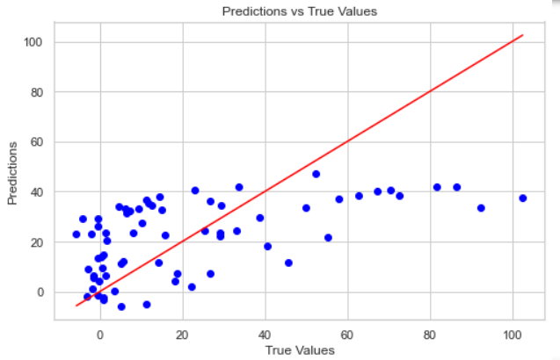
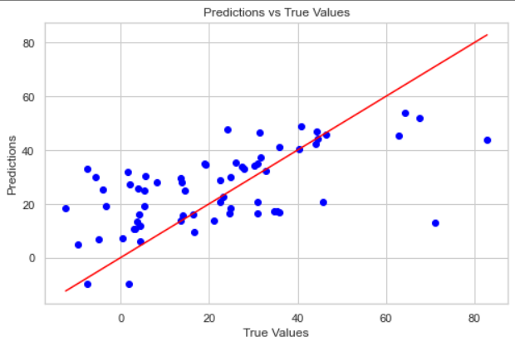
Hyperparameter Tuning
MSE: 343
MSE: 456
MSE: 492
MSE: 298

Slide 9
Results
With 300 n estimators, 7 total features, and a max depth of 30 we were able to obtain a MSE low of 234

Slide 10
Feedback
What did we learn?
None of us had a strong background in Statistics, Drilling, or Completions.
We all ended up learning something new about Plug and Perf Operations and Geostatistics.
What did we like?
Problem was interesting and applicative; it was challenging but not TOO challenging.
What could be done better next year?
Nothing!!!1!! We had a great time!

