Slide 1
Candidate_Elimination Algorithm

Slide 2
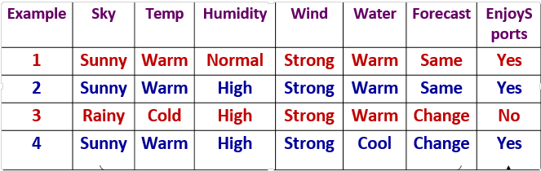
A Concept Learning Task – EnjoySport Training Examples
A set of example days, and each is described by six attributes.
The task is to learn to predict the value of EnjoySport for arbitrary day, based on the values of its attribute values . This id Target concept

Slide 3
Candidate Elimination Algorithm
For each training example d, do
If d is a positive example
Remove from G any hypothesis inconsistent with d
For each hypothesis s in S that is not consistent with d
Remove s from S
Add to S all minimal generalizations h of s such that
o h is consistent with d, and some member of G is more general than h
Remove from S any hypothesis that is more general than another hypothesis in S

Slide 4
If d is a negative example
Remove from S any hypothesis inconsistent with d
For each hypothesis g in G that is not consistent with d
Remove g from G
Add to G all minimal specializations h of g such that
o h is consistent with d, and some member of S is more specific than h
– Remove from G any hypothesis that is less general than another hypothesis in G

Slide 5
S ← minimally general hypotheses in H, G ← maximally general hypotheses in H Initially any hypothesis is still possible
S₀ = ⟨∅, ∅, ∅, ∅, ∅, ∅⟩
G₀ = ⟨?, ?, ?, ?, ?, ?⟩
Initialize G to the set of maximally general hypotheses in H
Initialize S to the set of maximally specific hypotheses in H

Slide 7
Initial Values
S₀ :
G₀ :
⟨∅, ∅, ∅, ∅, ∅. ∅⟩
⟨?, ?, ?, ?, ?, ? ⟩

Slide 8
Example: after seeing ⟨Sunny, Warm, Normal, Strong, Warm, Same ⟩ +
S₀:
S₁:
G₁, G₂ :
⟨∅, ∅, ∅, ∅, ∅. ∅⟩
⟨Sunny, Warm, Normal, Strong, Warm, Same⟩
⟨?, ?, ?, ?, ?, ?⟩

Slide 9
Example: after seeing ⟨Rainy, Cold, High, Strong, Warm, Change ⟩ −
S_{2,} S₃:
G₃:
G₂:
⟨Sunny, Warm, ?, Strong, Warm, Same⟩
⟨Sunny, ?, ?, ?, ?, ?⟩ ⟨?, Warm, ?, ?, ?, ?⟩ ⟨?, ?, ?, ?, ?, Same⟩
⟨ ?, ?, ?, ?, ?, ?, ?⟩

Slide 10
Example: after seeing ⟨Sunny, Warm, High, Strong, Cool Change ⟩ +
S₃ :
S₄ :
G₄:
G₃:
⟨Sunny, Warm, ?, Strong, Warm, Same⟩
⟨Sunny, Warm, ?, Strong, ?, ?⟩
⟨Sunny, ?, ?, ?, ?, ?⟩ ⟨?, Warm, ?, ?, ?, ?⟩
⟨Sunny, ?, ?, ?, ?, ?⟩ ⟨?, Warm, ?, ?, ?, ?⟩ ⟨?, ?, ?, ?, ?, Same⟩

Slide 11
The S boundary of the version space forms a summary of the previously encountered positive examples that can be used to determine whether any given hypothesis is consistent with these examples.
The G boundary summarizes the information from previously encountered negative examples. Any hypothesis more specific than G is assured to be consistent with past negative examples.

Slide 12
CGPA | Interactiveness | Practical Knowledge | Communication Skills | Logical Thinking | Interest | Job offer
>9 | Yes | Excellent | Good | Fast | Yes | Yes
>9 | Yes | Good | Good | Fast | Yes | Yes
>8 | No | Good | Good | Fast | No | No
>9 | Yes | Good | Good | Slow | No | Yes

Slide 13
So=
Go=
I1= {>9,Yes, Excellent, Good, Fast, Yes}
S1= {>9,Yes, Excellent, Good, Fast, Yes}
G1= {?, ?, ?, ?, ?, ? }
I2 ={>9,Yes, Good, Good, Fast, Yes}
S2={>9,Yes, ?, Good, Fast, Yes}
G2= {?, ?, ?, ?, ?, ? }
⟨∅, ∅, ∅, ∅, ∅. ∅⟩
⟨?, ?, ?, ?, ?, ? ⟩

Slide 14
I3 ={>8, No, Good, Good, Fast, No} NEGATIVE
S3={>9,Yes, ?, Good, Fast, Yes}
G3= {(>9, ?, ?, ?, ?, ? )
(?, Yes, ?, ?, ?, ?)
(?, ?, ?, ?, ?, Yes)}
I4 ={>9, Yes, Good, Good, Slow, No}
S4={>9,Yes, ?, Good, ?, ?}
G3= {(>9, ?, ?, ?, ?, ? )
(?, Yes, ?, ?, ?, ?) }

Slide 15
Final Version Space:
{(>9, Yes, ?, ?, ?, ? )
(?, Yes, ?, Good, ?, ?)
(?,Yes, ?, Good, ?, ?)}

Slide 16
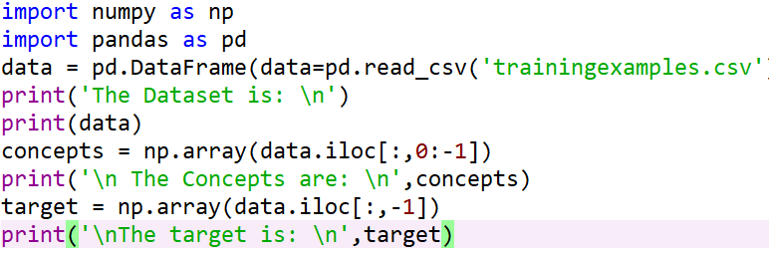
Program

Slide 17
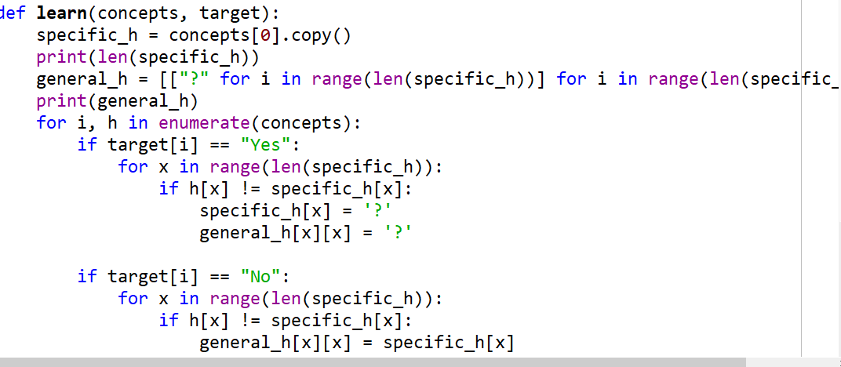

Slide 18
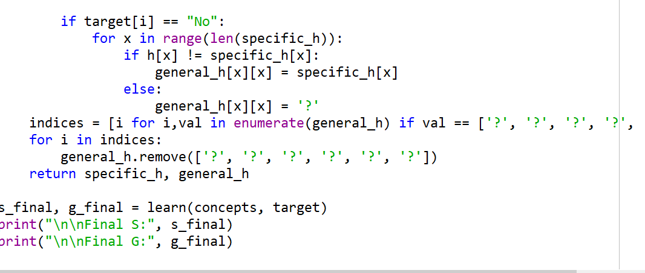

Slide 19
