Slide 1
Capstone Project
Patrick Green-Holloway

Slide 2
Introduction
I was assigned to perform a sales analysis for EmporiUm, a student bookstore chain that also sells tech products, art supplies, and other products in the state of New York.
Ellen Lemon( East Region, Connecticut), was the manager assigned to me.

Slide 3
Sales Analysis
What is total revenue overall for sales in the assigned territory, plus the start date and end date that tell you what period the data covers?
What is the month-by-month revenue breakdown for the sales territory? Provide a comparison of total revenue for the specific sales territory and the region it belongs to.
What is the number of transactions per month and average transaction size by product category for the sales territory?
Can you provide a ranking of in-store sales performance by each store in the sales territory, or a ranking of online sales performance by state within an online sales territory?
What is your recommendation for where to focus sales attention on the next quarter?

Slide 4
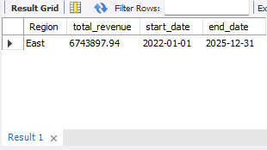
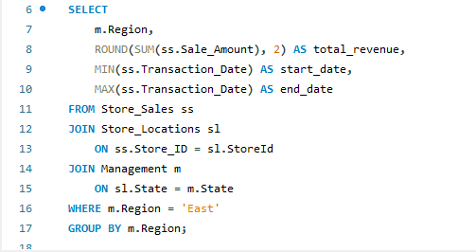
What is the total revenue overall for sales in the assigned territory, plus the start date and end date that tell you what period the data covers?
Result
Query
In simple terms, this query answers:
How much money did the East region make, and what period does the data cover?
$6743897.94 from 2022 to 2025

Slide 5
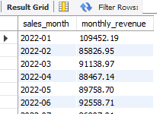
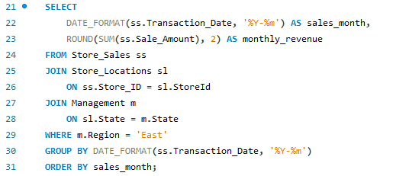
What is the month-by-month revenue breakdown for the sales territory?
Result
Query
This query helped show whether revenue is increasing, decreasing, or staying steady over time.
The strongest month was October 2025, with $301,070.13 in revenue. The weakest month was November 2022, with $84,353.10 in revenue.
This told me that the revenue increased over the 3-year period

Slide 6
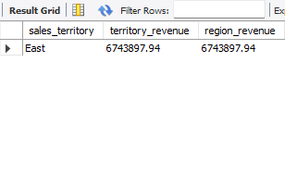
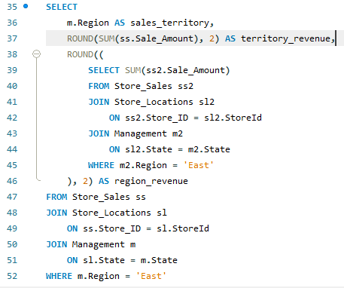
Provide a comparison of total revenue for the specific sales territory and the region it belongs to.
Result
Query
Since my selected territory is the East region, this query gives one total revenue number for that region.
Since the territory and region are both East in this case, the totals may match.
The total revenue being $6743897.94

Slide 7
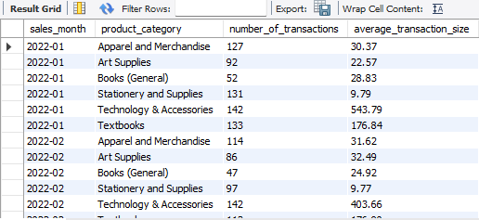
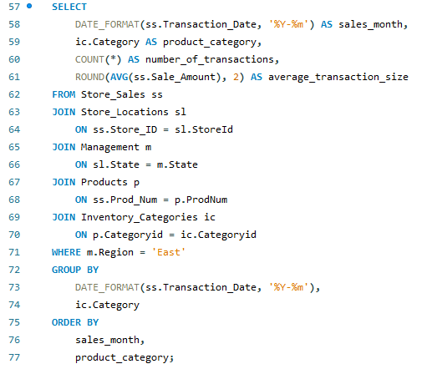
What is the number of transactions per month and average transaction size by product category for the sales territory?
Result
Query
The strongest product category was Technology & Accessories, with:
$4,779,056.69 in revenue
10,117 transactions
$472.38 average sale
The lowest average sale category was Stationery and Supplies, with:
$102,864.65 in revenue
10,268 transactions
$10.02 average sale

Slide 8
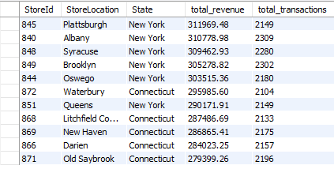

Can you provide a ranking of in-store sales performance by each store in the sales territory?
Result
Query
The top-performing store was New York, NY, with:
$621,565.02 in revenue
4,476 transactions
The lowest-performing store was Old Saybrook, Connecticut with:
$277,399.26 in revenue
2,196 transactions

Slide 9
My findings & recommendations for where to focus sales attention on the next quarter!
One issue is that the East region depends heavily on New York. Since New York brings in most of the revenue, Connecticut could use more attention.
Another issue is that 2025 had more transactions, but the average sale amount went down. That means customers were buying more often but spending less each time.
Also, some categories like Stationery and Supplies get a lot of sales, but the purchases are small. So, they help with transaction count, but not as much with total revenue.
The sales team should focus more on Technology & Accessories because it has the highest revenue and highest average sale amount.
They should also support the top stores, especially New York and Rochester, since those locations are already performing well.
For Connecticut and lower-performing stores, the company could try better promotions, stronger product displays, and more focus on higher-value items.

Slide 10
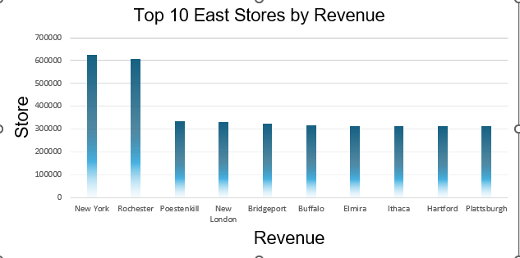
Visualization
PivotChart
I created a Top 10 Stores by Revenue column chart for the east region. This helps highlight the strongest stores without overcrowding the visual with too much information.
The top-performing store was New York, NY
The lowest-performing store was Old Saybrook, CT

Slide 11
GitHub Repository
https://github.com/PGHollo/Capstone_1.git

