Slide 1
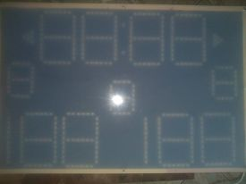
FOUL
FOUL
PERIOD
HOME
AWAY

