Slide 1

BOSS: Biological Operations modeled through Stochastic Simulation
By: Logan Brosemer, Juliana Hong, Raashmi Krishnasamy, Danial Nasirullah, Rosalie Sowers, Madeleine Taylor-McGrane, and Nalini Ramanathan

Slide 2
Overview of Project (objective)
The objective of this project is model different biological stochastic systems using a simulator called BOSS. In order to show the competency of our program, we have modeled four different biological systems: simple diffusion across a cell membrane, substrate binding with wild type HIV protease 1, inhibitor binding with wild type HIV protease,and inhibitor binding with mutant HIV protease.

Slide 3
ODE vs. SSA
ODE
Ordinary Differential Equations
Equations containing a function of one independent variable and all of its derivatives
incorporates the factor of randomness present within any system to choose which reaction will be carried out. For this reason, the stochastic model is more practical and accurate and thus, supersedes the ODE model
SSA
Stochastic Simulation Algorithms
incorporates the factor of randomness present within any system to choose which reaction will be carried ou

Slide 4
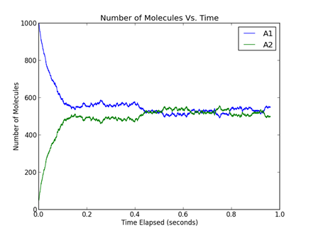
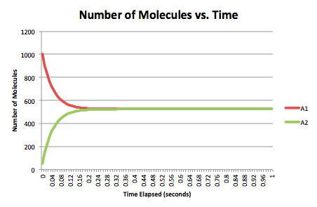
ODE vs. SSA
ODE
SSA

Slide 5
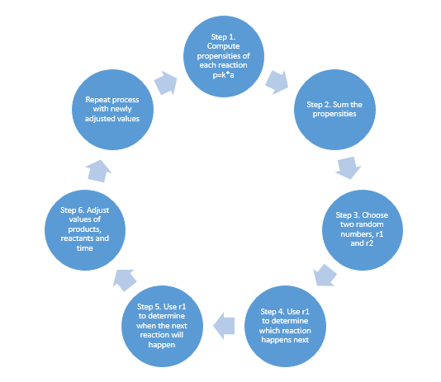
Gillespie Algorithm

Slide 6
Why Gillespie

Slide 7
Overview of our Python Program
DEMO HERE

Slide 8
Input/Output?
Input: SCREEN SHOT OF PARSE HERE

Slide 9
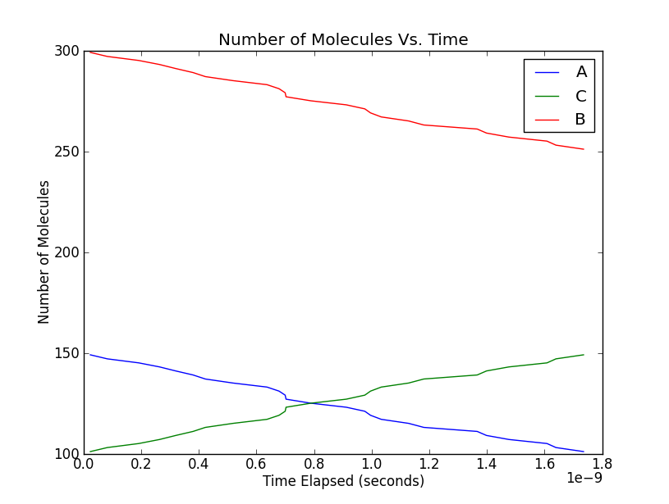
Input/Output
Output: Saquinavir
A + B → C
C → A + B
A - [Enzyme]
B - [Inhibitor]
C - [Enzyme-Inhibitor]

Slide 10
Test cases
1. Simple Diffusion Across a Cell Membrane
2. Lotka - Volterra
3. HIV Protease 1 Examples

Slide 11
HIV-1 Protease - Simple Substrate Concentrations

Slide 12
Future Developments
Extensive Testing
Graphical User Interface
Internal unit conversion capabilities
Tau-leaping (increased efficiency)
Delayed reactions

Slide 13
Conclusion

Slide 14
Acknowledgements
We would like to acknowledge the following individuals…

Slide 15

The End

