Slide 1

BOSS: Biological Operations modeled through Stochastic Simulation
By: Logan Brosemer, Juliana Hong, Raashmi Krishnasamy, Danial Nasirullah, Rosalie Sowers, Madeleine Taylor-McGrane, and Nalini Ramanathan
Notes:
Rosie

Slide 2
Introduction
Objectives:
Research different methods of stochastic simulation
Develop a simulator using the Gillespie method
Test our simulator, BOSS, on several biological systems:
Simple diffusion across a cell membrane
Lotka-Volterra system
HIV-1 Protease substrate binding and inhibition
Notes:
Rosie
Stress the fact that we made a simulator - no need to discuss the “python 101”

Slide 3
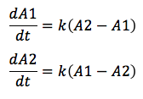

ODE vs. SSA
ODE
Ordinary Differential Equations
Deterministic
Static equations
Continuous timescale
Good for large-scale systems
SSA
Stochastic Simulation Algorithms
Probabilistic
Factors that vary according to probabilities
Randomness
Good for small-scale systems
Notes:
Juliana

Slide 4
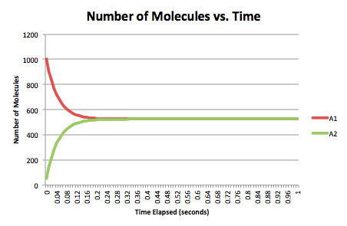
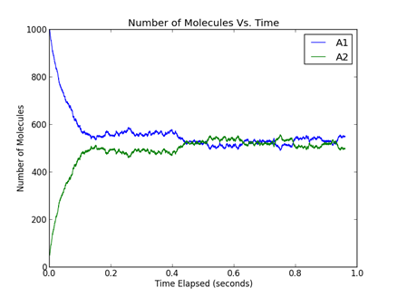
Model of Simple Cellular Diffusion
ODE
SSA
Notes:
Juliana
insert diffusion picture into this slide/before the slide
annotate molecules in graph and in the picture
be sure to explain axes of graphs and units along with what the graph actually is

Slide 5
Why Gillespie?
Developed by Daniel T. Gillespie in 1977
No “Master Equation”
Simple
Efficient
Notes:
Maddie

Slide 6
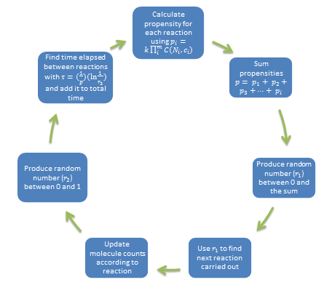
The Gillespie Algorithm
Notes:
Maddie

Slide 7
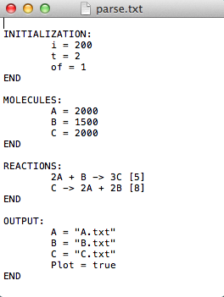
Input
i = num. of iterations
t = time running
of = Output frequency
Molecules = initial num. of molecules
Reactions = reaction and reaction rate
Output = File to output values of each molecule
Plot = graph Yes/no and what are the axis labels
Notes:
Dan
Picking a reaction based on probabilities and getting them t work

Slide 8
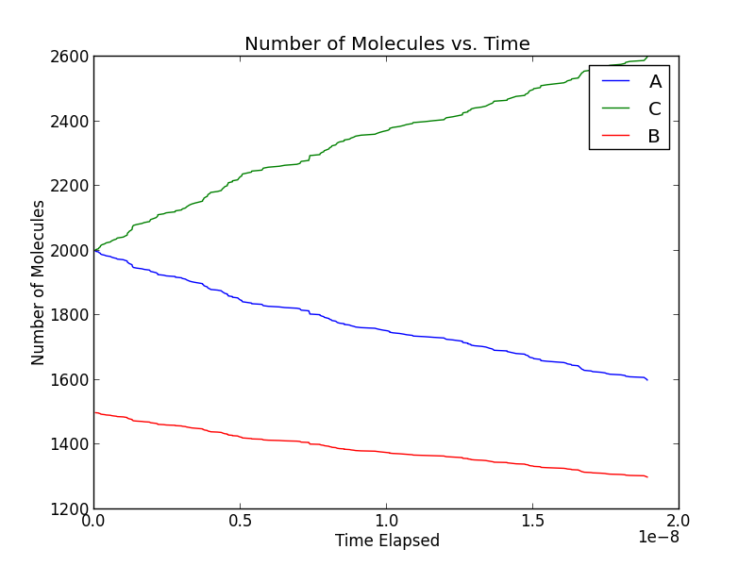
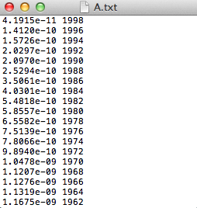
Output
Notes:
Dan

Slide 9
Demonstration of BOSS
Notes:
Logan
Have a slide where the demonstration is actually explained - go through specific steps and how to produce output

Slide 10
Test cases
1. Simple Diffusion Across a Cell Membrane
2. Lotka-Volterra
3. HIV-1 Protease Examples
a. T1 and T2
b. E3, E4 and E5
Notes:
Raashmi
As you observed earlier, one of our test cases was Simple Diffusion across a cell membrane. Along with this case, we tested 2 others: lotka - volterra and HIV Protease -1. With the lotka volterra test, we modeled rabbit and wolf populations and with HIV - 1 protease we tested two different types of groups. The first set was the “T Series” and the second set was “E series”. We will discuss these shortly.

Slide 11
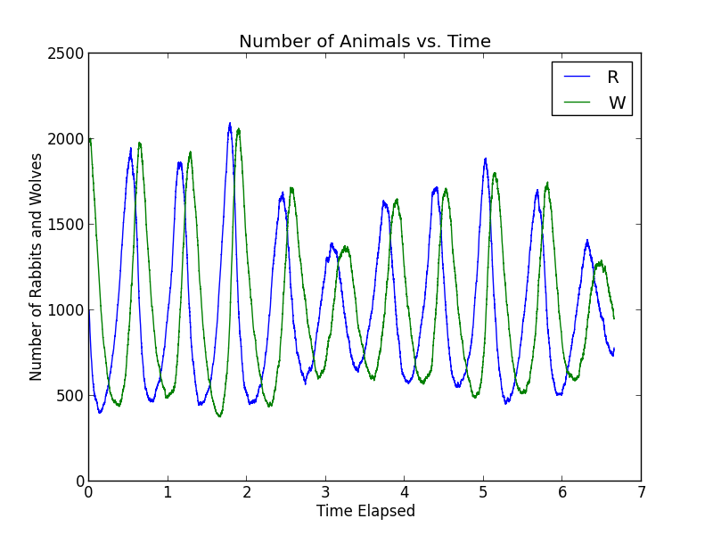
Lotka-Volterra: Wolves and Rabbits
Reactions:
R -> 2R [k1]
R + W -> 2W [k2]
W -> nil [k3]
Notes:
Nalini
describe what graph is too
The Lotka-Volterra model is used to simulate many cyclical processes, particularly ecological interactions including interspecific competition, parasite-host relationships, and predator-prey relationships.
One more common example of this is the predator-prey relationship between the wolf and the rabbit, which has been applied to our system. The k values show the rates at which certain events that affect population growth occur. The first equation illustrates reproduction of rabbits. The second shows a wolf eating a rabbit, thus allowing the wolf to reproduce. The third shows the natural death of a wolf. As one can see, when these equations are put into this algorithm, BOSS replicates this cyclical graph expected in the Lotka-Volterra model.

Slide 12
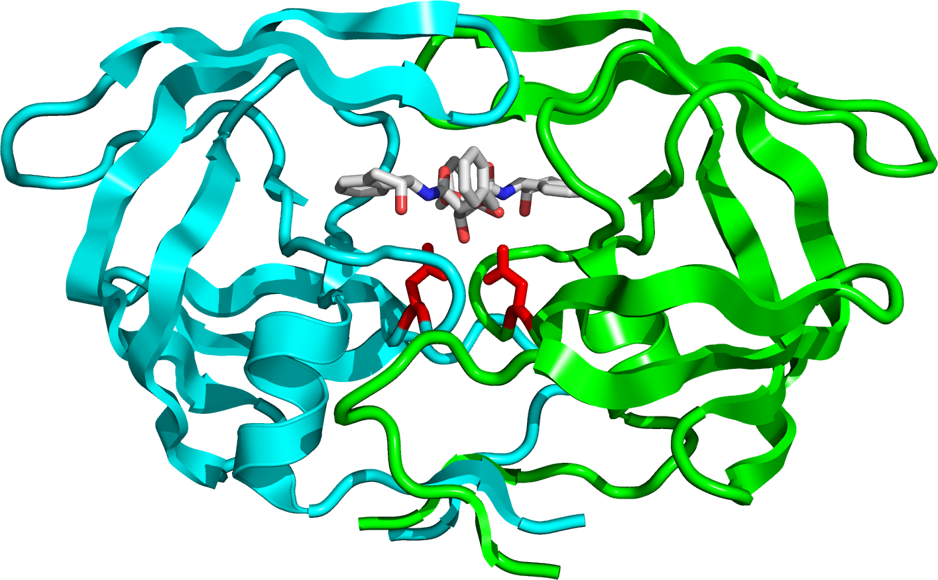
Our Main Application: HIV-1 Protease
Notes:
Raashmi

Slide 13
HIV-1 Protease: An Overview
General Information
HIV - Human Immunodeficiency Virus
HIV-1 Protease - enzyme that plays a crucial role in the replication of HIV
No cure for virus, drugs that inhibit HIV-1 Protease are currently being tested
HIV Protease Mutations and Drug Resistance
mutations in the enzyme → changes shape of enzyme → resistance to specific inhibitors
Some mutated versions of HIV-1 Protease:
G48V
V82A
I84V
L90M
G48V/L90M
Notes:
Raashmi
HIV - an immunodeficiency virus that eventually leads to acquired immunodeficiency syndrome
HIV -1 protease - enzyme that is responsible for the replication of the virus
No cure, but the effectiveness of different inhibitors is being tested to develop an efficient drug against the virus
Unfortunately, there are hurdles, also known as mutations in HIV -1 Protease. These mutations change the shape of the enzyme which then gives rise to drug resistance.
Talk about how they are all different - talk abou how the different mutations change the K val
Also - present the hypothesis

Slide 14
Different Test Groups
T1 and T2 Groups
focused on “base cases”
T1 - tested different inhibitors on Wild Type and Mutant Type HIV - 1 Protease
T2 - tested one substrate on Wild Type
E3, E4, and E5 Groups
experimental groups - “inductive cases”
E3 - focused on substrate and inhibitor interactions on Wild Type
E4 - one substrate and one inhibitor on Mutant Types
E5 - change in volume of substrate on Wild Type
Notes:
Raashmi

Slide 15
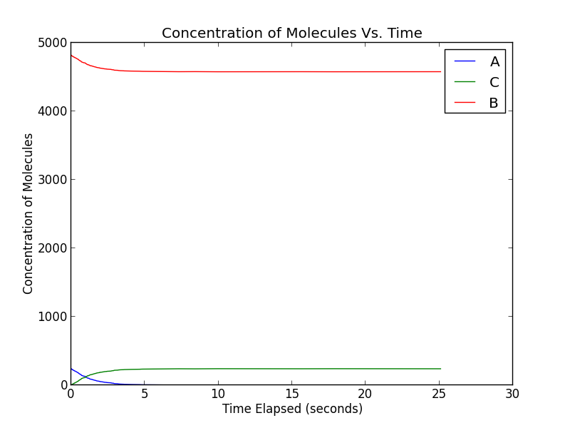
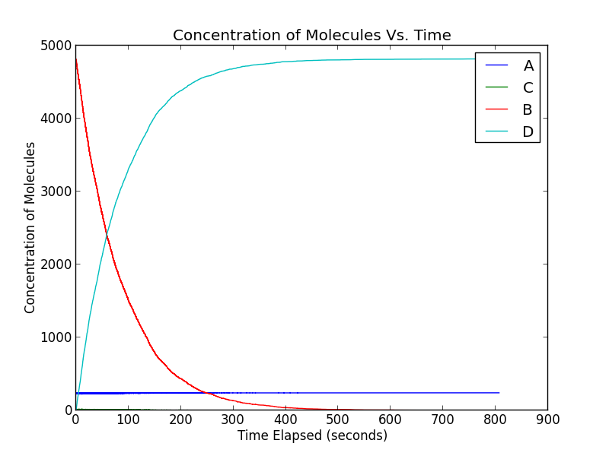
T1 and T2 Data
T1: Saquinavir
T2: TNSATIM*MQRGNF
Notes:
Raashmi
T1 - saquinavir 1 wildtype
T2 - Substrate only
As you can see, to the right, we have an output example from the T1 series and on the left, we have an output example from the T2 series. In both images, A is the Enzyme concentration, B is the Inhibitor/substrate concentration and C is the Enzyme-inhibitor/enzyme-substrate concentration. It can be observed from both graphs that the the enzyme concentration is significantly lower than the substrate/inhibitor concentration - this is to ensure that the enzyme becomes saturated. The decreasing concentration of both the enzyme and inhibitor/substrate, comes together to form a curve that steadily increases and eventually reaches a flat line…?
Change the y axis - NUMBER not CONCENTRATION
make the graph “self containeed”
include a key insight on this slide

Slide 16
Effectiveness of Different Inhibitors
Substrate Equations:
A + B → C [Kon]
C→ A + B [Koff]
C→ A + D [Kcat]
Inhibitor Equations:
A + E → F [Kon]
F→ A + E [Koff]
A= Enzyme B= Substrate
C= Enzyme-Substrate Complex D= Product
E= Inhibitor F= Enzyme-Inhibitor Complex
Notes:
Nalini
After testing the legitimacy of BOSS in modeling known test results, we move into the unknown.
First, we tested the effectiveness of different inhibitors in the context of our specific substrate, using the equations presented here. The first equation shows the formation of an enzyme-substrate complex and the second shows its dissociation. The third shows the catalysis of a substrate, moving from the enzyme-substrate complex to a separate enzyme and product. The last two equations show the formation and dissociation of an enzyme-inhibitor complex.
The Kon value illustrates the rate at which a substrate or inhibitor binds to an enzyme, and the Koff value illustrates the rate at which the two dissociate. The Kcat value illustrates the rate at which catalysis.

Slide 17
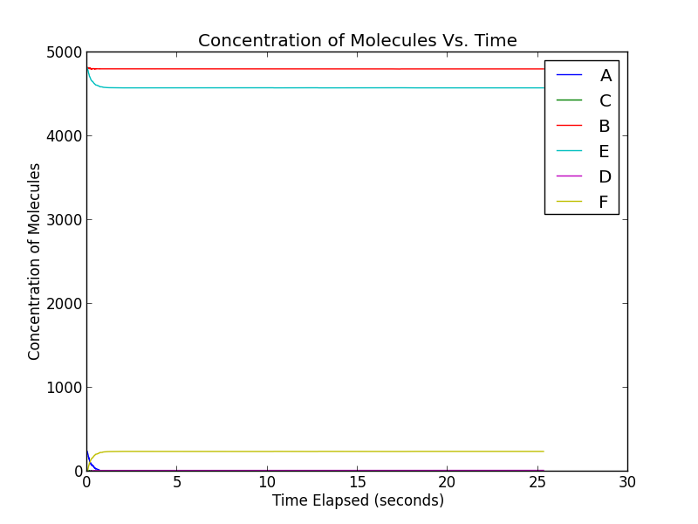
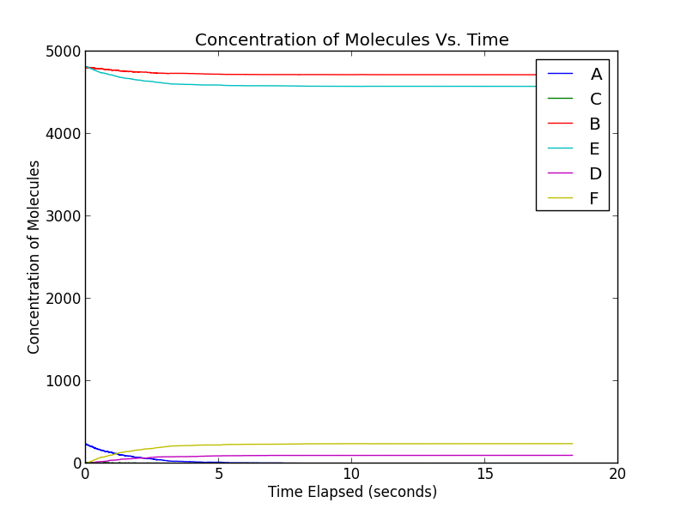
E3: Testing Different Substrates
Ritonavir (Best): Nelfinavir (Worst):
A= Enzyme B= Substrate
C= Enzyme-Substrate Complex D= Product
E= Inhibitor F= Enzyme-Inhibitor Complex
Notes:
Nalini
This first part of this test looks at the effectiveness of different competitive inhibitors on wildtype HIV-1 protease in preventing the binding of substrate. As one can see, ritonavir proves most effective, with the number of molecules of product staying very close to 0 over time. Nelfinavir, in contrast, proves least effective, although the number of molecules of product still remains at a significantly lower value over time.
Nalini
WHY?
Ritonavir: 2nd largest Kon (2nd largest Koff)
Nelfinavir: smallest Kon (smallest Koff)

Slide 18
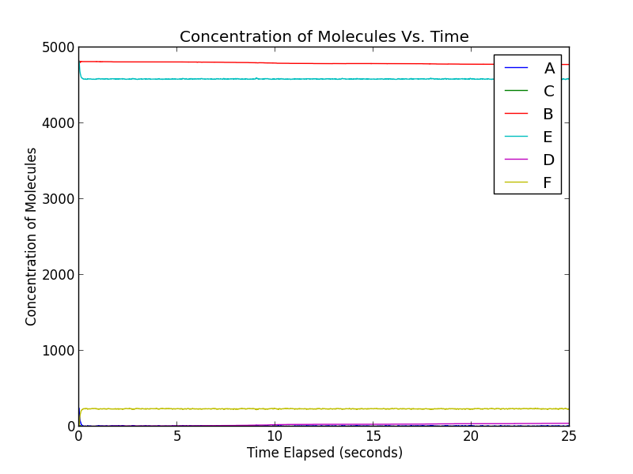
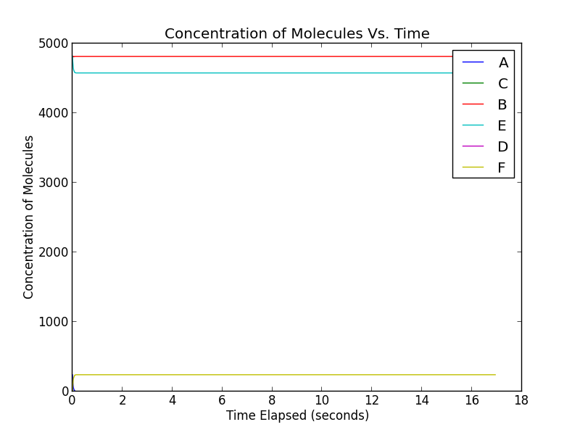
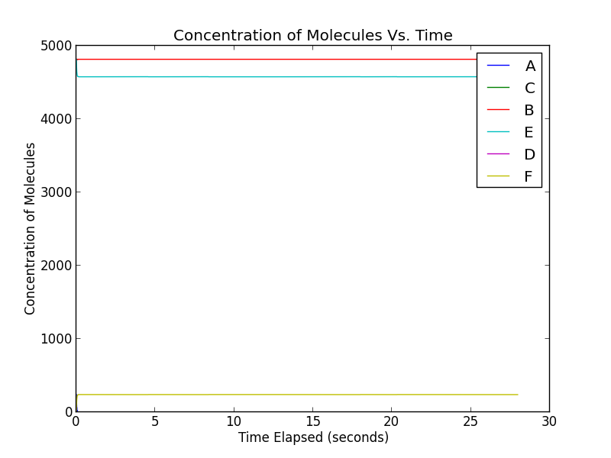
E4: Mutations and Inhibitor Activity
G48V/L90M: WT: L90M:
A= Enzyme B= Substrate
C= Enzyme-Substrate Complex D= Product
E= Inhibitor F= Enzyme-Inhibitor Complex
Notes:
Nalini
The second part looks at the effectiveness of the inhibitor saquinavir on wildtype and mutated forms of HIV-1 protease. As one can see, inhibitors can become less effective with these mutations, as seen in the greater amount of product made by the G48V/L90M mutant form despite the presence of saquinavir. However, some mutant forms, such as the L90M, still interact with the inhibitor in about the same way as the wildtype form.
WHY? WT and L90 have same Kon value, L90 has slightly larger Koff but not visually obvious
G48V/L90M has very large Koff value, lowest Kon value

Slide 19
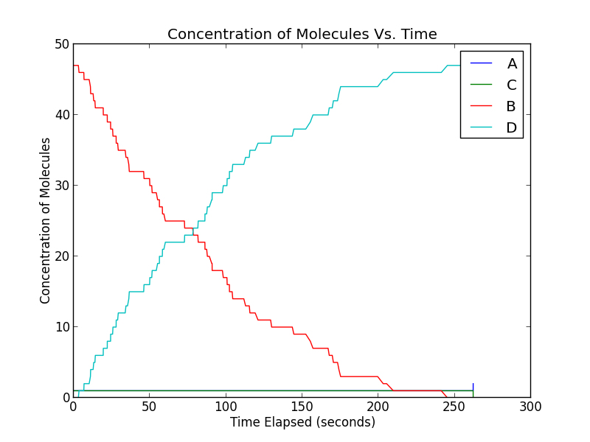
E5: Sample Size and Fluctuation
2 molecules: 241 molecules:
A= Enzyme B= Substrate
C= Enzyme-Substrate Complex D= Product
E= Inhibitor F= Enzyme-Inhibitor Complex
Notes:
Nalini
The third part looks at the way sample size can affect a system. As seen in the graphs, when only 2 molecules out of a certain concentration of molecules are observed, fluctuation has a much greater impact than when 241 molecules from this same concentration are observed. This also emphasizes the importance of our stochastic simulator, as it takes into account this random fluctuation which has a much greater effect on small-scale systems.

Slide 20
Discussion
Future Developments
Extensive testing
Graphical user interface
Internal unit conversion capabilities
Tau-leaping
Applications to Other Systems
Notes:
Rosie

Slide 21
Acknowledgements
We would like to acknowledge the following individuals and groups…
Dr. Markus Dittrich
Maria Cioffi
Dr. Gordon Rule
Dr. Barry Luokkala
PGSS Alumni Association and Donors
Notes:
Dan

Slide 22
Citations
"About HIV/AIDS." Centers for Disease Control and Prevention. Ed. CDC. Centers for Disease Control and Prevention, 12 Feb. 2014. Web. 28 July 2014.
Asmussen, Søren, and Peter W. Glynn. "Introduction." Stochastic Simulation: Algorithms and Analysis. New York: Springer, 2007. N. pag. Print.
AVERT. "What Is the Difference between HIV-1 and HIV-2? | FoundCare." What Is the Difference between HIV-1 and HIV-2? | FoundCare. Forte, 2014. Web. 29 July 2014.
Beals, M., L. Gross, and S. Harrell. "INTERSPECIFIC COMPETITION." INTERSPECIFIC COMPETITION. The University of Tennessee, 1999. Web. 29 July 2014.
Beals, M., L. Gross, and S. Harrell. "PREDATOR-PREY DYNAMICS."PREDATOR-PREY DYNAMICS. The University of Tennessee, 1999. Web. 29 July 2014.
"BindingDB PrimarySearch_ki." BindingDB PrimarySearch_ki. Ed. The Binding Database.
Chem Axon, n.d. Web. 29 July 2014.
Dittrich, Markus. "PGSS Team Project." PGSS Team Project - Stochastic Biochemical Reaction Simulator 0.1 Documentation. Markus Dittrich, 2013. Web. 29 July 2014.
Erban, Radek, Johnathan Chapman, and Philip Maini. "ArXiv.org Q-bio ArXiv:0704.1908." [0704.1908] A Practical Guide to Stochastic Simulations of Reaction-diffusion Processes. Cornell University Library, 15 Apr. 2007. Web. 29 July 2014.

Slide 23
Citations cont.
Exact stochastic simulation of coupled chemical reactions. Daniel T. Gillespie, J. Phys. Chem., 1977, 81 (25), 2340-2361
FDA. "FDA-Approved HIV Medicines | HIV/AIDS Fact Sheets | Education Materials | AIDSinfo." AIDSinfo. Food and Drug Administration, 30 Sept. 2013. Web. 29 July 2014.
Goodsell, David. "HIV-1 Protease." RCSB PDB-101. RCSB Protein Data Bank, June 2000. Web. 29 July 2014.
Graphpad. "GraphPad Curve Fitting Guide." GraphPad Curve Fitting Guide. Graph Pad, 2014. Web. 29 July 2014.
London's Global University. "Enzyme Inhibitors." Untitled Document. London's Global University, n.d. Web. 29 July 2014.
Meng, Tan Chee, Sandeep Somani, and Pawan Dhar. "Modeling and Simulation of Biological Systems with Stochasticity." Bioinformatics Institute Singapore 4.24 (2004): n. pag. Print.
Stowell, Dan. "The Molecules Of HIV." HIV Changes to Avoid Detection. Dan Stowell, 2006. Web. 29 July 2014.
Sutton, H. E., and R. P. Wagner. "Mutation and Enzyme Function in Humans." Annual Review of Genetics 9.1 (1975): 187-212. Web.

Slide 24

The End

