Slide 1

Promethium
By Petya Stoyanova, Ivan Georgiev, Aleksandra Petrova, Galya Ivanova

Slide 2
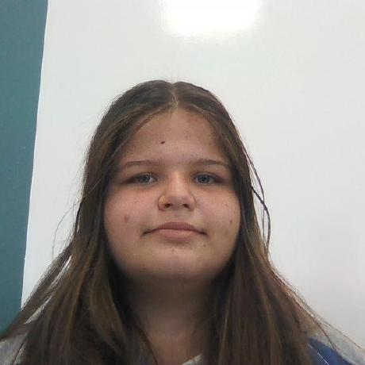
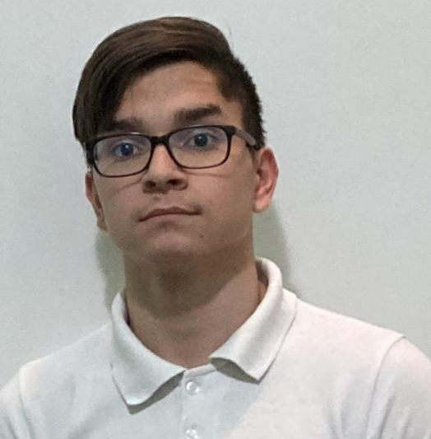
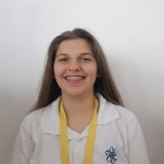

Our Team
Petya Stoyanova
Ivan Georgiev
Aleksandra Petrova
Backend developer
Galya Ivanova
Designer
Scrum trainer
Frontend developer

Slide 3
Our Project
Our project is a History and Geography site. In the home page there are two boxes - History and Geography map. By choosing each one you open a map and you can see information about three places. There are "About us" and "Feedback" pages in the navbar too. You can see our socials in the footer that is positioned at the bottom of each page.

Slide 4
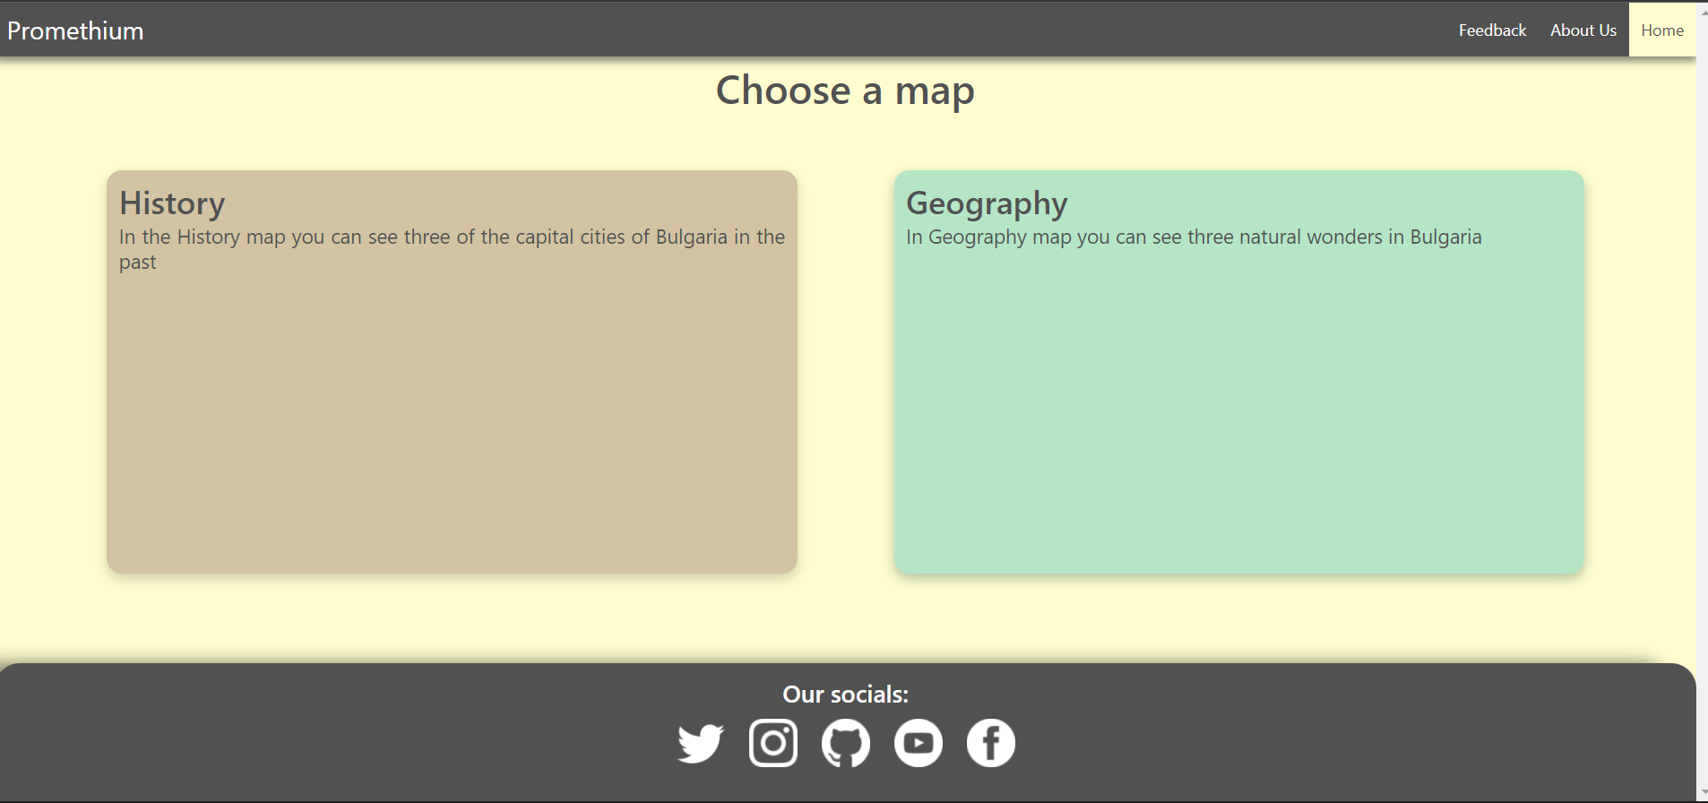
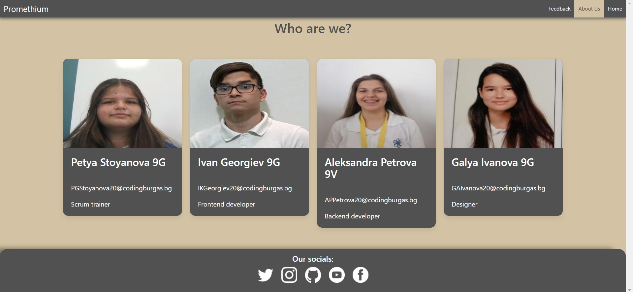
Our site

Slide 5
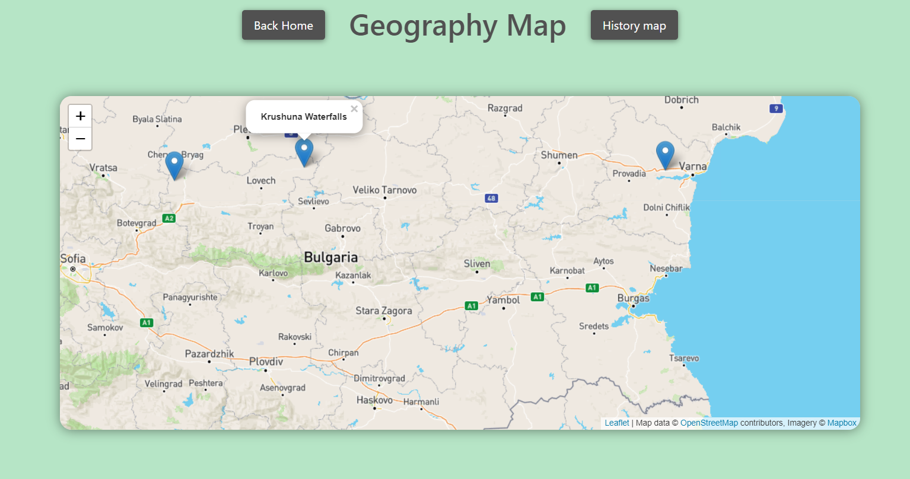
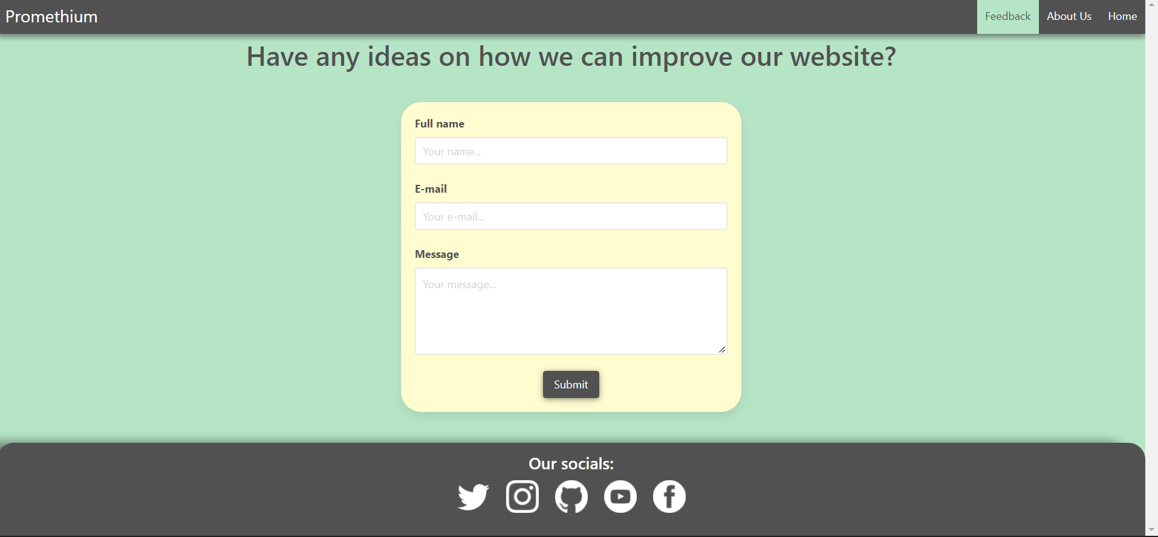
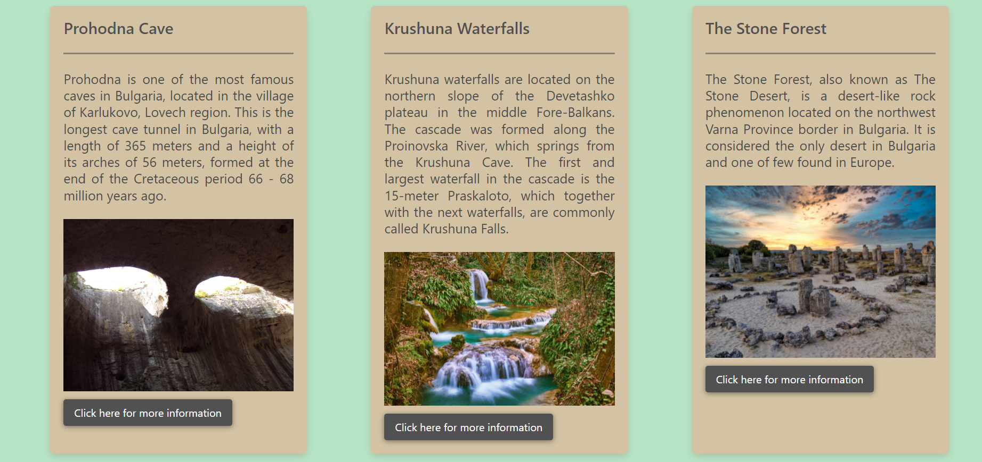
Our site

Slide 6
Stages of development
Idea
Realization
Presenting
Phase 2
Organization
Testing

Slide 7







Used programs
Phase 2

Slide 8
Let’s move to the site!

